Slide 1
Cyclistic Bike-Share Analysis
Presented by: Victor Okanda
Last Updated: 16/11/2022

Slide 2
Executive Summary
Cyclistic, a bike share company, is determined to understand how casual and annual members differ. The information will be prudent in designing marketing strategies to get more casuals to acquire annual memberships.

Slide 3
Objective
Identify the differentials among casuals and annual member bike riders, and determine ways of converting casuals to an annual membership.

Slide 4
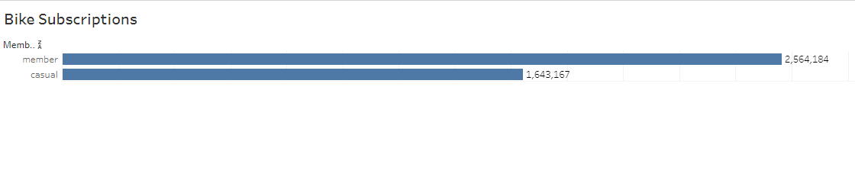
Subscriptions
Annual members are more than casual riders.

Slide 5
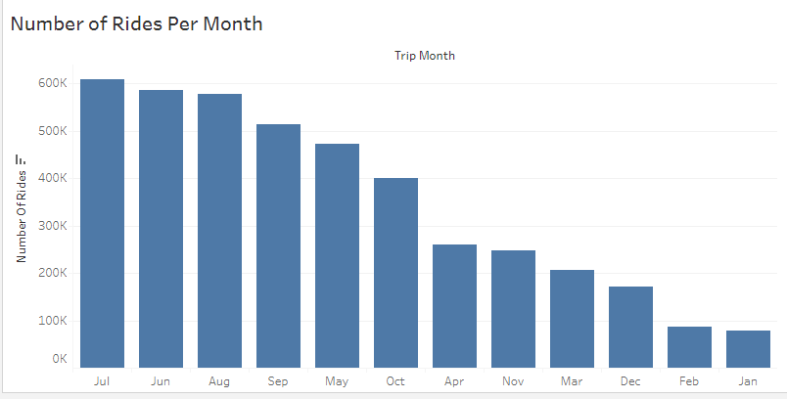
Monthly Trends
Many cyclists prefer riding during the summer months, with very low records of riding in winter.

Slide 6
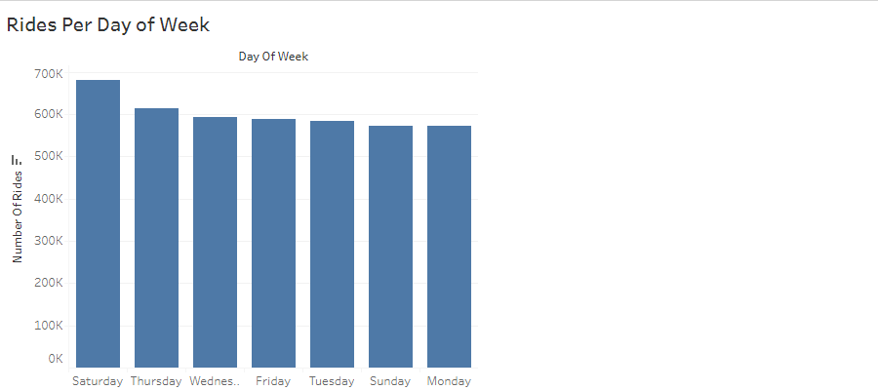
Daily Trends
Many cyclists prefer Saturdays. There is low preference for cycling on Mondays.

Slide 7
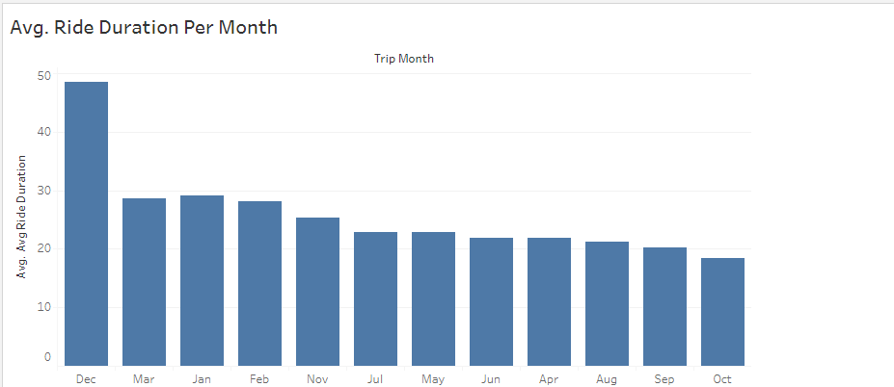
Duration
Cyclists take an inordinate amount of time with bikes in December.

Slide 8
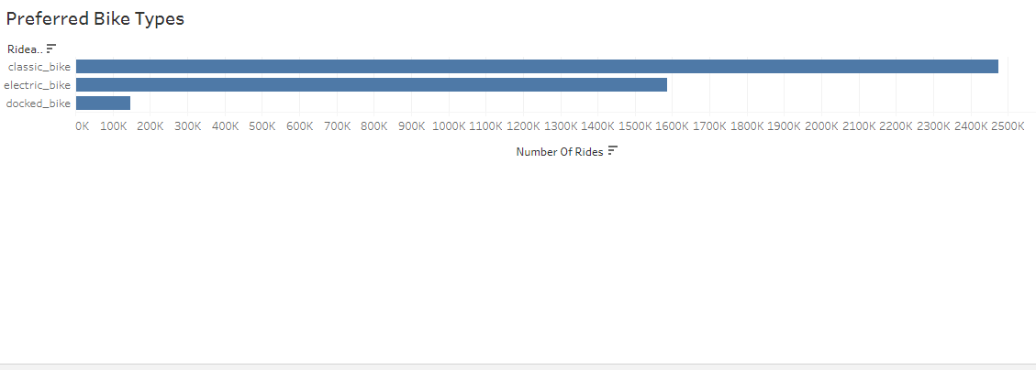
Preferred Bike Types
Many riders prefer classic bikes, with only a paltry liking the docked bikes.

Slide 9
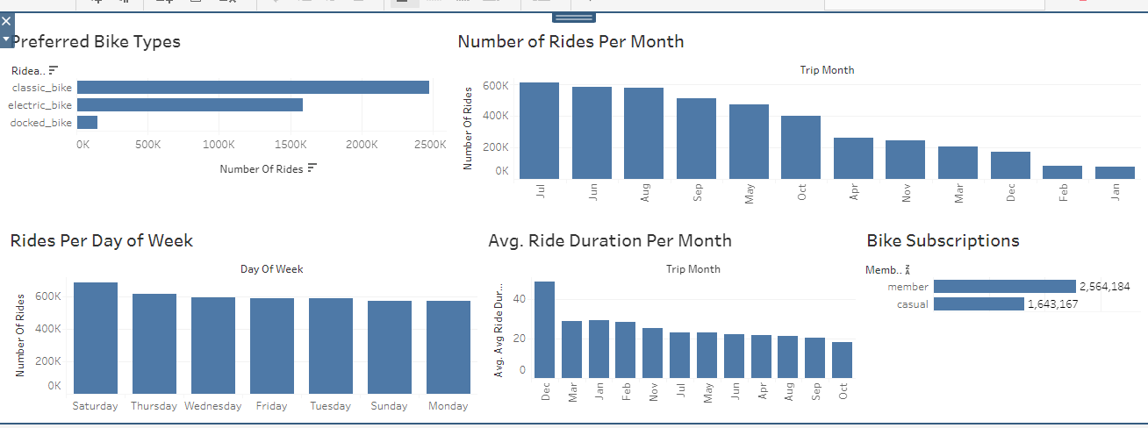
Summary
July recorded the highest cycling record (609519) for the last two months.
There is low cycling in January.
Saturdays are preferred days for cycling

Slide 10

Recommendations
More campaigns should be geared towards reaching casual cyclists on Saturdays. This can be promotional adverts or discounts for the annual membership.
Preferential treatment during the December holidays for the annual members. This may convince casual cyclists to opt for annual subscriptions.
Significantly reducing the charges for using classic bikes as a package for the annual membership.

