Slide 1
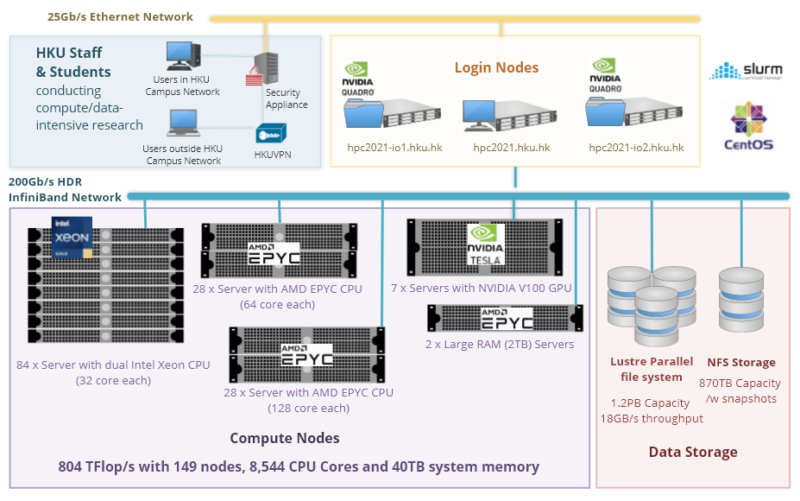

Features of a Linux server (HPC)
High-Performance Hardware
GPUs (Graphics Processing Units)
Massive storage
System integrity

Slide 2
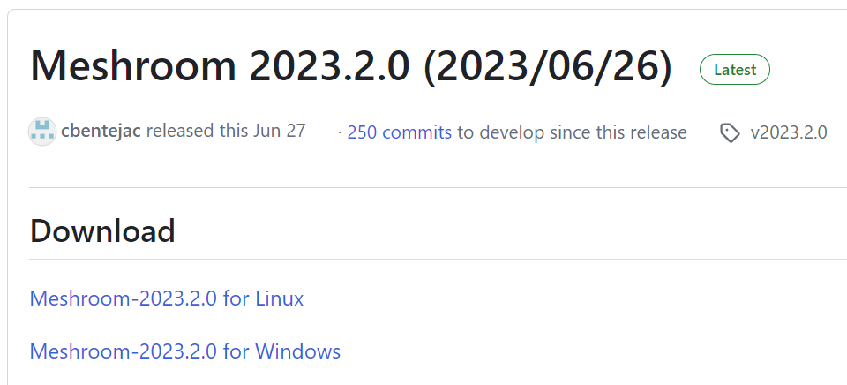
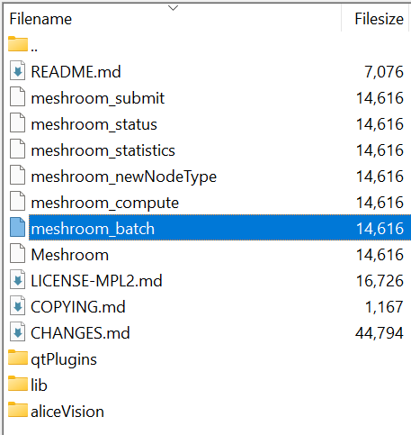
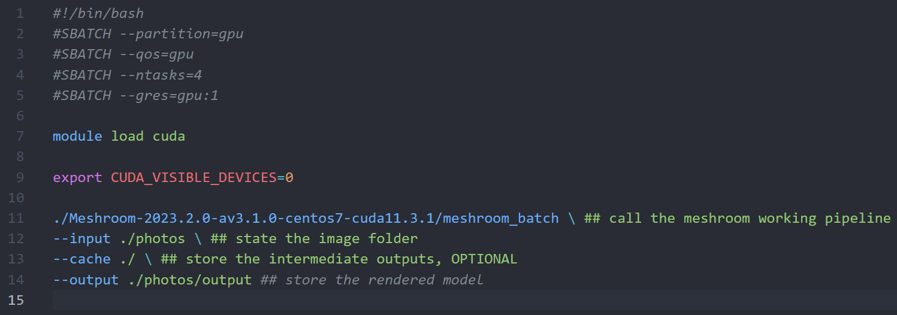
Meshroom operation on Linux server
tar -xf Meshroom-2023.2.0-linux.tar.gz
Meshroom documentations
Meshroom in Google Colab

Slide 3
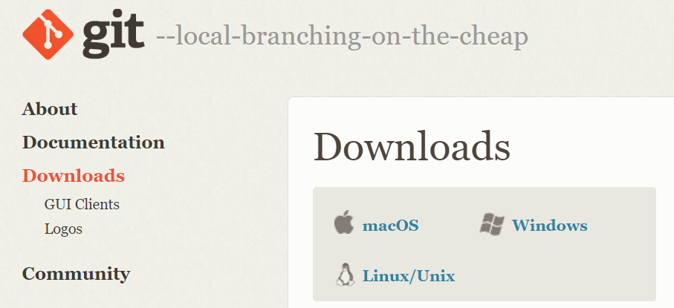
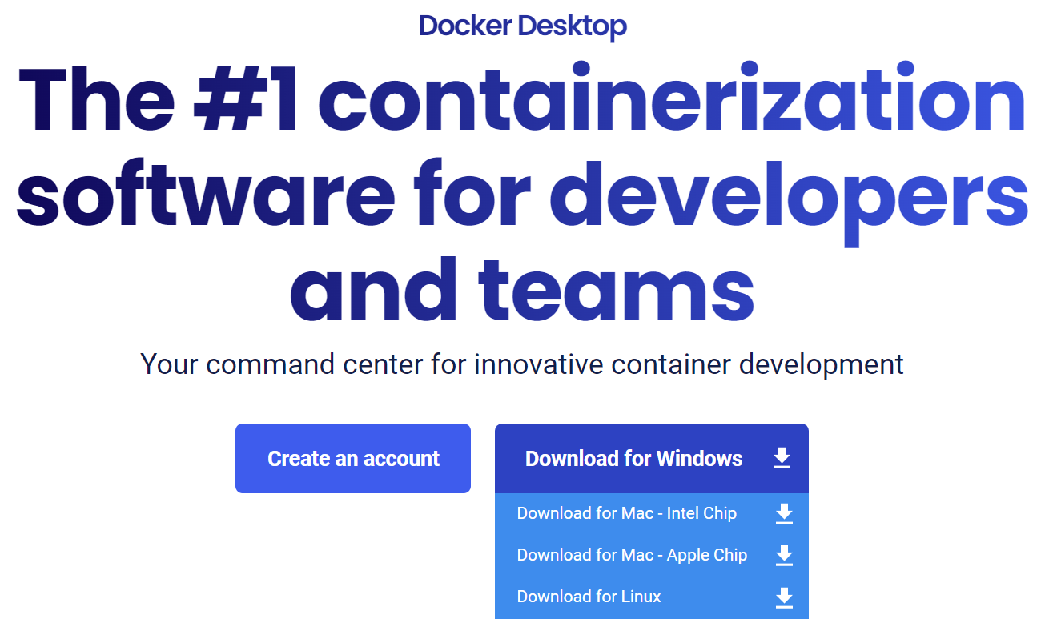
WebODM installation on Windows & Mac

Slide 4
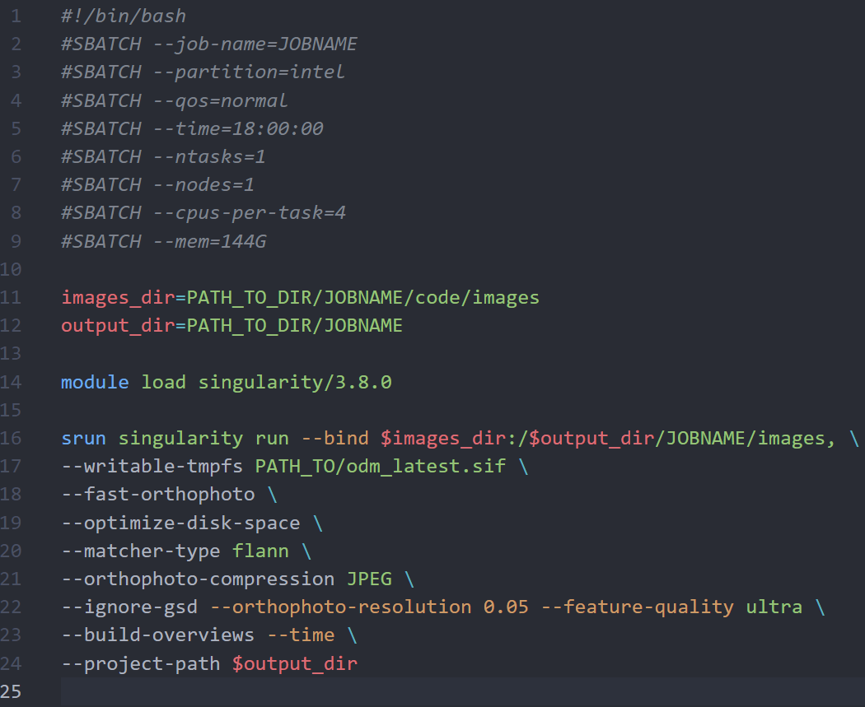
ODM installation on Linux server
ODM documentations

