Slide 1
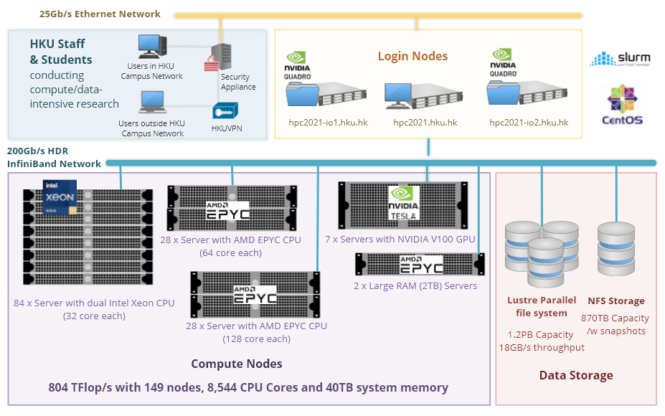

Features of a Linux server (HPC)
High-Performance Hardware
GPUs (Graphics Processing Units)
Massive storage
System integrity

Slide 2
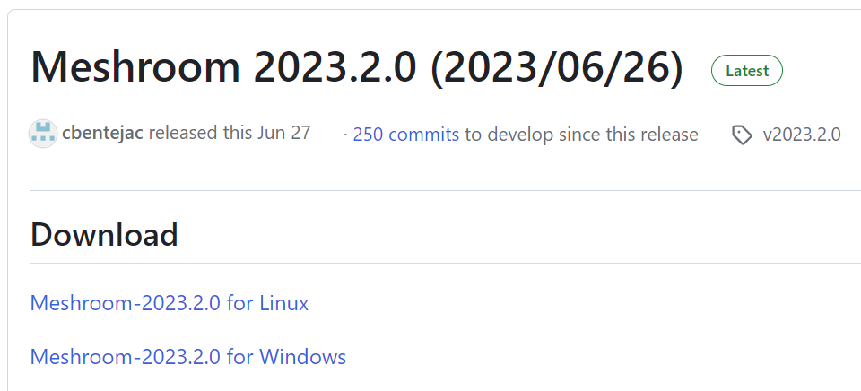
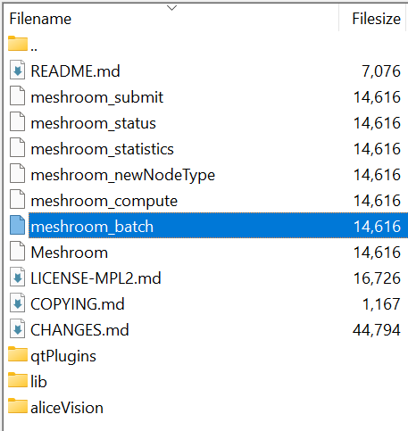
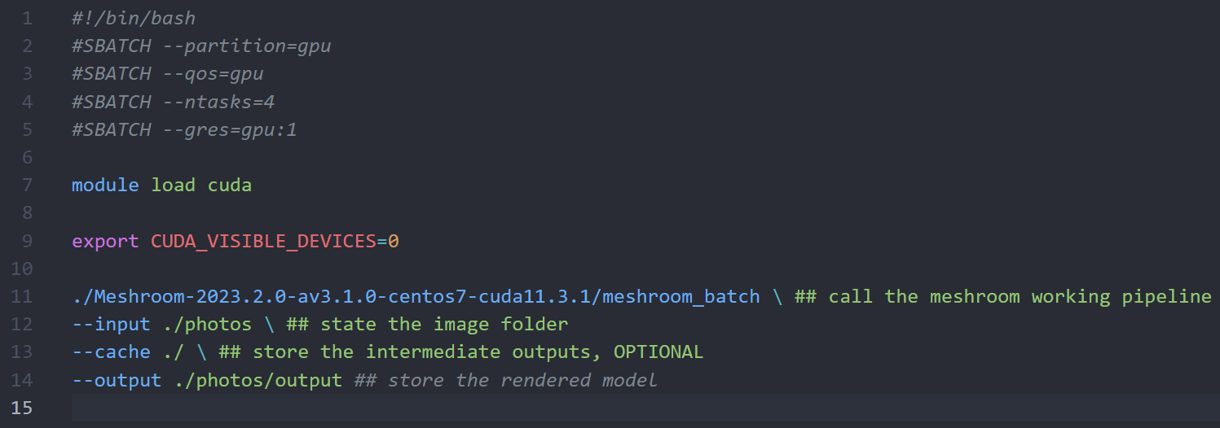
Meshroom operation on Linux server
tar -xf Meshroom-2023.2.0-linux.tar.gz
Meshroom documentations
Meshroom in Google Colab

Slide 3
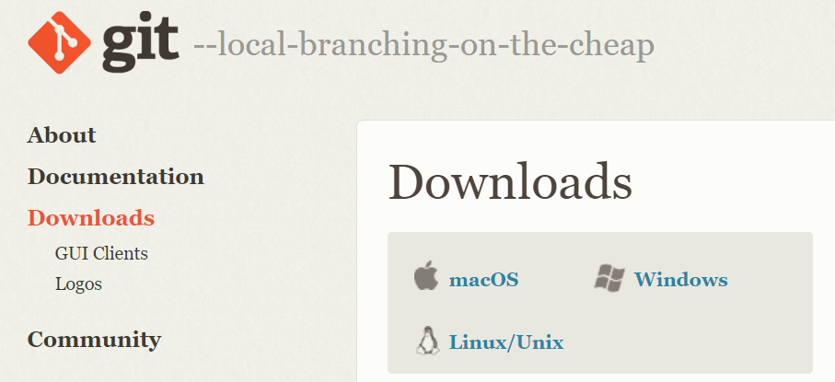
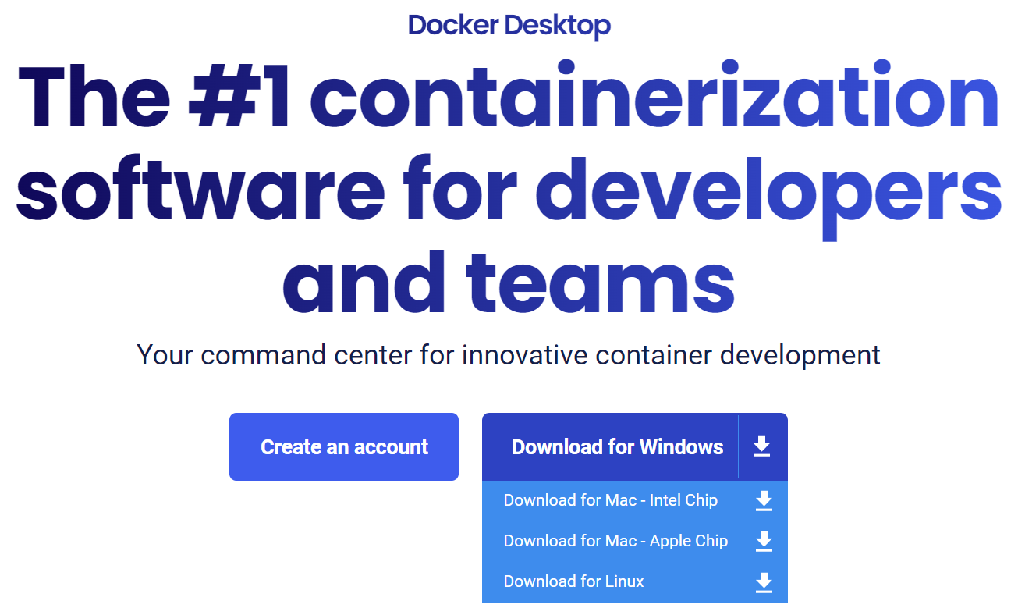
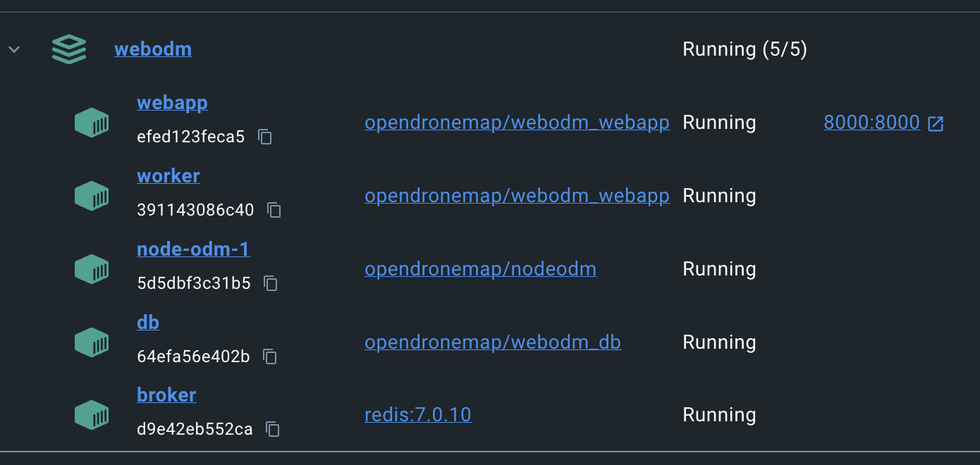
WebODM installation on Windows & Mac
git clone https://github.com/OpenDroneMap/WebODM --config core.autocrlf=input --depth 1
cd WebODM
./webodm.sh start

Slide 4

WebODM interface & functions

Slide 5
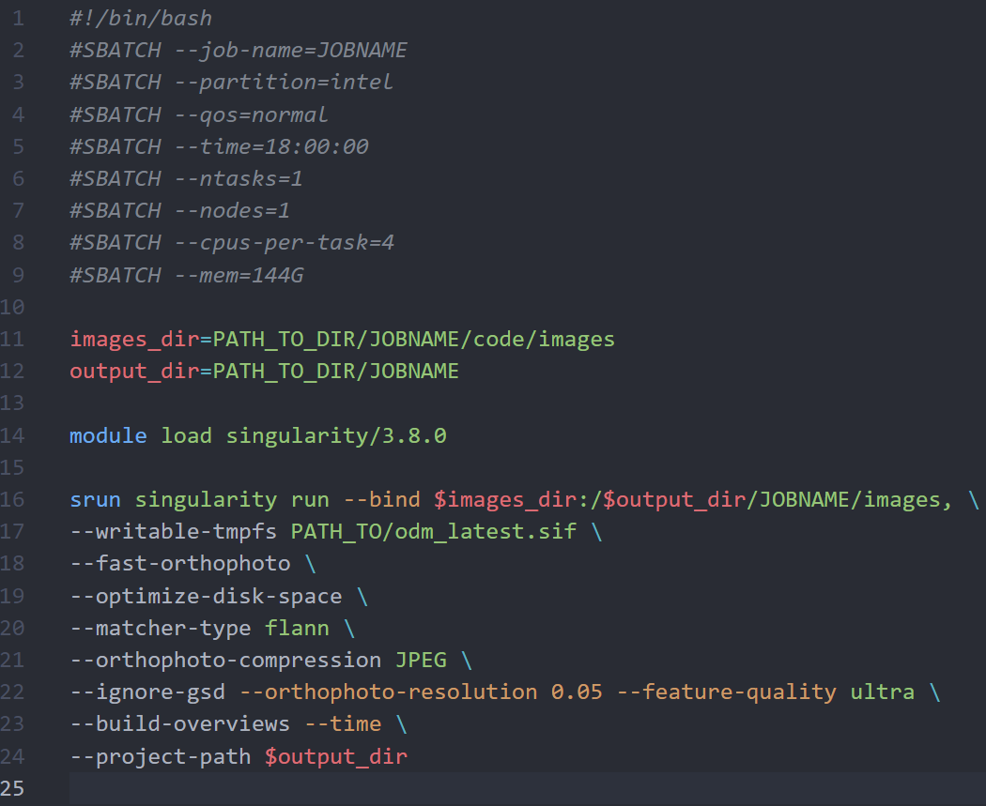
ODM running on Linux server
System RAM demanded for large project (4CPU cores + 144GB RAM)
Singularity container to ensure compatibility across different system
ODM documentations

