Slide 1



Slide 2

What we see in Ai2000
Apparel brands are moving off legacy ERPs
Many still run product, orders and books in separate systems
Ai2000 has the depth larger brands need
Retail EDI, warehouse and financials sit in one platform, so it sticks
Help Ai2000 grow with outbound sales and AI
We add an outbound engine and build AI into daily workflows
Recur Software Highly Confidential – Not for Distribution

Slide 3








The opportunity for Ai2000
Apparel and home goods brands want one system for product, retail orders and books
Customer size
OUR TAKE
Ai2000 runs product, retail orders and financials for large brands in one system
Small-brand tools lack the depth big retail programs need
Ops-only suites push the books into a second system
Large brands
Small &
mid brands
Product scope
Ops only
Ops + financials

Slide 4
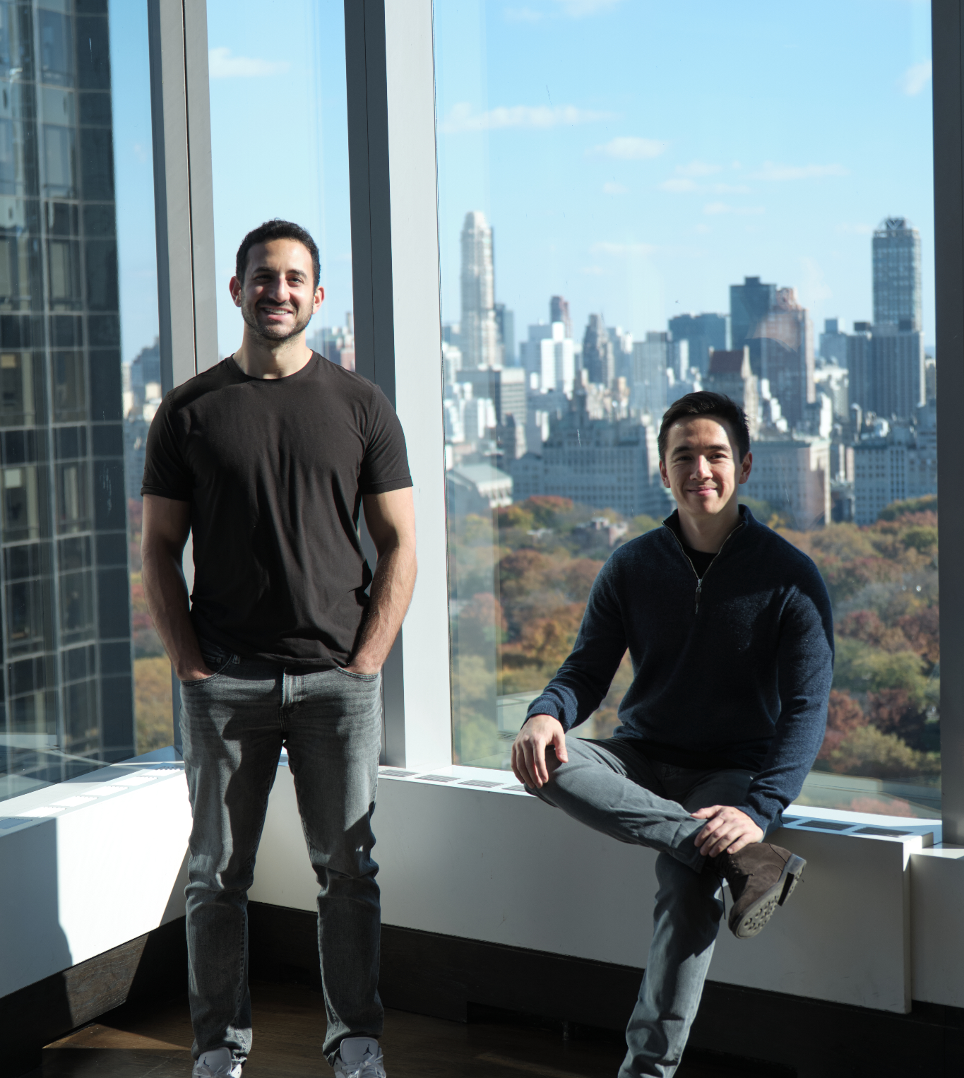




Who we are
Our heritage
We’ve spent the past decade working alongside software founders and growing their businesses
We’re experienced software investors, board members and builders from Accel, General Atlantic and more
We’re long-term stewards of great software businesses and the teams who built them
Charlie
Co-Founder
Henry
Co-Founder
Recur Software Highly Confidential – Not for Distribution
Notes:
Sources: Henry's v18, slide 2

Slide 5









We’re software specialists – we know what great looks like
OUR TRACK RECORD
OUR COMPANIES
25+
Years in software
Manufacturing ERP
Food Processing Mgmt
Medical Device QMS
$650M+
Capital invested
Receivables CRM
Public Safety
Equipment Dealer Service
$1B+
Combined ARR
14
Countries
Recruiting & Staffing
Automotive Quality
Enterprise IT
Recur Software Highly Confidential – Not for Distribution
Notes:
Sources: Henry's v18, slide 9

Slide 6







Backed by the world’s top technology
investors and companies
VC with $20B+ assets (our alma mater)
First investors in Slack, Atlassian, CrowdStrike
Experienced company-builders turned investors
from LinkedIn, project44, Relativity
$100B technology company
Owners of Delivery Hero, PayU, OLX
Long-term, permanent capital vehicle led by
industry veterans
And founders / partners from…
Recur Software Highly Confidential – Not for Distribution
Notes:
Sources: Henry's v18, slide 4

Slide 7


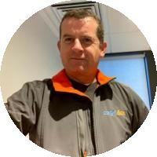
We acquire mission-critical vertical software businesses
01
An enduring home
We buy and hold forever, with no fund clock and no exit plan
“As a first-time seller, I had no idea what to expect from an acquisition process. Recur walked us through every step, explained what was coming next, and made what could have been overwhelming feel completely manageable.”
Mark T. – Founder of Statii
02
Software native
Decades of experience building and backing software
“Working with the Recur team was refreshingly straightforward. They said we’d close in what seemed like a tight timeline, and we did. No surprises, no moving goalposts – exactly what they promised from start to finish.”
Brian B. – Founder of Innova Zones
03
Growth first
Go-to-market, product and AI expertise to grow your business
“They have a deep understanding of how to grow industry-specific software products without losing what makes them special. Their AI-driven approach and operational depth stood out to us from day one and we’re excited for their support.”
Joe B. – CEO of Cognidox
Recur Software Highly Confidential – Not for Distribution
Notes:
Sources: Henry's v18, slide 7

Slide 8
Our values at Recur
Stewardship
We keep your product, people
and legacy intact.
Growth
Everything we’ve built is designed
to drive organic growth.
Partnership
Thought partners and sounding boards,
in it for the long haul.
Ambition
A shared, aspirational vision
for every product we own.
Speed
Conviction-led. We move quickly
and do what we say.
Recur Software Highly Confidential – Not for Distribution

Slide 9
Case studies: how we’ve helped
AI-native GTM
AI rebuild
AI modernization
Built the bench
Recur OS → 40% of August new logos and +50% demos YoY
Recur FDE rebuilt the product in less than three months
Rebuilt legacy form layer in C#, >10x faster and cheaper
Recur brought in a new CEO, Head of Sales, VP Eng
Recur Software Highly Confidential – Not for Distribution
Notes:
Sources: Henry's v18, slide 13

Slide 10

Thank you
charlie@recursoftware.com / henry@recursoftware.com
Notes:
Sources: Henry's v18, slide 24

