Slide 1
PROBLEM STATEMENT : A retail company that wants to better understand its customers and optimize marketing campaigns. The company sells various products across different regions and collects transaction data daily. Management wants you to: - Analyze customer behavior - Segment customers - Provide data-driven recommendations to boost sales and retention
Project Title:
Customer Segmentation & Sales Insights for a Retail Business
By Prasad Vichare
By Prasad Vichare

Slide 2
LIBRARIES
Pandas:
Used for: Reading CSV files, cleaning data, handling duplicates, and performing transformations.
Why: Pandas provides high-performance, easy-to-use data structures (DataFrames) .
NumPy :
Used for: Numerical operations and efficient array handling.
Why: Provides the foundation for mathematical operations behind Pandas and Scikit-learn.
Matplotlib:
Used for: Plotting basic graphs and visualizations.
Why: Gives you full control over creating static, animated, and interactive plots.
Seaborn:
Used for: Advanced statistical plots with better styling (heatmaps, pairplots, histograms).
Why: Makes it easier to explore patterns in retail data with clean, beautiful plots.
Datetime
Used for: Handling date/time conversions (e.g., purchase dates, customer behavior over time).
Why: Essential for time-series analysis in retail.
Scikit-learn:
Used for: Machine learning tasks such as clustering customers and normalizing data.
Why: Provides reliable algorithms for clustering (KMeans) and preprocessing (scaling) for better model performance.

Slide 3
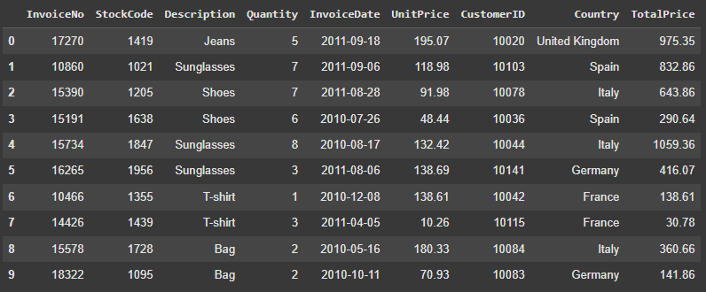
DATA CLEANING
Removing duplicates.
What it means: Sometimes, the same customer transaction or record appears more than once in the dataset.
Why it matters: Duplicates can lead to biased results — for example, inflating sales figures or customer counts.
Solution: Use tools like Pandas (df.drop_duplicates()) to keep only unique records.
Handling missing values.
What it means: Missing values occur when certain fields (like customer age, transaction amount, or product category) have no entry.
Why it matters: Missing data can distort analysis and cause errors in algorithms.
Solutions:
Remove rows/columns if too many values are missing.
Impute (fill) with statistical methods (mean, median, mode)
domain knowledge.
Leave as is if the algorithm used can handle missing data.

Slide 4
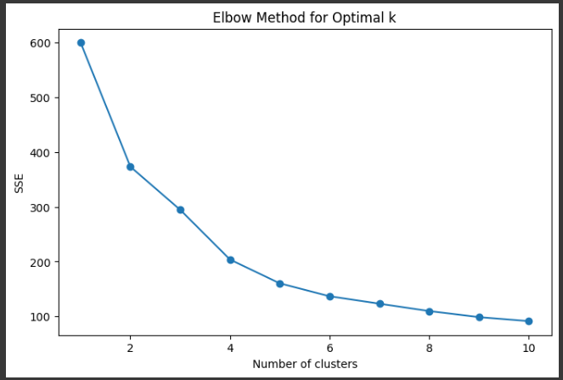
Exploratory Data Analysis
EDA is the process of exploring and understanding a dataset before applying advanced models. It helps uncover patterns, spot anomalies, test assumptions, and summarize key characteristics using both statistics and visuals.

Slide 5
RFM Analysis
Algorithms used in project :
KMeans Clustering
What it is: KMeans is an unsupervised machine learning algorithm used to group similar data points into clusters. Example: Customers with similar purchasing behaviors grouped together.
How it works:
You choose the number of clusters (K).
The algorithm randomly selects K centroids (cluster centers).
Each data point is assigned to the nearest centroid.
Centroids are recalculated based on the assigned points.
Steps 3–4 repeat until centroids stop moving significantly.
Why you used it:
To segment customers in retail data.
Helps identify patterns such as:
High-value vs. low-value customers.
Seasonal shoppers vs. regular shoppers.
Product category preferences.
Useful for targeted marketing and decision-making.

Slide 6
2. StandardScaler (Preprocessing)
What it is: A preprocessing algorithm that standardizes features by removing the mean and scaling to unit variance. Formula:
Why you used it:
KMeans is distance-based (uses Euclidean distance).
If one feature (like Sales) has larger values than another (like Quantity), it can dominate clustering.
StandardScaler ensures all features contribute equally.
3. Exploratory Data Analysis (EDA) with Statistical Visuals
Histograms & Distribution plots: To check how sales and other features are distributed.
Heatmaps (Correlation Matrix): To see how different variables relate to each other.
Why you used them: EDA helps understand the dataset before applying machine learning. It reveals:
Outliers
Feature relationships
Potential clusters in the data

Slide 7
Business Insights
1.Actionable Insights from the Data
High-Value Customers Drive Majority of Revenue
Seasonal/Regional Trends Exist
At-Risk Customers Identified
2.Strategies for Customer Retention & Upselling
Retention
Launch loyalty programs
Send personalized offers to at-risk customers
Upselling / Cross-Selling
Recommend related products based on purchase history
Use bundled offers
Provide tiered discounts
3.Customer Segment to Target in the Next Campaign
Focus on the “High-Potential” Segment:
Customers who spend moderately but purchase frequently.
They are more likely to be converted into high-value customers with targeted upselling and engagement.
Secondary focus on “At-Risk Customers”:
With timely re-engagement, they can be retained at a lower cost compared to acquiring new customers.

Slide 8
THANK YOU

