Slide 1
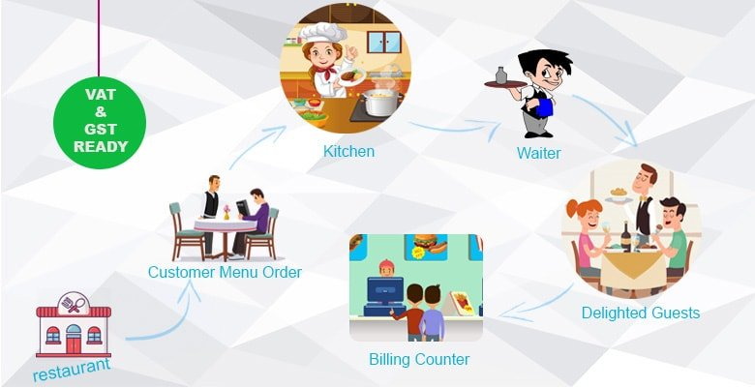
UML CLASS
DIAGRAMM

Slide 2
GLOBAL
HumanManager
Restaurant
1
# name : string
# address : string
OrderManager
1
RoomManager
1

Slide 3
Human
HumanManager
Customer
OrderItem
Person
cashier
*
*
# id : number
# name : string
# age : number
Staff
# phone : number
Chef
*
-salary:number
*
*
gender
1
<Enum>
category
1
Waiter
Gender
<Enum>
StaffCategory
MALE
FEMALE
Chef
waiter
cashier

Slide 4
orderManger
Enum
Enum
Drink
Menu
Food
+ Title: MenuCategory[]
+ Price:number
+ Description?
+ addMenu()
Rice
Fried
Soup
Stack
Salad
Roast-Chicken
Break
Water
Coca
Sprite
Wine
*
*
*
Order
Id:number;
Customer:customer;
menuItems:menu[]=[];
-addMenu(…menu:Menu[])

Slide 5
Room
RoomsManager
1/*
Kitchen
- id : number
*
Room
- id : number
Order
1/*
Order
*
Table
0/*
Customer
- id : number
customer
status
1
<Enum>
TableStatus
NEW
TO_FIX
OLD

Slide 6
Kitchen
KitchenManager
Chef
*
Chef

