Slide 1

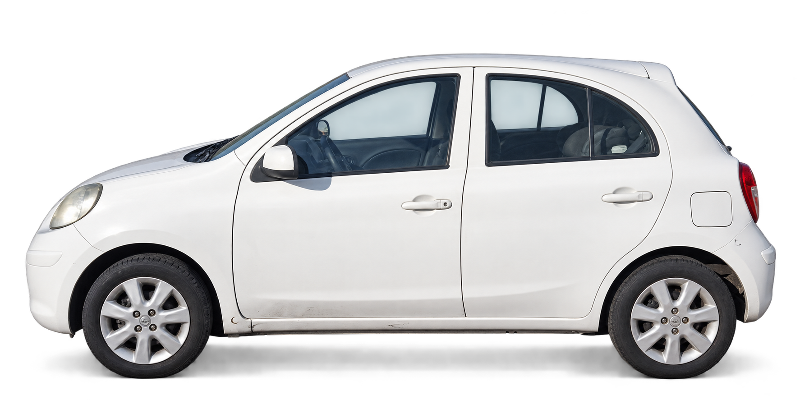
Strategic Marketing
Workshop · Nov 2026
InfoCar
B2B & B2C· For used-car dealers in Chile
Our plan to learn what certainty is worth.
Caro B. · Cuero D.· León M. · Marín G.· Parraud J. · Ramírez S. · Ramírez V.
Professor: Claudia Scherman B.
Notes:
About 0:45. InfoCar is B2B: we sell to used-car dealers in Chile, with a second line for private buyers. This deck builds on the last one: context, objectives and method stay, with your feedback applied. Today's new part is population and sample: who we will ask, and how many.

Slide 2
Dynamic: Information asymmetry
The seller knows the real car's condition.
SELLER
Knows the car
Past crashes, repaint, hidden filler, old faults.
?
BUYER
Sees a price
An ad, a few photos, a short test drive.
RESULT
Every car is discounted
Doubt sets the price, so good cars leave the market.
Information gap
Condition is hard to check before paying
What the gap costs
2.0–68.9M
CLP asking prices for the same model, the Ford F‑150, in 2025. Price alone does not reveal condition.
Guzmán, 2026
52.3 days
average time a car spends in an insured repair workshop. Hidden damage shows up late.
Farías, 2026
Hidden condition = a cost on every deal
Concept: market for lemons (Akerlof, 1970). Sources: Guzmán (2026), Emol; Farías (2026), La Tercera.
Notes:
About 1:15. The core of the project is information asymmetry. The seller knows the car's history: crashes, repaint, hidden filler. The buyer only sees an ad and a price. Akerlof called this a market for lemons: since the buyer cannot check, every car is discounted and good cars leave. Two numbers show the cost: the same model is listed from 2 to almost 69 million pesos, so price does not reveal condition; and a car spends 52.3 days on average in an insured repair workshop, so hidden damage shows up late and is costly.

Slide 3
Big market, AI pricing arriving, but no Chilean dealer tool reads damage from photos
1,060,919
used-car transfers in 2025, up 5.8%
15.3%
bought by companies in Sep 2026 (13,094 cars)
58%
of transfers happen in Santiago
3.4
used cars sold for every new one
Who we serve first SII, activity 451002
Competition
Condition from photos
Rodar
Max purchase price from comparables and OBD2 readings. Closest to us.
✕
TAM
4,116
vehicle retailers, SII 451002 (a ceiling)
GoAuto, AutoGest
Market pricing for dealers. No photo-based condition, no fault database.
✕
SAM
1,066
small and medium, all of Chile
Autofact, Carvuk, own eye
Legal history, in-person inspection (about CLP 44,990) or spreadsheets.
✕
487
small and medium dealers in Santiago
InfoCar
SOM
✓
Where we stand out: damage read from photos, plus a fault database by model and salvage auctions. No hardware; works on any car, even one seen in a listing.
Sources: CAVEM (2026); SII (2026): activity 451002, year 2025, and list of firms in Santiago, 2024 (includes new-car sellers; large groups and micro-businesses out of focus); competitor websites, checked 26 Sep 2026.
3

Slide 4
Who carries the gap of information
Who faces it
Share of used-car buyers, Sep 2026
What widens it
Chinese brands, share of sales
Who protects the buyer?
Legal cover by type of seller
People 84.7%
New cars · ANAC 2026
✓
From a dealer
No legal warranty on used cars, but consumer law applies.
84.7%
people
41.4%
Companies 15.3%
Most buyers are people, but few buy often.
Used cars · CAVEM 2026
✕
From a private seller
No SERNAC protection: the buyer carries the risk.
12.95%
How often they buy
Private buyer
1 car every 8 years
They reach the used market with little local record of typical faults or part prices.
41,700
vehicle-fraud cases, Jan–Sep 2025, up 64%
Melelli Viveros, 2026
Typical dealer
≈3 cars a month
Our scope: 487 dealers in Santiago
Dealers face the gap on every purchase, new brands widen it, and the law barely covers it.
Sources: CAVEM (2026a, 2026c, 2026e); ANAC (2026); SII (2026), purchases per dealer = sales ÷ average price; Ley N.° 19.496 (1997); SERNAC (2019); Melelli Viveros (2026).
Notes:
About 1:30. Now we project the gap onto the market. Who faces it: in 2025 there were 1,060,919 used-car transfers, and in September 2026 people were 84.7% of buyers, but a person buys a car only every few years. Our dealers, the 487 small and medium firms of Santiago, buy about three cars a month each: they face the gap every month. What widens it: Chinese brands are 41.4% of new sales and 12.95% of used transfers; as their warranties end, they reach the used market with little local record of faults or part prices. Who protects the buyer: used cars have no legal warranty, even from a dealer; but a dealer is covered by consumer law, so it must inform truthfully and keep any warranty it offers. A private seller is not covered at all, and vehicle-fraud cases rose 64% in the first nine months of 2025.

Slide 5
What a dealer pays to know
Every way to check a car today is slow, expensive, or blind to its physical condition.
Pre-purchase inspection
82–102k
CLP per car
1–3 hours. A mechanic checks the car in person.
Serviteca CyT, Ojo Mecánico
Chileautos home inspection
59,990
CLP per car + travel
130+ points, digital report in about an hour.
Chileautos
Autofact report
6–9k
CLP per car (5,990–8,990)
Price and legal history. Nothing on physical condition.
Autofact
Portals + spreadsheets
Hours
of staff time per car
Each salesperson prices the same car differently.
InfoCar Internal Analysis
Working price hypothesis: about CLP 59,990 a month, less than one inspection
Sources: Serviteca CyT (n.d.), Ojo Mecánico (n.d.), Chileautos (n.d.), Autofact (n.d.); prices checked 11 Oct 2026.
Notes:
These are the substitutes we compete with. A full pre-purchase inspection costs CLP 82,000 to 85,990 and takes one to three hours. Chileautos' home inspection costs CLP 59,990 plus travel. An Autofact report is cheap but says nothing about the physical condition. Most dealers just browse portals and keep spreadsheets. Our working price, about CLP 60,000 a month, is a hypothesis to test in interviews.

Slide 6
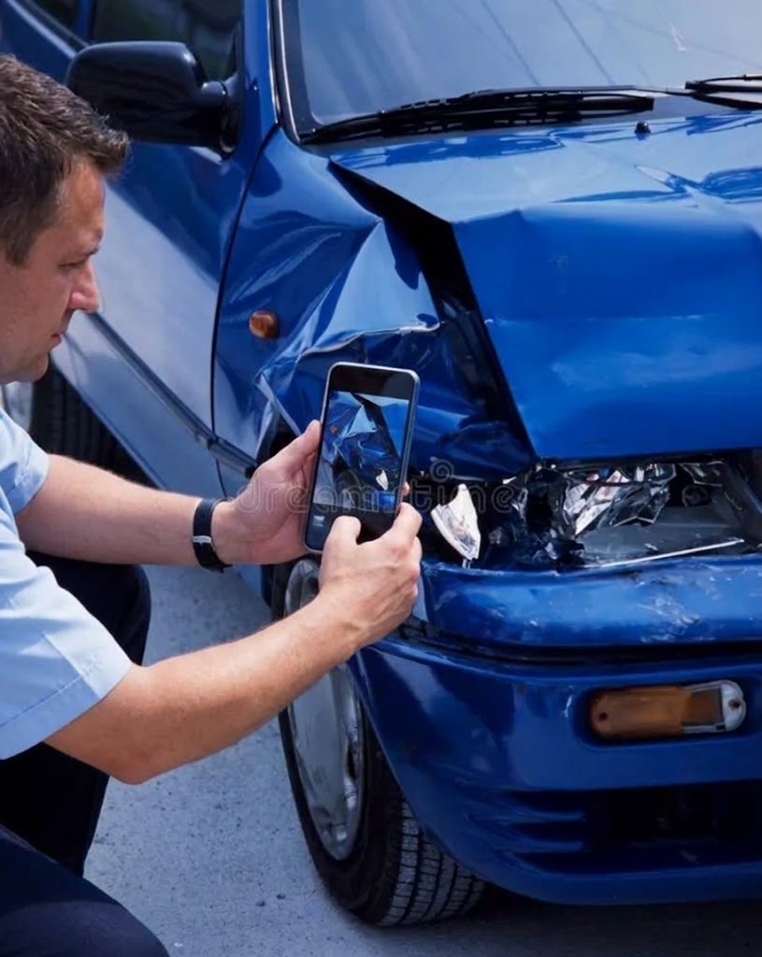
Your own mechanic in your pocket
01
Snap the car
Guided photos, plus make, model, year, mileage and asking price.
02
InfoCar does the maths
Market comparables + the model’s typical faults (validated by mechanics) + damage detected in the photos.
03
Get a clear call
Maximum purchase price, repair-cost range, and Buy / Negotiate / Pass.
Max price = market value − repairs − risk margin
A pre-screen, not a certificate: photos can’t see inside the engine or gearbox. The price comes from a regression, not from the language model.
Notes:
The dealer takes guided photos and enters the car details. InfoCar combines market comparables, the typical faults of each model validated by mechanics, and the damage visible in the photos. The output is a maximum purchase price, a repair-cost range and a clear Buy, Negotiate or Pass. The price is set by a regression, not by the language model. Photos cannot see inside the engine or gearbox, so InfoCar pre-screens and gives a negotiating argument; it does not certify.

Slide 7
So… how to close the gap
Two revenue lines: the dealer pays a plan, and a private buyer pays per report.
INFOCAR
Condition report
Damage and repair cost, built from phone photos.
One report, two ways to pay.
B2B · THE DEALER PAYS
Prices with the repair cost known
Monthly plan · CLP 59,900–149,900
Visual appraisal with AI
Parametric workshop budget
B2C · THE BUYER PAYS
Buys a car from a private seller
Where the law protects least.
One report · CLP 7,990–24,990
Maximum purchase offer
Today vs. InfoCar
Mechanic inspection
Rodar
InfoCar
Cost per car
CLP 82,000–102,000
Not public
≈CLP 20,000 on the plan
Time per car
1–3 hours
Needs a scanner fitted
Minutes (goal: under 5)
What it checks
Engine, body, chassis
Engine data (OBD-II)
Exterior body only | OBD-II*
Sources: Serviteca CyT; Ojo Mecánico; Rodar (n.d.). InfoCar per car = CLP 59,900 ÷ ≈3 cars a month (SII, 2026). Prices: hypotheses tested in SO5.
Notes:
About 1:15. Who pays to close the gap. InfoCar builds one condition report from phone photos, and there are two ways to pay for it. B2B: the dealer pays a monthly plan and prices each car knowing the repair cost. B2C: a person buying from a private seller, where there is no legal warranty, buys a single report. Today the alternative is a mechanic: a pre-purchase inspection costs CLP 82,000 to 85,990 per car and takes 1 to 3 hours; an in-house mechanic costs about CLP 4,000 an hour in salary, our estimate, but is not always free. On the plan, InfoCar costs about CLP 20,000 per car, the 59,900 plan divided by about 3 cars a month, and takes minutes. To be fair, photos only see the exterior body; a mechanic also checks the engine and chassis. Rodar reads engine data with an OBD-II scanner. Both prices are hypotheses that specific objective 5, on the next slide, tests.

Slide 8
Why not just ask ChatGPT?
A general chatbot has no current Chilean listings, and when it reads car damage from photos it often invents things.
Vehicle damage reports with hallucinations
What InfoCar adds
General vision model, image only
78%
✓
Up-to-date Chilean market data
✓
Vision models built for car damage
Same model anchored to a dedicated damage-segmentation model
31%
✓
Ranges with a confidence level
✓
Traceable estimates and human review
100 human-checked reports (Hogale et al., 2026)
Accuracy is the top AI barrier for 74% of US dealers (Cox Automotive, 2025): sell verifiable accuracy, not “AI”
Sources: Hogale et al. (2026), arXiv 2608.02470; Cox Automotive (2025).
Notes:
The obvious objection is: why not just ask ChatGPT? In the only quantitative study we found on vehicle damage, a general vision model produced reports with hallucinations in 78% of cases from images alone. Anchoring it to a dedicated segmentation model brought that down to 31%. So our value against a chatbot rests on Chilean market data, specialised vision models, confidence ranges and traceability. Our own product can also be wrong and must say so. In a Cox Automotive survey of 537 US dealers, concern about accuracy was the top barrier to AI, cited by 74%. So we sell verifiable accuracy, not 'AI'.

Slide 9
What we need to understand to make it real
General objective: to understand how technical and economic certainty is valued when setting the transaction value of used cars.
Specific objective (SO)
one dimension each
S
Specific
What exactly
M
Measurable
How we measure it
A
Achievable
Why it is doable
R
Relevant
Decision it informs
T
Time-bound
Weeks 1–4
SO1 · Physical & aesthetic
Identify the physical and aesthetic attributes that determine how a car's condition is valued.
classification of body damages: dents, scratches, panel gaps, lights, repaint
Severity on a Likert 1–5 scale (1 = barely visible, 5 = structural)
Dealers judge these damages by eye every day
Sets the damage classes the app must detect
1
SO2 · Cost foresight
Analyze how anticipating reconditioning costs affects how the purchase offer is set.
CLP discount on the offer for each diagnosed damage
Choice experiment: blind case vs. case with repair cost
Pricing a trade-in is a daily task for appraisers
Calibrates the offer rule and the dealer's margin
2
SO3 · Adoption barriers
Evaluate the distrust barriers, resistance to automated diagnosis and technical uncertainty that shape transactions.
Fear of AI errors, of Chinese brands and of opaque appraisals
Coded objections + agreement on a Likert 1–5 scale
Objections come up on their own in interviews
Shapes how the report explains itself
3
SO4 · Workshop experience
Describe the operating experience and time bottlenecks of conventional exterior inspection and repair costing.
Days a car is stopped; hours to quote body and paint work
Time metrics (days, hours) + journey map
A known pain: 52.3 days in insured workshops
Sets the app flow and the time limit per report
4
SO5 · Appeal and adoption
Evaluate the perceived appeal, differentiation and adoption intent of a digital condition report vs. traditional appraisal.
B2B intent to subscribe; B2C intent to buy a report
Top-2 Box intent + Van Westendorp price meter
A clear stimulus: a mock-up of the digital report
Sets B2B and B2C prices before building the software
5
T = theoretical plan, all five SOs within one month: W1 explore (stage 1) · W2 build and pilot the questionnaire · W3–W4 measure (stage 2).

Slide 10
Listen first, then measure
A mixed, sequential design: what we hear in stage 1 becomes the questions and scales of stage 2.
Qualitative, to explore
In-depth interviews (B2B) · Focus groups (B2C)
We learn the dealers' words, their rules of thumb for pricing, and what makes them distrust.
Bridge
Findings become variables, scales and closed answers.
Quantitative, to conclude
F2F + CATI (B2B) · CAWI + intercepts (B2C)
We measure the impact of each variable that we found, test our hypotheses, and estimate willingness to pay.
Stage 1
Stage 2
Explores SO1–SO5: the words and reasons
Measures SO1–SO5: how each variable impacts
Notes:
About 1:45. We chose a mixed, sequential design. Stage 1 is qualitative, to explore; stage 2 is quantitative, to conclude. The order matters for two reasons. First, appraisal in Chile has no standard: it runs on rules of thumb and informal words, so a closed survey first would measure the wrong things. Second, what we hear in stage 1 becomes the answer options and scales of stage 2. Both stages cover the five specific objectives, SO1 to SO5: stage 1 finds the words and reasons, stage 2 measures how common they are.

Slide 11

Qualitative: one technique per customer
Interviews for what dealers keep private; groups for what buyers share.
In-depth interviews, one-on-one
B2B
Mid-size dealer owners
Appraisers
Why it fits best
Margins and workshop deals are trade secrets. Nobody shares them in front of competitors.
What it gives us
Hidden pricing rules, how far they trust AI, what fails in today’s tools.
Technique · Semi-structured interview guide, 30–35 min, one-on-one
Moderated focus groups
B2C
Bought a used car in the last 12 months
Plan to buy one
Why it fits best
Fear of fraud is social: hearing others' stories makes people talk.
What it gives us
Shared risk perceptions, the buyer's own words, first reaction to the report.
Technique · Moderator's discussion guide, 75–90 min
Notes:
About 1:45. For dealers the technique is the one-on-one in-depth interview: margins and workshop deals are trade secrets, and nobody shares them in front of competitors. The instrument is a semi-structured interview guide of 30 to 35 minutes. It gives us hidden pricing rules, how far dealers trust AI, and what fails in tools like GoAuto or Rodar. For private buyers the technique is the moderated focus group: fear of fraud is social, and hearing other people's stories makes buyers talk. The instrument is a moderator's discussion guide for 6 to 8 people, 75 to 90 minutes. It gives us shared risk perceptions, the buyer's own words, and a first reaction to the report.

Slide 12

Quantitative: meet each customer
Dealers in person at work, buyers online at scale. Phone calls and intercepts close the gaps.
B2B
B2C
F2F in situ + CATI
How we reach them
At the dealer's workplace, drawn from the SII list of firms: dealers rarely answer web surveys. CATI reaches firms we cannot visit.
Technique
Structured questionnaire on a tablet, 8–10 min, with the report prototype.
What it measures
Pricing rules at scale, reaction to the prototype, intent to subscribe.
CAWI with quotas + intercepts
How we reach them
Online panel with quotas by seller type and purchase timing. Intercepts at notaries and PRT if a quota fills slowly.
Technique
Self-administered online questionnaire with the same report mock-up.
What it measures
How common each fear is, intent to buy a report, price range (PSM).
Each mode reaches one customer; together they cover both sides of the deal.
Notes:
About 1:30. For dealers we go face to face to their workplace, drawing firms from the tax office list of Santiago, because dealers rarely answer web surveys; phone calls (CATI) reach the firms we cannot visit. The instrument is a structured questionnaire of 8 to 10 minutes on a tablet, so we can show the report prototype. For private buyers we use an online panel with quotas by seller type and purchase timing, and intercept buyers at notaries if a quota fills slowly. The instrument is a self-administered online questionnaire with the same mock-up. The exact numbers come in the new section.

Slide 13
From method to objectives
Specific objective (SO)
Step 1 · Explore (qualitative)
Step 2 · Measure (quantitative)
Step 3 · Decide
In-depth interviews
B2B
Focus groups
B2C
becomes
questions
F2F in situ + CATI
B2B
CAWI + intercepts
B2C
Business decision
1
SO1
Physical & aesthetic
Words for each damage
Impact in the buying decision
→
Severity of kinds of damages, Likert 1–5
Most relevant aspects, Likert 1–5
Damage classes in the app
2
SO2
Cost foresight
Hidden costs
Choice experiment: blind vs. costed
Offer rule and margin
3
SO3
Adoption barriers
Objections to AI
Fear of fraud
→
Criticality, Likert 1–5
How common each fear is
How the report explains itself
4
SO4
Workshop experience
Where time is lost
→
Days stopped, hours to quote
App flow and timing
5
SO5
Appeal and adoption
First reaction to the prototype
→
Concept test, Top-2 Box
Intent + PSM
B2B and B2C prices
Notes:
About 1:30. This matrix links the method to the five specific objectives, SO1 to SO5. Read each row from left to right. Step one, in yellow, is stage 1: the outlined boxes are what interviews and focus groups explore, such as the dealers' words for each damage or their objections to AI. That becomes the questions of stage 2, in black: the filled boxes are what the surveys measure, such as severity on a 1 to 5 scale, a choice experiment with and without the repair cost, or a concept test with the Van Westendorp price sensitivity meter (PSM). Step three, in blue, is the business decision each objective informs. A dash means that technique is not used for that objective. Who answers each objective, and how many cases we need, is the new section that starts now.

Slide 14

The story so far
Three facts to keep in mind before we decide who to ask.
THE PROBLEM
Blind
Buyers can't see a used car's condition, and used cars carry no legal warranty.
OUR CUSTOMER
487
small and medium dealers in Santiago, buying ≈3 cars a month each.
OUR GOAL
SO1–5
Understand what certainty is worth: listen first, then measure.
Next: who we will ask, and how many
Sources: SERNAC (2019); SII (2026), list of firms 2024 and company statistics 2025; cars a month = SII sales ÷ CLP 18.4M average price.
Notes:
About 0:50. Before the new part, three facts. The problem: buyers cannot see a used car's condition, and used cars have no legal warranty, even from a dealer. Our first customer: 487 small and medium dealers in Santiago, and each buys about three cars a month. Our goal: understand what technical and economic certainty is worth, listening first and then measuring. Now, who we will ask, and how many.

Slide 15
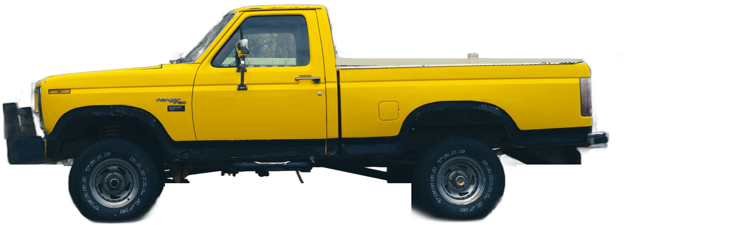
Who we ask
& how many
Population and sample · this week
The last link of the chain: from diagnosis and objectives to the people we will actually interview and survey.
Notes:
About 0:30. This is the new part: population and sample. It closes the chain that started with information asymmetry: after the diagnosis, the objectives and the method, we now decide who we will interview and survey, and how many. We show an ideal design first and then a realistic one.

Slide 16

Our dealers: 487 in Santiago
A named list from the tax office, so we count them instead of guessing.
487
small and medium firms that buy used cars to resell, in the Santiago Metropolitan Region.
Tax code 451002
2,400–100,000 UF a year
Santiago only
Bought used, last 3 months
4,116 in Chile
1,066 small & medium
487 in Santiago
We talk to whoever sets the purchase price
Sources: SII (2026), company statistics 2025 and list of legal persons 2024 (tax ID, sales bracket, comuna).
Notes:
About 0:50. Our first population is B2B, because the dealer pays every month. The tax office publishes a list of firms with their activity, size and comuna, so we can count them. Of 4,116 vehicle retailers in Chile, 1,066 are small or medium, and 487 of those are in Santiago, each with a name and tax ID. They must have bought a used car to resell in the last three months. We talk to whoever sets the purchase price.

Slide 17
Three sizes of dealer
We use the tax office's own sales brackets: every firm on the list already has one.
B1 · SMALL
255
firms
≈1 car a month
Sales of 2,400–10,000 UF
B2 · MEDIUM-SMALL
136
firms
≈3 cars a month
Sales of 10,000–25,000 UF
B3 · MID-SIZE
96
firms
≈9 cars a month
Sales of 25,000–100,000 UF
Out, with evidence: large groups (89% of sales) · micro firms · importers · other regions
Sources: SII (2026), list of firms in Santiago 2024 by sales bracket. Cars a month = SII sales ÷ CLP 18.4M (Guzmán, 2026), a reference.
Notes:
About 0:40. We split the 487 by the tax office's own sales brackets, so every firm is already classified. 255 small firms buy about one car a month, 136 buy about three, and 96 mid-size firms buy about nine. Large groups, micro firms, importers and other regions stay out, each with evidence: for example, the largest firms make 89 percent of sales and appraise in-house.

Slide 18

Our buyers: people paying with their own money
Private buyers in Santiago who just bought a used car, or are about to.
≈485,000
used cars bought by people in Santiago each year (our estimate)
ASKED, NOT A QUOTA
Age, sex, income level (AIM 2023, anonymous), car value, whether they knew the seller and checked the car.
No data says what quota to set for them.
✓
18 or older
✓
Lives in Santiago
✓
Bought in the last 12 months, or will in the next 6
✓
Pays with own or household money
✓
Takes part in the decision
Estimate: 1,060,919 transfers (2025) × 58.0% in the RM × 84.7% bought by people × 93% cars, SUVs and pickups. Sources: CAVEM (2026b, 2026c); AIM (2024). Future buyers: the screener counts them.
Notes:
About 0:50. The second population is private buyers in Santiago: about 485,000 used cars bought by people every year. Five filters apply to everyone: 18 or older, living in Santiago, a purchase in the last 12 months or planned in the next 6, own money, and a part in the decision. Age, sex, income and the value of the car are asked but are not quotas, because no data tells us what quota to set.

Slide 19
Two questions split our buyers
Who did they buy from, and when? Together they make four groups.
When?
Already bought · last 12 months
Will buy · next 6 months
WHY THESE TWO
Seller: the law protects a company sale, not a private one.
Timing: one remembers a real purchase; the other tells us what they need before paying.
From whom?
A private seller
Lived it, with
no legal cover
Needs it, with
no legal cover
A company
Lived it, with
consumer law
Needs it, with
consumer law
This 2 × 2 sets our focus groups and our survey cells
Sources: SERNAC (2019); Ley N.° 19.496. People about to buy report the seller type they expect.
Notes:
About 0:50. Two questions split our buyers. First, who did they buy from: a private seller, with no legal cover, or a company, where consumer law applies. Second, when: people who already bought tell us what really happened, and people about to buy tell us what they need before paying. Together they make four groups, and this grid sets both our focus groups and our survey cells.

Slide 20
Who they are, in five dimensions
From class: demographic and geographic always; the others when an objective needs them.
Demographic
Always
Dealers
Firm size (tax bracket)
Buyers
Age, sex, income level
Geographic
Always
Dealers
Santiago
Buyers
Santiago
Consumption
SO2 · SO5
Dealers
Bought used cars to resell
Buyers
Seller type and timing
Need
SO1 · SO4
Dealers
Prices cars without a full inspection
Buyers
Checked the car before paying?
Psychographic
SO3
Dealers
Trust in AI, risk aversion
Buyers
Fear of fraud, trust in tech
Blue cards are required by the class rule; white cards are used because the objective named on them needs them (Scherman, 2026a, 2026b).
Notes:
About 0:50. This is the profile of both populations in the five dimensions from class. Demographic and geographic are always required: for dealers, firm size and Santiago; for buyers, age, sex, income level and Santiago. The other three appear because an objective needs them: consumption for SO2 and SO5, need for SO1 and SO4, and psychographic for SO3.

Slide 21
Every car has an official value: its permit
Set by law from the tax office appraisal, before any sale. We use it to group cars into three values.
56%
Low value
permit up to CLP 97,653 · typical car: 2011
28%
Mid value
CLP 97,654 – 292,958 · typical car: 2019
16%
High value
permit over CLP 292,958 · typical car: 2023
brand + model + year → permit in the SII table
Why these cuts: Dalenius–Hodges, the classic rule for grouping a skewed value. Equal thirds fail: 28% of cars pay the legal minimum.
Sources: SII (2026), appraisal and permit table 2026 (65,812 versions), weighted by CAVEM (2026b) transfers; Decreto Ley 3.063, art. 12; Dalenius & Hodges (1959). Cuts: 100 and 200 UTM of appraisal.
Notes:
About 1:00. In class you asked us to make the vehicle groups explicit. Every car pays a circulation permit, set by law from the tax office appraisal before any sale, so it is objective and public. We group cars into three values: low, mid and high, 56, 28 and 16 percent of the market. The cuts come from Dalenius–Hodges, the classic rule for grouping a skewed value; equal thirds fail because 28 percent of cars pay the legal minimum. To classify a car we only need brand, model and year.

Slide 22
Stage 1: ten dealer interviews
Ideal design: five dealer profiles, two different interviews in each, plus two in reserve.
1
Small dealer
one low-value stock, one mid
2 interviews
10 + 2
We stop when two interviews in a row bring nothing new.
2
Mid-size dealer
one appraiser, one owner
2 interviews
3
Flipper
buys, fixes and resells
2 interviews
4
High-value dealer
mostly high-value cars
2 interviews
5
Franchise appraiser
a contrast, not a customer
2 interviews
Class: 2 interviews per profile (Scherman, 2026b). Empirical saturation: 9–17 interviews (Hennink & Kaiser, 2022).
Notes:
About 0:50. Stage 1, ideal design, for dealers: five profiles, and two different interviews in each, so ten, plus two in reserve. Different means, for example, one small dealer with low-value stock and one with mid-value stock. The franchise appraiser is a contrast, not a customer. We stop when two interviews in a row bring nothing new.

Slide 23
Stage 1: four buyer focus groups
Ideal design: one group for each box of our 2 × 2, so we hear every perspective.
Bought · last 12 months
Will buy · next 6 months
Private seller
FG1
6–8 people
FG2
6–8 people
Company
FG3
6–8 people
FG4
6–8 people
Inside each group: low, mid and high car value · mixed sex, age, income
Class: 3 groups per segment is ideal, 2 rigorous, 1 the realistic minimum (Scherman, 2026a).
Notes:
About 0:40. For buyers, the ideal is one focus group for each box of our two-by-two: private seller or company, already bought or about to buy. Four groups of six to eight people. Inside each group we mix car values, sex, age and income, so the groups are diverse.

Slide 24
Ideal: 100 dealer surveys
Drawn at random from the tax office list, with at least 30 dealers in every size.
100
B1 · small
40
of 255
B2 · medium-small
30
of 136
B3 · mid-size
30
of 96
of the 487 dealers, one informant each
±9.1%
reference error for the total
How we split the 100
Proportional
52 · 28 · 20
Floor of 30
B2 and B3 go up
Final
40 · 30 · 30
Firms answer 34–55% of surveys → we contact ≈180–290, almost all 96 mid-size
Response rates for firm-level surveys, 2015 and 2020 (Holtom et al., 2022). Error with the finite-population correction and weights back to the real mix (design effect 1.07).
Notes:
About 1:00. The ideal dealer survey has 100 of the 487 dealers, drawn at random from the tax office list. How do we split them? A proportional split gives 52, 28 and 20, but every size needs at least 30 cases, so the two smaller sizes go up to 30 and the remaining 40 go to the small dealers. Weights bring totals back to the real mix: plus or minus 9.1 percent. Recent studies show firms answer 34 to 55 percent of surveys, so we contact 180 to 290 dealers.

Slide 25
Each dealer prices three cars
The choice experiment for SO2: how much does knowing the repair cost change the offer?
Low value
priced blind, or with the repair cost
Mid value
priced blind, or with the repair cost
High value
priced blind, or with the repair cost
300
appraisals
100
per value
50 / 50
blind vs. with cost
Notes:
About 0:40. Each dealer prices three cars, one of each value, some blind and some with the repair cost known, rotated so nobody prices the same car twice. With 100 dealers that is 300 appraisals, 100 per value. The difference between blind and costed offers is what SO2 measures.

Slide 26
Ideal: 300 buyer surveys
75 in each box of our 2 × 2: far above the 30-case floor.
Bought
Will buy
±5.7%
for all 300
±8.0%
per seller type or timing
HOW WE REACH THEM
≥220 online panel
≤80 intercepts at notaries
Car value weighted to 56 / 28 / 16
Private seller
75
75
Company
75
75
Prices are read on each seller type: 150 buyers each
Reference error 1.96·√(0.25/n), 95%; quota samples have no true margin of error (Baker et al., 2013).
Notes:
About 0:50. The ideal buyer survey has 300 people: 75 in each box of the two-by-two, far above the 30-case floor. That gives plus or minus 5.7 percent for the total and 8 percent for each seller type or timing, where we read prices. Most answers come from an online panel, up to 80 from intercepts at notaries, and car value is weighted to the market mix.

Slide 27
Ideal vs. realistic
Ideal meets our precision targets with no limits. Realistic is what seven of us can run in two weeks.
IDEAL
slides 22–26
100 dealer surveys · ±9.1%
300 buyer surveys · ±5.7%
10 + 2 dealer interviews
4 focus groups
REALISTIC
two weeks · no paid panel
60 dealer surveys · ±14.1%
180 buyer surveys · ±7.3%
8 + 2 dealer interviews
2 focus groups, online
WHAT WE LOSE
Precision in every reading
The franchise contrast
The timing split inside the groups
Both designs in Santiago. Realistic: 2 dealer sizes of 30 (design effect 1.37) and 4 buyer cells of 45. Class: 1 focus group per segment is the realistic minimum (Scherman, 2026a).
Notes:
About 0:50. Why are the previous slides the ideal design? Because they meet our precision targets, with no limit of time or money. The realistic design is what seven of us can run in two weeks without a paid panel: 60 dealers, 180 buyers, eight interviews and two online focus groups. We lose precision, the franchise contrast, and the timing split inside the groups.

Slide 28
Every objective has its cell
Who answers each specific objective, where we read it, and the decision it informs.
Specific objective (SO)
Who answers
Where we read it
Decision
1
SO1 Physical & aesthetic
B2B
B2C
Severity of each damage, by car value segment
Damage classes
2
SO2 Cost foresight
B2B
Appraisals blind vs. with cost, by value segment
Offer rule
3
SO3 Adoption barriers
B2B
B2C
Private vs. company; bought vs. about to buy
Report wording
4
SO4 Workshop experience
B2B
Days and hours lost, by dealer size (SII bracket)
App flow and timing
5
SO5 Appeal and adoption
B2B
B2C
Prices: dealer total (100); each seller type (150)
B2B and B2C prices
Ideal: 100 dealers + 300 buyers · Realistic, two weeks: 60 dealers + 180 buyers
Each row: who answers the objective, the cell where we read it, and the business decision it informs. Ideal design (slides 22–26).
Notes:
About 0:50. This closes the loop with the matrix from before. Each specific objective has a population and a place where we read it: SO1 by car value segment, SO2 in the appraisals blind and with cost, SO3 comparing private and company sellers and people who bought with people about to buy, SO5 with prices on the dealer total and on each seller type. At the bottom, the two designs: ideal, 100 dealers and 300 buyers; realistic, 60 and 180.

Slide 29
Thank you
Diagnosis
Information asymmetry between buyers and sellers.
Objective
Understand what certainty is worth.
1
2
Method
Listen first, then measure.
Sample
Ideal: 100 + 300 surveys. In two weeks: 60 + 180.
3
4
Questions?
InfoCar · Strategic Marketing · Universidad del Desarrollo · November 2026
Notes:
About 0:45. To close: the diagnosis is a market for lemons; our objective is to understand what certainty is worth; the method is to listen first and then measure; and the sample is 100 dealers and 300 buyers in the ideal design, or 60 and 180 in two weeks in Santiago. Thank you. We are happy to take your questions.

Slide 30
References
Akerlof, G. A. (1970). The market for "lemons": Quality uncertainty and the market mechanism. The Quarterly Journal of Economics, 84(3), 488–500. https://doi.org/10.2307/1879431
Asociación Nacional Automotriz de Chile [ANAC]. (2026). Informe del sector automotor: Cierre 2025 y evolución acumulada 2026. https://www.anac.cl
Cámara de Comercio Automotriz de Chile [CAVEM]. (2026a). Informe del mercado automotor diciembre 2025: Balance de transferencias de livianos y medianos. https://www.cavem.cl/informes/6981f16e190e9.pdf
Cámara de Comercio Automotriz de Chile [CAVEM]. (2026c). Informe estadístico septiembre 2026: Transferencias acumuladas de usados y ventas de nuevos. https://www.cavem.cl/informes/6ac52d8391f8d.pdf
Cámara de Comercio Automotriz de Chile [CAVEM]. (2026e, October 11). Marcas chinas de autos usados en Chile: cuántas se transfieren y qué buscan los compradores según CAVEM. https://www.cavem.cl/noticias/marcas-chinas-de-autos-usados-en-chile-cuntas-se-transfieren-y-qu-buscan-los-compradores-segn-cavem
Cazvid. (n.d.). ¿Cuánto gana un mecánico en Chile? Retrieved October 26, 2026, from https://cazvid.com/es/blog/cuanto-gana-un-mecanico-en-chile
Farías, C. (2026, May 8). El dolor de cabeza tras chocar: Reparaciones de vehículos en talleres asegurados promedian 52 días. La Tercera. https://www.latercera.com
GoAuto. (n.d.). GoAuto. Retrieved October 26, 2026, from https://www.goauto.cl/
Guzmán, J. P. (2026, February 13). Radiografía al mercado de autos usados en Chile 2025: Precios promedio suben 5% y Ford F-150 lidera búsquedas. Emol Economía. https://www.emol.com
Ley N.° 19.496. (1997, March 7). Establece normas sobre protección de los derechos de los consumidores. Biblioteca del Congreso Nacional de Chile. https://www.bcn.cl/leychile/navegar?idNorma=61438
Ley N.° 21.398. (2021, December 24). Establece medidas para incentivar la protección de los derechos de los consumidores. Biblioteca del Congreso Nacional de Chile. https://www.bcn.cl/leychile/navegar?idLey=21398
Melelli Viveros, A. (2026, October 6). Récord de fraudes vehiculares en Chile: Causas judiciales ingresadas suben 64% en 2025. The Clinic. https://www.theclinic.cl
Ojo Mecánico. (n.d.). Revisión pre compra. Retrieved October 26, 2026, from https://www.revisionprecompra.cl/
Rodar. (n.d.). Rodar. Retrieved October 26, 2026, from https://www.rodar.cl/
Servicio de Impuestos Internos [SII]. (2024). Estadísticas de empresas por rubro y actividad económica. https://www.sii.cl/sobre_el_sii/estadisticas_de_empresas.html
Serviteca CyT. (n.d.). Inspección pre compra full. Retrieved October 26, 2026, from https://servitecacyt.cl/product/inspeccion-pre-compra-full/

Slide 31
References (2)
Population and sample. APA 7th edition. Appendix.
Asociación de Investigadores de Mercado y Opinión Pública [AIM]. (2024). Actualización y manual de aplicación: GSE AIM 2023. https://aimchile.cl/wp-content/uploads/2024/01/Actualizacion-y-Manual-GSE-AIM-2023_VF.pdf
Baker, R., Brick, J. M., Bates, N. A., Battaglia, M., Couper, M. P., Dever, J. A., Gile, K. J., & Tourangeau, R. (2013). Summary report of the AAPOR Task Force on Non-Probability Sampling. Journal of Survey Statistics and Methodology, 1(2), 90–143. https://doi.org/10.1093/jssam/smt008
Cámara de Comercio Automotriz de Chile [CAVEM]. (2026b). Anuario automotor 2025. https://www.cavem.cl/informes/6a7c9bdb0cbc1.pdf
Dalenius, T., & Hodges, J. L., Jr. (1959). Minimum variance stratification. Journal of the American Statistical Association, 54(285), 88–101. https://doi.org/10.1080/01621459.1959.10501501
Decreto Ley N.° 3.063. (1979). Establece normas sobre rentas municipales (art. 12, permiso de circulación). Biblioteca del Congreso Nacional de Chile.
Hennink, M., & Kaiser, B. N. (2022). Sample sizes for saturation in qualitative research: A systematic review of empirical tests. Social Science & Medicine, 292, 114523. https://doi.org/10.1016/j.socscimed.2021.114523
Holtom, B., Baruch, Y., Aguinis, H., & Ballinger, G. A. (2022). Survey response rates: Trends and a validity assessment framework. Human Relations, 75(8), 1560–1584. https://doi.org/10.1177/00187267211070769
Scherman, C. (2026a). Investigación de mercado: Población y muestra [Class slides]. Strategic Marketing, Universidad del Desarrollo.
Scherman, C. (2026b). Workshop: Defining population and sample [Assignment instructions]. Strategic Marketing, Universidad del Desarrollo.
Servicio de Impuestos Internos [SII]. (2026). Estadísticas de empresas (2025), nómina de personas jurídicas (2024) y tasación fiscal de vehículos 2026. https://www.sii.cl
Servicio Nacional del Consumidor [SERNAC]. (2019, February 21). Recomendaciones para comprar un auto usado. https://www.sernac.cl/portal/607/w3-article-1256.html
Notes:
Appendix. Sources for the population and sample section.

