Slide 1

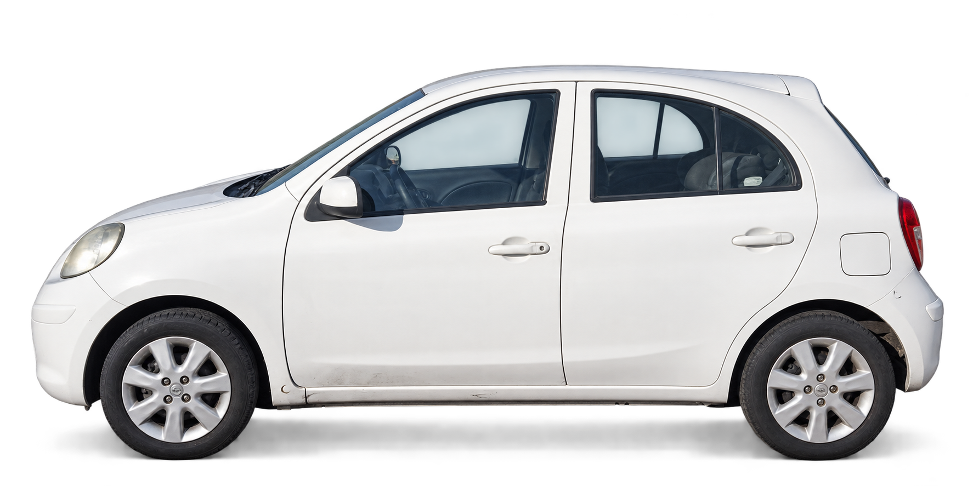
Strategic Marketing
Exam 1 · Oct 2026
InfoCar
B2B & B2C· For used-car dealers in Chile
Our plan to learn what certainty is worth.
Caro B. · Cuero D.· León M. · Marín G.· Parraud J. · Ramírez S. · Ramírez V.
Professor: Claudia Scherman B.
Notes:
About 1:00. InfoCar is B2B: we sell to used-car dealers in Chile. Today we present our research methodology: the context and what changed after your feedback, our objectives, the mixed sequential method, and the techniques.

Slide 2
Dinamic: Information asymmetry
The seller knows the real car's condition.
SELLER
Knows the car
Past crashes, repaint, hidden filler, old faults.
?
BUYER
Sees a price
An ad, a few photos, a short test drive.
RESULT
Every car is discounted
Doubt sets the price, so good cars leave the market.
Information gap
Condition is hard to checked before paying
What the gap costs
2.0–68.9M
CLP asking prices for the same model, the Ford F‑150, in 2025. Price alone does not reveal condition.
Guzmán, 2026
52.3 days
average time a car spends in an insured repair workshop. Hidden damage shows up late.
Farías, 2026
Hidden condition = a cost on every deal
Concept: market for lemons (Akerlof, 1970). Sources: Guzmán (2026), Emol; Farías (2026), La Tercera.
Notes:
About 1:15. The core of the project is information asymmetry. The seller knows the car's history: crashes, repaint, hidden filler. The buyer only sees an ad and a price. Akerlof called this a market for lemons: since the buyer cannot check, every car is discounted and good cars leave. Two numbers show the cost: the same model is listed from 2 to almost 69 million pesos, so price does not reveal condition; and a car spends 52.3 days on average in an insured repair workshop, so hidden damage shows up late and is costly.

Slide 3
Big market, AI pricing arriving, but no Chilean dealer tool reads damage from photos
1,060,919
used-car transfers in 2025, up 5.8%
12.95%
bought by companies, about 14,300 a month
58%
of transfers happen in Santiago
3.4
used cars sold for every new one
Who we serve first SII, activity 451, 2024
Competition
Condition from photos
Rodar
Max purchase price from comparables and OBD2 readings. Closest to us.
✕
TAM
4,325
all vehicle-sales companies (a ceiling)
GoAuto, AutoGest
Market pricing for dealers. No photo-based condition, no fault database.
✕
SAM
1,109
small and medium dealers
Autofact, Carvuk, own eye
Legal history, in-person inspection (about CLP 44,990) or spreadsheets.
✕
557
core: 3+ purchases a month
InfoCar
SOM
✓
Where we stand out: damage read from photos, plus a fault database by model and salvage auctions. No hardware; works on any car, even one seen in a listing.
Sources: CAVEM (2026); SII company statistics 2024, activity 451 (also counts importers and new-car sellers; large groups and micro-businesses out of focus); competitor websites, checked 26 Sep 2026.
3

Slide 4
Who carries the gap of information
Who faces it
Share of used-car buyers, 2025
What widens it
Chinese brands, share of sales
Who protects the buyer?
Legal cover by type of seller
People 83.8%
New cars · ANAC 2026
✓
From a dealer
6-month legal warranty (Ley 21.398).
83.8%
people
41.4%
Companies 16.2%
Most buyers are people, but few buy often.
Used cars · CAVEM 2026
✕
From a private seller
No SERNAC protection: the buyer carries the risk.
12.95%
How often they buy
Private buyer
1 car every 8 years
They reach the used market with little local record of typical faults or part prices.
41,700
vehicle-fraud court cases in 2025, up 64%
Melelli Viveros, 2026
Core dealer
≈9 cars a month
Our scope: 557 core dealers
Dealers face the gap on every purchase, new brands widen it, and the law barely covers it.
Sources: CAVEM (2026a, 2026c, 2026e); ANAC (2026); SII (2024), own estimate of purchases per dealer; Ley N.° 21.398 (2021); Melelli Viveros (2026).
Notes:
About 1:30. Now we project that gap onto the market. Who faces it: in 2025 there were 1,060,919 used-car transfers; people are 83.8% of buyers, but they buy a car every few years. Our scope, the 557 core dealers from the TAM-SAM-SOM, buy between 3 and 27 cars a month, about 9 on average and some 4,900 in total: they face the gap on every purchase. What widens it: Chinese brands are 41.4% of new sales and 12.95% of used transfers; as their 3 to 5 year warranties end, they reach the used market with little local record of faults or part prices. Who protects the buyer: a dealer sale has a 6-month legal warranty; a private sale has no SERNAC protection, and vehicle-fraud cases rose 64% in 2025 to 41,700.

Slide 5
What a dealer pays to know
Every way to check a car today is slow, expensive, or blind to its physical condition.
Pre-purchase inspection
82–102k
CLP per car
1–3 hours. A mechanic checks the car in person.
Serviteca CyT, Ojo Mecánico
Chileautos home inspection
59,990
CLP per car + travel
130+ points, digital report in about an hour.
Chileautos
Autofact report
6–9k
CLP per car (5,990–8,990)
Price and legal history. Nothing on physical condition.
Autofact
Portals + spreadsheets
Hours
of staff time per car
Each salesperson prices the same car differently.
InfoCar Internal Analysis
Working price hypothesis: about CLP 59,990 a month, less than one inspection
Sources: Serviteca CyT (n.d.), Ojo Mecánico (n.d.), Chileautos (n.d.), Autofact (n.d.); prices checked 11 Oct 2026.
Notes:
These are the substitutes we compete with. A full pre-purchase inspection costs CLP 82,000 to 85,990 and takes one to three hours. Chileautos' home inspection costs CLP 59,990 plus travel. An Autofact report is cheap but says nothing about the physical condition. Most dealers just browse portals and keep spreadsheets. Our working price, about CLP 60,000 a month, is a hypothesis to test in interviews.

Slide 6
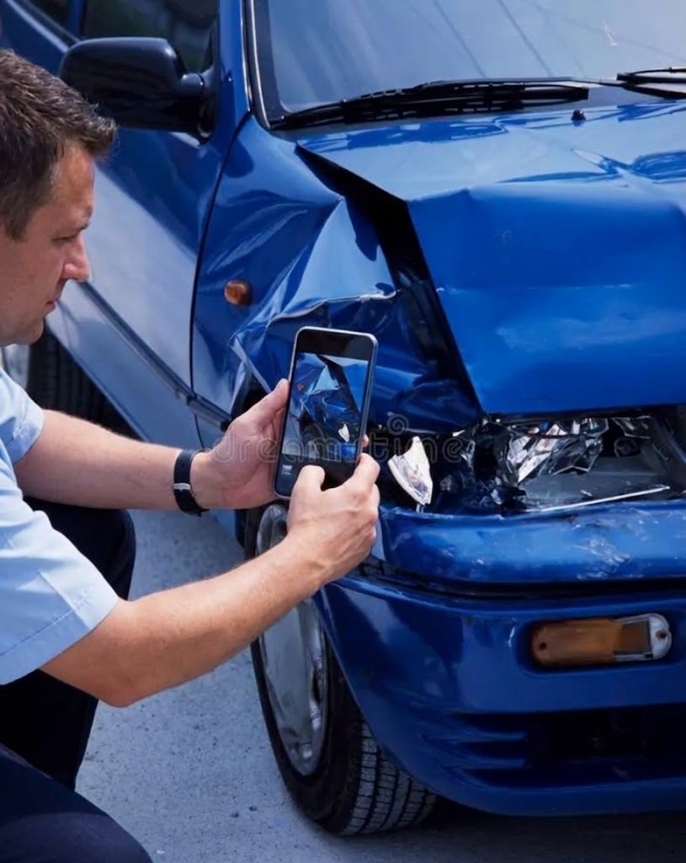
Your own mechanic in your pocket
01
Snap the car
Guided photos, plus make, model, year, mileage and asking price.
02
InfoCar does the maths
Market comparables + the model’s typical faults (validated by mechanics) + damage detected in the photos.
03
Get a clear call
Maximum purchase price, repair-cost range, and Buy / Negotiate / Pass.
Max price = market value − repairs − risk margin
A pre-screen, not a certificate: photos can’t see inside the engine or gearbox. The price comes from a regression, not from the language model.
Notes:
The dealer takes guided photos and enters the car details. InfoCar combines market comparables, the typical faults of each model validated by mechanics, and the damage visible in the photos. The output is a maximum purchase price, a repair-cost range and a clear Buy, Negotiate or Pass. The price is set by a regression, not by the language model. Photos cannot see inside the engine or gearbox, so InfoCar pre-screens and gives a negotiating argument; it does not certify.

Slide 7
So… how to close the gap
Two revenue lines: the dealer pays a plan, and a private buyer pays per report.
INFOCAR
Condition report
Damage and repair cost, built from phone photos.
One report, two ways to pay.
B2B · THE DEALER PAYS
Prices with the repair cost known
Monthly plan · CLP 59,900–149,900
Visual appraisal with AI
Parametric workshop budget
B2C · THE BUYER PAYS
Buys a car from a private seller
Where the law protects least.
One report · CLP 7,990–24,990
Maximum purchase offer
Today vs. InfoCar
Mechanic inspection
Rodar
InfoCar
Cost per car
CLP 82,000–102,000
Not public
≈CLP 6,700 on the plan
Time per car
1–3 hours
Needs a scanner fitted
Minutes (goal: under 5)
What it checks
Engine, body, chassis
Engine data (OBD-II)
Exterior body only | OBD-II*
Sources: Serviteca CyT; Ojo Mecánico; Rodar (n.d.). InfoCar per car = CLP 59,900 ÷ ≈9 cars a month. Prices: hypotheses tested in SO5.
Notes:
About 1:15. Who pays to close the gap. InfoCar builds one condition report from phone photos, and there are two ways to pay for it. B2B: the dealer pays a monthly plan and prices each car knowing the repair cost. B2C: a person buying from a private seller, where there is no legal warranty, buys a single report. Today the alternative is a mechanic: a pre-purchase inspection costs CLP 82,000 to 85,990 per car and takes 1 to 3 hours; an in-house mechanic costs about CLP 4,000 an hour in salary, our estimate, but is not always free. On the plan, InfoCar costs about CLP 6,700 per car, the 59,900 plan divided by about 9 cars a month, and takes minutes. To be fair, photos only see the exterior body; a mechanic also checks the engine and chassis. Rodar reads engine data with an OBD-II scanner. Both prices are hypotheses that specific objective 5, on the next slide, tests.

Slide 8
Why not just ask ChatGPT?
A general chatbot has no current Chilean listings, and when it reads car damage from photos it often invents things.
Vehicle damage reports with hallucinations
What InfoCar adds
General vision model, image only
78%
✓
Up-to-date Chilean market data
✓
Vision models built for car damage
Same model anchored to a dedicated damage-segmentation model
31%
✓
Ranges with a confidence level
✓
Traceable estimates and human review
100 human-checked reports (Hogale et al., 2026)
Accuracy is the top AI barrier for 74% of US dealers (Cox Automotive, 2025): sell verifiable accuracy, not “AI”
Sources: Hogale et al. (2026), arXiv 2608.02470; Cox Automotive (2025).
Notes:
The obvious objection is: why not just ask ChatGPT? In the only quantitative study we found on vehicle damage, a general vision model produced reports with hallucinations in 78% of cases from images alone. Anchoring it to a dedicated segmentation model brought that down to 31%. So our value against a chatbot rests on Chilean market data, specialised vision models, confidence ranges and traceability. Our own product can also be wrong and must say so. In a Cox Automotive survey of 537 US dealers, concern about accuracy was the top barrier to AI, cited by 74%. So we sell verifiable accuracy, not 'AI'.

Slide 9
What we need to understand to make it real
General objective: to understand how technical and economic certainty is valued when setting the transaction value of used cars.
Specific objective (SO)
one dimension each
S
Specific
What exactly
M
Measurable
How we measure it
A
Achievable
Why it is doable
R
Relevant
Decision it informs
T
Time-bound
Weeks 1–4
SO1 · Physical & aesthetic
Identify the physical and aesthetic attributes that determine how a car's condition is valued.
classification of body damages: dents, scratches, panel gaps, lights, repaint
Severity on a Likert 1–5 scale (1 = barely visible, 5 = structural)
Dealers judge these damages by eye every day
Sets the damage classes the app must detect
1
SO2 · Cost foresight
Analyze how anticipating reconditioning costs affects how the purchase offer is set.
CLP discount on the offer for each diagnosed damage
Choice experiment: blind case vs. case with repair cost
Pricing a trade-in is a daily task for appraisers
Calibrates the offer rule and the dealer's margin
2
SO3 · Adoption barriers
Evaluate the distrust barriers, resistance to automated diagnosis and technical uncertainty that shape transactions.
Fear of AI errors, of Chinese brands and of opaque appraisals
Coded objections + agreement on a Likert 1–5 scale
Objections come up on their own in interviews
Shapes how the report explains itself
3
SO4 · Workshop experience
Describe the operating experience and time bottlenecks of conventional exterior inspection and repair costing.
Days a car is stopped; hours to quote body and paint work
Time metrics (days, hours) + journey map
A known pain: 52.3 days in insured workshops
Sets the app flow and the time limit per report
4
SO5 · Appeal and adoption
Evaluate the perceived appeal, differentiation and adoption intent of a digital condition report vs. traditional appraisal.
B2B intent to subscribe; B2C intent to buy a report
Top-2 Box intent + Van Westendorp price meter
A clear stimulus: a mock-up of the digital report
Sets B2B and B2C prices before building the software
5
T = theoretical plan, all five SOs within one month: W1 explore (stage 1) · W2 build and pilot the questionnaire · W3–W4 measure (stage 2).

Slide 10
Listen first, then measure
A mixed, sequential design: what we hear in stage 1 becomes the questions and scales of stage 2.
Qualitative, to explore
In-depth interviews (B2B) · Focus groups (B2C)
We learn the dealers' words, their rules of thumb for pricing, and what makes them distrust.
Bridge
Findings become variables, scales and closed answers.
Quantitative, to conclude
F2F + CATI (B2B) · CAWI + intercepts (B2C)
We measure the impact of each variable that we found, test our hypotheses, and estimate willingness to pay.
Stage 1
Stage 2
Explores SO1–SO5: the words and reasons
Measures SO1–SO5: how each variable impacts
Notes:
About 1:45. We chose a mixed, sequential design. Stage 1 is qualitative, to explore; stage 2 is quantitative, to conclude. The order matters for two reasons. First, appraisal in Chile has no standard: it runs on rules of thumb and informal words, so a closed survey first would measure the wrong things. Second, what we hear in stage 1 becomes the answer options and scales of stage 2. Both stages cover the five specific objectives, SO1 to SO5: stage 1 finds the words and reasons, stage 2 measures how common they are.

Slide 11

Qualitative: one technique per customer
Interviews for what dealers keep private; groups for what buyers share.
In-depth interviews, one-on-one
B2B
Mid-size dealer owners
Appraisers
Why it fits best
Margins and workshop deals are trade secrets. Nobody shares them in front of competitors.
What it gives us
Hidden pricing rules, how far they trust AI, what fails in “ our competitors”.
Technique · Semi-structured interview guide, 30–35 min, one-on-one
Moderated focus groups
B2C
Bought a used car in the last 12 months
Plan to buy one
Why it fits best
Fear of fraud is social: hearing others' stories makes people talk.
What it gives us
Shared risk perceptions, the buyer's own words, first reaction to the report.
Technique · Moderator's discussion guide, 75–90 min
Notes:
About 1:45. For dealers the technique is the one-on-one in-depth interview: margins and workshop deals are trade secrets, and nobody shares them in front of competitors. The instrument is a semi-structured interview guide of 30 to 35 minutes. It gives us hidden pricing rules, how far dealers trust AI, and what fails in tools like GoAuto or Rodar. For private buyers the technique is the moderated focus group: fear of fraud is social, and hearing other people's stories makes buyers talk. The instrument is a moderator's discussion guide for 6 to 8 people, 75 to 90 minutes. It gives us shared risk perceptions, the buyer's own words, and a first reaction to the report.

Slide 12

Quantitative: meet each customer
Dealers in person at work, buyers online at scale. Phone calls and intercepts close the gaps.
B2B
B2C
F2F in situ + CATI
How we reach them
At the dealer's workplace in car hubs (e.g. Gran Avenida, Av. Bilbao): dealers rarely answer web surveys. CATI covers regions.
Tecnique
Structured questionnaire on a tablet, 8–10 min, with the report prototype.
What it measures
Pricing rules at scale, reaction to the prototype, intent to subscribe.
CAWI with quotas + intercepts
How we reach them
Online panel with quotas by gender, age, car age and buying channel. Intercepts at notaries and PRT if a quota fills slowly.
Tecnique
Self-administered online questionnaire with the same report mock-up.
What it measures
How common each fear is, intent to buy a report, price range (PSM).
Each mode reaches one customer; together they cover both sides of the deal.
Notes:
About 1:30. For dealers we go face to face to their workplace, in car hubs like Gran Avenida or Av. Bilbao, because dealers rarely answer web surveys; phone calls (CATI) cover regions. The instrument is a structured questionnaire of 8 to 10 minutes on a tablet, so we can show the report prototype. For private buyers we use an online panel with quotas by gender, age, car age and buying channel, and intercept buyers at notaries and inspection plants if a quota fills slowly. The instrument is a self-administered online questionnaire with the same mock-up. What each one measures, objective by objective, is on the next slide.

Slide 13
From method to objectives
Specific objective (SO)
Step 1 · Explore (qualitative)
Step 2 · Measure (quantitative)
Step 3 · Decide
In-depth interviews
B2B
Focus groups
B2C
becomes
questions
F2F in situ + CATI
B2B
CAWI + intercepts
B2C
Business decision
1
SO1
Physical & aesthetic
Words for each damage
Impact in the buying decision
→
Severity of kinds of damages, Likert 1–5
Most relevant aspects, Likert 1–5
Damage classes in the app
2
SO2
Cost foresight
Hidden costs
Choice experiment: blind vs. costed
Offer rule and margin
3
SO3
Adoption barriers
Objections to AI
Fear of fraud
→
Criticality, Likert 1–5
How common each fear is
How the report explains itself
4
SO4
Workshop experience
Where time is lost
→
Days stopped, hours to quote
App flow and timing
5
SO5
Appeal and adoption
First reaction to the prototype
→
Concept test, Top-2 Box
Intent + PSM
B2B and B2C prices
Notes:
About 1:30. This matrix links the method to the five specific objectives, SO1 to SO5. Read each row from left to right. Step one, in yellow, is stage 1: the outlined boxes are what interviews and focus groups explore, such as the dealers' words for each damage or their objections to AI. That becomes the questions of stage 2, in black: the filled boxes are what the surveys measure, such as severity on a 1 to 5 scale, a choice experiment with and without the repair cost, or a concept test with the Van Westendorp price sensitivity meter (PSM). Step three, in blue, is the business decision each objective informs. A dash means that technique is not used for that objective. As the brief says, population and sample size come in the next stage.

Slide 14
Thank you
Diagnosis
Information asymmetry between buyers and sellers.
Objective
Understand what certainty is worth.
Method
Listen first, then measure.
1
2
3
Questions?
InfoCar · Strategic Marketing · Universidad del Desarrollo · October 2026
Notes:
About 0:45. To close: the diagnosis is a market for lemons; our objective is to understand what certainty is worth; and the method is to listen first and then measure. Thank you. We are happy to take your questions.

Slide 15
References
Akerlof, G. A. (1970). The market for "lemons": Quality uncertainty and the market mechanism. The Quarterly Journal of Economics, 84(3), 488–500. https://doi.org/10.2307/1879431
Asociación Nacional Automotriz de Chile [ANAC]. (2026). Informe del sector automotor: Cierre 2025 y evolución acumulada 2026. https://www.anac.cl
Cámara de Comercio Automotriz de Chile [CAVEM]. (2026a). Informe del mercado automotor diciembre 2025: Balance de transferencias de livianos y medianos. https://www.cavem.cl
Cámara de Comercio Automotriz de Chile [CAVEM]. (2026c). Informe estadístico septiembre 2026: Transferencias acumuladas de usados y ventas de nuevos. https://www.cavem.cl
Cámara de Comercio Automotriz de Chile [CAVEM]. (2026e, October 11). Marcas chinas de autos usados en Chile: cuántas se transfieren y qué buscan los compradores según CAVEM. https://www.cavem.cl/noticias/marcas-chinas-de-autos-usados-en-chile-cuntas-se-transfieren-y-qu-buscan-los-compradores-segn-cavem
Cazvid. (n.d.). ¿Cuánto gana un mecánico en Chile? Retrieved October 26, 2026, from https://cazvid.com/es/blog/cuanto-gana-un-mecanico-en-chile
Farías, C. (2026, May 8). El dolor de cabeza tras chocar: Reparaciones de vehículos en talleres asegurados promedian 52 días. La Tercera. https://www.latercera.com
GoAuto. (n.d.). GoAuto. Retrieved October 26, 2026, from https://www.goauto.cl/
Guzmán, J. P. (2026, February 13). Radiografía al mercado de autos usados en Chile 2025: Precios promedio suben 5% y Ford F-150 lidera búsquedas. Emol Economía. https://www.emol.com
Ley N.° 19.496. (1997, March 7). Establece normas sobre protección de los derechos de los consumidores. Biblioteca del Congreso Nacional de Chile. https://www.bcn.cl/leychile/navegar?idNorma=61438
Ley N.° 21.398. (2021, December 24). Establece medidas para incentivar la protección de los derechos de los consumidores. Biblioteca del Congreso Nacional de Chile. https://www.bcn.cl/leychile/navegar?idLey=21398
Melelli Viveros, A. (2026, October 6). Récord de fraudes vehiculares en Chile: Causas judiciales ingresadas suben 64% en 2025. The Clinic. https://www.theclinic.cl
Ojo Mecánico. (n.d.). Revisión pre compra. Retrieved October 26, 2026, from https://www.revisionprecompra.cl/
Rodar. (n.d.). Rodar. Retrieved October 26, 2026, from https://www.rodar.cl/
Servicio de Impuestos Internos [SII]. (2024). Estadísticas de empresas por rubro y actividad económica. https://www.sii.cl/sobre_el_sii/estadisticas_de_empresas.html
Serviteca CyT. (n.d.). Inspección pre compra full. Retrieved October 26, 2026, from https://servitecacyt.cl/product/inspeccion-pre-compra-full/

