Slide 1

FIGHTING CRIME WITH BIG DATA
ADM project
Contributors:
Viktoriya Bodnar
Yasser Aboua Haila
UniGe 2018

Slide 2
MOTIVATION and INSPIRATION
Crime rising even more steeply
Intuition behind
Bigger picture
Store, use, analyze ----------------> PREDICT

Slide 3
APPLICATION DOMAIN
Police departments
Policy makers
-> Insert new crime
-> Update crime details
-> Find relevant information
-> Analyze relationships
Law agencies
Statistical analysis centers

Slide 4
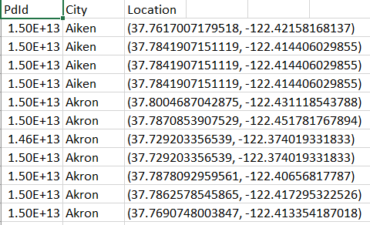
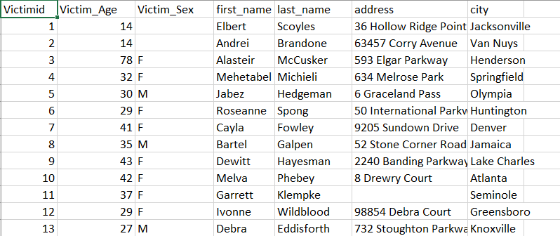
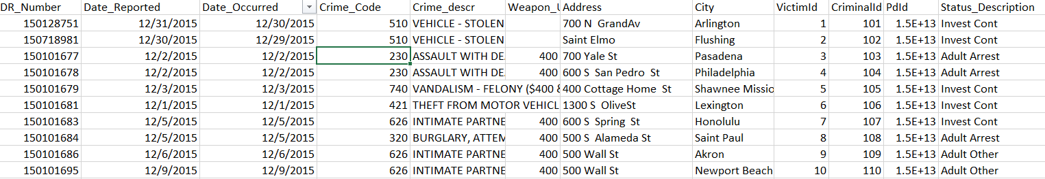
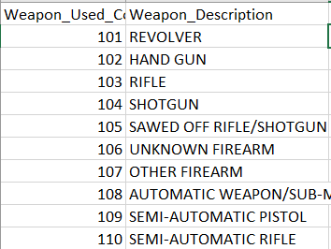
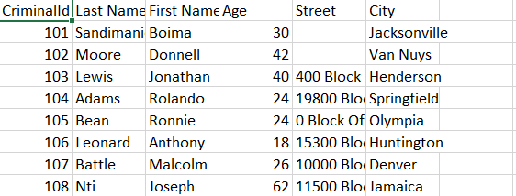
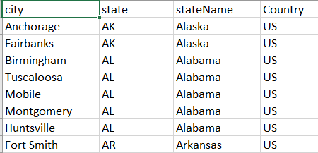
DATASET
.???
VICTIMS
POLICE DEPARTMENTS
CRIMES
WEAPONS
CRIMINALS
CITIES

Slide 5

TECHNOLOGY
Dynamic and flexible schema
~15000 tuples of data
Time and cost saving
Relationship significance
Identify patterns and insights
Easy SQL-like Cypher lang.

Slide 6
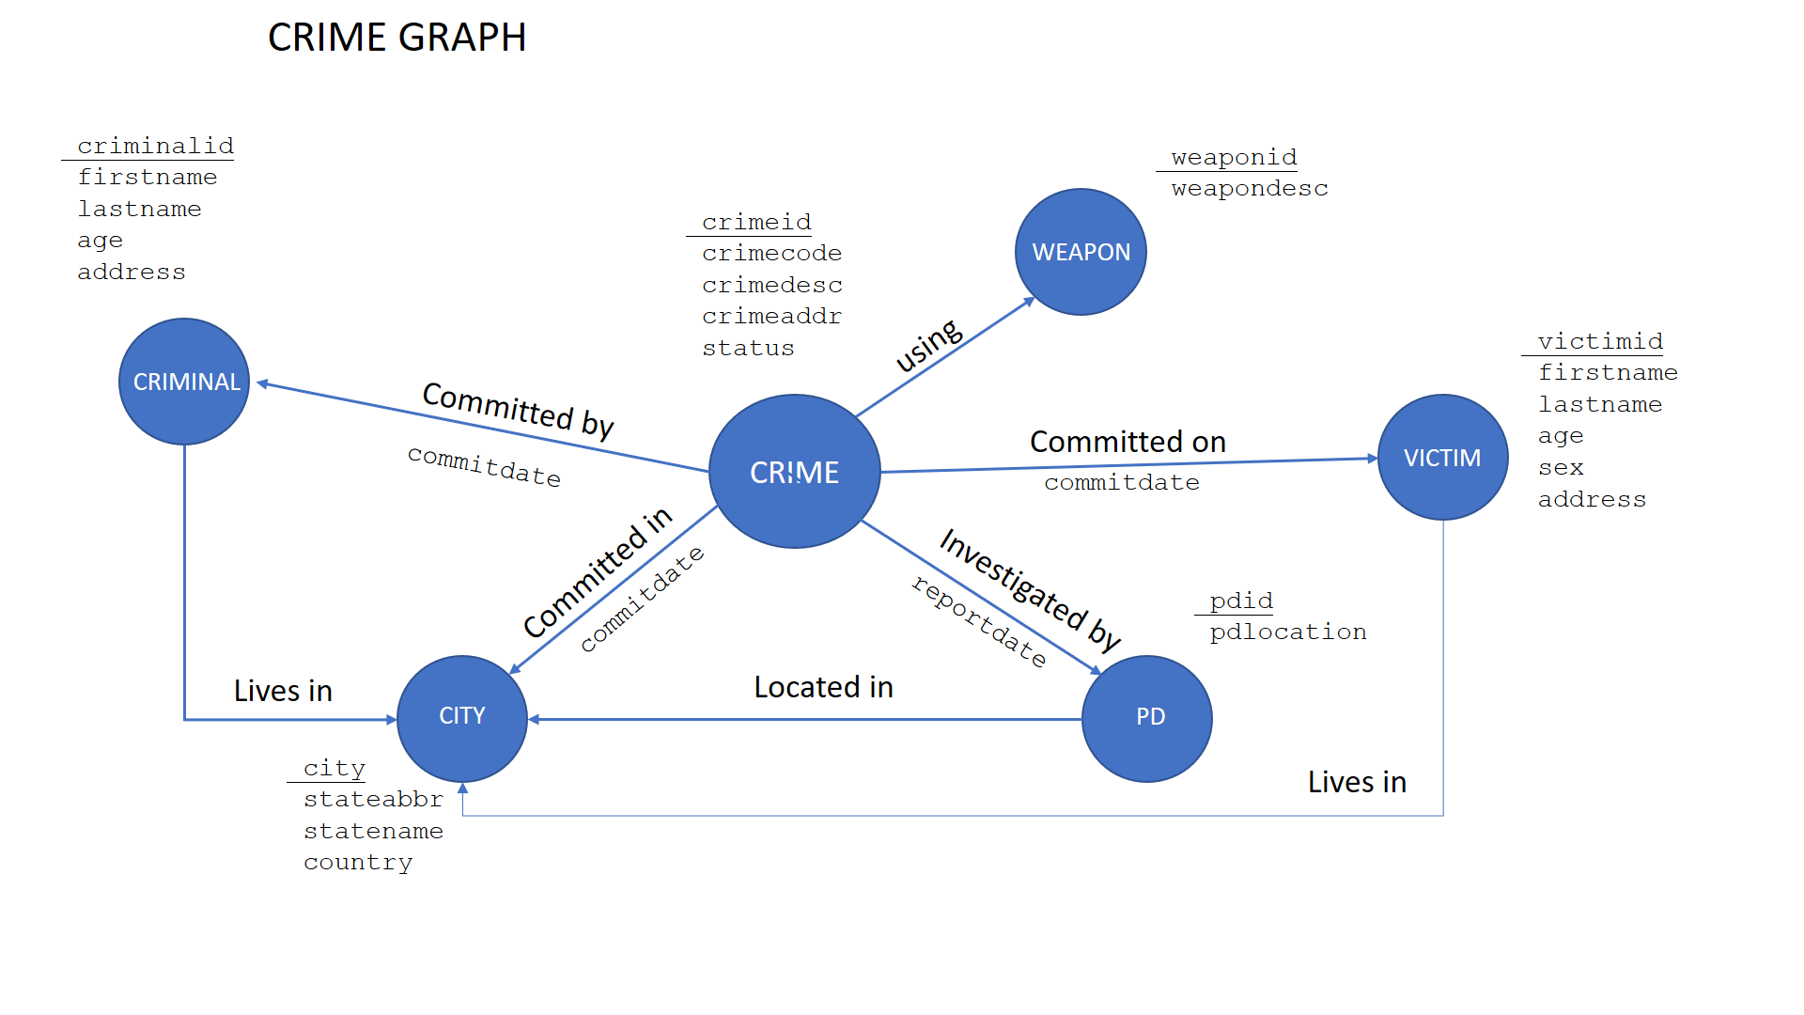
DATA MODEL

Slide 7
WORKLOAD
OLTP + simple ‘analytical-style’ queries
Graph traversal
Interconnectivity of objects
CRIMINALS-VICTIMS
CRIMINALS – VICTIMS - CITIES
CRIMINALS - CITIES
CRIMES - CITIES
CRIMES - PDS
CRIMES-WEAPONS

Slide 8
SCALABILITY ISSUES
Partitioning – NP problem
Minimal cut point
Multi-Leader Replication
Asynchrony
Eventual consistency
CAP: focus on CA
Polyglot persistence

Slide 9
EXTRAs
E-Governance application target
Add, find, visualize, analyze
Good performance
Speeded up
Lightweight in memory usage

Slide 10

Thank you
for attention!

