Slide 1
+
MediQuick AI
An Advanced Multimodal Medical Triage Assistant
Final Project Review · June 2026
Dissertation: Rishwanth [Last Name] Developer: Vignesh V BITS ZG628T

Slide 2
+
The Problem
“How urgent is this — and who should I see?”
Noise, not clarity Search results are overwhelming and often alarming, not reassuring.
1
Cost & access Booking a consultation for every minor concern is impractical and expensive.
2
Wrong question People need to know the urgency and the right specialist — not a self-diagnosis.
3

Slide 3
+
The Approach
MediQuick AI triages — it does not diagnose. Describe symptoms in chat, optionally add a photo, and receive a structured, urgency-ranked assessment.
Multimodal
Structured JSON
Understands text and images together via a Vision-Language Model.
Every reply follows a strict, validated six-field schema.
Three urgency tiers
Safe by design
Self-care · consult a doctor · seek emergency care.
Emergency override and a disclaimer on every response.

Slide 4
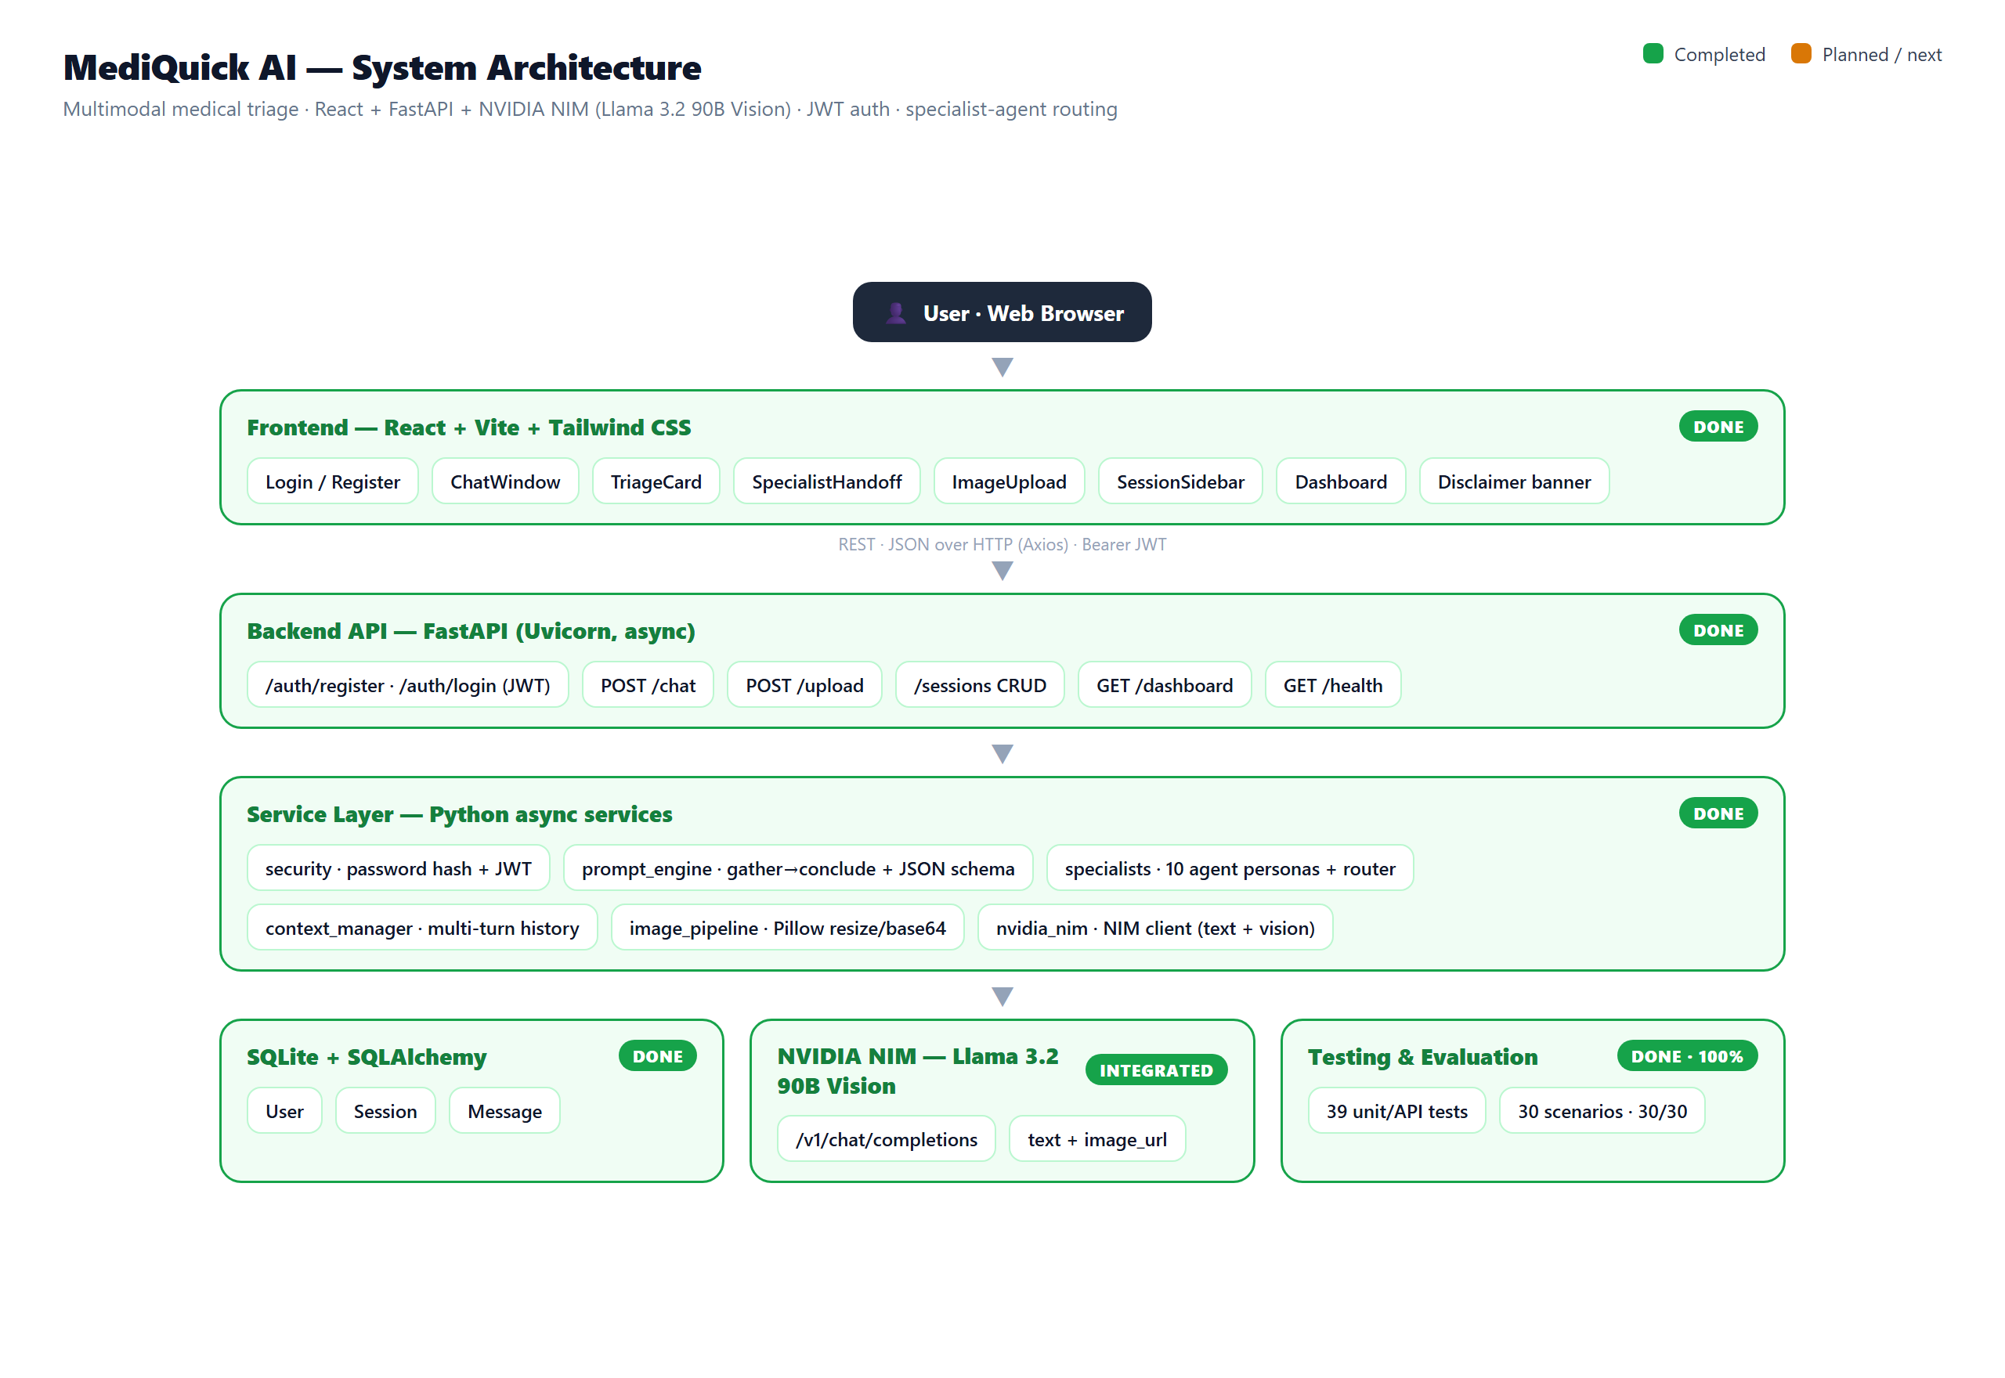
+
System Architecture
React + FastAPI + NVIDIA NIM · JWT auth · specialist-agent routing — all layers complete and validated.

Slide 5
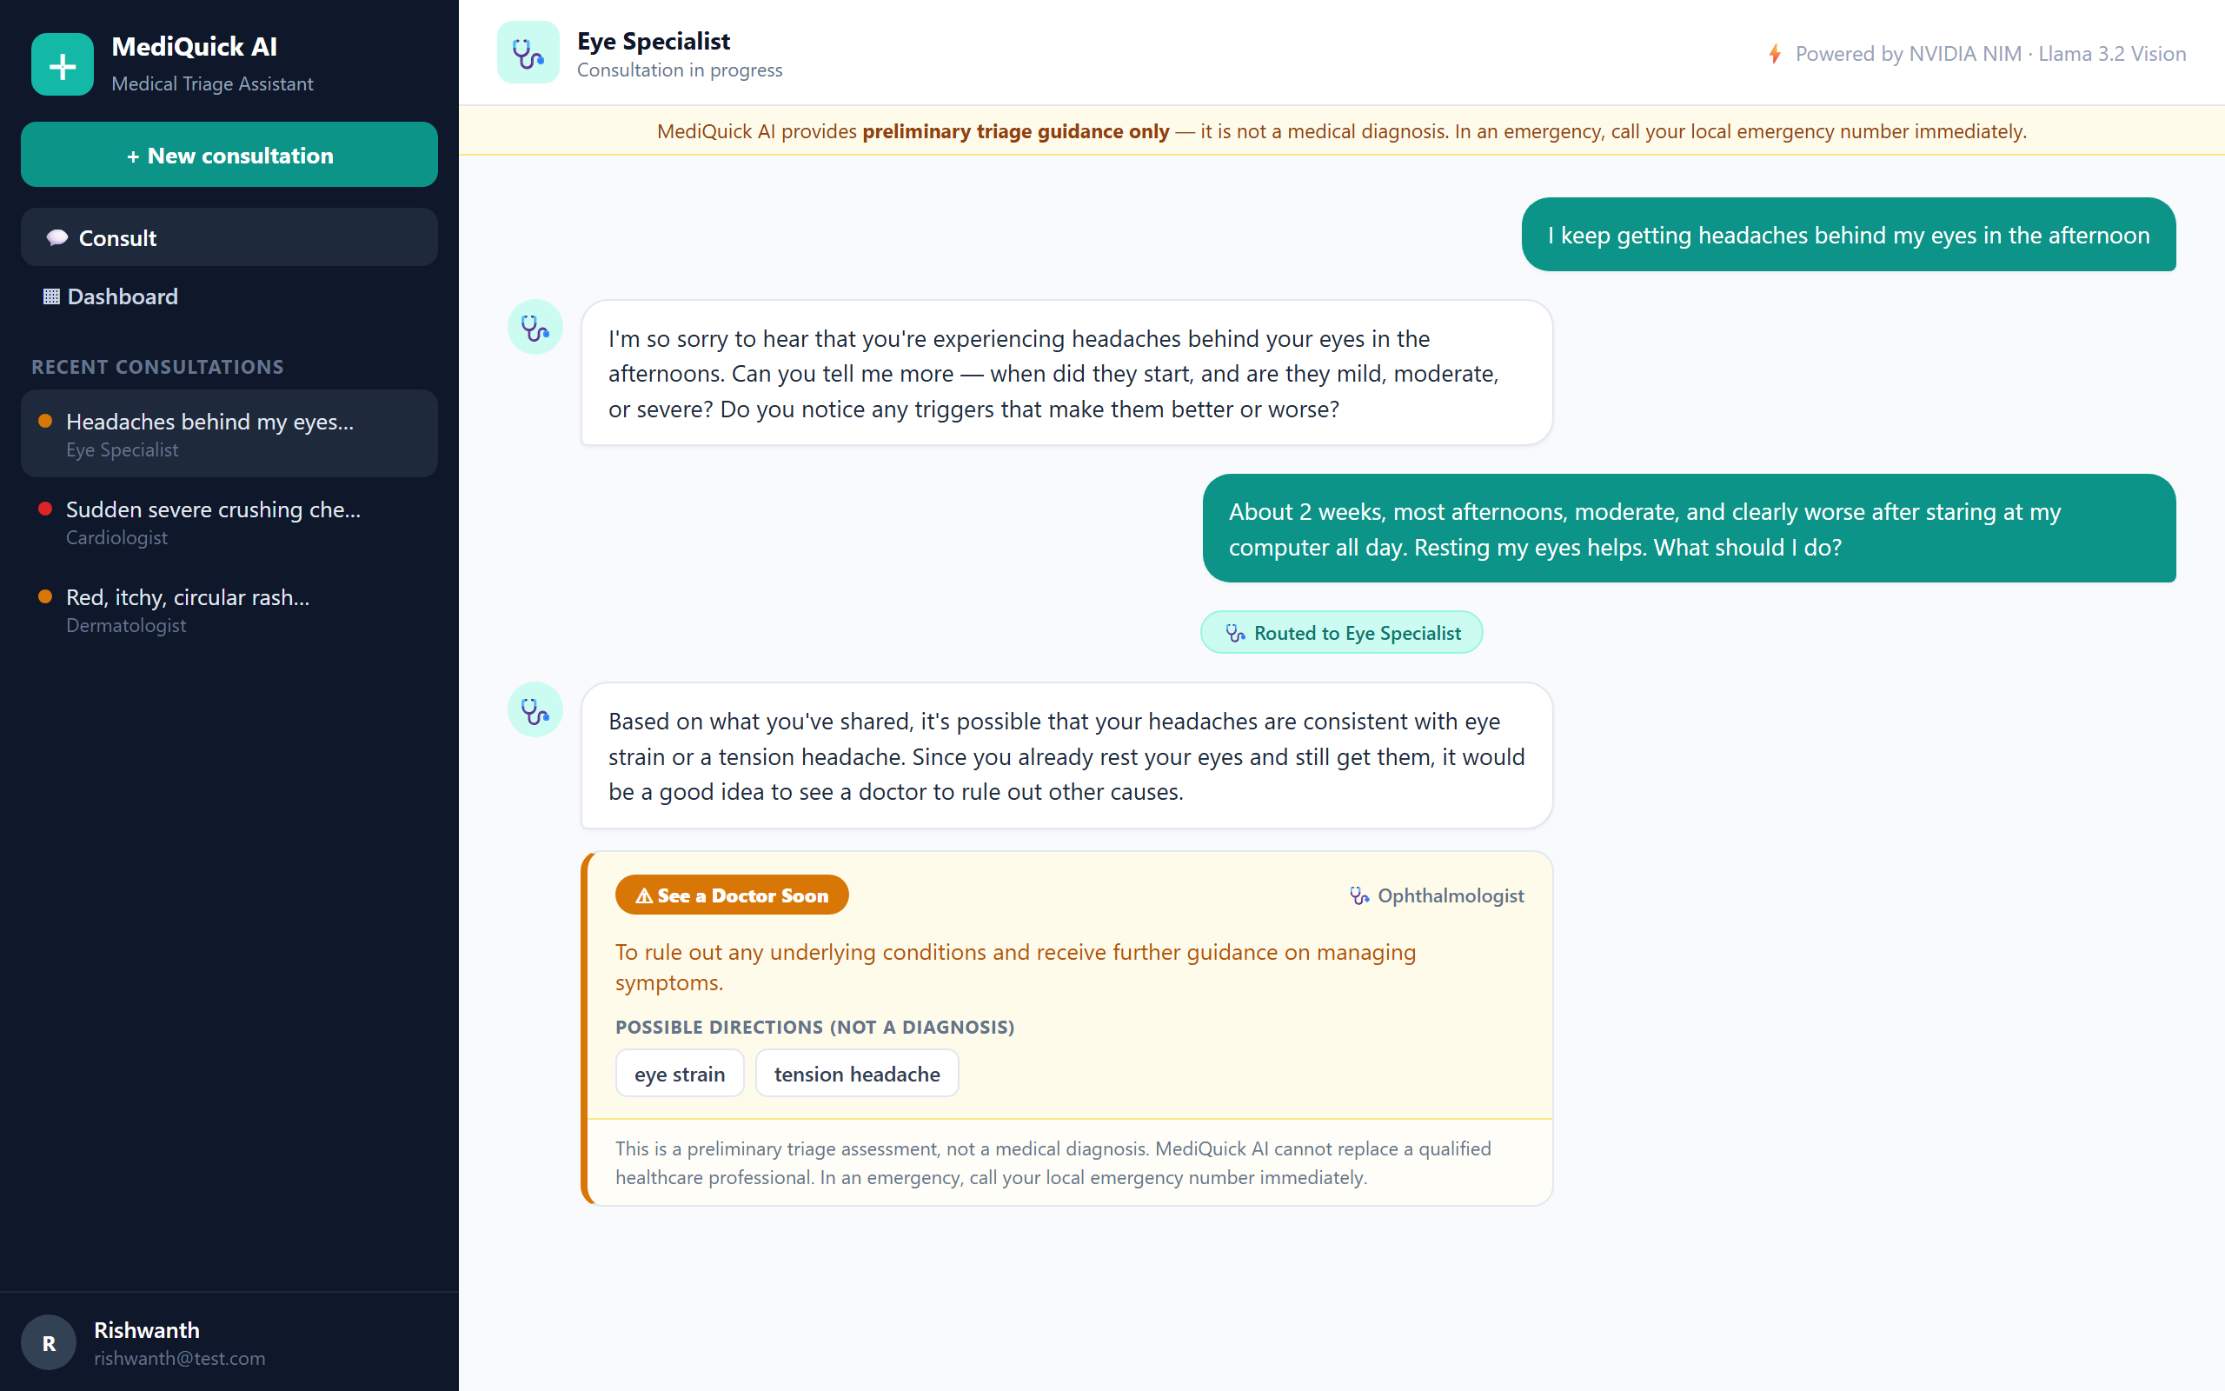
+
Demo · Doctor-Style Consultation
1
User describes a symptom in plain language.
2
The assistant asks focused follow-up questions.
3
It hands off to the right specialist agent.
4
It concludes with a colour-coded triage card.
Real consultation: General Physician → Eye Specialist handoff, concluding with a triage card.

Slide 6
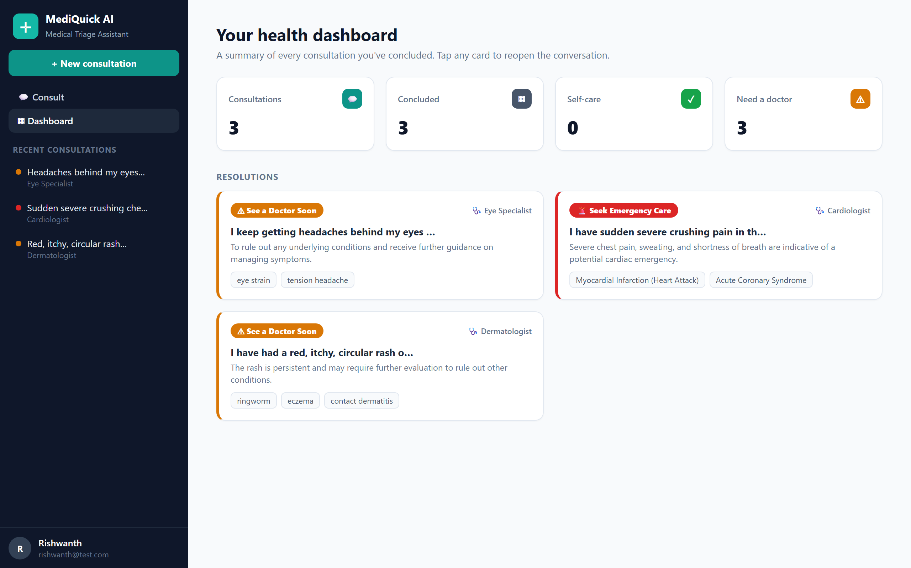
+
Specialist Routing & Dashboard
10 agents
General Physician routes to the right specialist
Context carried
Full history follows the handoff
Photos in-memory
Validated, resized, never saved to disk
Dashboard: every concluded consultation summarised by urgency and specialist — no medication content.

Slide 7
+
Verified Three Ways
39 / 39
30 / 30
29 / 29
Automated Tests
Evaluation Scenarios
Live End-to-End Checks
pytest suite · ~1s runtime · isolated DB · mocked NIM client
100% urgency accuracy · 0 unsafe under-triage
on the running app, registration through cross-user isolation
Evaluation Breakdown by Category
10 / 10
10 / 10
10 / 10
30 / 30
Dermatology
General medicine
Minor injury
Overall
Compared against standard triage reference guidelines, across all three urgency tiers.

Slide 8
+
Defects Found & Fixed
1
Off-topic images broke the JSON contract
2
Hardcoded JWT secret fallback
An unrelated image (e.g. a company logo) made the model reply in raw prose claiming it “is a text-based AI assistant… not able to view images” — vision was actually working, the image had reached the model. Fixed with a strengthened prompt plus a single strict “reformat as JSON” retry. Re-tested and confirmed fixed.
The environment template shipped with no JWT_SECRET, so every install fell back to a hardcoded default that is public in the repository — login tokens could be forged across deployments. The installer now generates a unique random secret per installation (idempotent).
3
Vision timeout too tight
4
Dead configuration value
Observed NIM vision latency runs 14–42s; raised the timeout from 60s to 100s backend / 110s client.
Removed a leftover config value pointing at the wrong port.
All four issues surfaced through live end-to-end testing and are now resolved and re-verified.

Slide 9
+
Project Complete
100%
Completed
Delivered Highlights
✓ FastAPI backend + JWT auth
★ 39 automated tests passing
✓ NVIDIA NIM client (text + vision)
★ 30/30 evaluation (100%)
✓ Prompt engine, gather→conclude
★ 29/29 live checks passed
of the project complete
every planned phase shipped, tested, and verified
✓ 10 specialist agents + routing
★ Mobile-responsive UI
✓ React UI: chat, card, sidebar
★ Security hardened (JWT)
✓ Dashboard of resolutions
✓ Evaluation — 30/30 (100%)

Slide 10
+
What's Next
1
Clinician-reviewed validation study Partner with practising clinicians to validate triage outputs against real cases.
2
Larger evaluation set Expand well beyond 30 scenarios for broader statistical confidence.
3
EHR integration Connect with electronic health record systems for richer patient context.
4
Multilingual support Extend triage and the interface beyond English.
5
On-device inference Explore local model inference to keep sensitive data on-device for privacy.

Slide 11
+
Thank You
MediQuick AI provides preliminary triage guidance only — not a medical diagnosis.
Rishwanth [Last Name] · BITS ZG628T Dissertation · Developer: Vignesh V · June 2026

