Slide 1
+
MediQuick AI
An Advanced Multimodal Medical Triage Assistant
Mid-Semester Progress Review · June 2026
Dissertation: Rishwanth [Last Name] Developer: Vignesh V BITS ZG628T

Slide 2
+
The Problem
“How urgent is this — and who should I see?”
Noise, not clarity Search results are overwhelming and often alarming, not reassuring.
1
Cost & access Booking a consultation for every minor concern is impractical and expensive.
2
Wrong question People need to know the urgency and the right specialist — not a self-diagnosis.
3

Slide 3
+
The Approach
MediQuick AI triages — it does not diagnose. Describe symptoms in chat, optionally add a photo, and receive a structured, urgency-ranked assessment.
Multimodal
Structured JSON
Understands text and images together via a Vision-Language Model.
Every reply follows a strict, validated six-field schema.
Three urgency tiers
Safe by design
Self-care · consult a doctor · seek emergency care.
Emergency override and a disclaimer on every response.

Slide 4
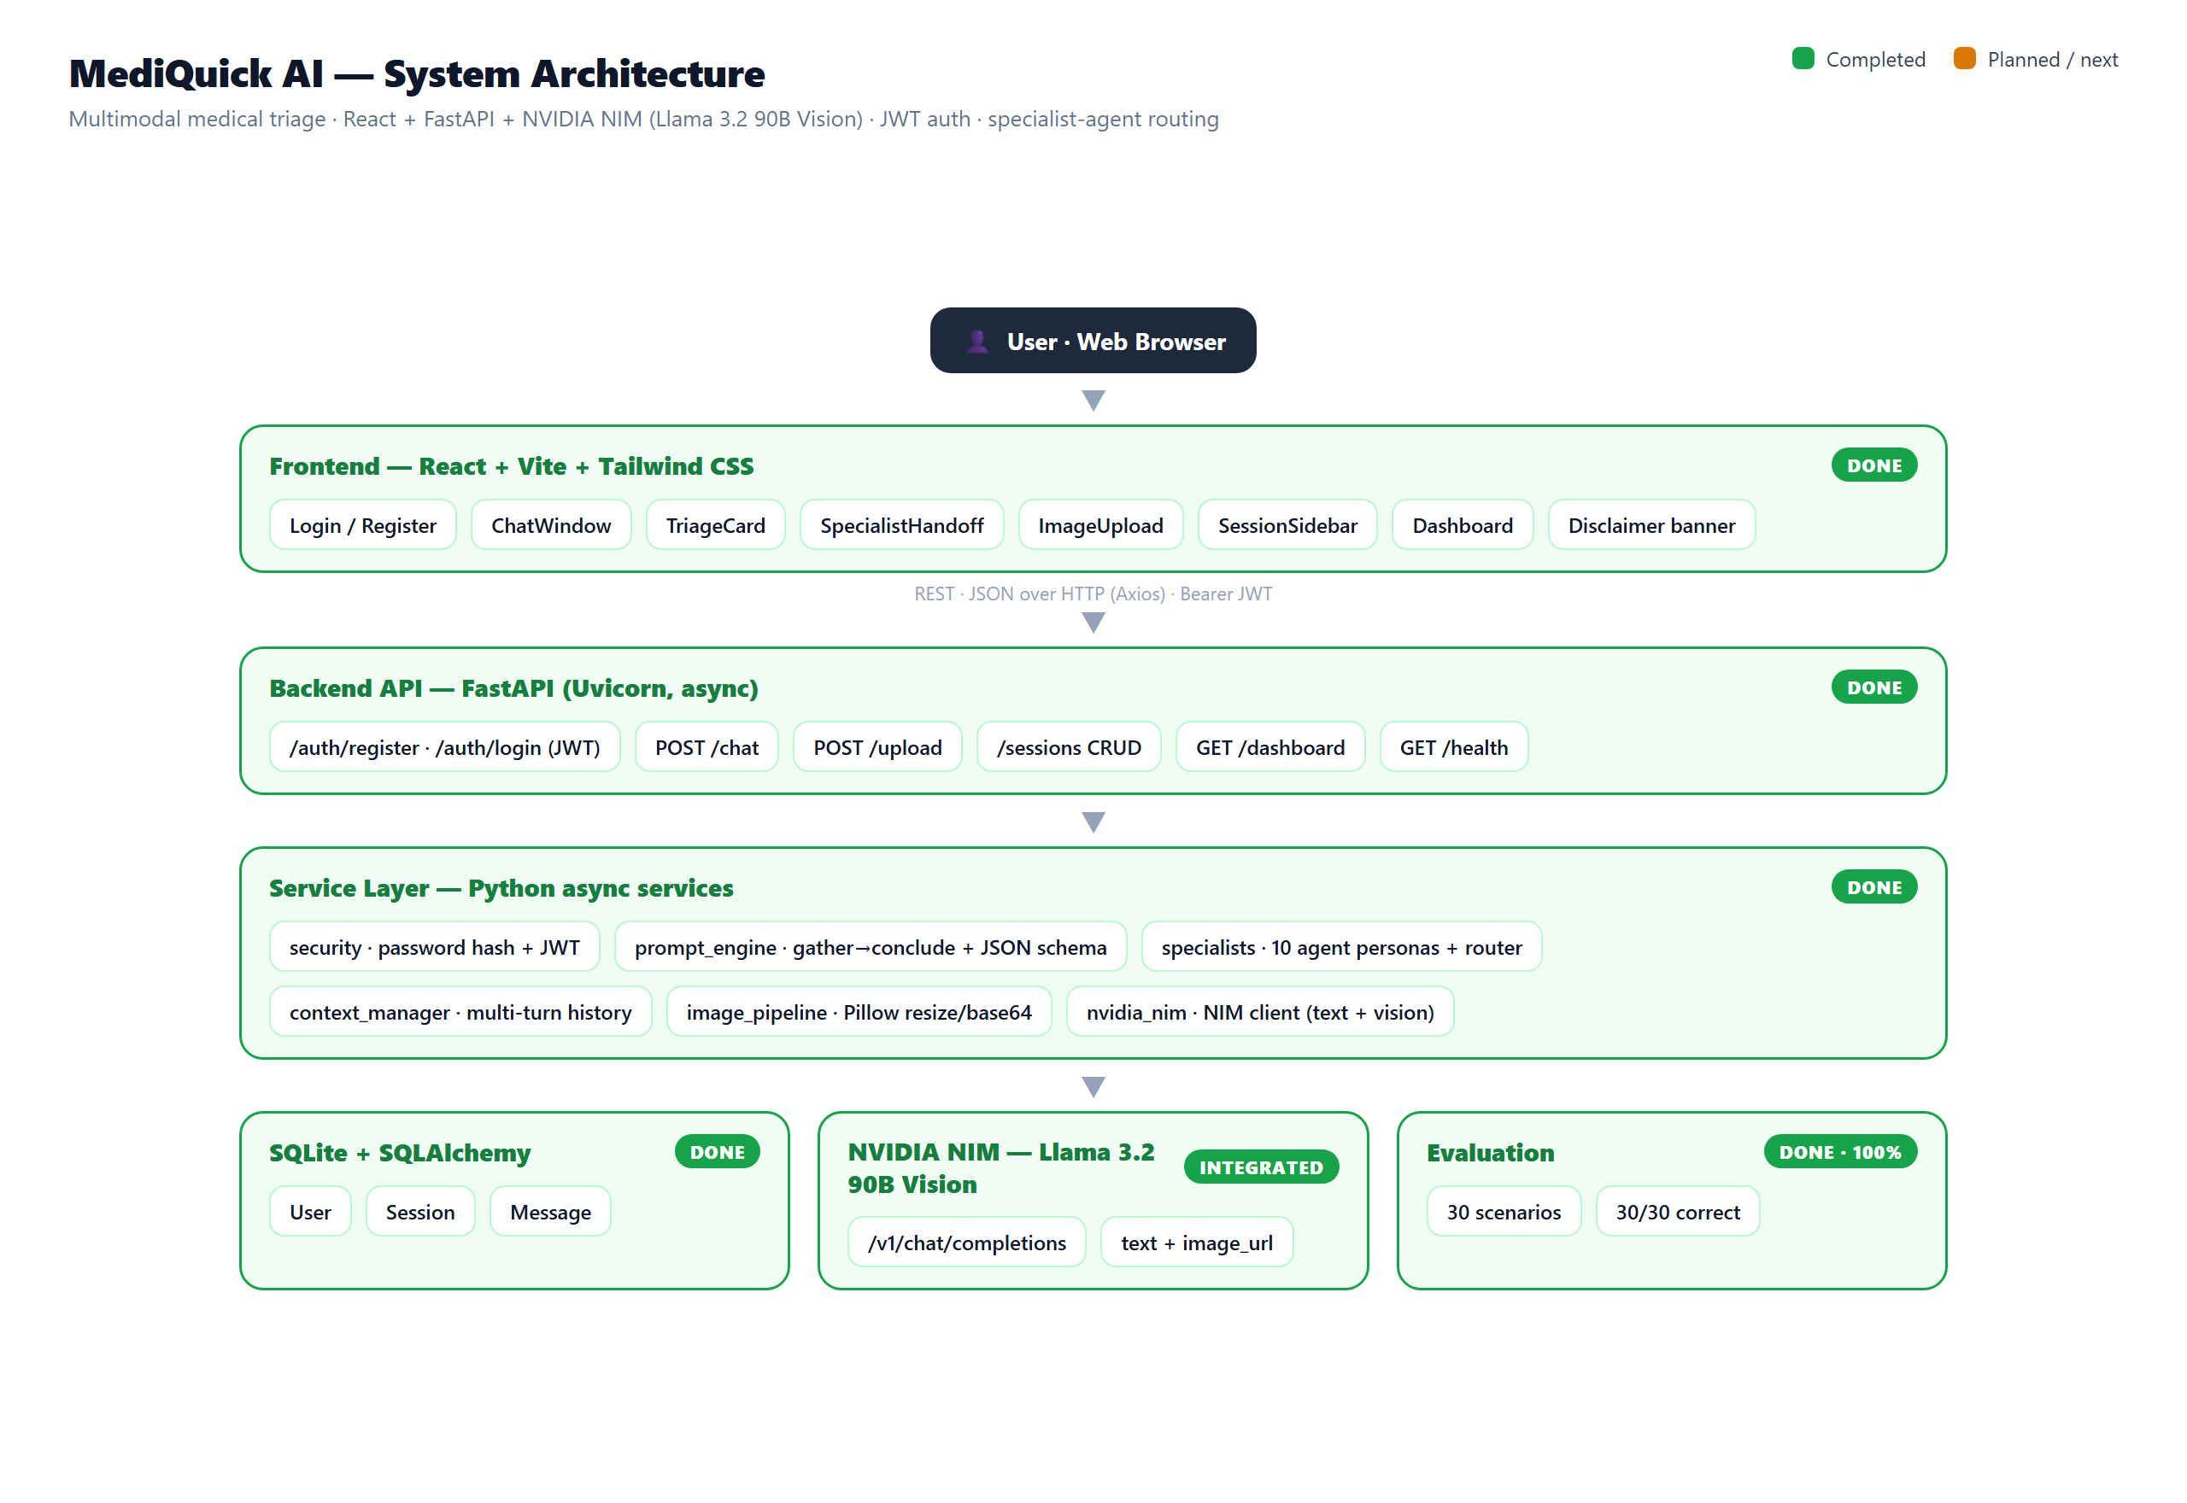
+
System Architecture
React + FastAPI + NVIDIA NIM · JWT auth · specialist-agent routing — all layers complete and validated.

Slide 5
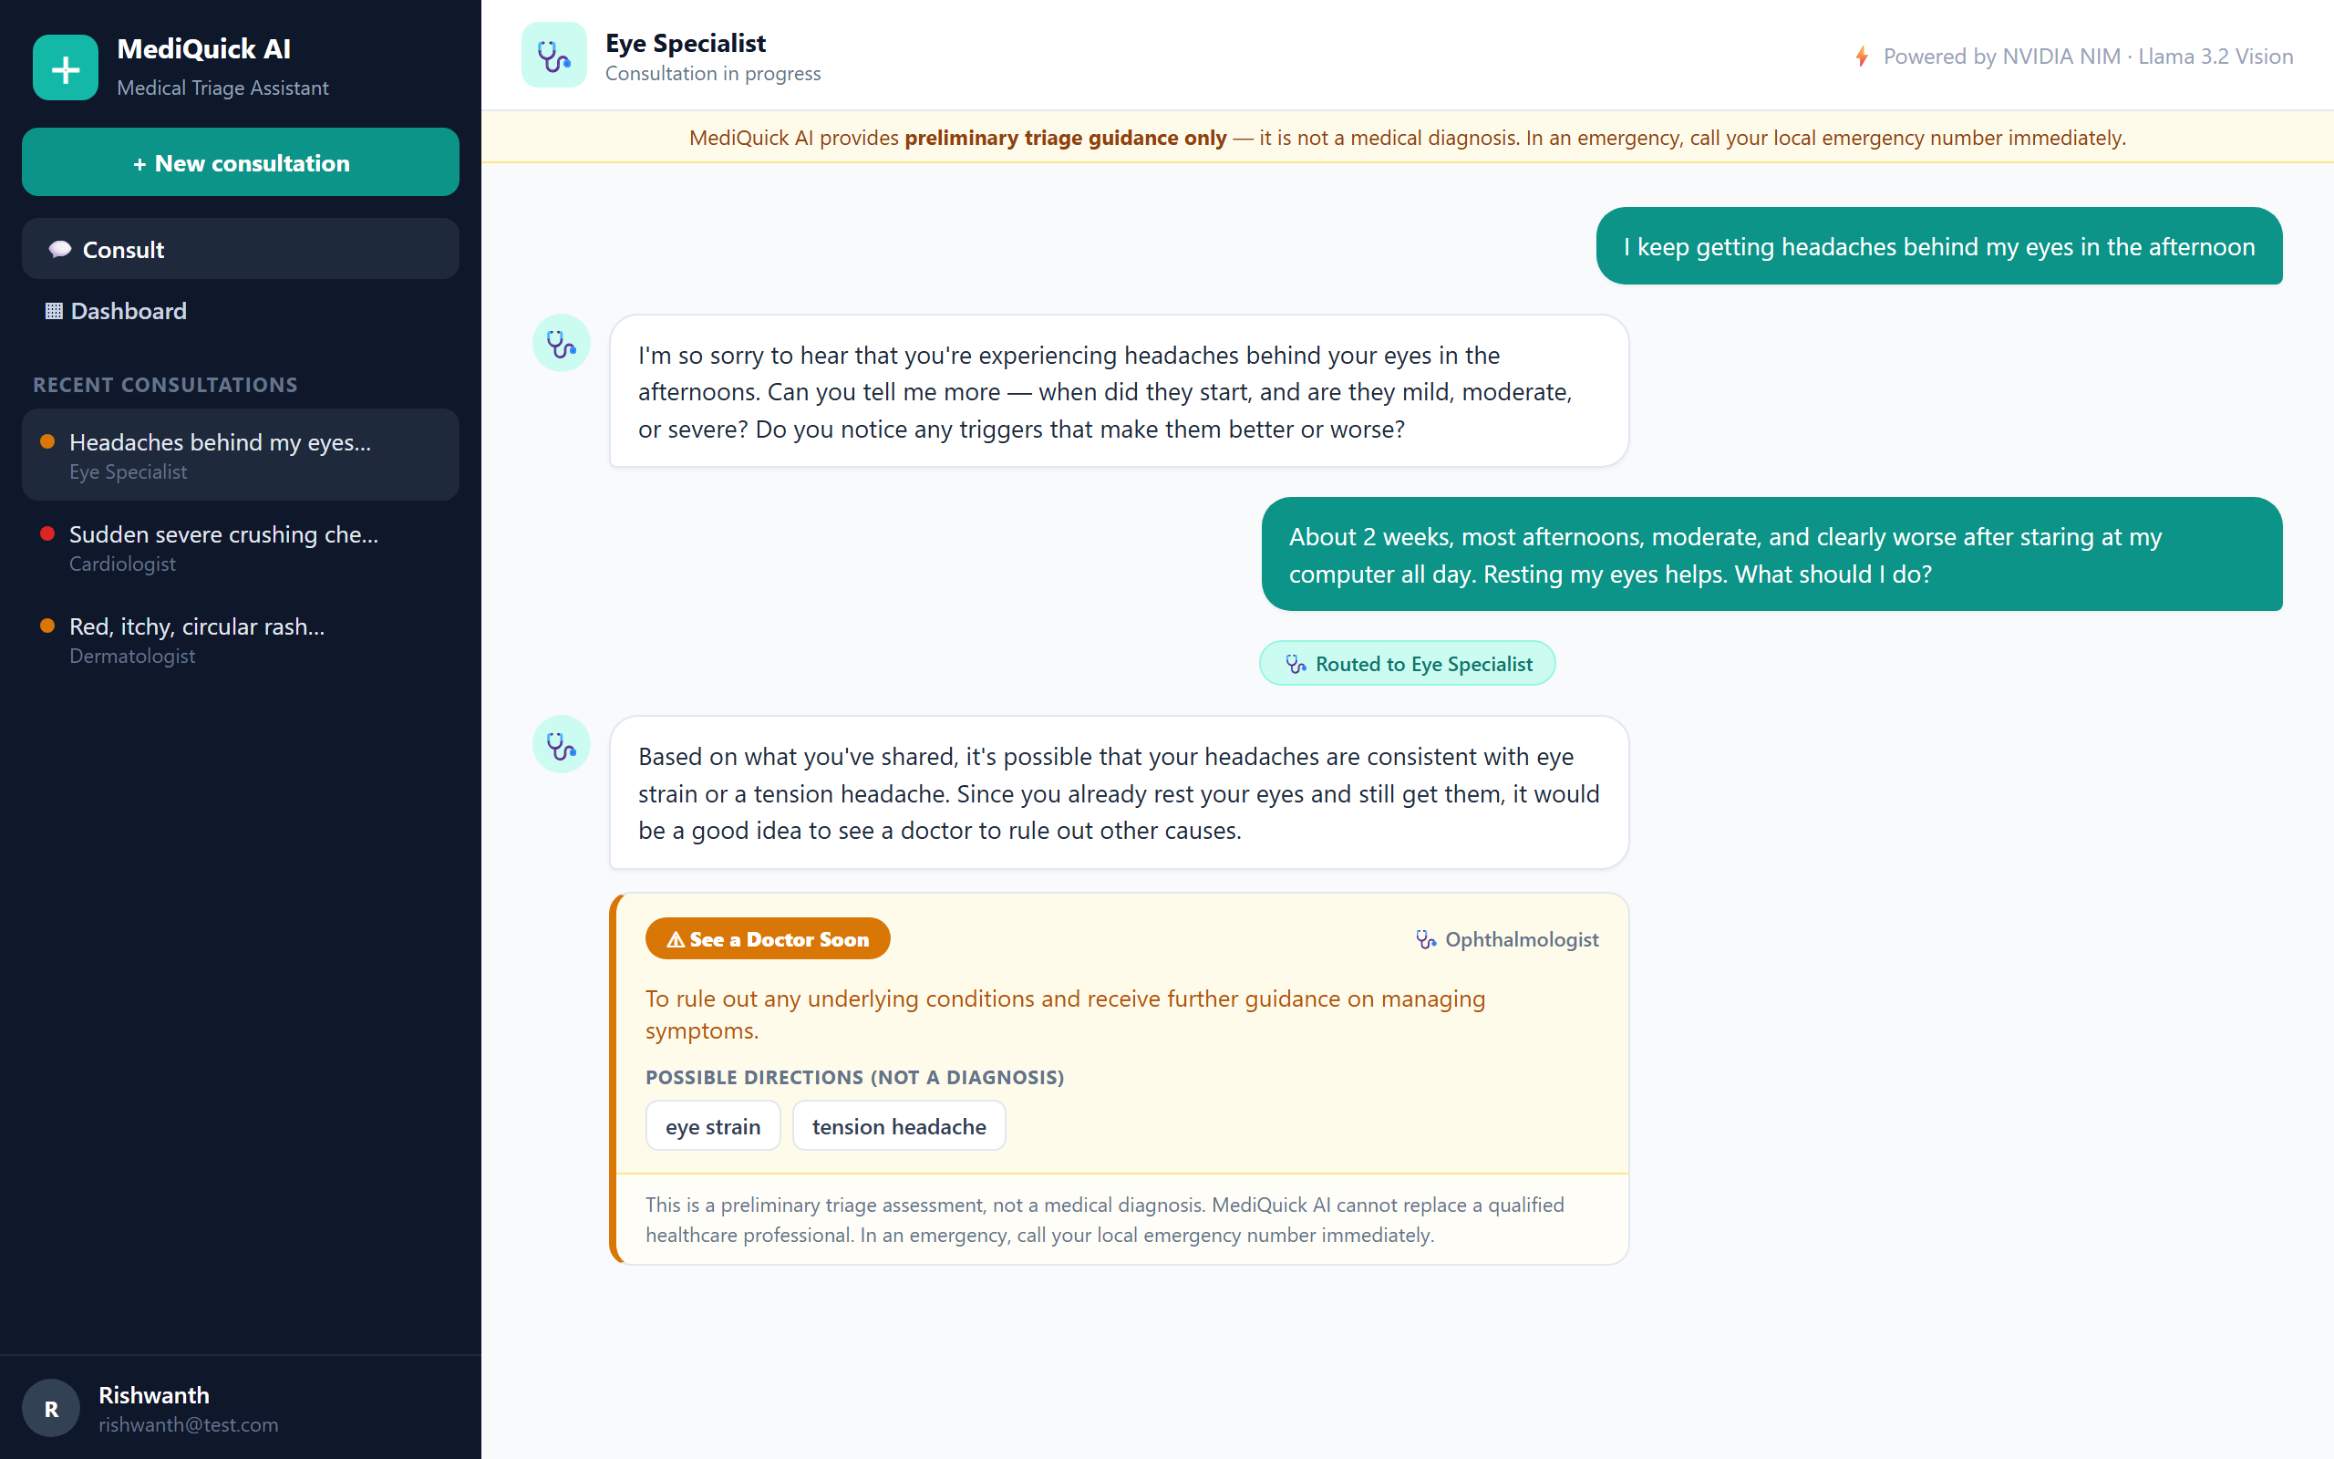
+
Demo · Doctor-Style Consultation
1
User describes a symptom in plain language.
2
The assistant asks focused follow-up questions.
3
It hands off to the right specialist agent.
4
It concludes with a colour-coded triage card.
Real consultation: General Physician → Eye Specialist handoff, concluding with a triage card.

Slide 6
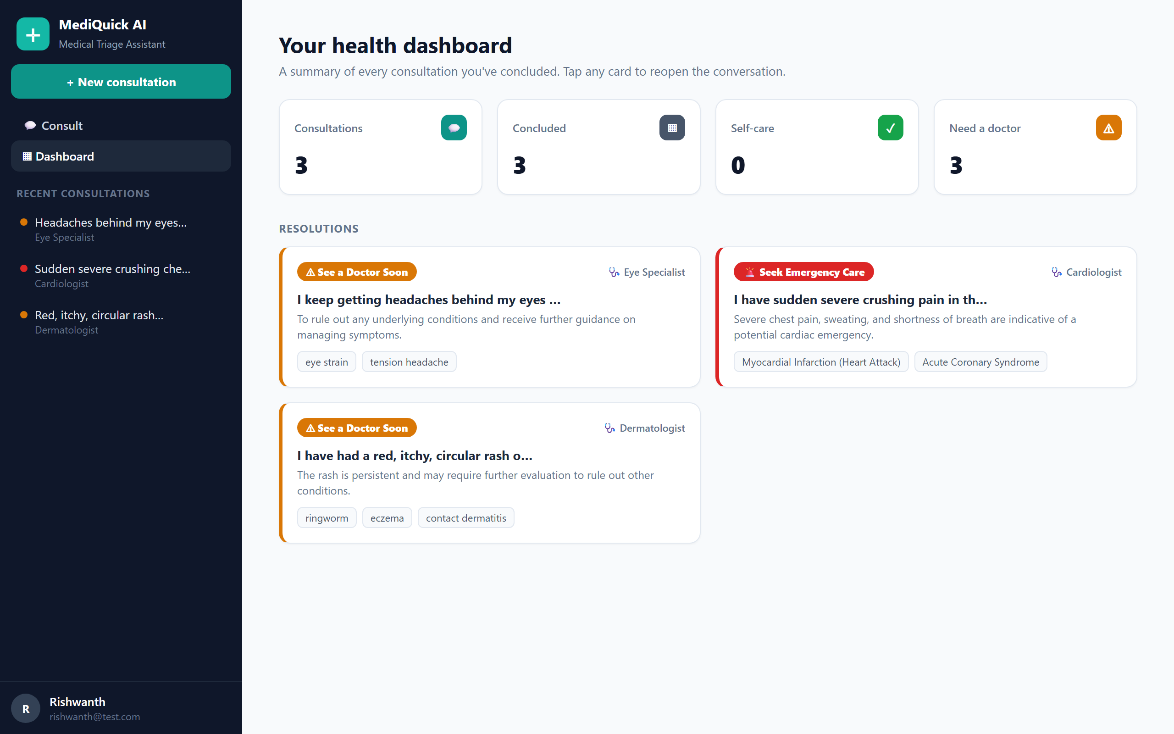
+
Specialist Routing & Dashboard
10 agents
General Physician routes to the right specialist
Context carried
Full history follows the handoff
Photos in-memory
Validated, resized, never saved to disk
Dashboard: every concluded consultation summarised by urgency and specialist — no medication content.

Slide 7
+
Evaluation · 30 Structured Scenarios
Dermatology
10 / 10
100%
General medicine
10 / 10
urgency-classification accuracy
Minor injury
10 / 10
0 unsafe under-triage cases
Overall
30 / 30
Compared against standard triage reference guidelines, across all three urgency tiers.

Slide 8
+
Progress at the Milestone
88%
Completed
Remaining
✓ FastAPI backend + JWT auth
○ Error-handling & UI polish
✓ NVIDIA NIM client (text + vision)
○ Automated backend tests
✓ Prompt engine, gather→conclude
○ Responsive-layout review
of the project complete
full app + evaluation — only polish remains
✓ 10 specialist agents + routing
○ Developer README & handover
✓ React UI: chat, card, sidebar
✓ Dashboard of resolutions
✓ Evaluation — 30/30 (100%)

Slide 9
+
What's Next
Polish error handling Harden empty / loading / error states across the interface.
1
Automated tests A short test suite for the backend services.
2
Responsive review Tune the layout for smaller screens.
3
Handover docs Developer README and setup guide for the team.
4

Slide 10
+
Thank You
MediQuick AI provides preliminary triage guidance only — not a medical diagnosis.
Rishwanth [Last Name] · BITS ZG628T Dissertation · Developer: Vignesh V · June 2026

