Slide 1
SmartEdit AI
An Intelligent Personal Finance Web App for Indian Salaried Users
Mid-Semester Project Review
Student: Shyam Sundar
Research Area: NLP · Personal Finance · AI Advisory · Behavioral Finance
June 2026

Slide 2
Agenda
The Problem
Objectives & Scope
1
2
System Architecture
Methodology — Parsing & NLP
3
4
AI Advisory & RAG Chatbot
Application Walkthrough
5
6
Progress & Demo
Plan to Completion
7
8
SmartEdit AI · Mid-Semester Review
2 / 10

Slide 3
The Problem
Where did the money go?
3 gaps no existing app solves together for Indian users:
End of month.
Rs.12,400 left in the account. You remember the rent and a few grocery runs. The rest — Swiggy, random UPI transfers, a forgotten subscription — is a blur.
The statement is right there as a PDF. But 80 rows of ‘POS-4521-RELIANCE’ and ‘UPI-SWIGGY-OKAXIS’ tell you nothing useful.
1
No Indian PDF support
1
SBI, HDFC, ICICI, Axis all use different layouts. Apps rely on SMS parsing (now blocked) or manual entry.
2
Advice is just arithmetic
2
“You spent 30% more on food” is a chart, not guidance. It never says what to change.
3
No plan from real data
3
No app reads your statement and builds a realistic next-month budget from how you actually spend.
SmartEdit AI · Mid-Semester Review
3 / 10

Slide 4
Objectives & Scope
Objectives
Scope
Parse Indian bank statement PDFs/CSVs (SBI, HDFC, ICICI, Axis)
Classify cryptic UPI/NEFT/NACH/POS descriptions into categories
Dashboard: income, expense, savings rate, category trends
AI advisory grounded in the user’s actual transactions
RAG chatbot to answer free-form questions on spending
Privacy-first: local LLM (Ollama) in the final version
IN SCOPE
Web app · PDF/CSV parsing · manual entry · classification · analytics · AI advisory · RAG chat · Indian salary (PF/HRA/TDS) model
OUT OF SCOPE (v1)
Investment portfolio tracking · real-time bank API linking · multi-currency · native mobile app
SmartEdit AI · Mid-Semester Review
4 / 10

Slide 5
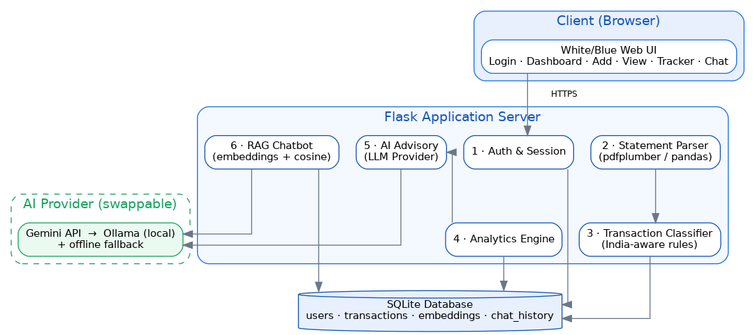
System Architecture
Six modules over Flask + SQLite, with a swappable AI provider
Frontend
HTML · CSS · Chart.js
Backend
Flask · SQLAlchemy
Database
SQLite
Parsing
pdfplumber · pandas
AI
Gemini → Ollama
RAG
MiniLM + cosine
SmartEdit AI · Mid-Semester Review
5 / 10

Slide 6
Methodology — Parsing & NLP Classification
1 · PDF / CSV Parsing
2 · Transaction Classification
pdfplumber extracts tables page-by-page; pandas reads CSV
Auto-maps Date / Narration / Debit / Credit columns
Handles mixed date formats & ₹1,23,456 separators
Normalises every row → (date, description, amount, type)
India-aware rule engine over the raw description
SWIGGY → Food · LIC → Insurance · NETFLIX → Subscriptions
Detects UPI / NEFT / NACH / POS / IMPS method markers
17 categories; unknown → Others, user can re-categorise
Example
“UPI-SWIGGY-OKAXIS-XXXX1234” → Food & Dining (method: UPI)
SmartEdit AI · Mid-Semester Review
6 / 10

Slide 7
AI Advisory & RAG Chatbot
RAG Chatbot (retrieval pipeline)
AI Savings Advisory
Chain-of-thought prompt over the categorised monthly summary produces specific, rupee-level advice — not generic tips.
“Your Swiggy + Zomato spend is Rs.1,348. Capping to 3 orders/week saves about Rs.800 next month.”
Provider: Gemini now → Ollama (local) later. Deterministic fallback if offline — the demo never breaks.
1
Embed
Question → vector (MiniLM, 384-d)
2
Search
Cosine similarity vs stored transaction vectors
3
Aggregate
Exact SQL totals so numbers are never hallucinated
4
Generate
Top-K + totals → LLM → grounded answer
SmartEdit AI · Mid-Semester Review
7 / 10

Slide 8
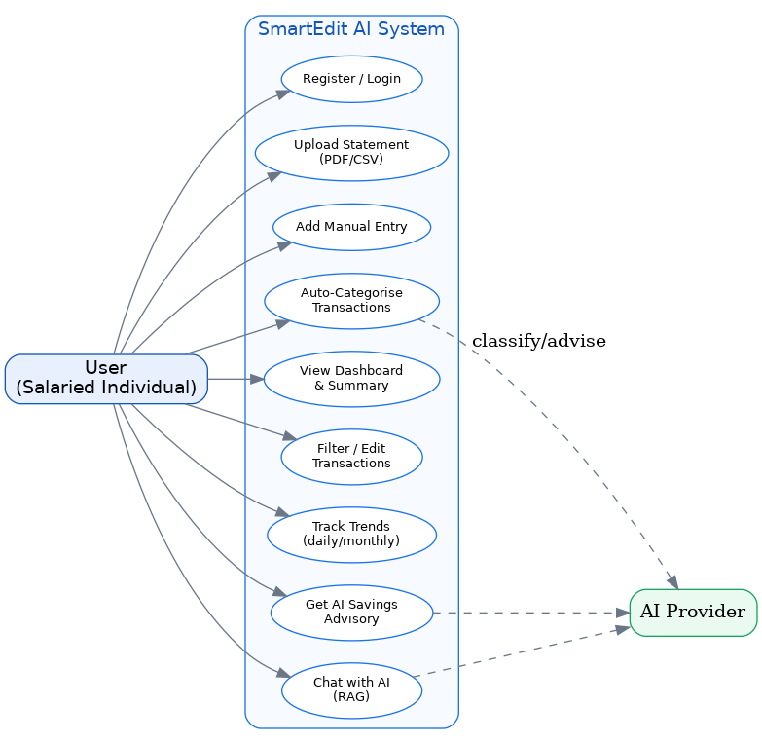
Application Walkthrough
Five clean screens: Dashboard · Add · View · Tracker · Chat
SmartEdit AI · Mid-Semester Review
8 / 10

Slide 9
Progress & Demo
100%
17
30+
6
Core app working
Spend categories
Txns parsed in demo
Backend modules
Done so far
Demo flow
Auth, dashboard, add-entry, view/database, tracker, chat
PDF/CSV parser + India-aware classifier (verified end-to-end)
AI advisory + RAG chatbot with offline fallback
Clean white/blue UI; SQLite persistence
Register → land on empty dashboard
Upload one month statement (CSV/PDF)
Transactions auto-categorised → dashboard fills
Ask chatbot: “how much on Amazon?” → exact total
SmartEdit AI · Mid-Semester Review
9 / 10

Slide 10
Plan to Completion
Now – Wk 2
Add more bank PDF formats; refine parser edge cases
Wk 3 – 4
Lightweight ML classifier for ambiguous descriptions
Wk 5 – 6
Indian salary (CTC/PF/TDS) module + savings goals
Wk 7 – 8
Swap Gemini → Ollama (local), evaluate advisory quality
Thank you
Upload your statement. See where every rupee went. Plan better.

