Slide 1
PL/SQL
-Ashu Mehta
Database Systems

Slide 2
INTRODUCTION
PL/SQL stands for procedural language/structured query language
It is an extension of the SQL language
It is the superset of structured query language
With the use of SQL user can only manipulate the information stored in the database
PL/SQL extends SQL by adding control structures found in other procedural languages.

Slide 3
Features of PL/SQL
PL/SQL allows sending an entire block of statements to the database at one time.
This reduces network traffic and provides high performance for the applications.
Applications written in PL/SQL are fully portable.
PL/SQL provides access to predefined SQL packages.
PL/SQL provides support for Object-Oriented Programming.
PL/SQL provides support for Developing Web Applications and Server Pages.

Slide 4
Architecture of pl/sql
Pl/sql engine executes pl/sql blocks.
Pl/sql engine executes only the procedural statements and send the sql statements to sql statement executor in the oracle server
Pl/sql engine resides in the oracle server
The call to the oracle engine needs to be made only once to execute any number of sql statements
Since the oracle engine is called only one for each block, resulting increased speed of processing as compared to call for each sql sentence.

Slide 5
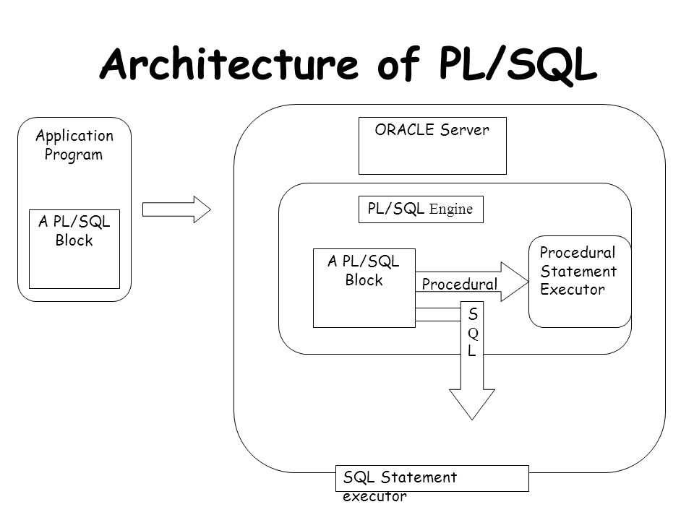

Slide 6
Structure of PL/SQL Language
Consist of following sections
Declare(optional)
Used to declare variables and constants
Is an optional section
Begin(required)
It is the executable section containing the code which is executed when block is run
Exception(optional)
Handles exceptions occurring during processing
Is an optional section.
End;(required)

Slide 7
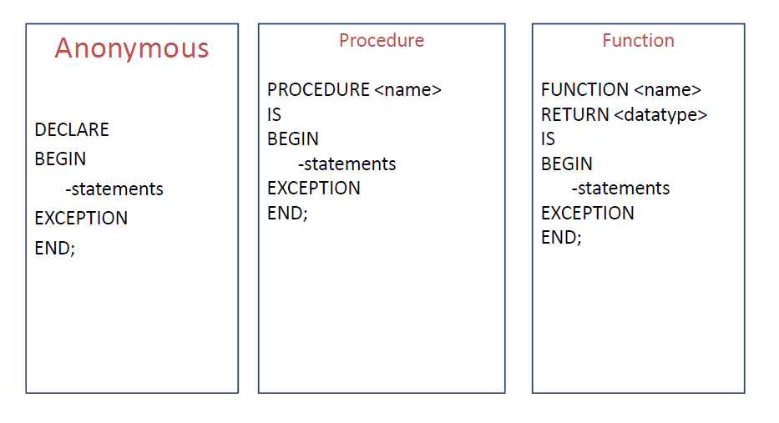
PL/SQL block types

Slide 8
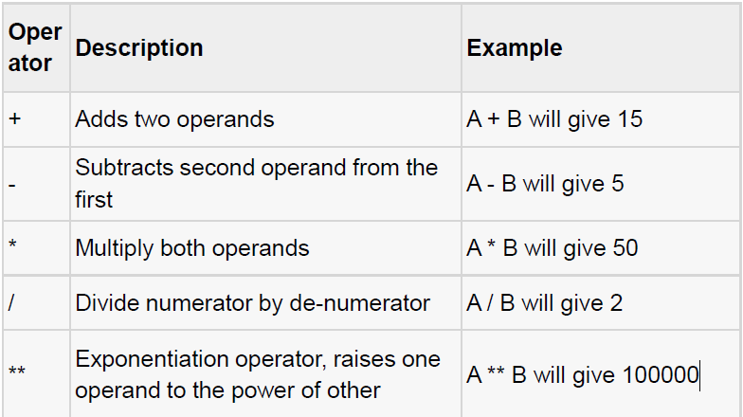
PL/SQL operators

Slide 9
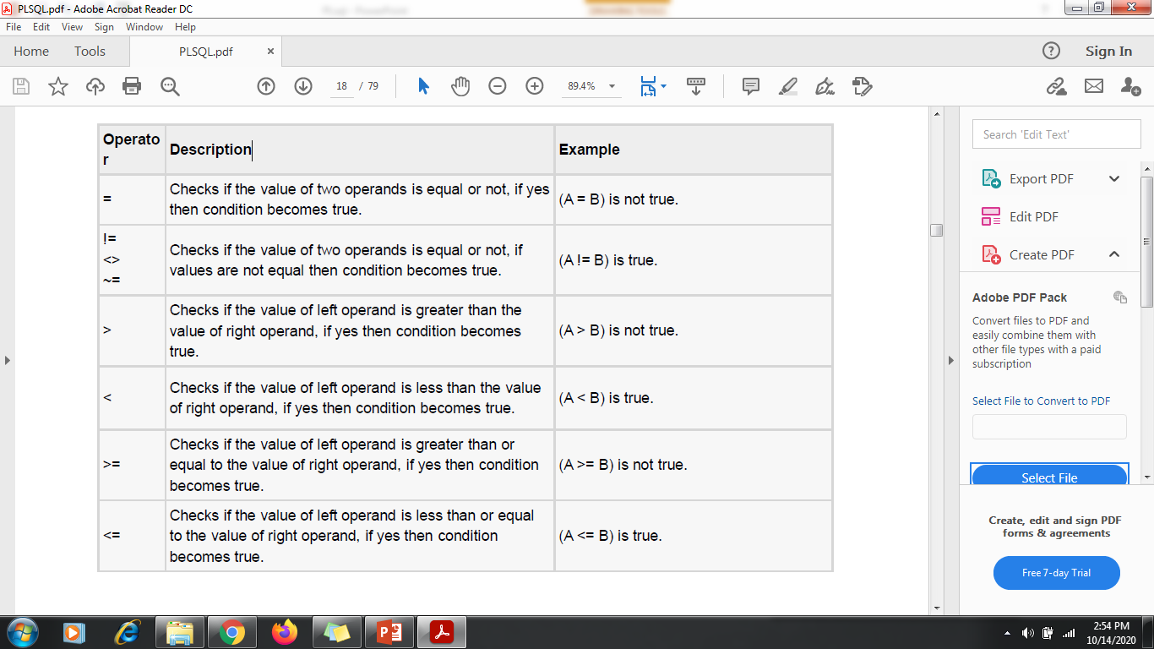
Relational operators

Slide 10
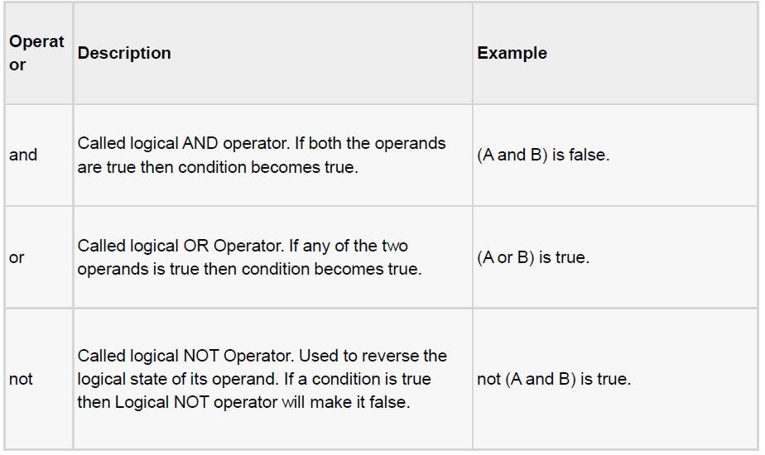
Logical operators

Slide 11
Variable Declaration
DECLARE
a number := 10;
b number := 20;
c number;
Declaring a Constant
PI CONSTANT NUMBER := 3.141592654;

Slide 12
Example Program
DECLARE
message varchar2(30):= ‘Hello World’;
BEGIN
dbms_output.put_line(message);
END;

Slide 13
Read a value during runtime
Num:= :num;
This will produce a message on screen
Enter the value of NUM:
User can enter any value at run time to NUM.

Slide 14
Example-
Declare
a number(2);
b number (2);
c number(2);
Begin
a:= :a;
b:= :b;
c:= a+b;
dbms_output.put_line(‘sum=‘ || c);
End;

Slide 15
Select into
Used to fetch values from some existing tables.
Syntax-
Select column_name into variable_name from table_name where condition;
Example-
declare
name varchar(10);
begin
select first_name into name from student where r_no=1;
dbms_output.put_line(name);
end;

Slide 16
Control statements
Conditional / selection
Iterative
Sequence

Slide 17
Conditional / selection
IF condition then
Sequence of statements;
Else
Sequence of statements;
End if;

Slide 18
Example-
Declare
Num1 number(2);
Num2 number(2);
Begin
Num1:= :num1;
Num2:= :num2;
If num1>num2 then
dbms_output.put_line(‘greater number is:=‘ || num1);
Else
dbms_output.put_line(‘greater number is:=‘ || num2);
End if;
End;

Slide 19
Iterative
Loop
While – loop
For-loop

Slide 20
Loop
Sequence of statements;
Exit when condition;
End loop;

Slide 21
Loop Example-
Declare
i number(2);
Begin
i:=1;
Loop
Dbms_output.put_line(i);
i:=i+1;
Exit when i>10;
End loop;
End;

Slide 22
While Loop Example-
Declare
A number(2);
Begin
A:=1;
While a<=10
Loop
Dbms_output.put_line(a*a);
A:=a+1;
End loop;
End;

Slide 23
For loop Example-
Declare
Total number(4);
Begin
For i in 1..10
Loop
Total:=2*i;
Dbms_output.put_line(‘2*’||i||’=‘||total);
End loop;
End;

Slide 24
Go To Example-
Declare
Num1 number(2);
Num2 number(2);
Begin
Num1:=&num1;
Num2:=&num2;
If num1> num2 then
Goto p1;
Else
Goto p2;
End if;
<<p1>>
Dbms_output.put_line(‘num1 is bigger’);
Goto p3;
<<p2>>
Dbms_output.put_line(‘num2 is bigger’);
<<p3>>
Dbms_output.put_line(‘End of Program ‘);
End;

Slide 25
Subprograms
Named pl/sql blocks that can accept parameters and be invoked are called as subprograms.
Two types
Procedure
Function
Stored procedure: a procedure that has been compiled and stored in any of the oracle engine’s system table.

Slide 26
Procedure Vs Function
A procedure or a function is a group of sql and pl/sql statements that is used to perform a specific task.
A procedure is used to perform an action whereas a function is used to compute a value.
A procedure may return no value whereas a function must return a value.

Slide 27
Why do we use subprograms?
Modularity: It allows a programmer to divide a program into more than one well defined units called modules.
Reusability: it enables a subprogram to be used in any number of applications.

Slide 28
Procedure
Declare
Global variables declaration;
Procedure procedure name
(Arguments IN/OUT/IN OUT data types)
IS/AS
Variable and constant declaration;
Begin
PL/SQL statements;
Exception
Statements;
End procedure name;
Begin
Executable statements;
Procedure calling;
End;

Slide 29
Procedure- example
declare
num1 number(2);
num2 number(2);
mul number(4);
procedure multiplication (num1 in number, num2 in number, mul out number)is
begin
mul:=num1*num2;
end multiplication;
begin
num1:=:num1;
num2:=:num2;
multiplication(num1, num2, mul);
dbms_output.put_line(mul);
end;

Slide 30
Stored procedure- Example
create or replace procedure addition(num1 in number, num2 in number, sum1 out number)
is
begin
sum1:=num1+num2;
end;

Slide 31
declare
num1 number(4);
num2 number(4);
sum1 number(4);
begin
num1:=:num1;
num2:=:num2;
addition(num1, num2, sum1);
dbms_output.put_line(sum1);
end;

Slide 32
Function
Declare
Global variables declaration;
Function Function name
(Arguments IN data types…….)
Return data type
IS/AS
Variable and constant declaration;
Begin
PL/SQL statements;
Exception
Statements;
End function name;
Begin
Executable statements;
Function calling;
End;

Slide 33
Function-Example
Declare
Num1 number(2);
Num2 number(2);
Mul number(4);
Function multiplication(num1 in number, num2 in number)
Return number is mul number;
Begin
Mul:=num1 * num2;
Return(mul);
End multiplication;
Begin
Num1:=:num1;
Num2:=num2;
Mul:=multiplication(num1, num2);
Dbms_output.put_line(mul);
End;

Slide 34
Function-Example
Declare
Fact number(4);
N number(2);
Function factorial(n in number)
Return number is I number(2);
Begin
Fact:=1;
For I in 1..n loop
Fact:=fact*I;
End loop;
Return(fact);
End factorial;
Begin
N:=:n;
Fact:=factorial(n);
Dbms_output.put_line(fact);
End;

Slide 35
%TYPE
Provide the data type of a variable or column.
Example-
sal employee.salary%TYPE;

Slide 36
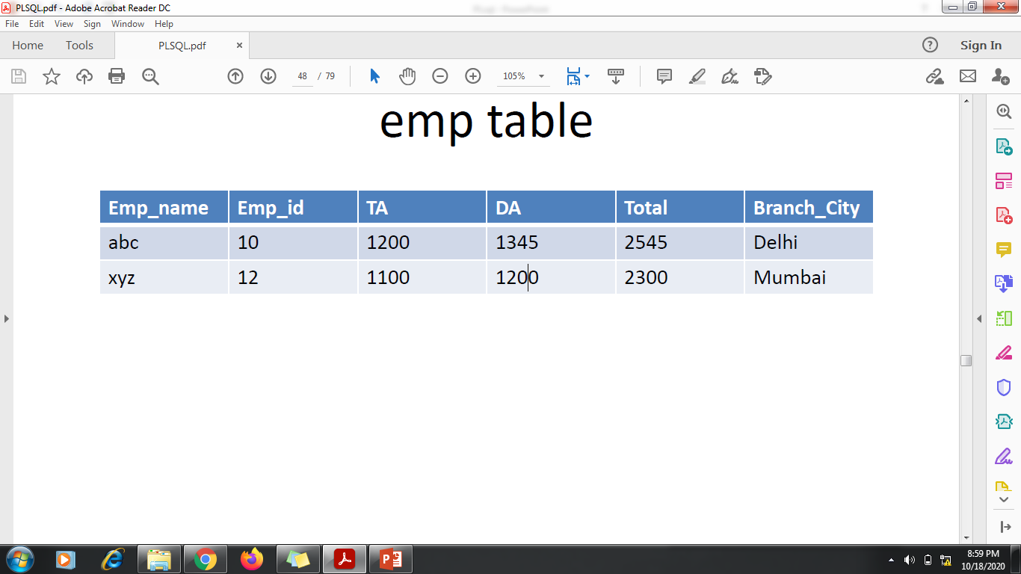

Slide 37
Example-
Declare
a emp.ta%TYPE;
b emp.da%TYPE;
t emp.total%TYPE;
Begin
Select ta,da into a,b from emp where emp_id=12;
t:=a+d;
Update emp set total =t where empid=12;
End;

Slide 38
%ROWTYPE
%ROWTYPE has all properties of %TYPE and one
additional that we required only one variable to access
any number of columns.
Example-
dept_rec dept%ROWTYPE; -- declaring record variable.
detp_rec.deptno;
dept_rec.deptname; -- accessing coloums

Slide 39
Declare
Record1 emp%ROWTYPE;
Begin
Select * into record1 from emp where empid=12;
Record1.total:=record1.ta+record1.da;
Update emp set total=record1.total where empid=12;
End;

Slide 40
Exception handling- example
create table emp(id int, name varchar(10));
insert into emp values(502, 'a');
insert into emp values(502, 'a');
insert into emp values(502, 'a');
declare
n emp.name%type;
begin
select name into n from emp where id=502;
dbms_output.put_line('empname :='||n);
exception
when too_many_rows then
dbms_output.put_line('more than one row returned');
end;

Slide 41
Exception handling- example
declare
a number;
b number;
c number;
e exception;
begin
a:=:a;
b:=:b;
if b=0 then
raise e;
end if;
c:=a/b;
dbms_output.put_line('result='||c);
exception when e then
dbms_output.put_line('error!- your divisor is zero');
end;

