Slide 1
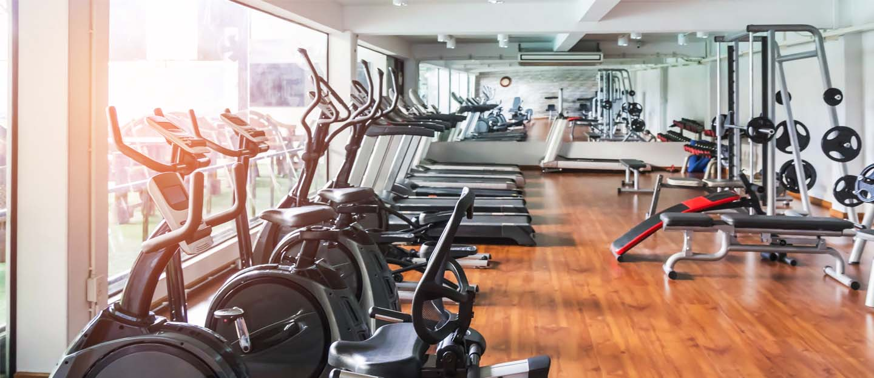
IBM Data Science Capstone Project
Find the best Gym-business Opportunity in
Melbourne Northern Region
Yige Li

Slide 2
Problem
As the development of Melbourne northern region, more and more modern people realize the importance of gym exercise. A positive and energetic work force collaborates better and is more appealing to customers, which means investing in a gym might be an ideal choice to start a business. The following points should be considered for a gym in chosen area:
Distance from the Suburb centre
Difference between gyms
Number of gyms in the near area/suburbs (number of competitors)

Slide 3
Data
List of Melbourne suburbs and relevant data
Geographic/location data of all relevant suburbs
Venue data and business information of the all neighbourhoods of the target suburbs

Slide 4
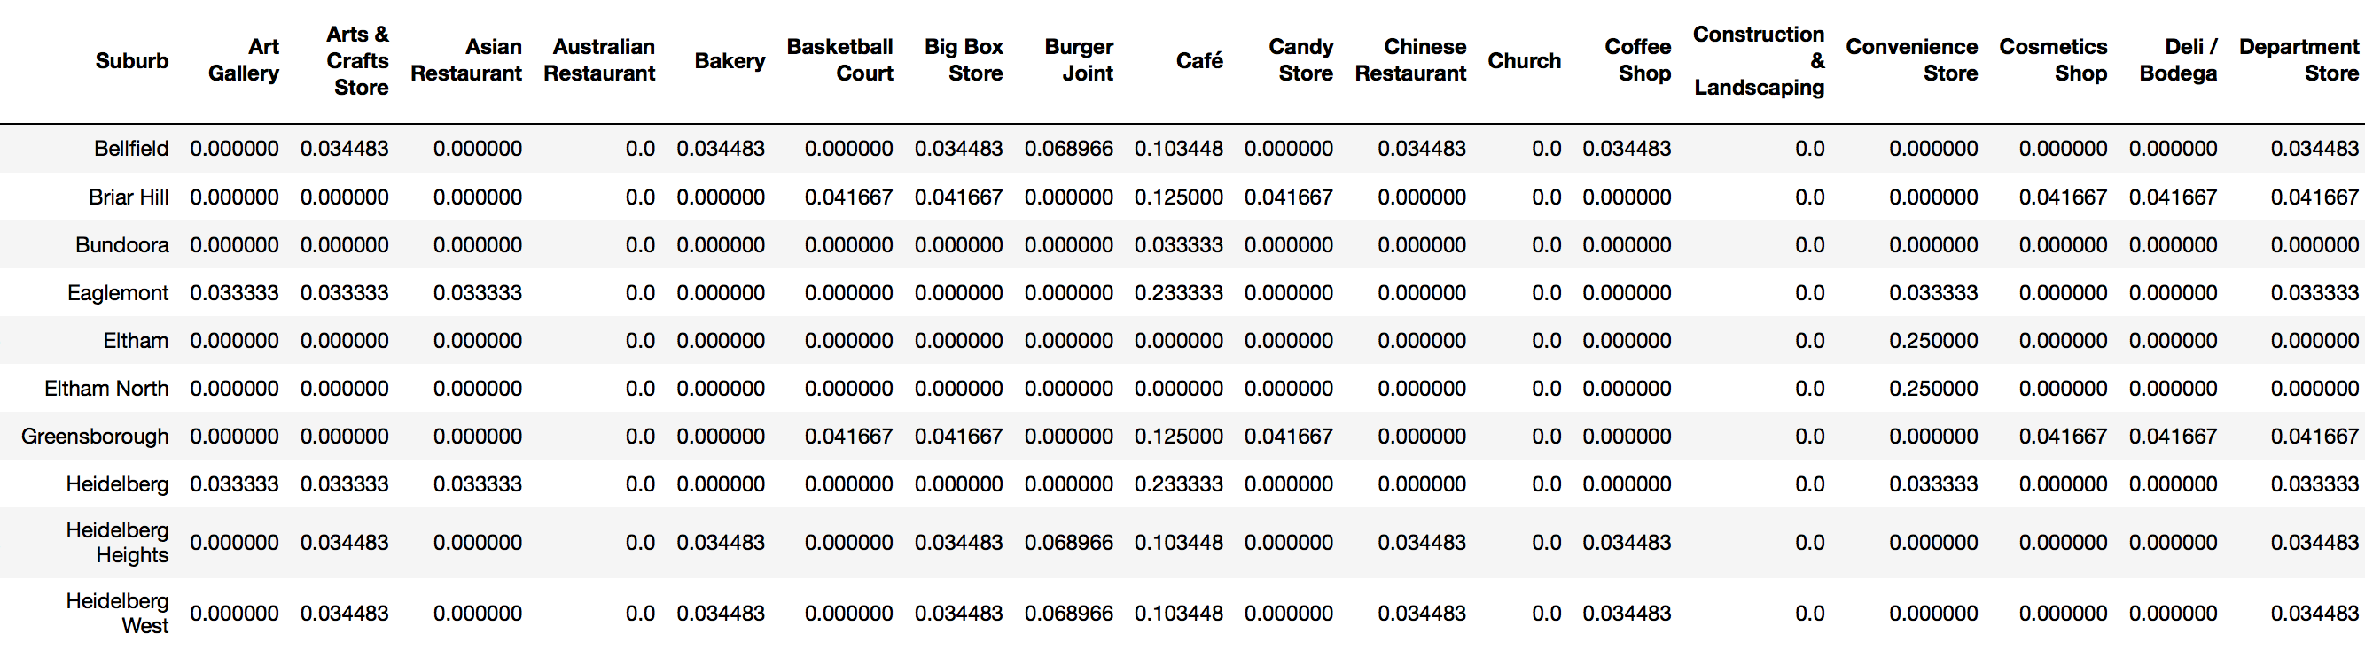
Methodology
1. we sort the mean of the frequency of occurrence of each category:

Slide 5
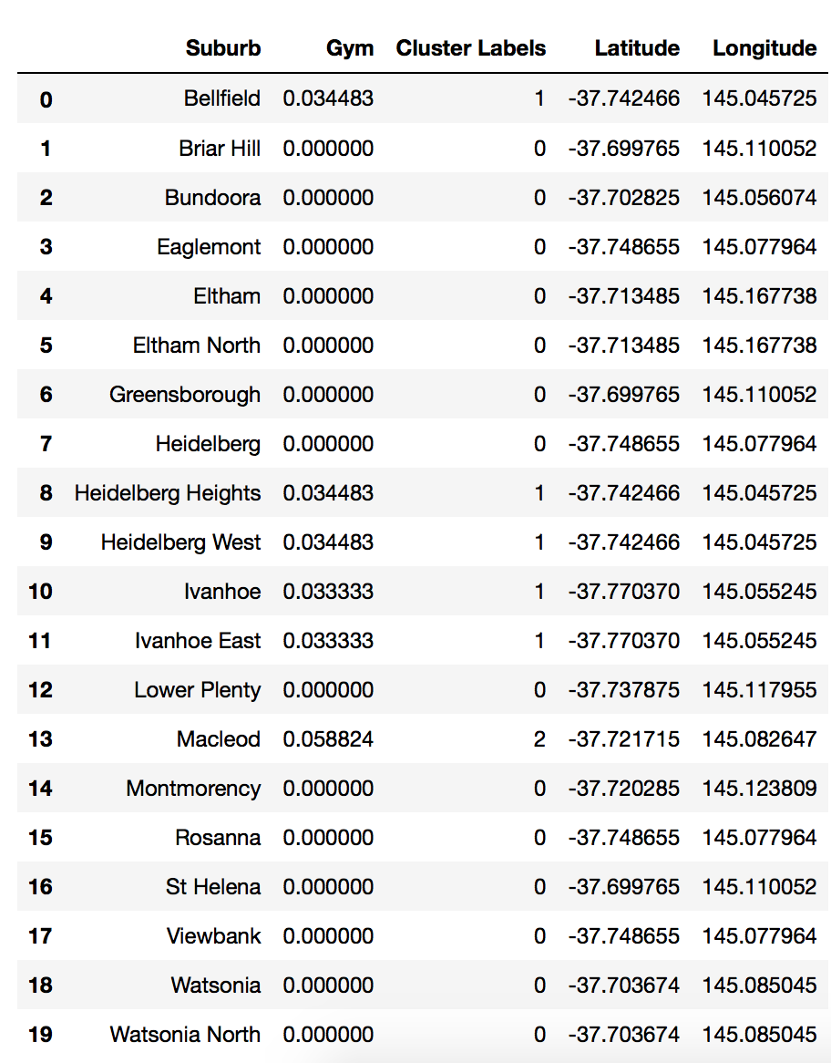
2. K-Mean Clustering is used, and the 19 suburbs are clustered into 3 groups. Every point is assigned to a cluster.

Slide 6
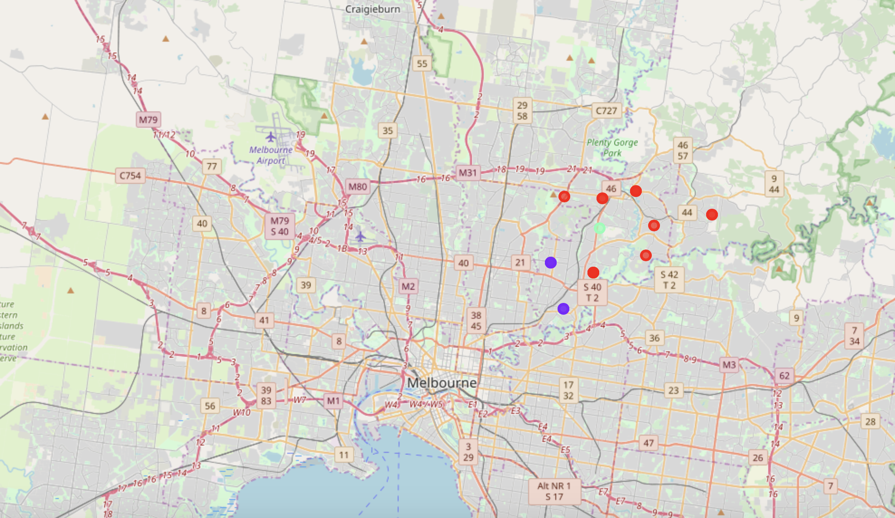
Result

Slide 7
Conclusion
5 suburbs have the highest mean of the frequency of occurrence of each category.
However, Gym is the 4th most common venue in Briar hill. If we take population of each suburb into consideration, we could recommend that the suburb within the 5 and with the largest population is the ideal one to invest.

