Slide 1
UNDERSTANDING LLM’s

Slide 2
Language AI refers to a subfield of AI that focuses on developing technologies capable of understanding, processing, and generating human language. The term Language AI can often be used interchangeably with natural language processing (NLP) with the continued success of machine learning methods in tackling language processing problems.
Language AI
History of LLM’s

Slide 3
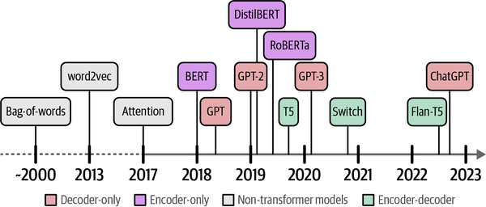
Bag of Words: Our history of Language AI starts with a technique called bag-of-words, a method for representing unstructured text. It was first mentioned around the 1950s but became popular around the 2000s. Bag-of-words works as follows: let’s assume that we have two sentences for which we want to create numerical representations. The first step of the bag-of-words model is tokenization, the process of splitting up the sentences into individual words or subwords (tokens).
Bag of Words
History of LLM’s
Bag of Words: The most common method for tokenization is by splitting on a whitespace to create individual words. However, this has its disadvantages as some languages, like Mandarin, do not have whitespaces around individual words. In the next chapter

Slide 4
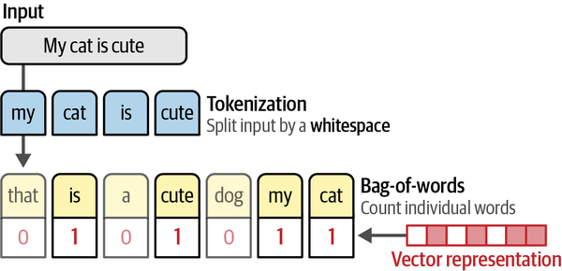
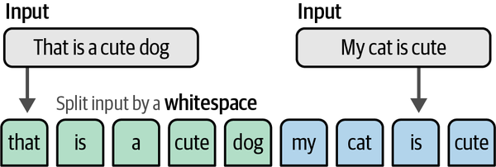
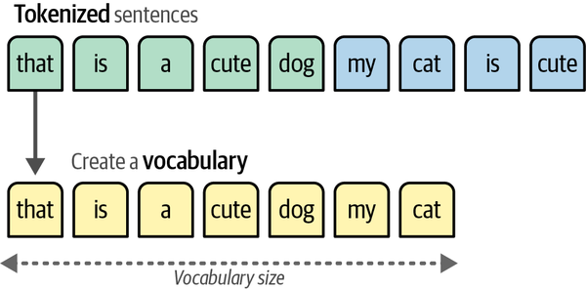
Bag of Words (Tokenization)
History of LLM’s
A vocabulary is created by retaining all unique words across both sentences.
Using our vocabulary, we simply count how often a word in each sentence appears, quite literally creating a bag of words. As a result, a bag-of-words model aims to create representations of text in the form of numbers, also called vectors or vector representations

Slide 5
Word2Vec
History of LLM’s
Given how bag of words ignores the semantic nature of text and simply places words into a bag. Word2vec, released in 2013 was the first successful attempt at capturing the meaning of text in embeddings.
Embeddings are vector representations of data that attempt to capture its meaning. To do so, word2vec learns semantic representations of words by training on vast amounts of textual data, like the entirety of Wikipedia.

Slide 6
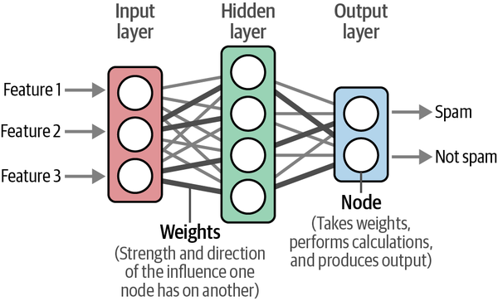
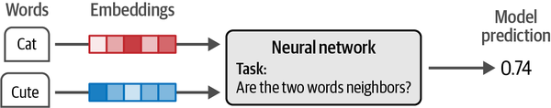
Word2Vec
History of LLM’s
To generate these semantic representations, word2vec leverages neural networks. These networks consist of interconnected layers of nodes that process information.
Using these neural networks, word2vec generates word embeddings by looking at which other words they tend to appear next to in a given sentence.
We start by assigning every word in our vocabulary with a vector embedding, say of 50 values for each word initialized with random values.
Then in every training step, we take pairs of words from the training data and a model attempts to predict whether or not they are likely to be neighbors in a sentence.

Slide 7
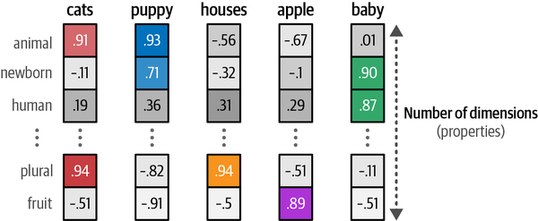
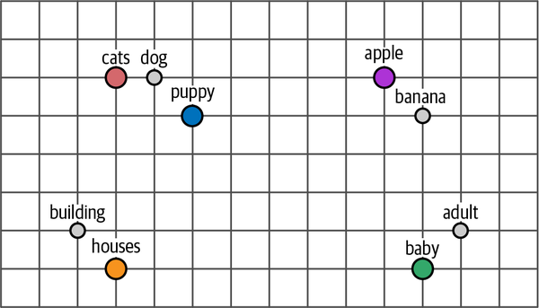
Word2Vec
History of LLM’s
Embeddings are tremendously helpful as they allow us to measure the semantic similarity between two words. Using various distance metrics, we can judge how close one word is to another.
If we were to compress these embeddings into a two-dimensional representation, you would notice that words with similar meaning tend to be closer.

Slide 8
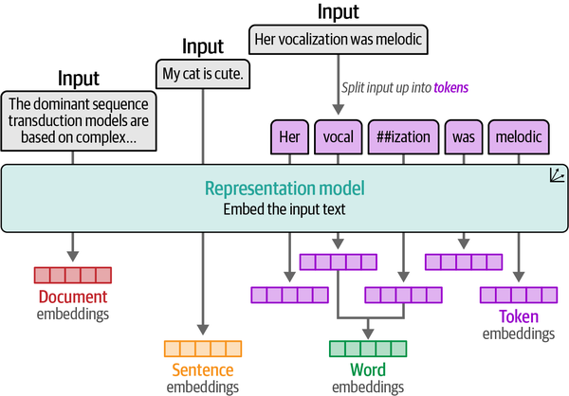
Word2Vec
History of LLM’s
Different types of embedding can be created.

Slide 9
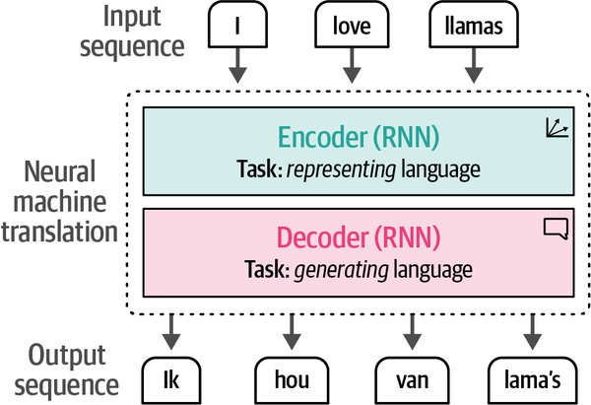
Word2Vec
History of LLM’s
The training process of word2vec creates static, downloadable representations of words. For instance, the word bank will always have the same embedding regardless of the context in which it is used. However, bank  can refer to both a financial bank as well as the bank of a river.
Its meaning, and therefore its embeddings, should change depending on the context. A step in encoding this text was achieved through recurrent neural networks (RNNs). These are variants of neural networks that can model sequences as an additional input.
To do so, these RNNs are used for two tasks, encoding or representing an input sentence and decoding or generating an output sentence. The figure beside shows how a sentence like I love llamas gets translated to the Dutch
Ik hou van lama’s

Slide 10
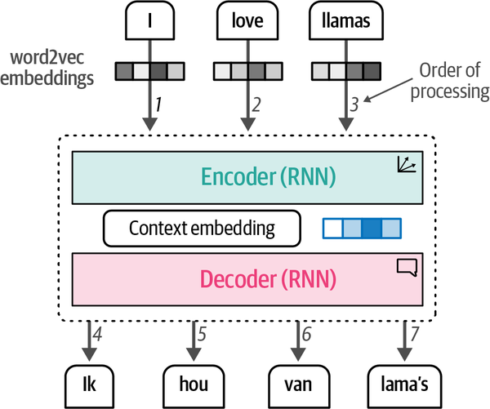
Word2Vec
History of LLM’s
Each step in this architecture is autoregressive. When generating the next word, this architecture needs to consume all previously generated words.
The encoding step aims to represent the input as well as possible, generating the context in the form of an embedding, which serves as the input for the decoder. To generate this representation, it takes embeddings as its inputs for words, which means we can use word2vec for the initial representations. In the figure beside, we can observe this process.
Note how the inputs are processed sequentially, one at a time, as well as the output

Slide 11
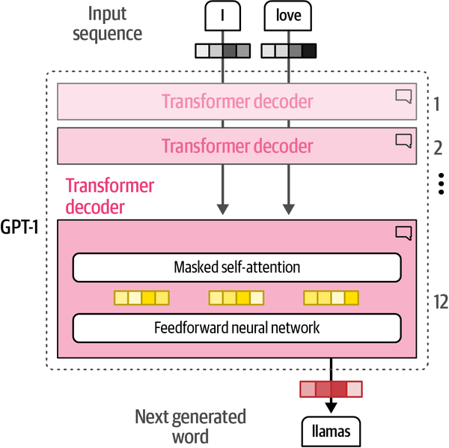
Generative Models
History of LLM’s
Similar to the encoder-only architecture of BERT, a decoder-only architecture was proposed in 2018 to target generative tasks.⁷ This architecture was called a Generative Pre-trained Transformer (GPT) for its generative capabilities (it’s now known as GPT-1 to distinguish it from later versions). As shown in the figure beside, it stacks decoder blocks similar to the encoder-stacked architecture of BERT. GPT-1 was trained on a corpus of 7,000 books and Common Crawl, a large dataset of web pages. The resulting model consisted of 117 million parameters. Each parameter is a numerical value that represents the model’s understanding of language.
If everything remains the same, we expect more parameters to greatly influence the capabilities and performance of language models. Keeping this in mind, we saw larger and larger models being released at a steady pace.

Slide 12
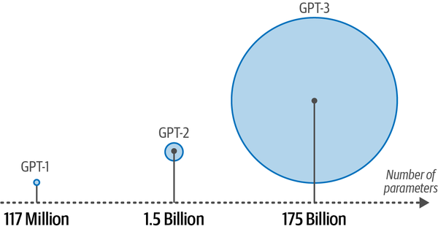
Generative Models
History of LLM’s
GPT-2 had 1.5 billion parameters and GPT-3 used 175 billion parameters quickly followed.
These generative decoder-only models, especially the larger models, are commonly referred to as large language models (LLMs). As we will discuss later in this chapter, the term LLM is not only reserved for generative models (decoder-only) but also representation models (encoder-only).
Generative LLMs, as sequence-to-sequence machines, take in some text and attempt to autocomplete it. Although a handy feature, their true power shone from being trained as a chatbot. Instead of completing a text, what if they could be trained to answer questions? By fine-tuning these models, we can create instruct or chat models that can follow directions.

Slide 13
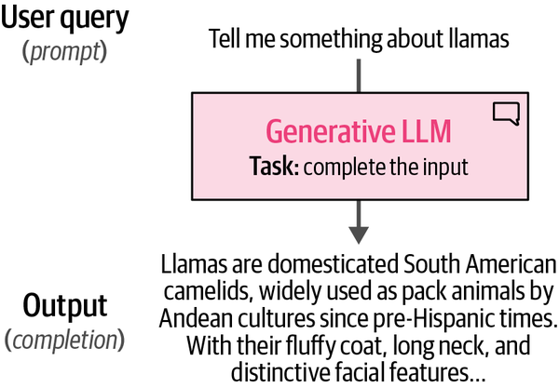
Generative Models
History of LLM’s
As illustrated in the figure beside, the resulting model could take in a user query (prompt) and output a response that would most likely follow that prompt. As such, you will often hear that generative models are completion models.

Slide 14
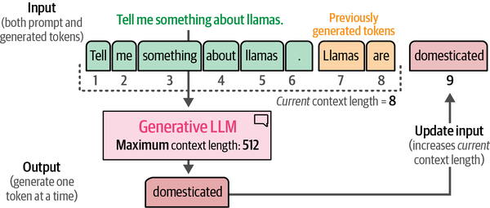
Generative Models
History of LLM’s
A vital part of these completion models is something called the context length or context window. The context length represents the maximum number of tokens the model can process, as shown in the figure beside.
A large context window allows entire documents to be passed to the LLM. Note that due to the autoregressive nature of these models, the current context length will increase as new tokens are generated.

Slide 15
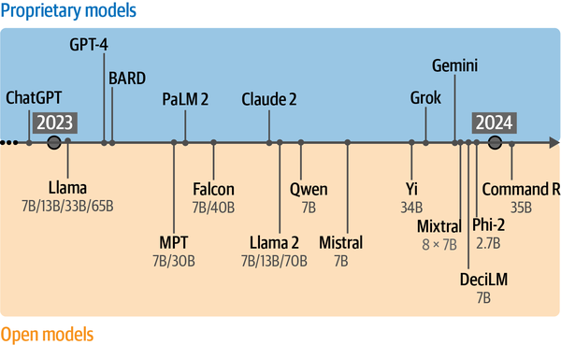
Generative Models
History of LLM’s
LLMs had a tremendous impact on the field and led some to call 2023 The Year of Generative AI with the release, adoption, and media coverage of ChatGPT (GPT-3.5).
When we refer to ChatGPT, we are actually talking about the product and not the underlying model.
When it was first released, it was powered by the GPT-3.5 LLM and has since then grown to include several more performant variants, such as GPT-4.

Slide 16
Creating LLM’s
Understanding LLM’s
Creating LLMs, in contrast, typically consists of at least two steps:
The first step,
called pretraining, takes the majority of computation and training time.
An LLM is trained on a vast corpus of internet text allowing the model to learn grammar, context, and language patterns.
This broad training phase is not yet directed toward specific tasks or applications beyond predicting the next word.
The resulting model is often referred to as a foundation model or base model.
These models generally do not follow instructions.
The second step - fine-tuning or sometimes post-training, involves using the previously trained model and further training it on a narrower task. This allows the LLM to adapt to specific tasks or to exhibit desired behavior. For example, we could fine-tune a base model to perform well on a classification task or to follow instructions. It saves massive amounts of resources because the pretraining phase is quite costly and generally requires data and computing resources that are out of the reach of most people and organizations. For instance, Llama 2 has been trained on a dataset containing 2 trillion tokens

Slide 17
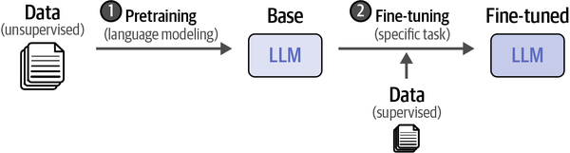
Creating LLM’s
Understanding LLM’s
Any model that goes through the first step, pretraining, we consider a pretrained model, which also includes fine-tuned models. This two-step approach of training is visualized in

Slide 18
Applications of LLM’s
Understanding LLM’s
Detecting whether a review left by a customer is positive or negative.
Developing a system for finding common topics in ticket issues.
Building a system for retrieval and inspection of relevant documents.
Constructing an LLM chatbot that can leverage external resources, such as tools and documents.
Constructing an LLM capable of writing recipes based on a picture showing the products in your fridge.
Large Language Model Applications: What Makes Them So Useful?
The nature of LLMs makes them suitable for a wide range of tasks. With text generation and prompting, it almost seems as if your imagination is the limit. To illustrate, let’s explore some common tasks and techniques:

Slide 19
Applications of LLM’s
Understanding LLM’s
Detecting whether a review left by a customer is positive or negative.
Developing a system for finding common topics in ticket issues.
Building a system for retrieval and inspection of relevant documents.
Constructing an LLM chatbot that can leverage external resources, such as tools and documents.
Constructing an LLM capable of writing recipes based on a picture showing the products in your fridge.
Large Language Model Applications: What Makes Them So Useful?
The nature of LLMs makes them suitable for a wide range of tasks. With text generation and prompting, it almost seems as if your imagination is the limit. To illustrate, let’s explore some common tasks and techniques:

