Slide 1









Project Blueprint & Data Pipeline
Server-Side
Backend
Frontend
API
POST
Request
Transform
Feature Extract
Pre-processing
Client-Side
Load
ML Model
Extract
Training Data
Serialized Model
Prediction Response
Serialization

Slide 2







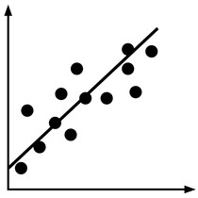
Project Blueprint & Data Pipeline
API
Daily
Extract
Dashboard
Daily
Extract
Extract
Basketball
Reference
Publish

Slide 3


Slide 4


