Slide 1








Model Blueprint & Data Pipeline
Server-Side
Backend
Frontend
API
POST
Request
Transform
Feature Extract
Pre-processing
Client-Side
Load
ML Model
Extract
Training Data
Serialized Model
Prediction Response
Serialization

Slide 2

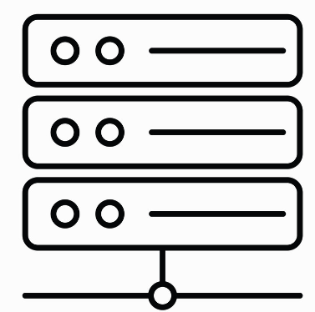

Model Blueprint & Data Pipeline
API
Extract
Training Data

