Slide 1

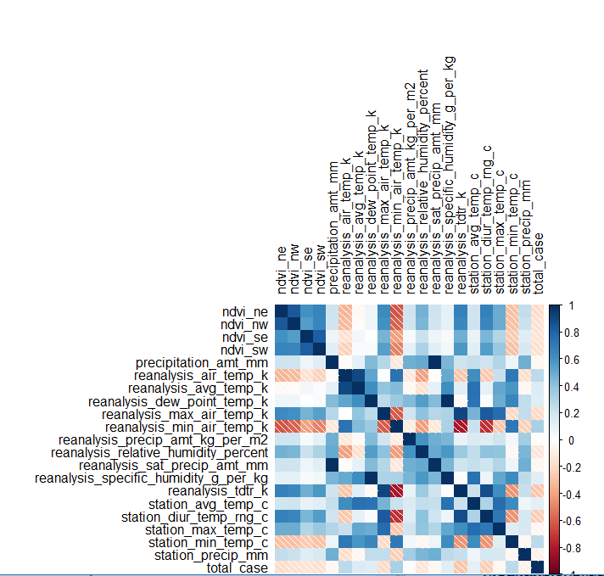
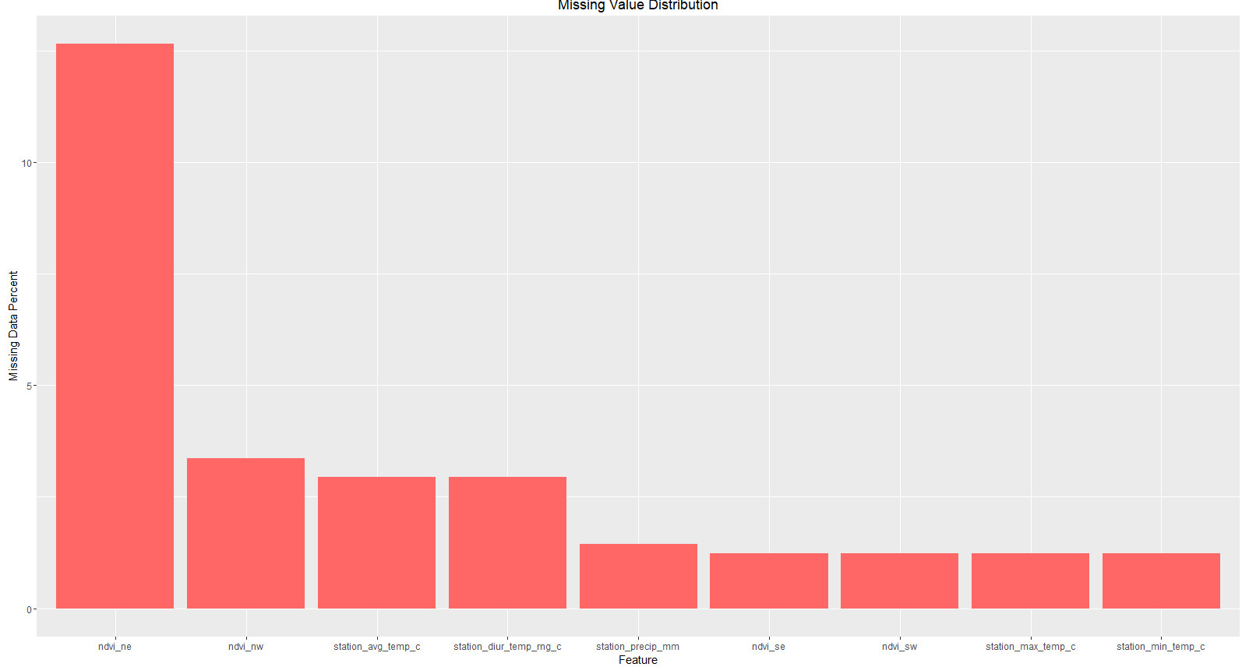
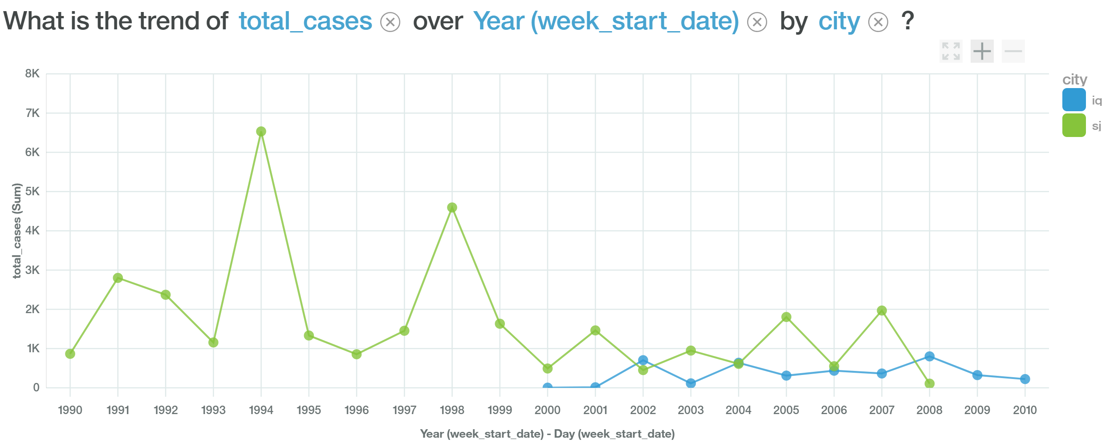
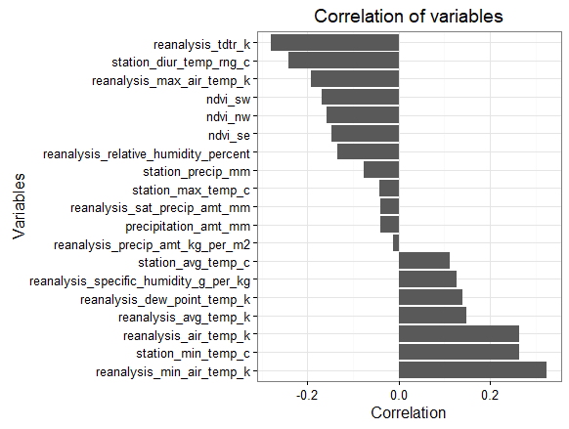
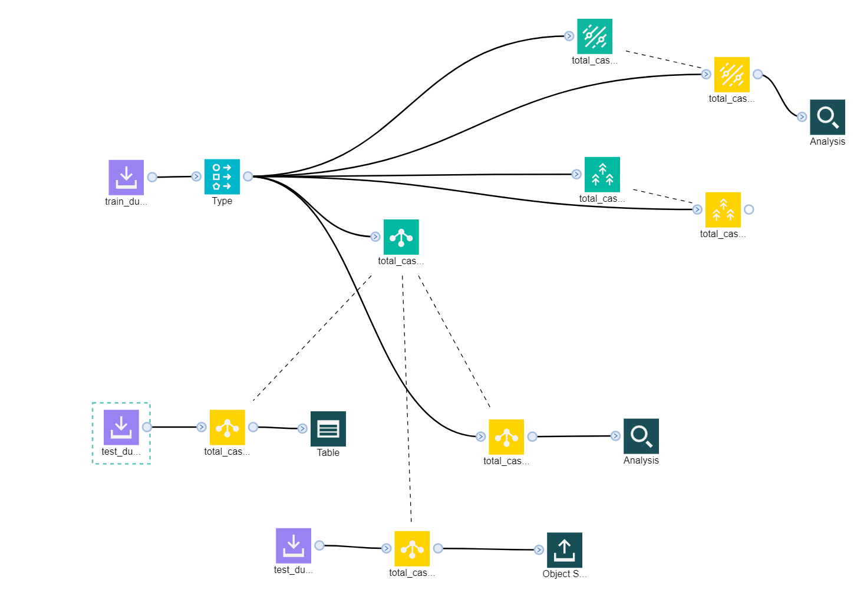
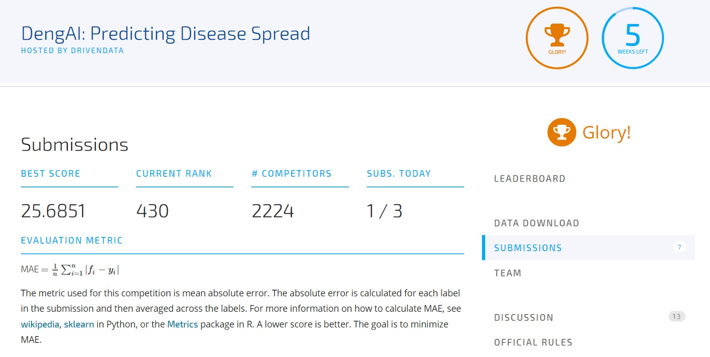
DengueAI: Predicting Disease Spread Vicky Rana, Pradeepkumar Prabakaran Instructor: Christopher Asakiewicz
Business Intelligence & Analytics
Motivation behind the project
Dengue fever is a mosquito-borne disease that occurs in tropical and sub-tropical parts of the world. In mild cases, symptoms are similar to the flu: fever, rash, and muscle and joint pain. In severe cases, dengue fever can cause severe bleeding, low blood pressure, and even death. Because it is carried by mosquitoes, the transmission dynamics of dengue are related to climate variables such as temperature and precipitation. Although the relationship to climate is complex, a growing number of scientists argue that climate change is likely to produce distributional shifts that will have significant public health implications worldwide.
In recent years dengue fever has been spreading. Historically, the disease has been most prevalent in Southeast Asia and the Pacific islands. These days many of the nearly half billion cases per year are occurring in Latin America.
So, using environmental data collected by various U.S. Federal Government agencies we will be predicting the number of dengue fever cases reported each week in different cities (San juan and Iquitos).
Approach
Accurate dengue predictions would help public health workers and the people around the world take steps to reduce the impact of these epidemics.
So, our primary goal is to predict the number of dengue cases each week in each location based on environmental variables describing changes in temperature, precipitation, vegetation, and more.
Data
Training Dataset – 1456 rows
Test Dataset – 416 rows
Exploratory Data Analysis
Finding key factors for predicting the target variable (total cases)
Model Building
Using Neural Networks in SPSS Modeler
Predicting Dengue Cases
Connection with Watson
Predicting Dengue cases in each city
Planning & Implementing Real Time
Strategy according to risk of Dengue Cases
Based upon Prediction can prevent dengue by tracking suitable solution
Predictive Model [SPSS Modeler]
We used SPSS-Modeler for model creation.
We created model using below mentioned algorithms.
1) Neural Networks
2) Random Forest
3) Linear SVM
We got the best result from Neural Network with mean absolute error as around 25 %.
Prediction [IBM Watson]
Using IBM Watson we can see the trend that will be occurring for the Dengue possibilities in each of the city and can take appropriate action accordingly.
Conclusion
Our primary goal is to predict the number of dengue cases each week in each location based on environmental variables describing changes in temperature, precipitation, vegetation, and more.
Using the model that we have built, we can use it for predicting the possibilities of dengue in a region based upon some of the variables.
This model can be used by governments, administrations, hospitals, social campaigns etc. in order to reduce the impact of these epidemics and can take early precautions against it.
http://www.stevens.edu/howe/academics/graduate/business-intelligence-analytics

