Slide 1
Signalr
easy, Real-time client-server messaging

Slide 2
Options for async messaging
AJAX
JSON via Web API/REST
WebSockets

Slide 3
Options for async messaging
AJAX
Request/response model
JSON via Web API/REST
WebSockets

Slide 4
Options for async messaging
AJAX
Request/response model
Usually means interval polling
JSON via Web API/REST
WebSockets

Slide 5
Options for async messaging
AJAX
Request/response model
Usually means interval polling
High overhead in cycles and bandwidth
High latency
Wasted calls if there's nothing to transmit
JSON via Web API/REST
WebSockets

Slide 6
Options for async messaging
AJAX
Request/response model
Usually means interval polling
High overhead in cycles and bandwidth
High latency
Wasted calls if there's nothing to transmit
Lots of code, coupling, overhead
JSON via Web API/REST
WebSockets

Slide 7
Options for async messaging
AJAX
JSON via Web API/REST
Less overhead
WebSockets

Slide 8
Options for async messaging
AJAX
JSON via Web API/REST
Less overhead
Request/response
Still doesn't solve polling issue
WebSockets

Slide 9
Options for async messaging
AJAX
JSON via Web API/REST
WebSockets
Direct connection between client and server
Uses long polling to keep connections alive

Slide 10
Enter SignalR

Slide 11
Why SignalR?
Pub/sub model instead of request/response

Slide 12
Why SignalR?
Pub/sub model instead of request/response
Uses WebSockets, which means long polling
Degrades gracefully to HTTP in older browsers

Slide 13
Why SignalR?
Pub/sub model instead of request/response
Uses WebSockets, which means long polling
Degrades gracefully to HTTP in older browsers
Small, dynamic code
Loose coupling
Automagically serializes to/from JSON

Slide 14
Why SignalR?
Pub/sub model instead of request/response
Uses WebSockets, which means long polling
Degrades gracefully to HTTP in older browsers
Small, dynamic code
Loose coupling
Automagically serializes to/from JSON
Allows grouping of connections/users

Slide 15
Why SignalR?
Pub/sub model instead of request/response
Uses WebSockets, which means long polling
Degrades gracefully to HTTP in older browsers
Small, dynamic code
Loose coupling
Automagically serializes to/from JSON
Allows grouping of connections/users
Built on top of OWIN/Katana

Slide 16
Why SignalR?
Pub/sub model instead of request/response
Uses WebSockets, which means long polling
Degrades gracefully to HTTP in older browsers
Small, dynamic code
Loose coupling
Automagically serializes to/from JSON
Built on top of OWIN/Katana
Allows grouping of connections/users
Support for web, iOS, Android, C#, and other clients

Slide 17
Signalr setup: It’s pretty fast and easy
Server side:
Pull down SignalR from NuGet
Implement Hub class
Add app.MapSignalR(); to the Configuration method in Startup.cs
Client side:
Write some JS event handlers
Include “magic” SignalR scripts

Slide 18
Let’s see some code

Slide 19
Hubs vs. Persistent Connections

Slide 20
Hubs vs. Persistent Connections
In general, use hubs except in the following circumstances:
The format of the actual message sent needs to be specified.
The developer prefers to work with a messaging and dispatching model rather than a remote invocation model.
An existing application that uses a messaging model is being ported to use SignalR.

Slide 21
SignalR performance
Generally good performance compared to other client/server messaging types
Allows 5000 concurrent requests per CPU by default
Can be configured
When request limit exceeded, server starts throttling requests with a queue
SignalR team offers SignalR.Crank tool to generate testing load

Slide 22
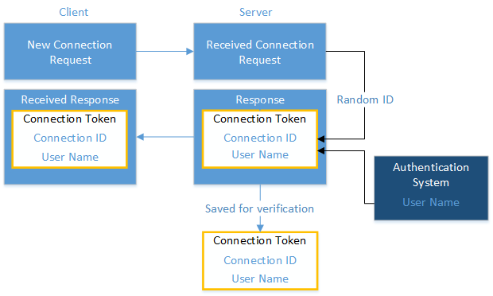
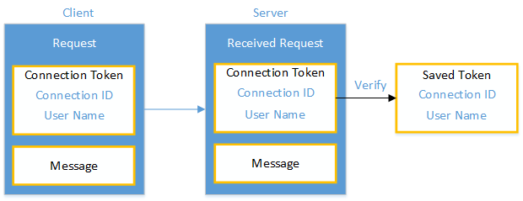
SignalR Authentication
Generate connection token
Send to server along with username

Slide 23
Conclusion: Why client/server async?

Slide 24
Further Information
SignalR project and wiki: https://github.com/SignalR/SignalR
Official SignalR site: http://www.asp.net/signalr
Why should ASP.NET devs consider SignalR for ALL projects: http://goo.gl/hedg7f
SignalR on iOS and Android: http://goo.gl/S1nziQ
All code and slides at: https://github.com/JustinMorgan/SignalR-Demo

