Slide 1
EMG Controlled Prosthetic Arm – An Affordable Solution for Enhanced Mobility
GROUP MEMBERS:
513121106093– SRIDHAR M
513121106065 – PARTHIBAN S
513121106078 – ROHANSHAJ K R
513121106710 – VIGNESH K
513121106047 – KEESAR KUMAR S

Slide 2
Problem Identification
Problem Statement:
Limited access to affordable, functional Prosthetic arms in India, with existing options priced from Rs. 10 to 40 lakhs.
Opportunity:
High demand for affordable, EMG-controlled prosthetics tailored to individual needs.

Slide 3
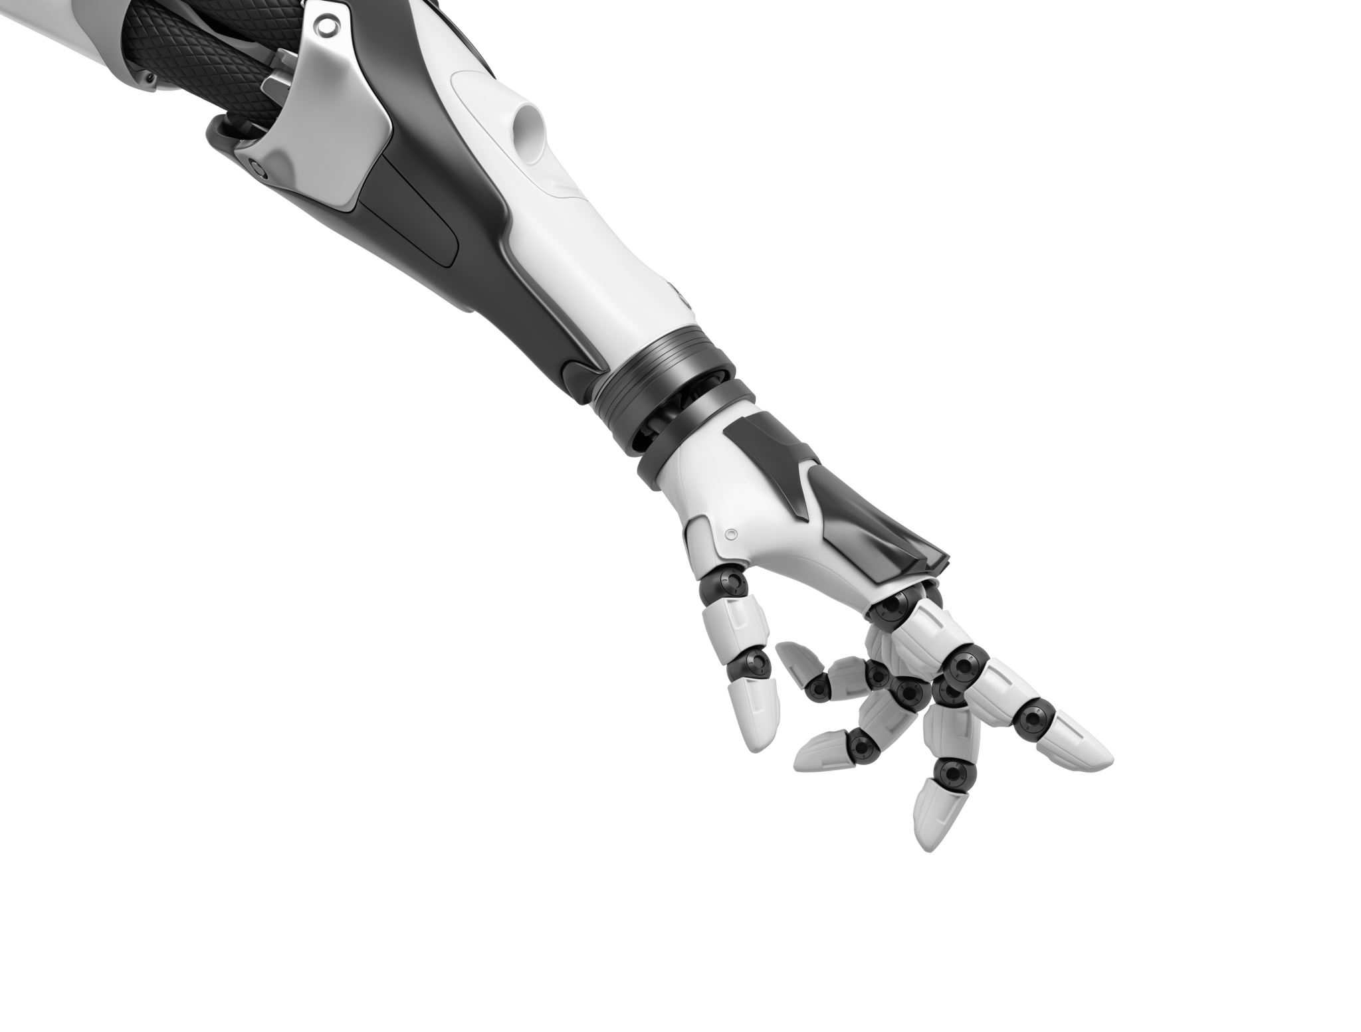
Solution
EMG-Controlled Prosthetic Arm:
Muscle-based control for intuitive user experience.
Customizable, lightweight design suited for daily use.
A cost-effective alternative for improved user independence and quality of life.

Slide 4

Market Opportunity
Target Audience: Individuals with limb loss, rehabilitation centers.
Market Size: Expanding prosthetics market in India with untapped demand.
Competitive Advantage: Low-cost, high-functionality EMG-controlled prosthetic.

Slide 5
Business Model
Canvas Model Highlights:
Value Proposition: Accessible, EMG-controlled prosthetic arm at a competitive price.
Revenue Streams: Direct sales, hospital and clinic partnerships.
Key Partners: Medical and rehabilitation centers, prosthetic suppliers.
Customer Segments: Individuals with limb disabilities, healthcare institutions.

Slide 6

Market Research
Research Insights:
Surveys with target users reveal strong demand.
Competitive Analysis: Limited options in the Indian market for affordable, EMG-controlled prosthetics.
Identified market split between B2B (hospitals, clinics) and B2C (individual users).

Slide 7

Marketing, Sales Strategy
Marketing & Sales Strategy:
Direct Sales: Targeting individuals, hospitals, and rehabilitation centers.
Partnerships: Hospital collaborations for trial demonstrations.
Digital Marketing: Website, social media engagement, influencer partnerships.

Slide 8

Operational Plan
Operational Workflow:
Production: Initial prototypes manufactured in-house; scale up with local suppliers.
Distribution: Direct-to-consumer sales, online and partner networks.
Customer Support: Dedicated support line for user assistance and feedback collection.

Slide 9

MVP Development
MVP Overview:
Functional prototype demonstrating EMG control for real-world user trials.
Continuous feedback loop with users for iterative improvements.
Designed for initial testing to refine and scale up production.

Slide 10

Financial Projections
Basic Estimates:
Prototype and manufacturing costs.
Target retail price and anticipated profit margin.
Potential funding needed to advance MVP to market-ready product.

Slide 11

Conclusion & Pitch Summary
Summary:
Affordable, EMG-controlled bionic arm that addresses an unmet market need.
Strong market demand, robust business model, and innovative MVP.
Call to Action: Seeking partnerships and investors to bring this solution to market.

