Slide 1
NLP Project
By:
Vicky Gangar (EE16B066)
Sai Narsimha Vedula (EE16B065)

Slide 2
Problem Statement
To develop an algorithm to recommend faculty members as reviewers for theses and dissertations submitted by research scholars from various fields and rank the reviewers according to their relevance.
Also develop a suitable evaluation measure for the algorithm, since we don’t have true rankings of reviewers.

Slide 3
Approach
Corpus NIPS 1987-2010
Train Documents (90%)
Maximum Similarity
Average Similarity
Test Documents (10%)
Dataset
TF-IDF Vectorizer
Dataset Split
Term Document Co-occurrence Matrix
Expertise Modelling
Concatenated Similarity
Expertise Model
Cosine Similarity
Query Retrieval

Slide 4
Evaluation
We don’t have human annotations to compare our results with, so we use following methods to evaluate our algorithm:
Vanilla ESA: We assume the authors of the test paper to be the only potential reviewers and thus obtain accuracy based on whether our model ranks the authors of test paper at top or in top 3. We also calculate MRR in certain cases.
ESA with Grouping: Since the authors of test papers might not be the only potential reviewers, we need some measure by which we can obtain other authors working in the same field. For this we group the documents in our dataset in N groups, based on a threshold, t. Each group is assumed to be a field of study. Authors of all the documents in a particular field of study are taken to be the potential reviewers of any paper in that field of study.

Slide 5
Results
Vanilla ESA:
Maximum Similarity:
Accuracy: 25.18%
Concatenated Similarity:
Accuracy-(Top1): 24.19%, -(Top 3): 37.23%
MRR: 0.2592
Average Similarity:
Accuracy: 16.78%
MRR: 0.2011

Slide 6
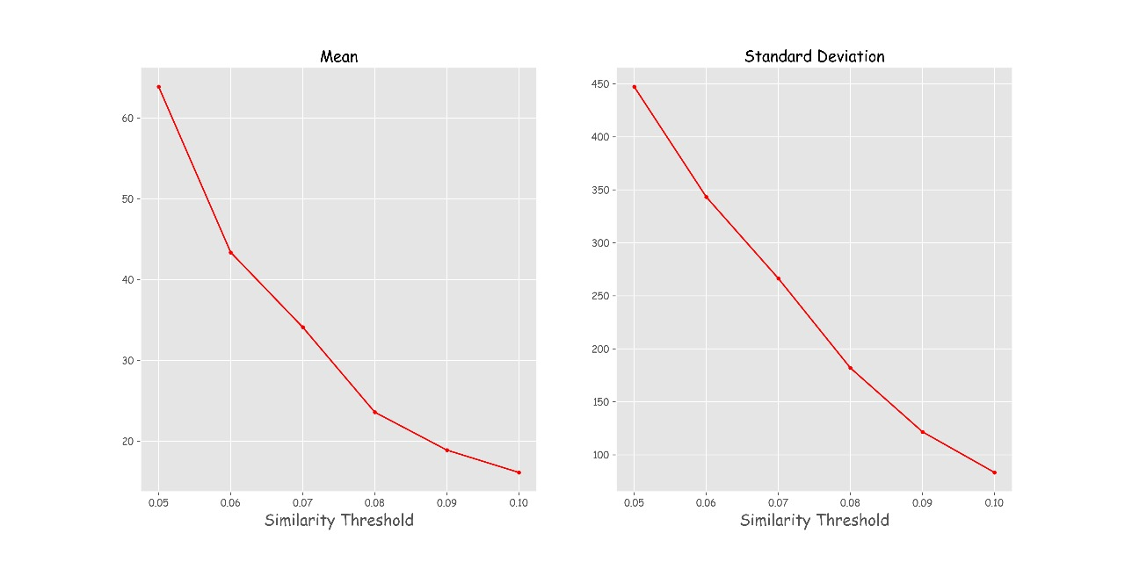
Results
Mean and Standard Deviation of Group Strength based on threshold value

Slide 7
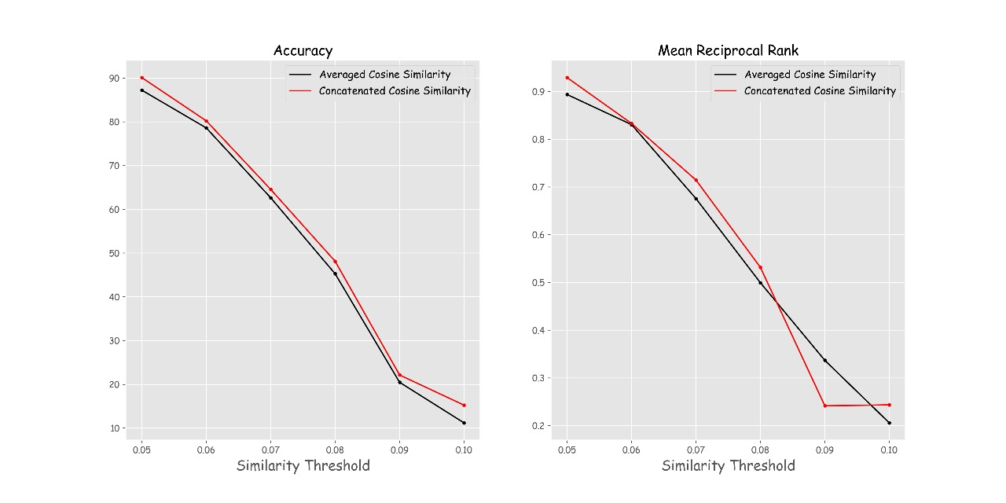
Results
Accuracy and MRR based on threshold value

Slide 8
Algorithm Working
Balaraman Ravindran: Improved Switching among Temporally Abstract Actions
Doina Precup (Specialization: AI, Thesis: Temporal Abstraction in RL, Doctoral Advisor: Richard S. Sutton)
Anna Koop (Director of Applied Machine Learning, Amii, Specialties: Artificial intelligence, machine learning, reinforcement learning)
Richard S. Sutton (one of the founding fathers of modern computational reinforcement learning, having several significant contributions to the field, including temporal difference learning, and policy gradient methods.)
Cosmin Paduraru (PhD work: investigating the properties of value function estimators in batch reinforcement learning)

Slide 9
Improvements Possible
To introduce some variability, the reviewers can be sampled from a distribution, where the similarities obtained may serve as probabilities.
The algorithm ranks reviewers only based on their relevance to the thesis. We can also include features that model other factors like workload of reviewers, conflicts of interests, etc.

Slide 10
THANK YOU

