Slide 1
Kultra Mega Stores Inventory Analysis
Business Intelligence Case Study (2009–2012)
Final Dashboard Project – Power BI & SQL
By: Ifeoma Onyemenam

Slide 2
Company Overview
Kultra Mega Stores (KMS) is based in Lagos, Nigeria.
They sell office supplies and furniture.
Customers include individuals, small businesses, and corporate clients.
This analysis focuses on the Abuja division using data from 2009–2012.

Slide 3
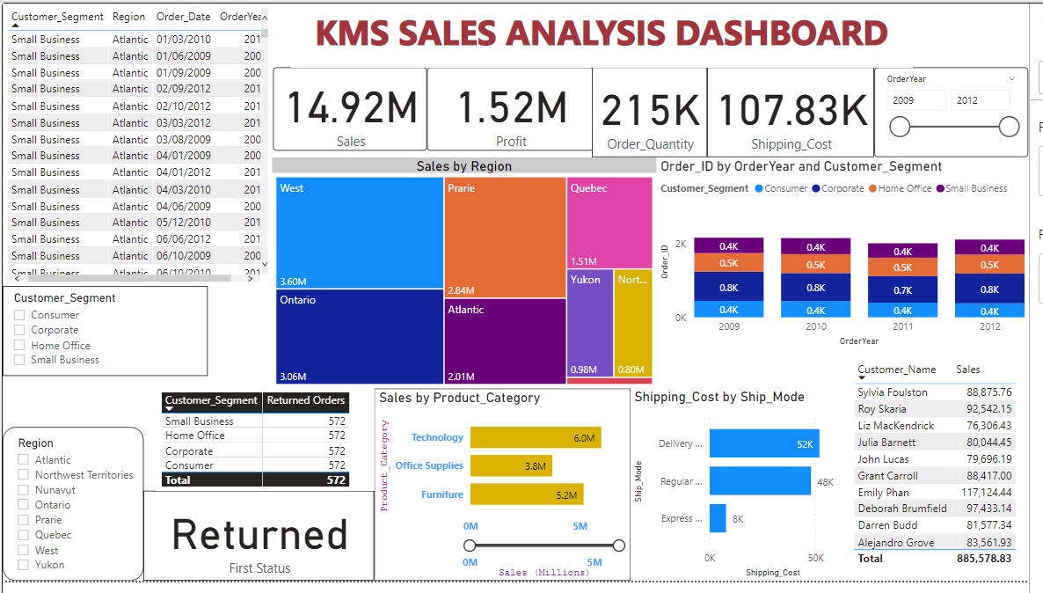
KMS Power BI Dashboard

Slide 4
Case Scenario I – Insights
1. Product Category with Highest Sales: Technology (₦6M)
2. Top 3 Regions by Sales: West (₦3.6M), Ontario (₦3.06M), Prairie (₦2.84M)
Bottom 3 Regions: Quebec (₦1.51M), Atlantic (₦2.01M), Northern (₦0.80M)
3. Total Sales of Appliances in Ontario: Not visible, but Ontario region = ₦3.06M
4. Bottom 10 Customers: Offer loyalty discounts, targeted promotions, follow-up marketing.
5. Highest Shipping Cost Mode: Delivery Truck (₦52K)

Slide 5
Case Scenario II – Customers & Logistics
6. Most Valuable Customers: Sylvia Foulston, Roy Skaria, Emily Phan
Product: Likely Technology and Furniture
7. Top Small Business Customer: Sylvia Foulston (₦88,875.76)
8. Most Orders by Corporate Customer: Emily Phan (₦117,124.44)
9. Most Profitable Consumer: Deborah Brumfield (₦97,433.14)
10. Returned Items: All segments (Consumer, Small Business, Corporate, Home Office)
11. Shipping Cost vs Order Priority: Misalignment observed – Express Air used on low priority

Slide 6
Summary & Recommendations
Align shipping method with order priority: Use Delivery Truck for low-priority, Express Air for urgent orders.
Promote bundled sales and discounts to bottom-tier customers to boost sales.
Investigate reasons for high return rates across all customer segments.
Focus more resources and ads in high-performing regions like West and Ontario.
Scale up Technology and Furniture offerings – these categories generate the highest sales.
Reduce reliance on high-cost shipping methods when not necessary.

