Slide 1
Pathfinding Visualizer
Maze generation, BFS and DFS search, animated with SFML in C++
Vipin Kumar
Minor Project | DSA Internship | TechnGlobal Private Limited

Slide 2
What the project does
Shows how the choice of data structure, queue or stack, changes how a search behaves.
1
2
3
Generate
Solve
Visualize
A recursive backtracker carves a random maze. The same seed always gives the same maze.
BFS and DFS search from the start to the goal and return the explored cells and the final path.
An SFML window replays the search step by step. Keys B, D and N run or change the maze.

Slide 3
Design: logic and drawing apart
Grid
Maze
Pathfinder
Renderer
Cells, walls, start and goal in a flat vector
Recursive backtracker and optional loops
BFS and DFS return a SearchResult
SFML window replays the result
Design rule: the algorithms never print or draw. They return the visit order and the path, and the renderer only replays them. The tests link the algorithm library without SFML, so they run with no window.

Slide 4
A grid is a graph
Every open cell is a node
Edges join a cell to its up, right, down and left neighbours
Walls and the border are never entered
A flat vector stores the grid: index = row × cols + col
0
1
2
3
4
5
6
7
8
Cell 7 is row 2, column 1. The bottom edge is the border, so it has three neighbours.

Slide 5
Breadth-first search
Push the start cell onto a queue
Pop the oldest cell and mark it explored
Push each open, unseen neighbour and record where it came from
Stop at the goal, then follow the parents back to the start
Slower compared to depth-first search
Shortest
path when every step costs the same
O(V)
time and space, V = rows × cols

Slide 6
Depth-first search
Any path
Push the start cell onto a stack
Pop the newest cell, skipping it if already explored
Push its open, unseen neighbours with the cell they came from
Stop at the goal, then follow the parents back to the start
Faster than breadth-first search, if a path exists
a valid route, not always the shortest
O(V)
time and space, V = rows × cols

Slide 7
Maze generation
1
Recursive backtracker
2
Perfect maze
A stack-based DFS jumps two cells at a time and removes the wall between them.
Odd sizes keep walls on even rows and columns. Exactly one route joins any two cells.
3
Optional loops
4
Reproducible
addLoops removes about 5% of inner walls, so BFS and DFS can return different paths.
A seed drives std::mt19937, so the same seed always rebuilds the same maze.

Slide 8
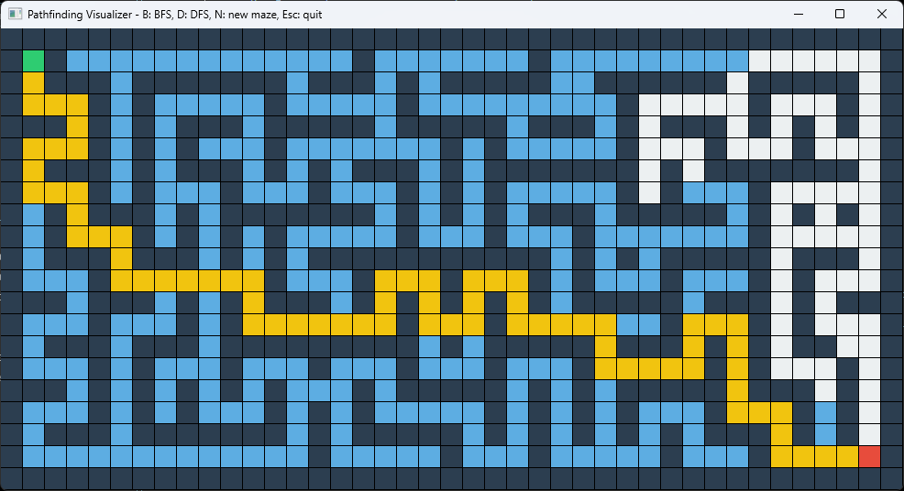
Result: BFS on seed 42
343
cells explored
73
cells in the path
Start
Goal
Explored
Final path
BFS on a 21 × 41 maze: explored cells in blue, final path in yellow
Wall

Slide 9
BFS and DFS compared
 | BFS | DFS
Data structure | Queue | Stack
Explores | In rings around the start | One corridor at a time
Path found | Always a shortest path | Valid, not always shortest
Time | O(V) | O(V)
Space | O(V) | O(V)
On a perfect maze both return the same path. With loops, BFS is never longer than DFS.

Slide 10
Testing
Grid loading, walls and bounds checks
BFS and DFS: valid path, blocked maze, start equals goal
Every path step moves one cell and avoids walls
BFS path is never longer than DFS path
100%
of tests pass
Catch2 and CTest

Slide 11
Takeaways and next steps
What this shows
Next
A queue or a stack decides whether the search finds the shortest path
Separating logic from drawing made the code easy to test
Seeded mazes make every result repeatable
A* with a Manhattan-distance heuristic
Weighted cells and Dijkstra
Reuse the SFML replay loop in the chess project

