Slide 1
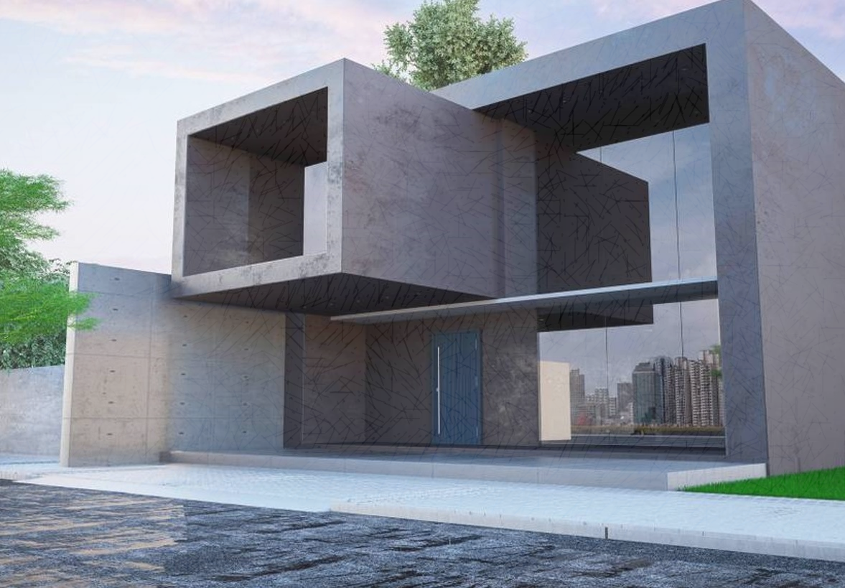
REAL ESTATE WEBSITE

Slide 2

MEMBERS
AVNISH SRIVASTAVA
HARI PRAKASH SHARMA
UTKARSH EKKA

Slide 3
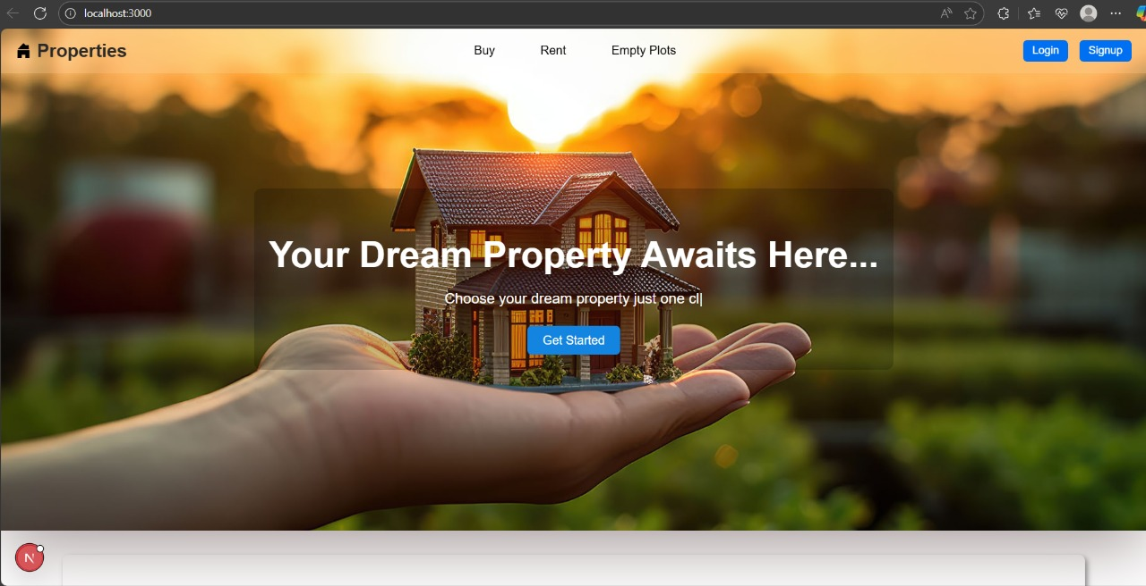
INTRODUCTION
The project is real estate listing website which is made over Next.js and its backend is supported on Node.js and Express.js with MongoDB as database.
The Project has:
Buy property page
rental property page
empty plots page
All three having a dedicated page for showing dynamic details for a particular property using express.js RESTful API and Leaflet map integration
The authentication system is made using JWT and OAuth authentication which enhances security.

Slide 4

FUNCTIONALITY
The frontend part of website is made over Next.js which provides an efficient way of routing between pages also Next.js has built-in leaflet map which helps us to incorporate maps without use of any external API.
The website has Buy property page, rental property page, empty plots page, with responsiveness and smooth UI
Backend is made over Node.js and Express.js as it provides us with middlewares and easy routing, also Express.js helps in smooth communication between frontend and database.
Database is built over MongoDB and Mongoose which is easily linked with backend and mongoose helps to define schemas to provide fixed structure of data being stored in database.

Slide 5
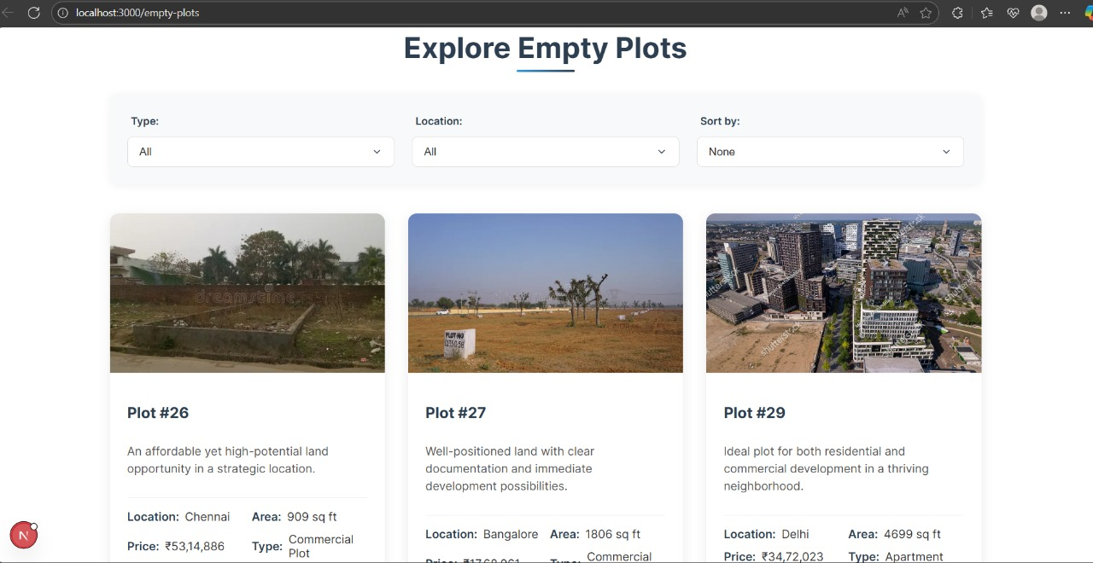
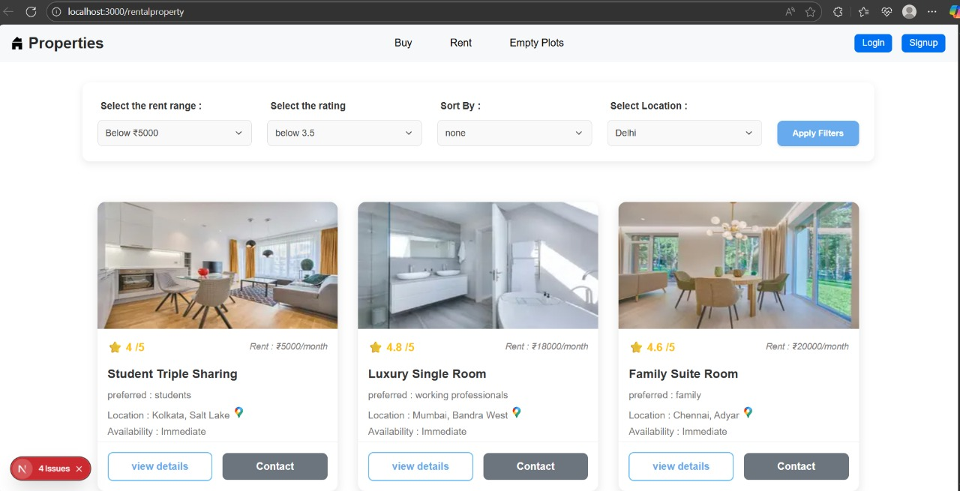
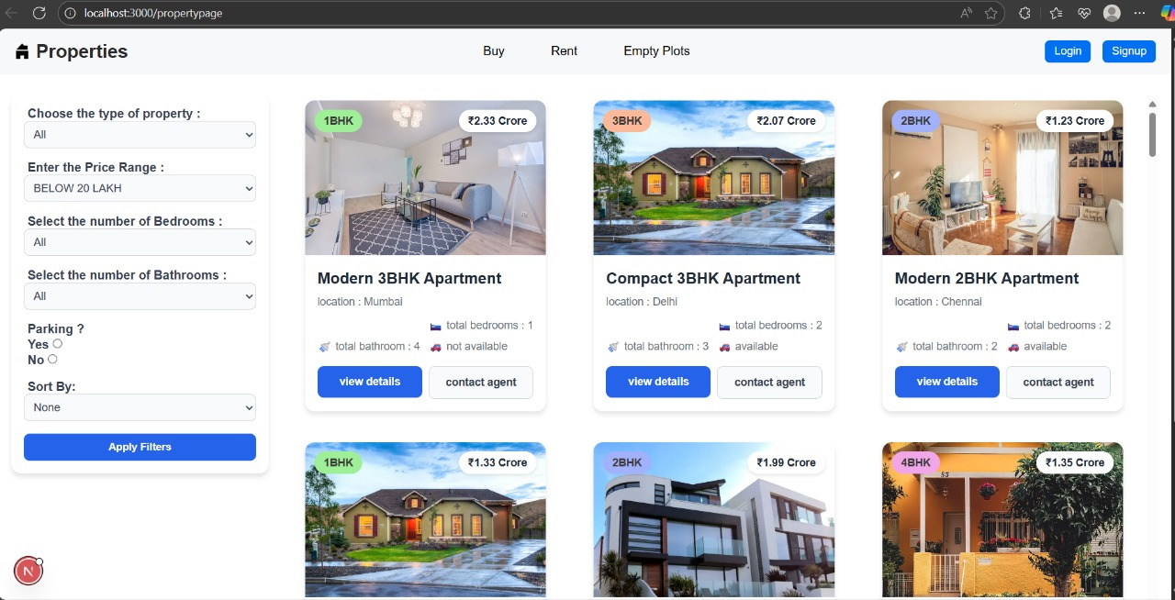
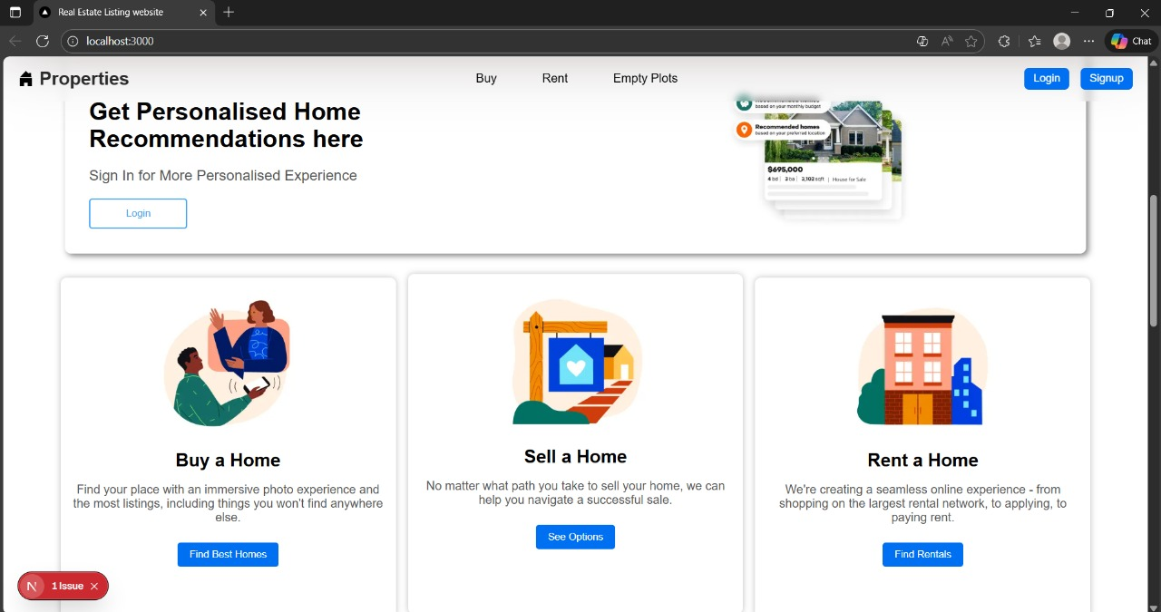

Slide 6
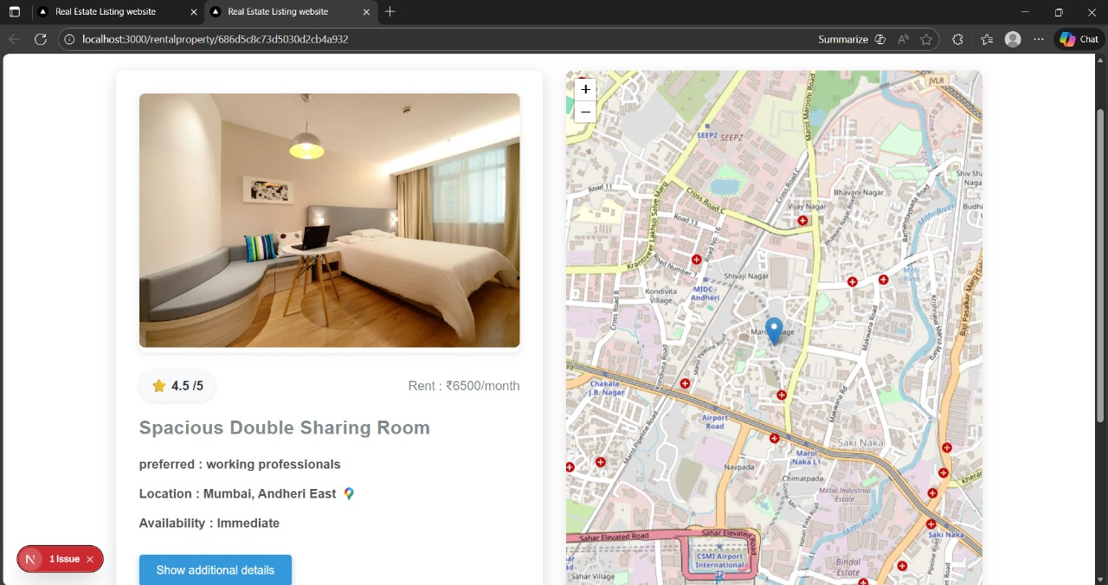

Slide 7

TECHNOLOGY
Frontend - Next.js, BetterAuth
Backend - Node.js, Express.js
Database - MongoDB and Mongoose

Slide 8

Thank you

