Slide 1
PUBLIC SAFETY & TRANSPORT ANALYTICS
London Transport
Crime Analysis
FY2009/10 - FY2023/24 · 904,790 reported incidents · 9 transport modes
Victoria Johnson | Tableau · Excel

Slide 2
SLIDE 1 · PROJECT OVERVIEW
What Did This Investigation Set Out to Answer?
Business Focus: Which London transport modes are most affected by crime, and how have patterns changed over 15 years?
Objectives
Dataset
Identify which transport modes carry the highest crime burden
Source:
TfL Transport Crime Dataset
Measure how total crime has changed across 15 fiscal years
Time Period:
FY2009/10 - FY2023/24
Uncover seasonal and monthly crime patterns
Fiscal Years:
15 years of data
Provide a risk matrix to prioritize security resource allocation
Transport Modes:
9 modes including Bus, Underground, Rail
Total Crimes:
904,790 reported incidents
Reported Incidents:
904,790

Slide 3
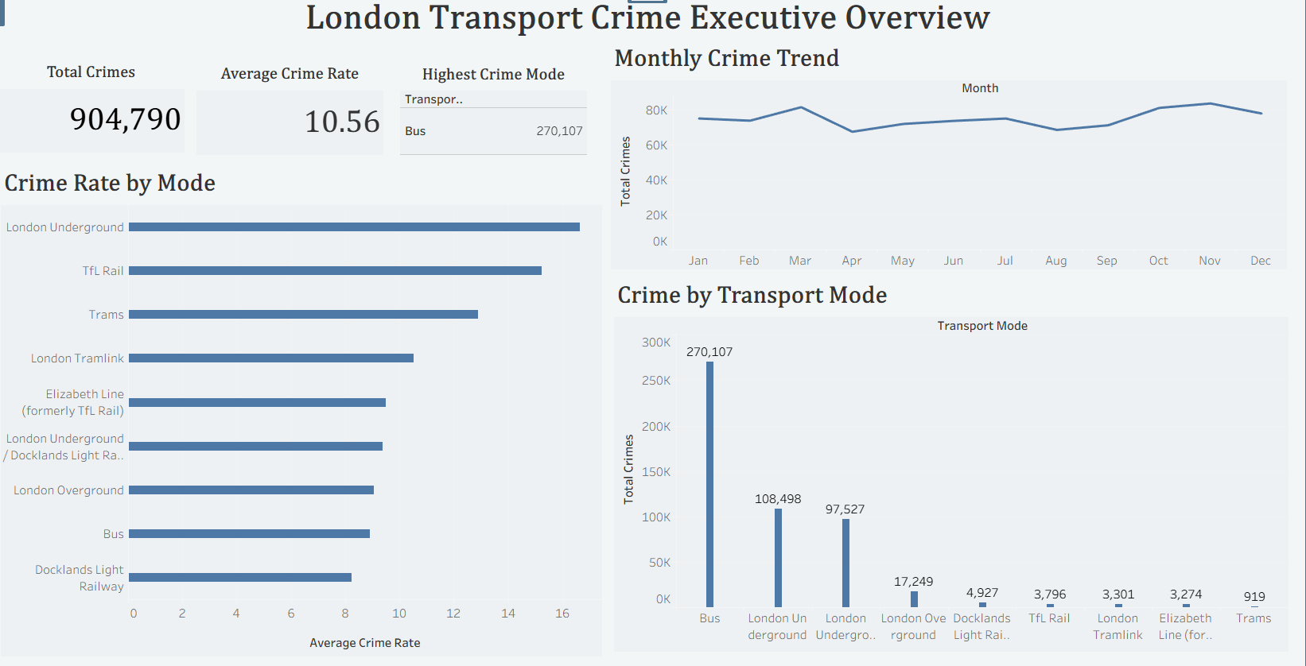
SLIDE 2 · EXECUTIVE OVERVIEW
Crime at a Glance
Total Reported Crimes
904,790
Analysis Period
15 Fiscal Years
Highest Crime Mode
Bus
Bus Total Crimes
270,107
Peak Crime Months
Oct - Nov

Slide 4
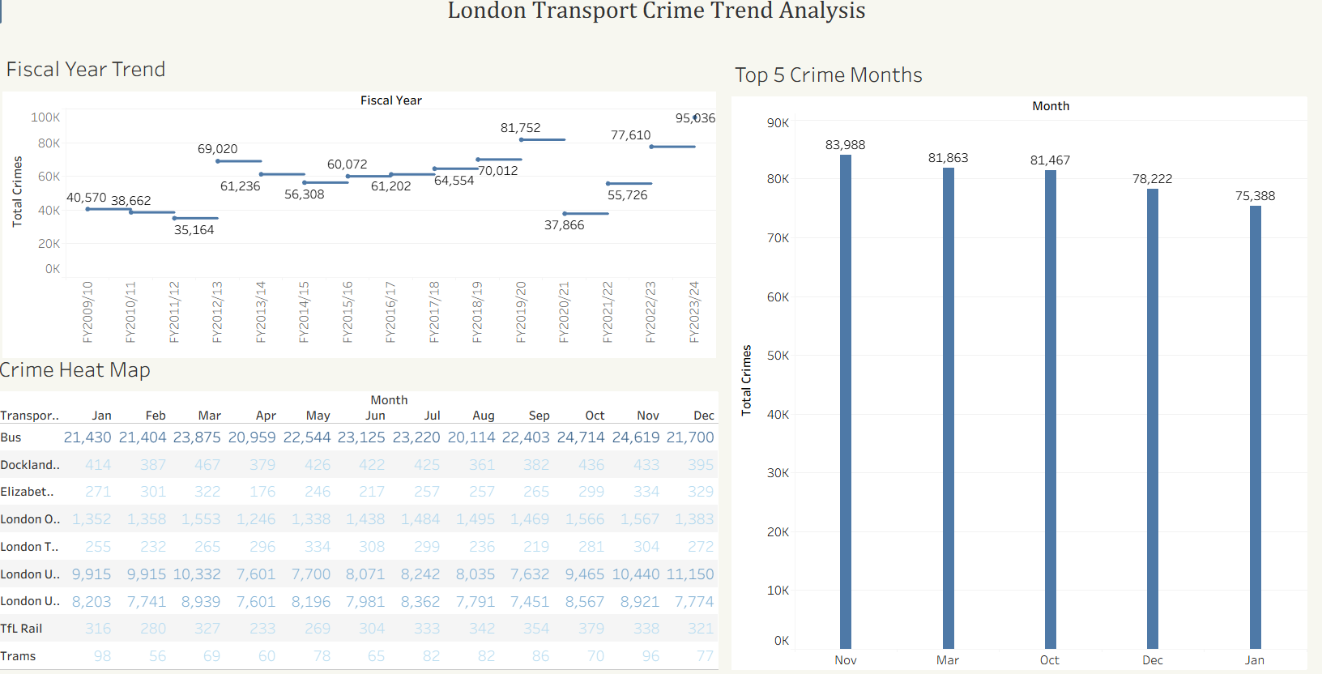
SLIDE 3 · TREND ANALYSIS
How Has Crime Changed Over 15 Years?
Business Focus: Is crime rising, falling, or cyclical - and which months drive the peaks?
Key Findings
Use the higher incident volumes observed in November and other high-volume months to support seasonal resource planning.
Treat FY2020/21 separately when comparing long-term trends because travel patterns were affected by the COVID-19 pandemic.
Review the London Underground November pattern in more detail to identify locations or crime categories contributing to the higher volume.
The five highest-volume months were November, March, October, December, and January.
Bus recorded consistently high incident volumes across months in the heat map.
London Underground recorded 10,440 incidents in November, its highest monthly value shown in the analysis.
RECOMMENDATIONS
Plan for year-end crime surge every Nov - Jan.
Apply COVID-dip context when benchmarking FY2020/21.
Monitor Underground's November spike specifically.

Slide 5
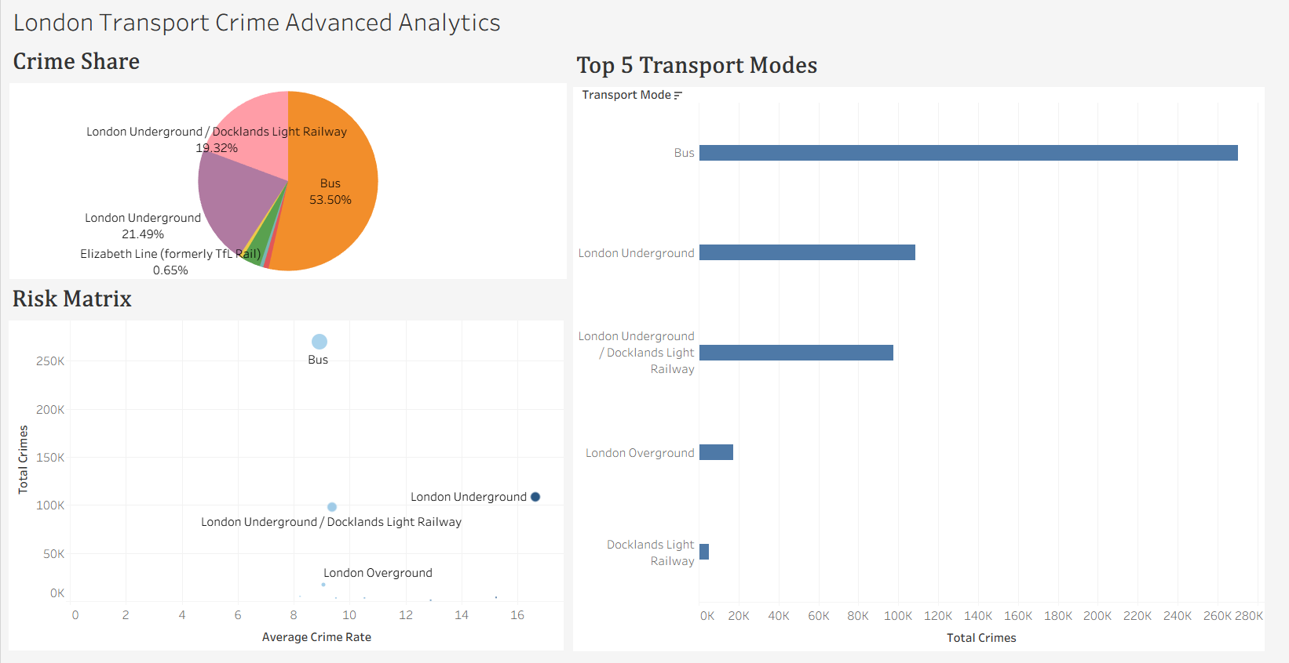
SLIDE 4 · ADVANCED ANALYTICS
Risk by Mode - Where Is Crime Concentrated?
Business Focus: Which transport modes recorded the highest reported crime volume, and how do they compare using the available rate measure?
Key Findings
Bus recorded the highest number of reported incidents with 270,107 across the analysis period.
London Underground recorded the highest average rate value among the transport modes in the dataset.
Bus and London Underground accounted for the largest share of reported incidents in the analysis.
The risk matrix highlights differences between transport modes when both incident volume and the available rate measure are considered.
Most reported incidents were concentrated within a small number of transport modes, while others recorded much lower volumes.
RECOMMENDATIONS
Review London Underground in more detail because it recorded the highest average rate value in the dataset.
Continue monitoring Bus because it recorded the highest total number of reported incidents.
Use both reported incident volume and the available rate measure when prioritizing security resources across transport modes.

Slide 6
MANAGEMENT RECOMMENDATIONS
Six Actions for TfL Crime Reduction
1
Increase security presence during higher-volume months identified in the analysis.
2
Investigate locations and incident types contributing to London's Underground higher average rate values.
3
Review the long-term increase in reported incidents to identify the main drivers behind recent growth.
4
Use historical monthly patterns to support seasonal resource planning.
5
Prioritize transport modes using both reported incident volume and the available rate measure.
6
Refresh the Tableau dashboard as new TfL crime data becomes available to support ongoing monitoring.

Slide 7
SLIDE 5 · SKILLS DEMONSTRATED
What This Project Proves
Tableau Dashboard Design
Data Visualization
Built three connected dashboards: Executive Overview, Trend Analysis, and Advanced Analytics with a risk matrix.
Selected appropriate chart types - bar, line, heat map, scatter plot - for each analytical question.
Trend Analysis
Risk Matrix Thinking
Analyzed 15 fiscal years of data to identify growth patterns, seasonal cycles, and event impacts (COVID dip).
Plotted transport modes on a volume-vs-rate scatter to separate high-volume from high-rate risks.
Business Storytelling
Excel & Data Preparation
Structured three dashboards around a single analytical thread: where is crime, when is it worst, and what should be done.
Cleaned and prepared TfL source data before Tableau analysis.

