Slide 1
HEALTHCARE OPERATIONS ANALYTICS
Hospital Emergency Room
Performance Analysis
Patient experience · Wait times · Operational efficiency · Demographics
Victoria Johnson | Excel · Power Query · Pivot Tables · Dashboard Design

Slide 2
SLIDE 1 · BUSINESS PROBLEM
What Does the Hospital Need to Know?
Business Focus: How can hospital management improve ER performance, patient experience, and operational efficiency?
What drives long patient wait times?
What drives low patient satisfaction?
Which departments face the highest pressure?
What factors contribute to readmissions?
Dataset: 10,100 Emergency Room Visits · Departments · Wait Times · Satisfaction · Admissions · Demographics · Triage · Physicians

Slide 3
SLIDE 2 · DATA PREPARATION
From Raw Data to Reliable Analysis
Business Focus: What quality issues existed in the raw data, and how were they resolved?
Issues Found in Raw Data
What I Did
5,523 missing Department values
Standardized 6 categorical fields (Gender, Shift, Triage, Admission, Readmission, Race)
7,088 missing Satisfaction Scores
Replaced missing categorical values with "Unknown" where appropriate to preserve row count.
16 negative wait times + 14 × 999-min placeholders
Retained blank satisfaction scores - absence of feedback ≠ poor satisfaction
Gender coded as M / F / Male / Female / 'Femaleemaleemale'
Removed 30 invalid wait-time records (0.30% of dataset)
Triage as 1 / L1 / ESI 1 / Level 1 - all meaning the same thing
Engineered date features: Year, Month, Day of Week, Hour
Shift as Morning / MORNING / Morning Shift
Built star schema: 1 Fact table + 4 Dimension tables
10,130 raw records - 10,100 clean records | 30 invalid wait-time records removed | Data quality issues documented in full audit report

Slide 4
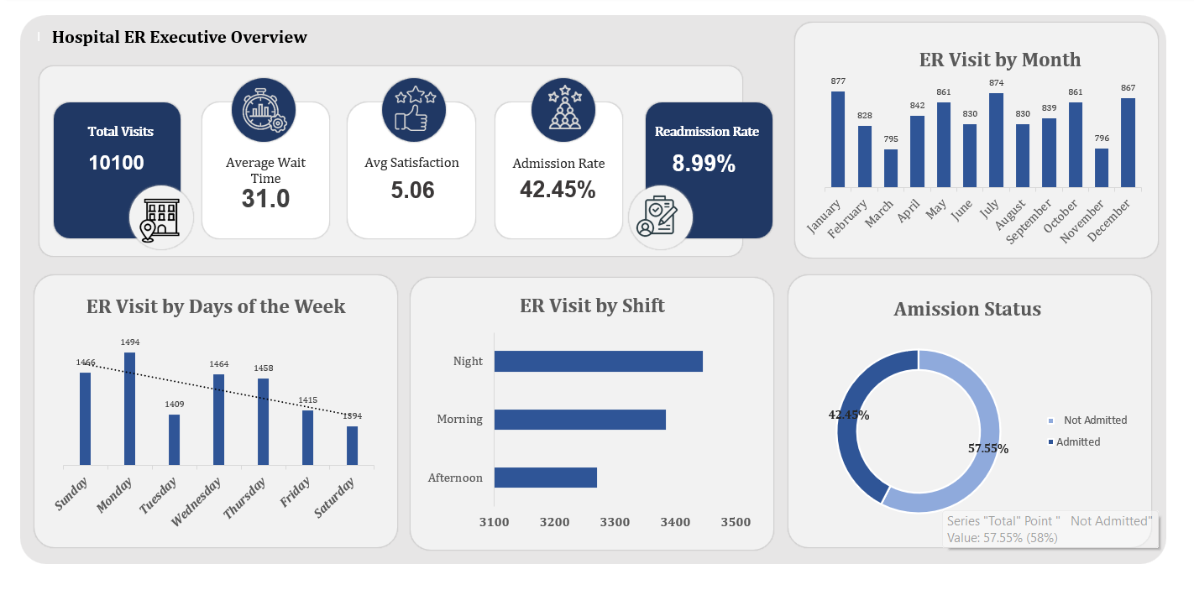
SLIDE 3 · EXECUTIVE OVERVIEW
ER at a Glance
Total Visits
10,100
Avg Wait Time
31 mins
Admission Rate
42.45%
Readmission Rate
8.99%
Avg Satisfaction
5.06/10

Slide 5
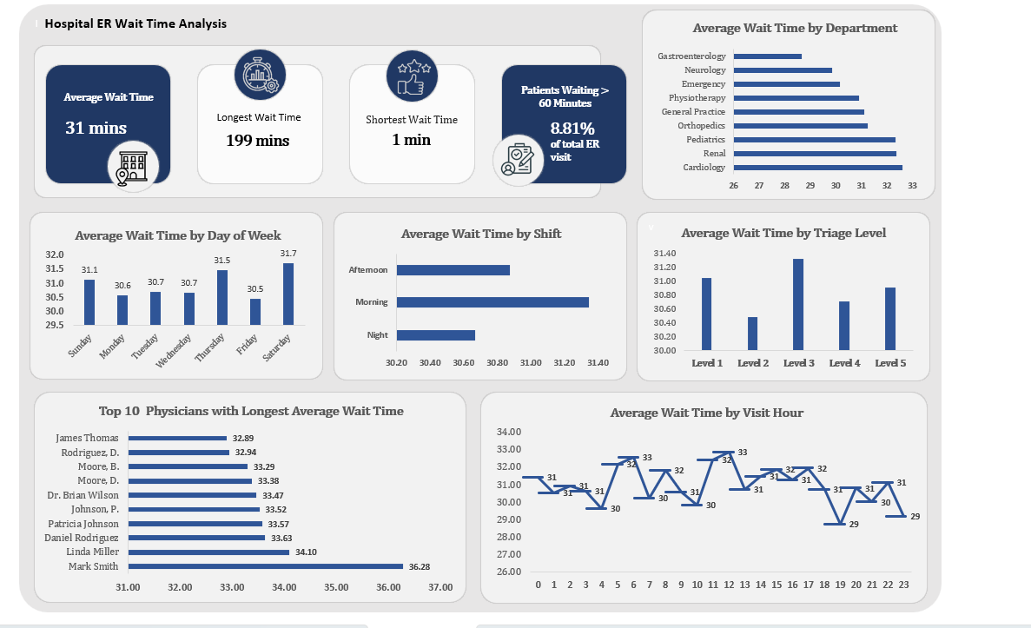
SLIDE 4 · WAIT TIME ANALYSIS
Where Are Patients Waiting Longest?
Business Focus: Which departments, shifts, and physicians drive the longest wait times?
Key Findings
Average wait: 31 minutes across all visits
Longest individual wait: 199 minutes
8.81% of patients waited over 60 minutes
Gastroenterology has the highest dept average (32.7 mins)
Afternoon shift shows longest waits vs Morning and Night
Average wait times varied little across triage levels in this dataset.
Mark Smith averages 36.28 mins - highest among all physicians
RECOMMENDATIONS
Investigate Gastroenterology bottlenecks and capacity.
Review afternoon shift staffing levels.
Audit high-wait physicians for workflow inefficiencies.

Slide 6
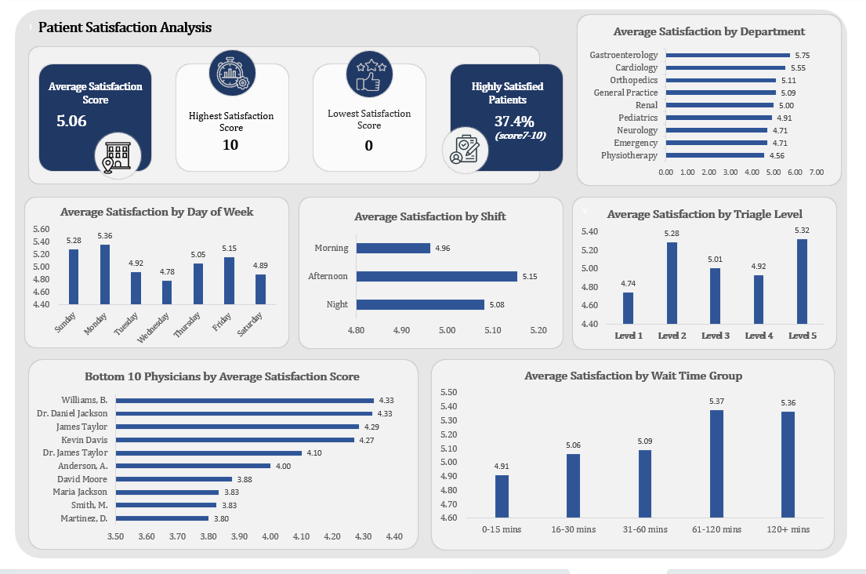
SLIDE 5 · PATIENT SATISFACTION
What Drives Patient Experience?
Business Focus: Which departments and physicians score highest and lowest on patient satisfaction?
Key Findings
Overall average satisfaction: 5.06 out of 10
Gastroenterology leads at 5.75 - highest department
Physiotherapy trails at 4.56 lowest department
37.4% of patients rated 7 to 10 (Highly Satisfied)
Night shift scores highest at 5.08 vs Morning at 4.96
Patients who waited 60 minutes or longer recorded higher average satisfaction scores in this dataset.
Further investigation would be needed to understand the factors contributing to this pattern.
Bottom physician: Martinez, D. at 3.80 average
RECOMMENDATIONS
Investigate Physiotherapy and Emergency care gaps.
Review the factors associated with higher satisfaction in Gastroenterology to determine whether any practices could be applied more broadly.
Review lowest-rated physicians for targeted coaching.

Slide 7
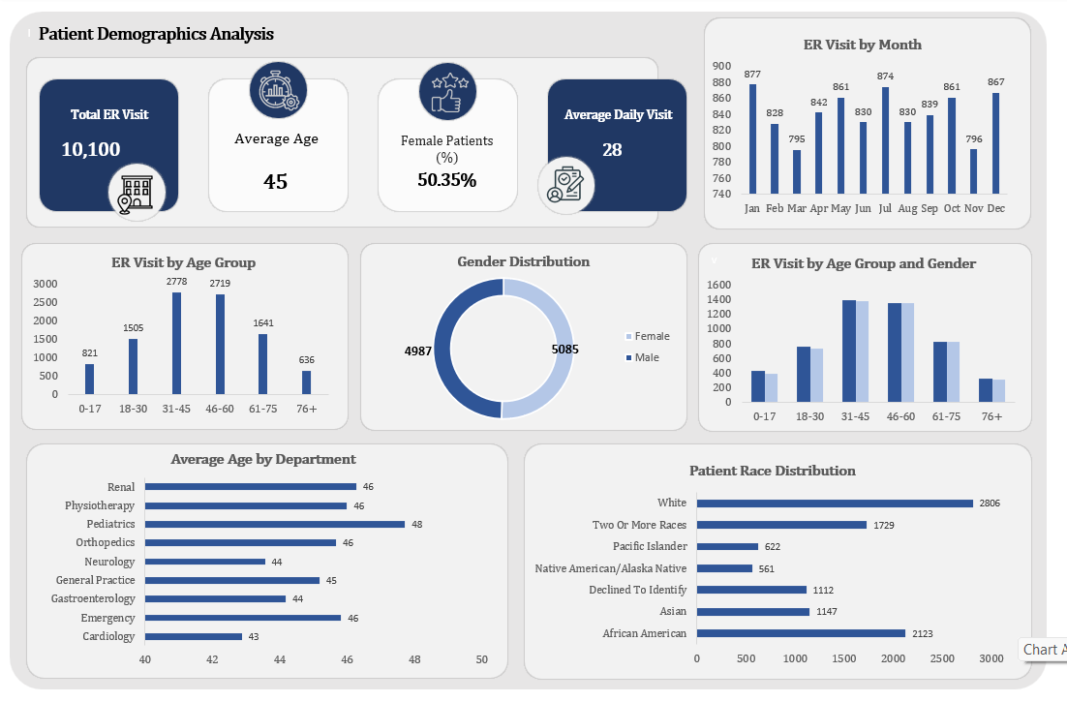
SLIDE 6 · PATIENT DEMOGRAPHICS
Who Is Coming to the ER?
Business Focus: What does the patient population look like and when do they arrive?
Key Findings
Average patient age: 45 years
Gender split is near-even: 50.35% Female, 49.65% Male
Largest age group: 31–45 (2,778 visits)
Busiest months: March (861), May (874), August (861)
Daily average: 28 ER visits per day
White patients are the largest racial group (2,806 visits)
Average age is consistent across all departments (43–48)
RECOMMENDATIONS
Staff for peak months: March, May, and August.
Ensure 31 - 45 age group receives age-appropriate triage resources.
Monitor wait times and satisfaction across patient groups to identify any meaningful differences over time.

Slide 8
SKILLS DEMONSTRATED
What This Project Proves
Excel & Power Query
Pivot Tables & DAX
Imported and cleaned 10,130 raw records; standardized 8 categorical fields; engineered date features for time-series analysis.
Built structured pivot tables for wait time, satisfaction, demographics, and physician performance across multiple dimensions.
Data Cleaning
Dashboard Design
Documented and resolved missing values, invalid records, inconsistent categories, and data-entry errors in a formal audit report.
Built four linked dashboards in Excel covering executive KPIs, wait time, satisfaction, and patient demographics.
Business Analysis
Data Storytelling
Framed four business questions, derived actionable findings, and produced specific operational recommendations per dashboard.
Structured the project as question → data → finding → recommendation - the same framework used in professional BI reporting.

