Slide 1
Software Architecture (F23)

Slide 2

Agenda
This session is recorded!
We are interested in feedback!
Introduction to the publish subscribe pattern, including Apache Kafka
Used later on in the course! And used in future courses!
Hands-on exercises with Kafka
Architectural Exercises
Select a software system
Describe its mission
Document the system, i.e. create views describing you system
Create a PowerPoint and provide feedback
Notes:
Det bliver brugt I vores kursus og senere I Big Data
Et meget kendt queue system, der også bliver brugt I virkligheden.

Slide 3
Context
A Pattern!
The publish subscribe pattern implemented in Kafka (Apache Kafka)
What is the publish subscribe pattern?
What is Kafka?
How is this related to this Course?
Exercises! Whop whop

Slide 4
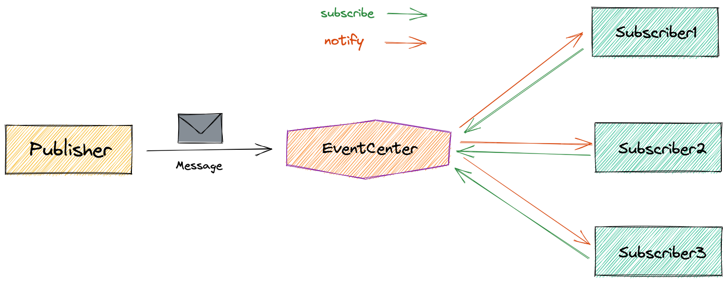
What is the publish subscribe pattern?
Publish-subscribe pattern uses topics/channels for messaging
Sender (publisher) sends message to topic, multiple receivers (subscribers) can receive
Decoupling of publisher and subscribers
Dynamic addition/removal of subscribers without affecting publisher
Enables parallel processing and load balancing
Can be implemented using message queues, event buses, and other messaging systems.
Used to implement event-driven architectures.

Slide 5
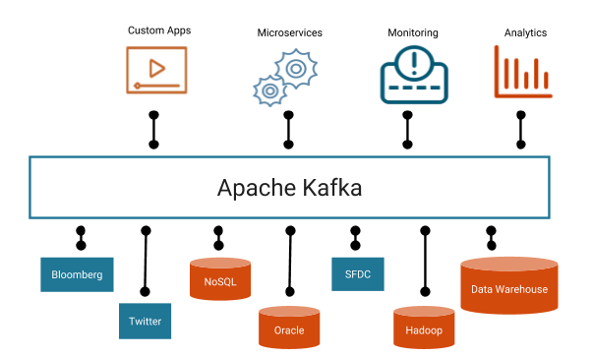
What is Apache Kafka?
Broad Overview
More detailed introduction in the 7th Semester, i.e. in Big Data and Data Technologies
A technology that is widely used in the industry (e.g. Uber)
A server, that enables
To publish and subscribe to streams of records, i.e. a message queue.
Store streams of records in a fault tolerant way
Wide Language Support
Libraries for languages like Go, .Net, Java, Python etc.

Slide 6
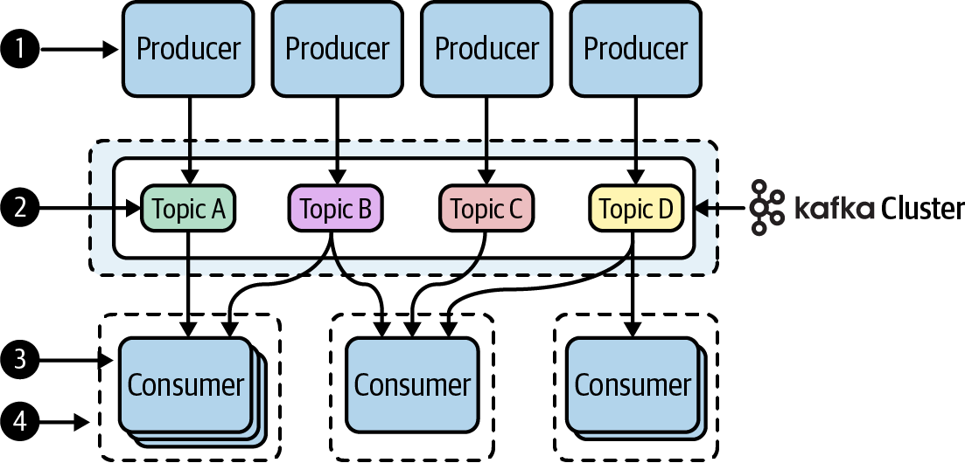
How does Kafka implement the pattern?
Producers
Publish without knowing the receiver
Subscribers
Subscribe to a topic and wait for data
Topics
Identified by a name
Number of topics are not limited
Has a partition size
With a replication factor

Slide 7
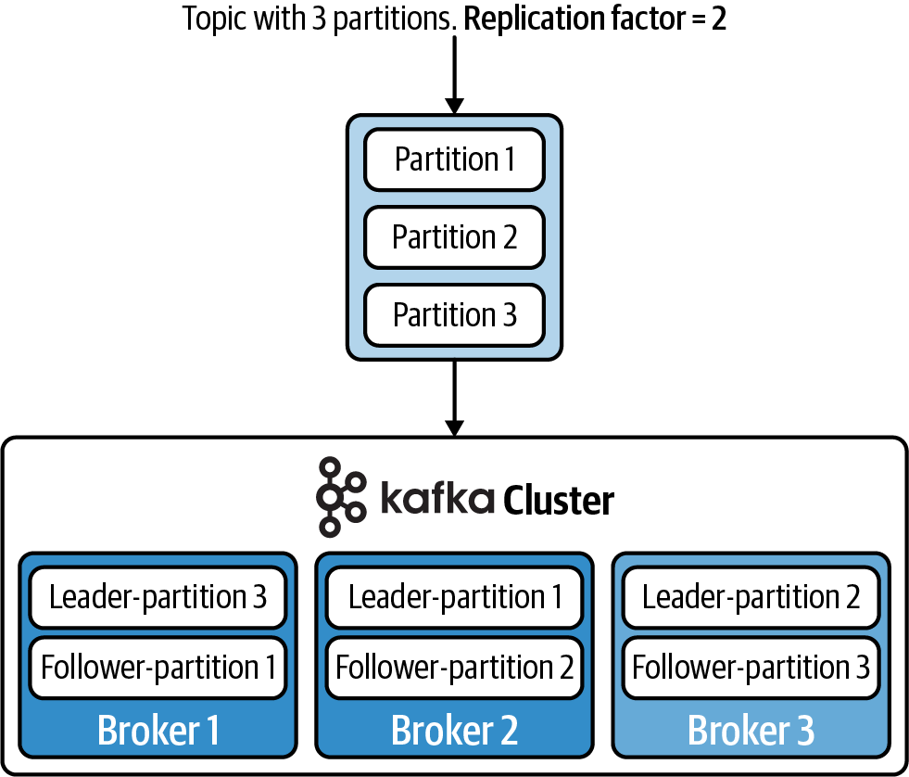
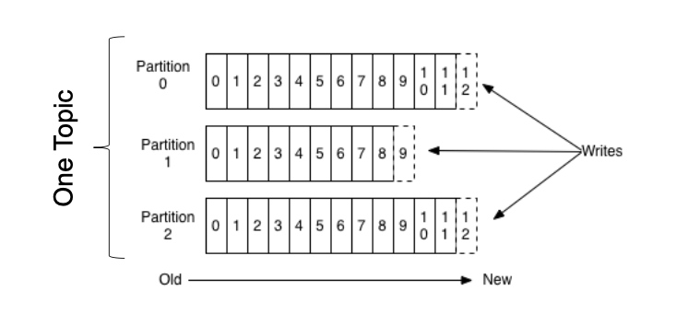
Increasing Availability
Producer
We have a cluster with three brokers
A topic with three partitions
A replication factor of 2

Slide 8
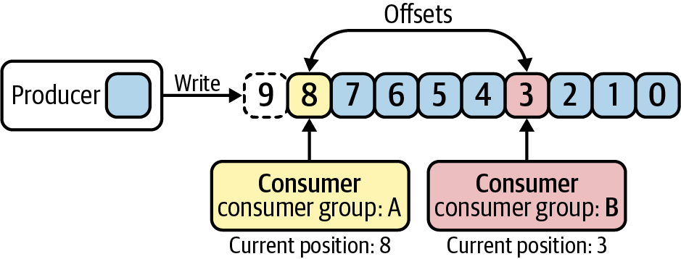
Producer
Producer
Write to a topic
Producers can create topics and define the replication factor and partitions

Slide 9
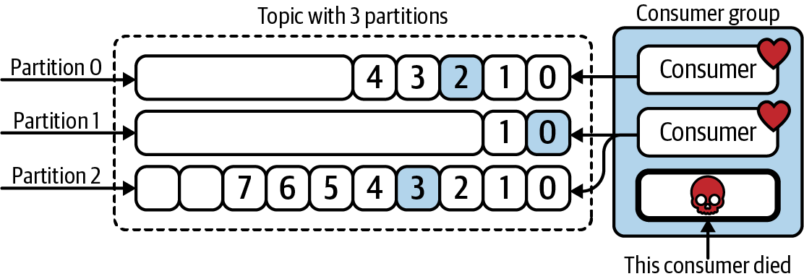
Consumers
Consumer
Reads from the beginning or a specific offset.
Offset is saved in the Kafka broker.
Belongs to a consumer group
Imagine one consumer is not able to handle all the data, what can be done?

Slide 10

Example!
A Quality Control system to check the product quality of tea bags

Slide 11
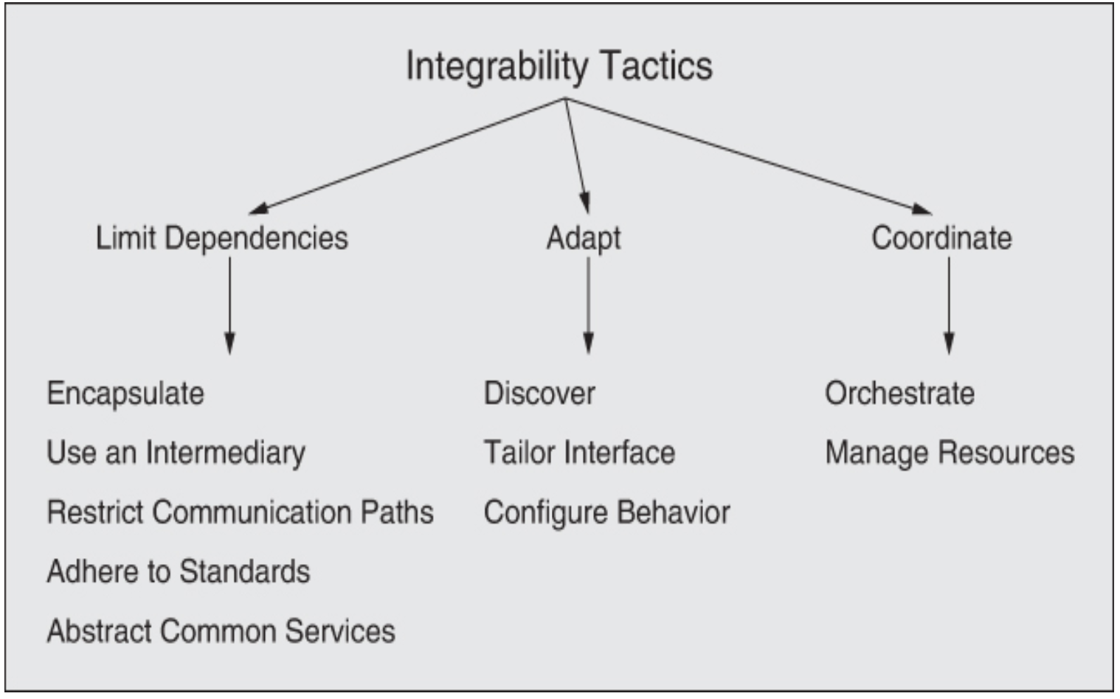
How is it related to this course?
Apache Kafka implements a series of tactics to accommodate Quality Attributes
Quality attributes are used to define software qualities like performance or availability
Tactics are ways of implementing these qualities
Use an Intermediary
Kafka can act as an intermediary between services
limit dependencies
make it easier to integrate new services
Restrict communication paths
Kafka reduces communication complexity, as every service communicates through kafka
Although topics have to managed
Notes:
Intro to tactics and quality attributes

Slide 12
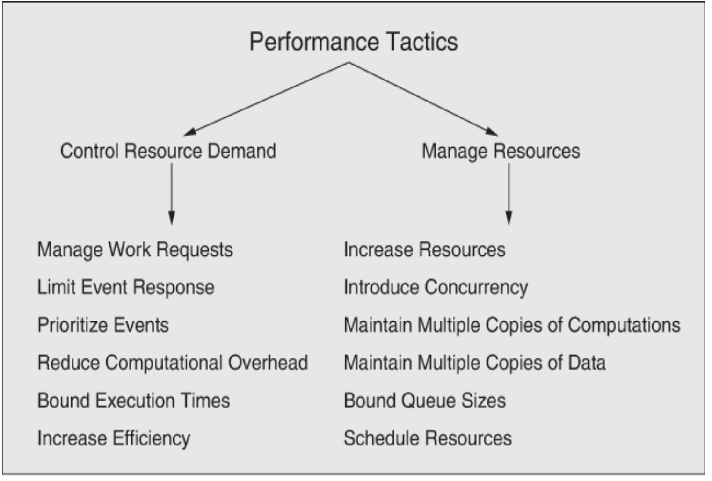
How is it related to this course?
Apache Kafka implements a series of tactics to accommodate Quality Attributes
Introduce concurrency
The ability to use consumer groups enables concurrent data analysis

Slide 13
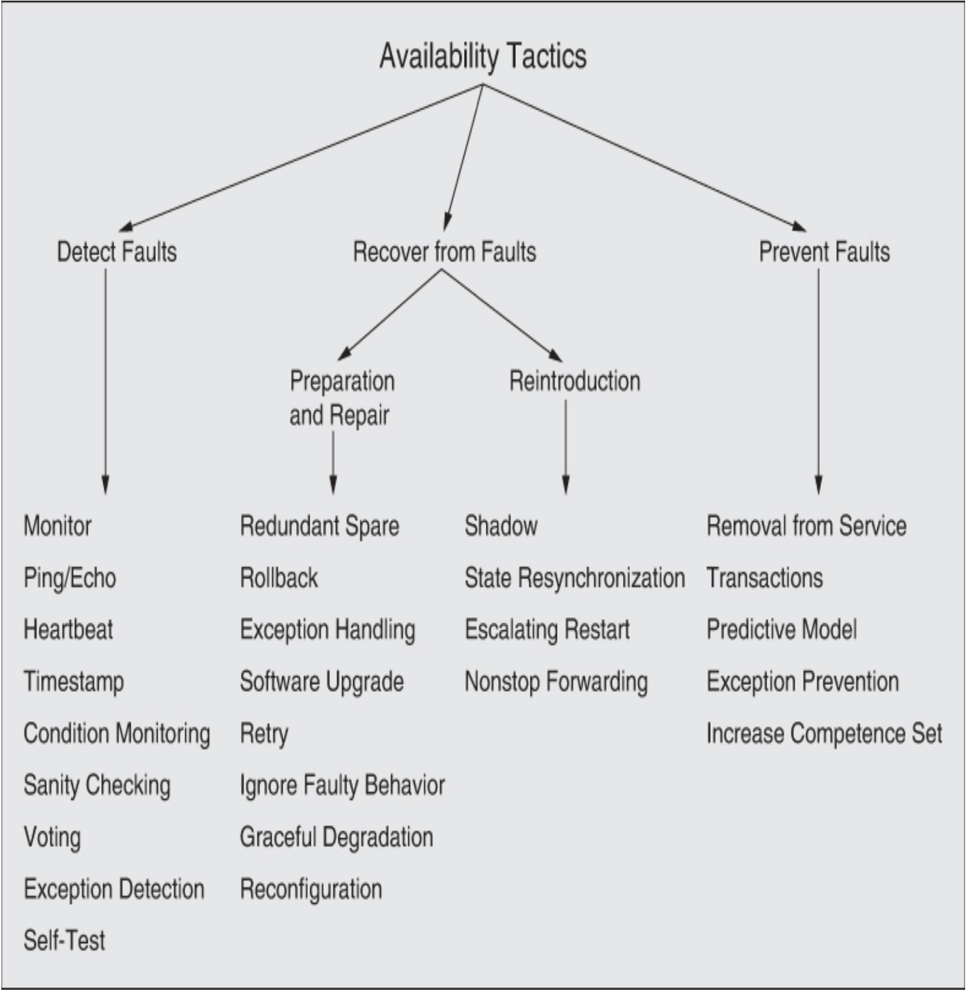
How is it related to this course?
Apache Kafka implements a series of tactics to accommodate Quality Attributes
Redundant spare
With a Cluster of three or more brokers, the failure of one broker does not necessarily introduce a problem
This assumes that topics are replicated across the brokers

Slide 14

Any Questions?
Optional: For a more detailed introduction, a Kafka 101 course by Confluent: https://www.youtube.com/playlist?list=PLa7VYi0yPIH0KbnJQcMv5N9iW8HkZHztH

Slide 15
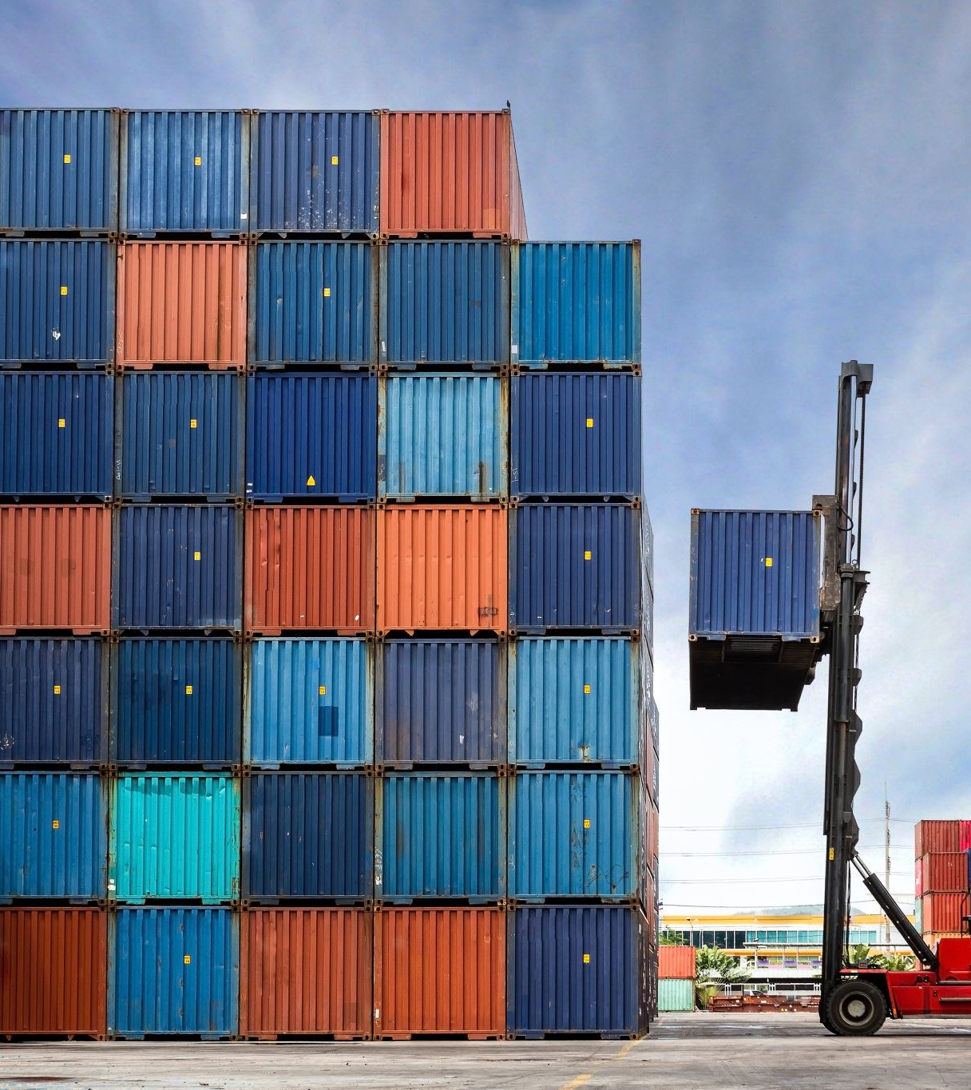
Docker Compose
Docker Compose is a tool for defining and running multi-container Docker applications.
Allows developers to define the services, networks, and volumes needed for an application in a single YAML file
Start, stop, and manage all the services with a single command.
Start
docker compose up
Stop
docker compose down

Slide 16
Kafka Exercise #1 – Whats going on?
Download the zip folder provided on ItsLearning
Examine the contents! It contains:
A readme.md file, shortly describing the exercises and relevant commands
A docker-compose.yml file which will start three Kafka brokers and a kafka ui tool (Kowl)
A .env file, where you can insert your ip address (only required if you want to use an external kafka client - not used in this exercise, but if you need it in future tasks)
Four folders, each containing the relevant code to interact with the kafka brokers.
Two folders are for dotnet, each either a consumer or a producer, including dockerfiles to dockerize the client
Two folders are for python, each either a consumer or a producer, including dockerfiles to dockerize the client

Slide 17
Kafka Exercise #2 – The Foundation
To start the Kafka cluster, open the folder “exercises_lecture02” in a terminal of your choice
Use the 'docker-compose up' command to start the Kafka cluster and the Kafka UI
This should start all kafka nodes and your cluster should be up and running, way to go!
Try to visit 'localhost:8088' to view a Kafka UI
Try to create a topic
Try to send a message to the topic
Notes:
Demo

Slide 18
Kafka Exercise #3 - The First Message!
Do you choose .Net or Python?
Publish one message per second, containing "{'test_key':'test_value'}"
Use the template for the producer to send your input to a kafka topic
Start the producer with the following commands: (assuming your terminal is located inside the producer directory)
Build the docker image
docker build . -t producer-client:latest
run the docker image
docker run --rm -it --network shared_network --name producer producer-client

Slide 19
Kafka Exercise #4 - The First Message, Received!
Subscribe to the topic you are publishing messages to!
Modify the subscriber template to subscribe to the topic where your producer publishes the messages
Start the consumer with the following commands (assuming your terminal is located inside the consumer directory)
Build the docker image
docker build . -t consumer-client:latest
run the docker image
docker run --rm -it --network shared_network --name consumer consumer-client
Notes:
Exercise with consumer groups

Slide 20
Kafka Exercise #5 (Optional) - The First Book!
Change the producer to read from a file and publish one line per second
Modify the producer template to read from alice-in-wonderland.txt file and publish the content one line at a time to a kafka topic.
modify it to publish 1 line per second.

Slide 21
Kafka Exercise #6 (Optional) - The First Book, Received!
Write the received data to a file.
Modify the subscriber template to write the received data into a file called 'the-rabbit-hole.txt'

Slide 22
Kafka Exercise #7 – Oh no, too many messages! We need help!
Go into the Kafka UI (localhost:8088) and if it exists, delete the topic foobar
Then create a new topic called foobar, but this time, set “partitions” to 3
Why do we have to do that?
Create two consumers, that are in the same consumer group
You can do this by starting two consumer docker containers of the consumer you just created
Start consumer #1 with the following commands (assuming your terminal is located inside the consumer directory)
Build the docker image
docker build . -t consumer-client:latest
run the docker image
docker run --rm -it --network shared_network --name consumer consumer-client
Start consumer #2 with the following commands (assuming your terminal is located inside the consumer directory)
run the docker image
docker run --rm -it --network shared_network --name consumer2 consumer-client
Manipulate the producer to send a continuous stream of data, e.g. numbers, to the foobar topic
Look at the output of the consumers, what happens?
Why is this important/relevant?

Slide 23
Kafka Exercise #6 – Oh no, a broker died! What happens now?
This scenario will primarily use the UI tool to visualize the effect.
Start by deleting the foobar topic created earlier
Now create the foobar topic again, but with 3 partitions and 3 replicas.
Now the topic is replicated across all brokers
Can you have more replicas? Why? Why not? Try it out!
Now look at the topic and specifically the partitions (in the partitions tab)
Who are the leading brokers for each partition?
Try to create some messages
Now kill a broker!
Open your favorite command line tool
Insert:
Docker stop kafka3
Now one of the three kafka instances will die
Are your messages still available?

Slide 24
Architecture Exercise #1
Select a system as a foundation for architecture practicing.
It can be a system from earlier projects that you want to develop further, or a system you want to develop.
The main point is to have a basis for working with the architectural concepts in future exercises not develop a fully functional system.
Shortly describe the mission of the system in a couple of sentences.
Made up example: “Our mission is to revolutionize the way people track satellites. With our software system, anyone with a smartphone can effortlessly point their camera to the sky and receive real-time information about the satellites in their view. We aim to make space exploration accessible and fascinating for all.”

Slide 25
Architecture Exercise #2
Give your understanding of documenting the software architecture of the chosen system.
The documentation should at least contain:
A module view
A component and connector view,
An allocation view
Other notations are also allowed.
To each view, provide a short description of the design rationale.
Remember to keep the architectural documentation at a sufficient abstraction level such that details that don’t impact the essential design decisions are omitted.

Slide 26
Architecture Exercise #3
Document main outcome from task #1 and task #2 in a PowerPoint
01
i.e. A short description of your system, your mission statement and a selection of views including the design rationale
Upload the PowerPoint to ItsLearning
Deadline: Sunday the 12.02.2023 at 23:59
02
Give feedback to another group using the feedback criteria on ItsLearning.
03
(To give feedback, open the PowerPoint of the other group, create a new slide, and insert your feedback)
Deadline: Tuesday the 14.02.2023
at 12:00

Slide 27
End of Presentation

