Slide 1

Mapping and Exploring Airbnb Listings in New York City (2019) Victor Matthew
DATA ANALYTICS | IRONHACK December, 2020

Slide 2
48884 Airbnb Listings
Research questions:
Does Manhattan have the highest traffic?
Who are the busiest hosts?
What insights can we get from the room prices, room availability, reviews.

Slide 3
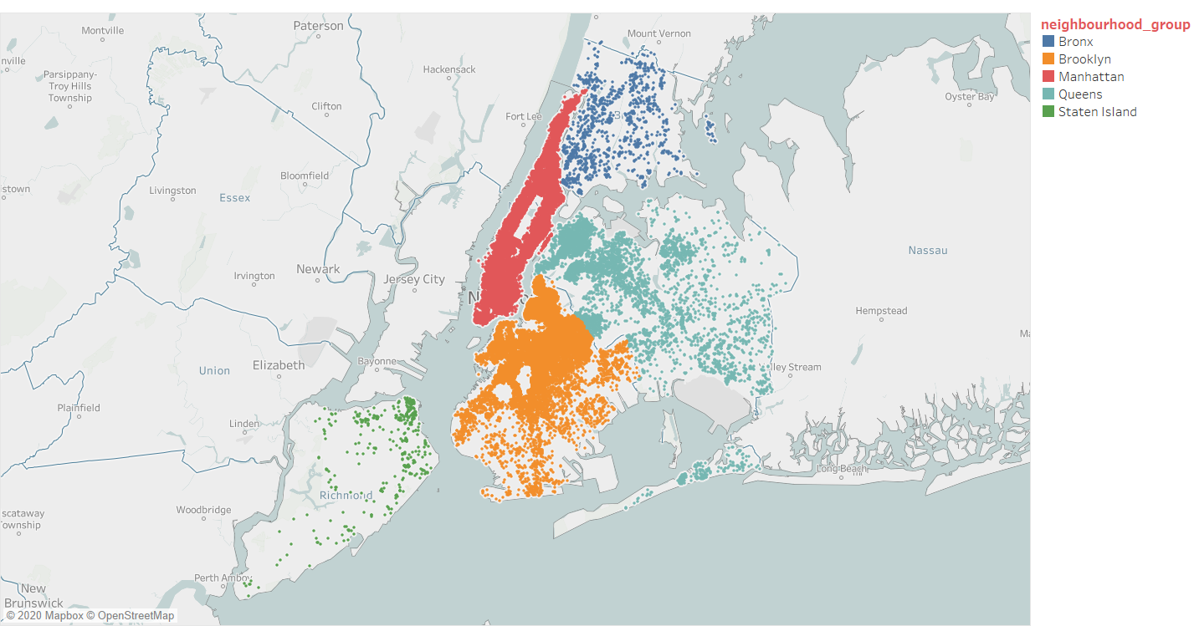
Distribution of Listings in 5 Neighbourhood groups

Slide 4
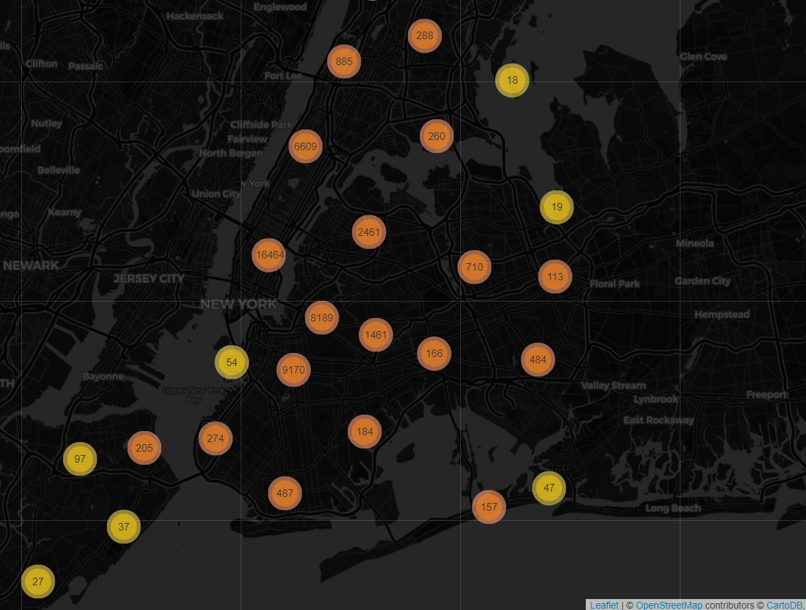

Slide 5
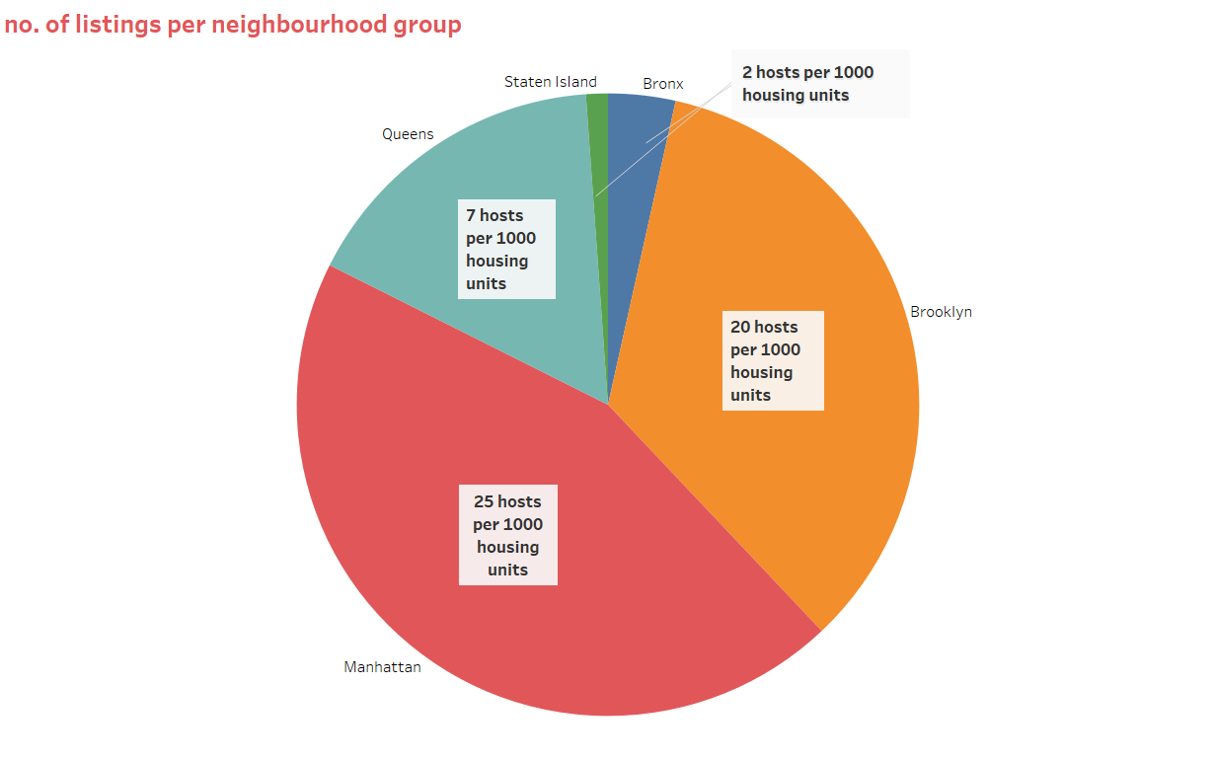

Slide 6
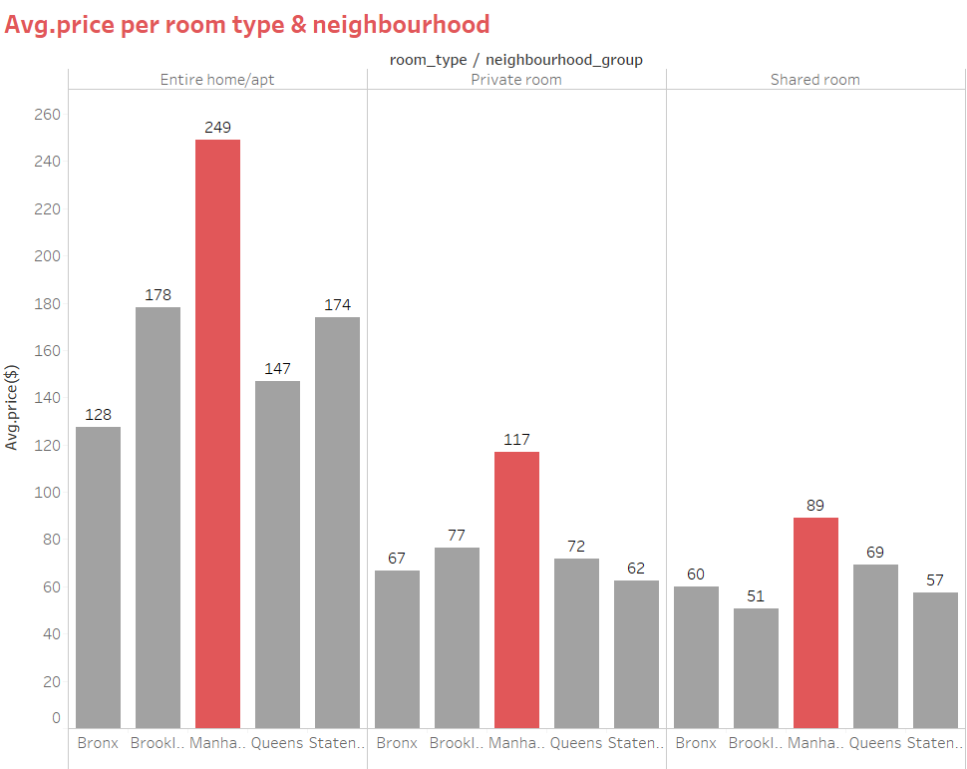
Room prices are higher in Manhattan

Slide 7
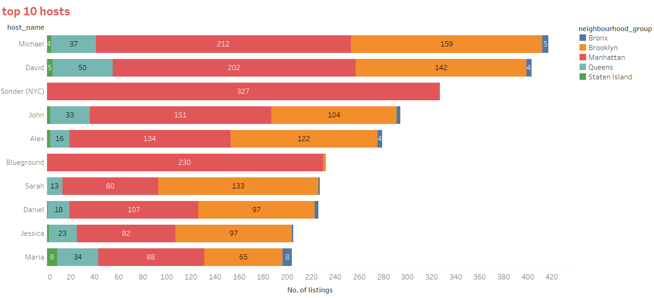
Top 10 hosts mostly have properties in all locations

Slide 8
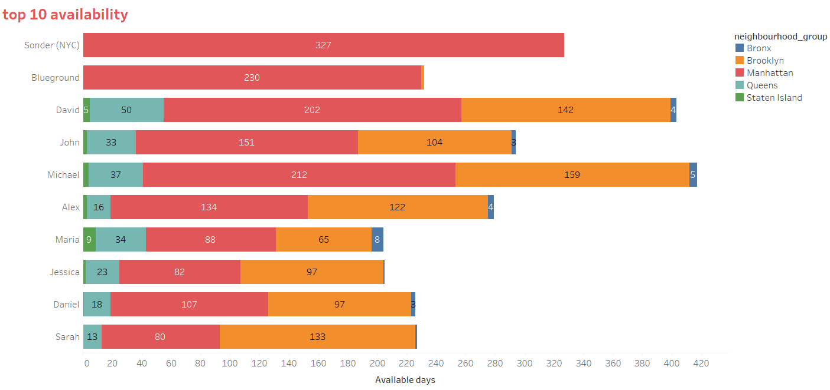
Higher availability reduces the chances of getting a place by residents

Slide 9
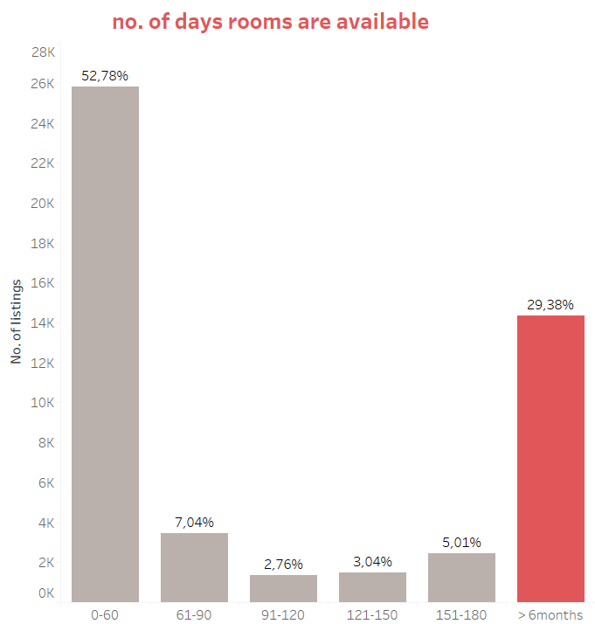

Slide 10
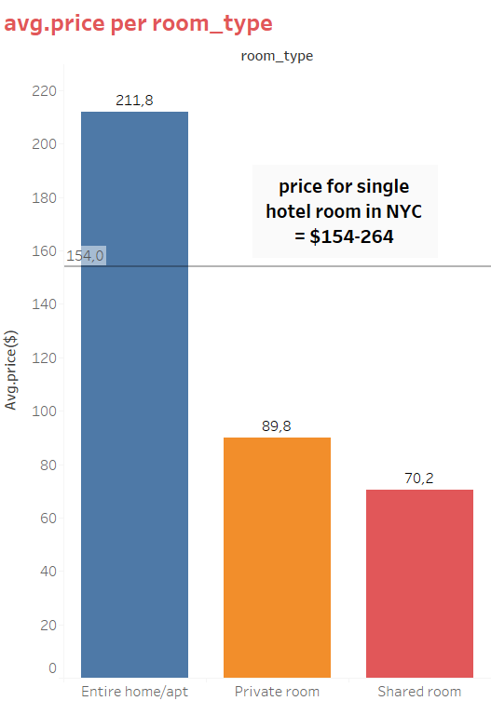

Slide 11
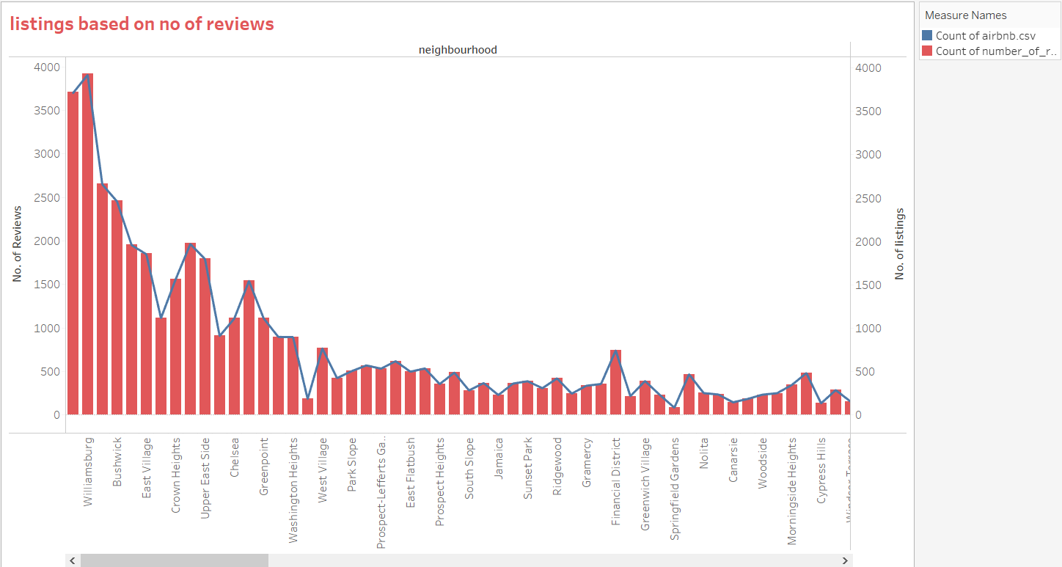

Slide 12
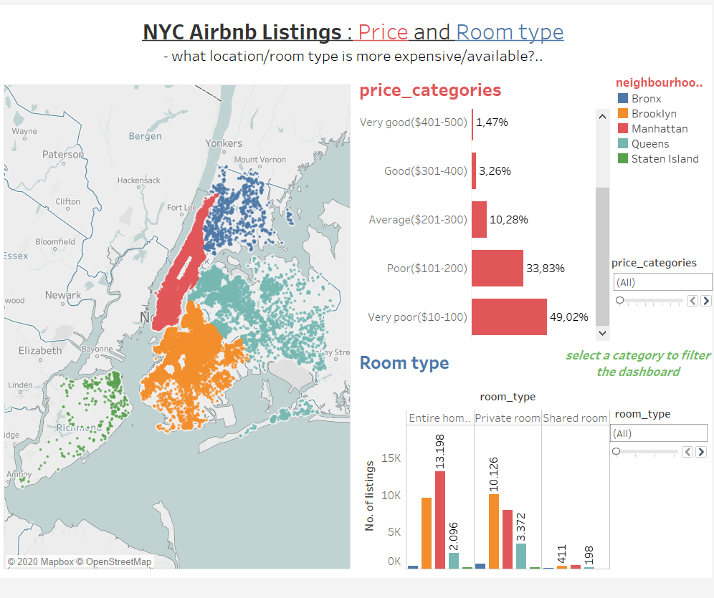

Slide 13
Conclysions
Manhattan has the most expensive listing
The busiest hosts have properties across the 5 neighbourhood groups
The readily available hosts are most likely operating a business.
Scope for future improvements
Include coordinates for the neighbourhoods
Use NLP to highlight the most used words for advertisement
Data source: https://www.kaggle.com/dgomonov/new-york-city-airbnb-open-data

Slide 14


