Slide 1

Mapping and Exploring Airbnb Listings in New York City (2019) Victor Matthew
DATA ANALYTICS | IRONHACK December, 2020

Slide 2
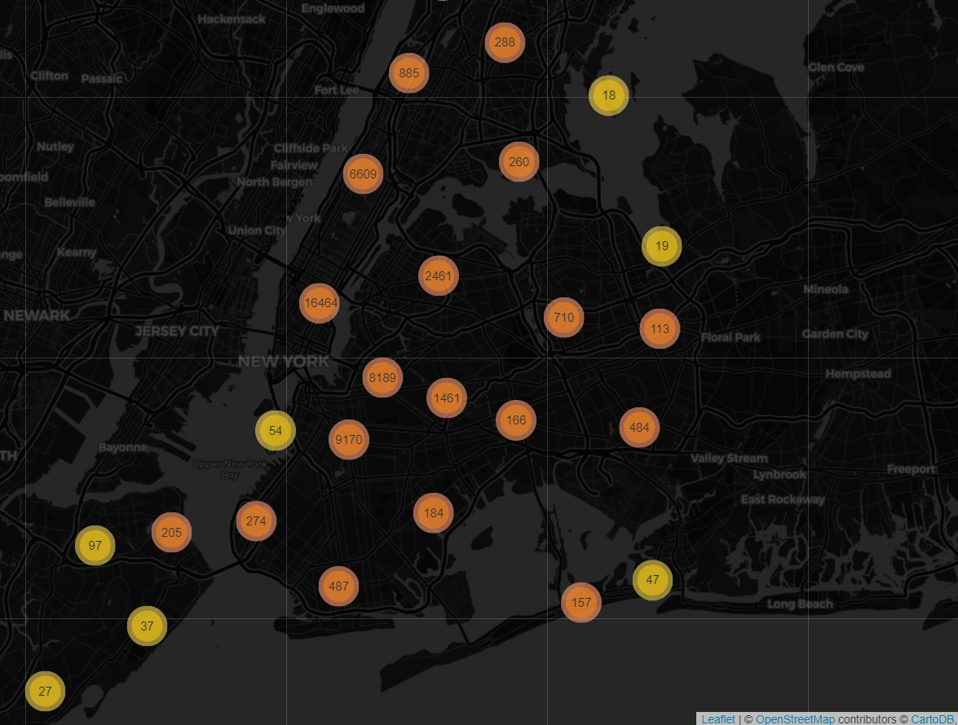

Slide 3
48884 Airbnb Listings
Does Manhattan have the highest traffic?
Who are the busiest hosts?
What insights can we get from the room prices, room availability, reviews.

Slide 4
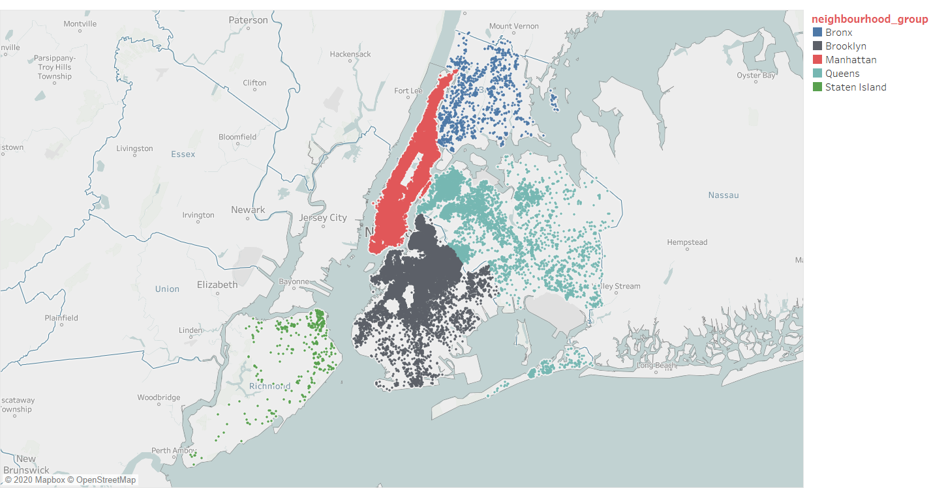
Distribution of Listings in 5 Neighbourhood groups

Slide 5
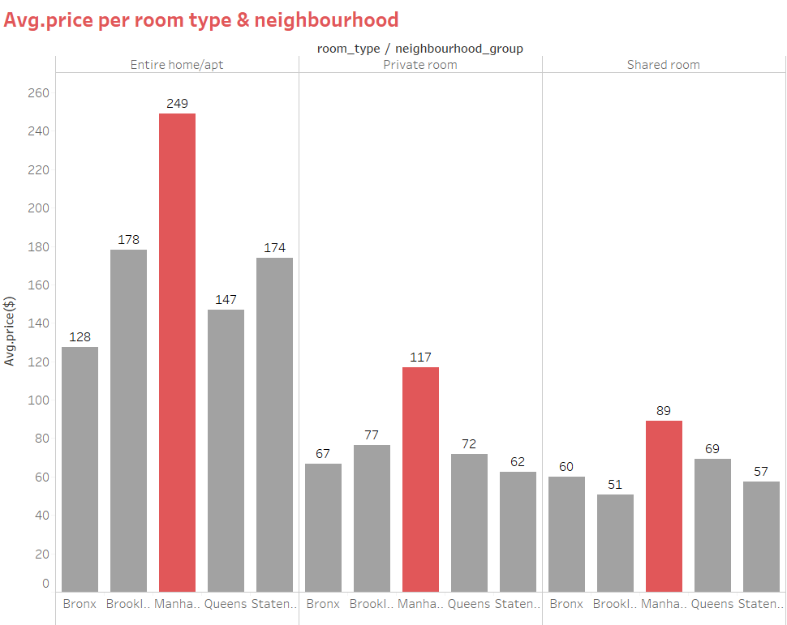
Room prices are higher in Manhattan

Slide 6
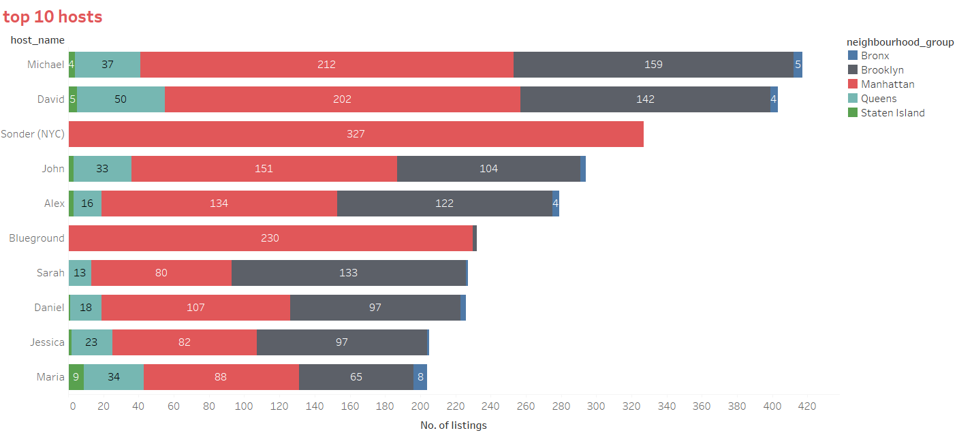
Top 10 hosts mostly have properties in all locations

Slide 7
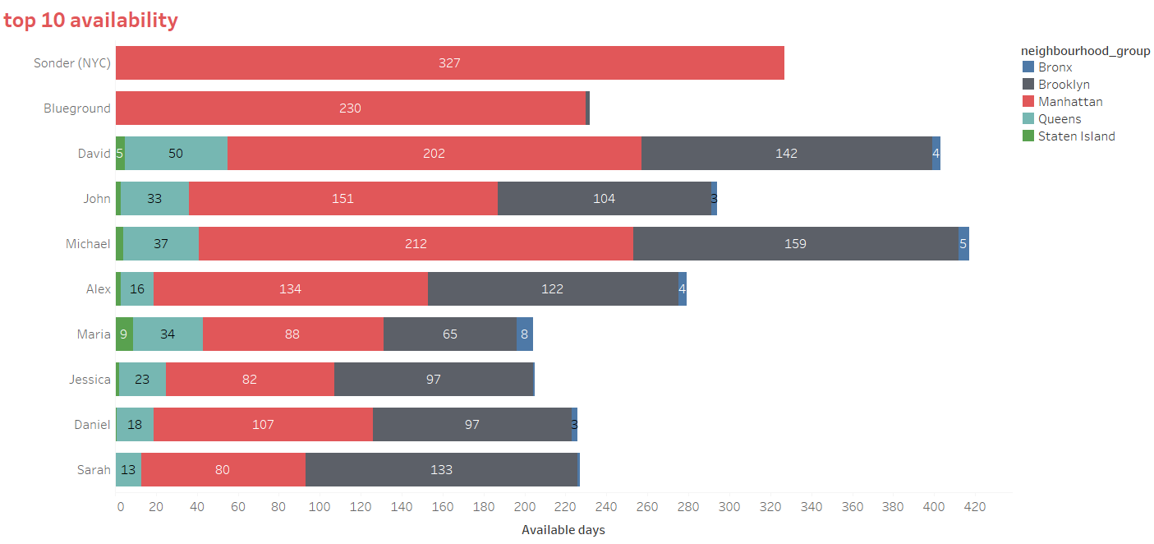
Higher availability reduces the chances of getting a place by residents

Slide 8
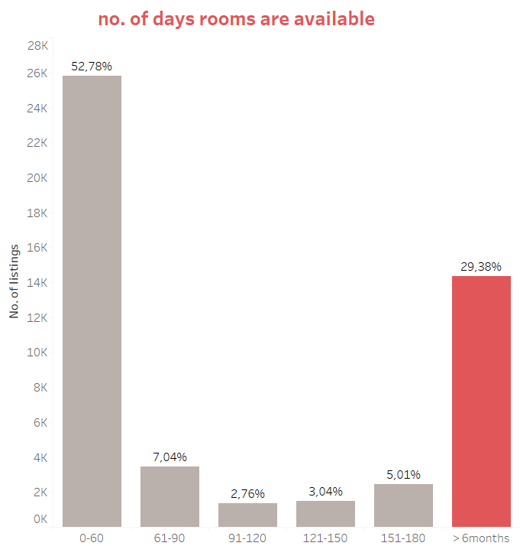

Slide 9
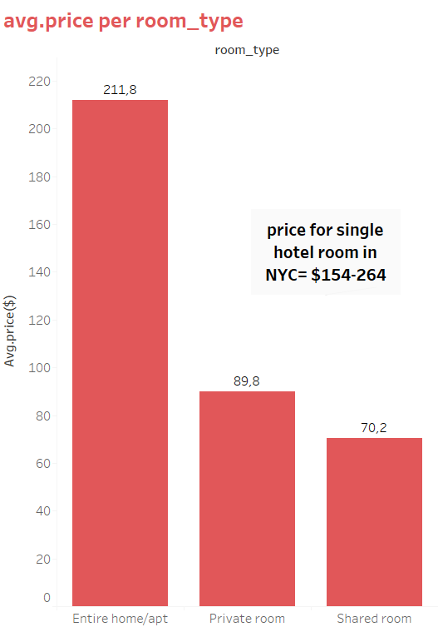

Slide 10
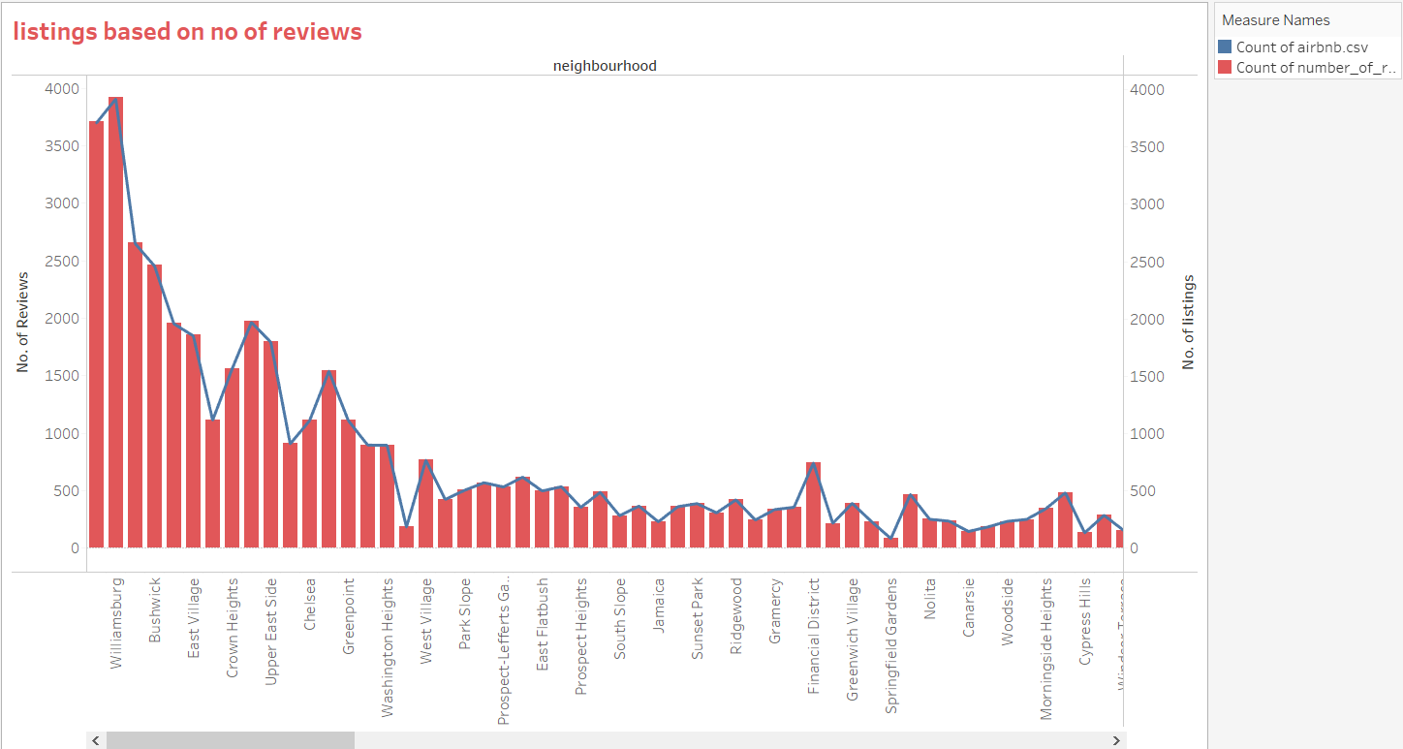

Slide 11
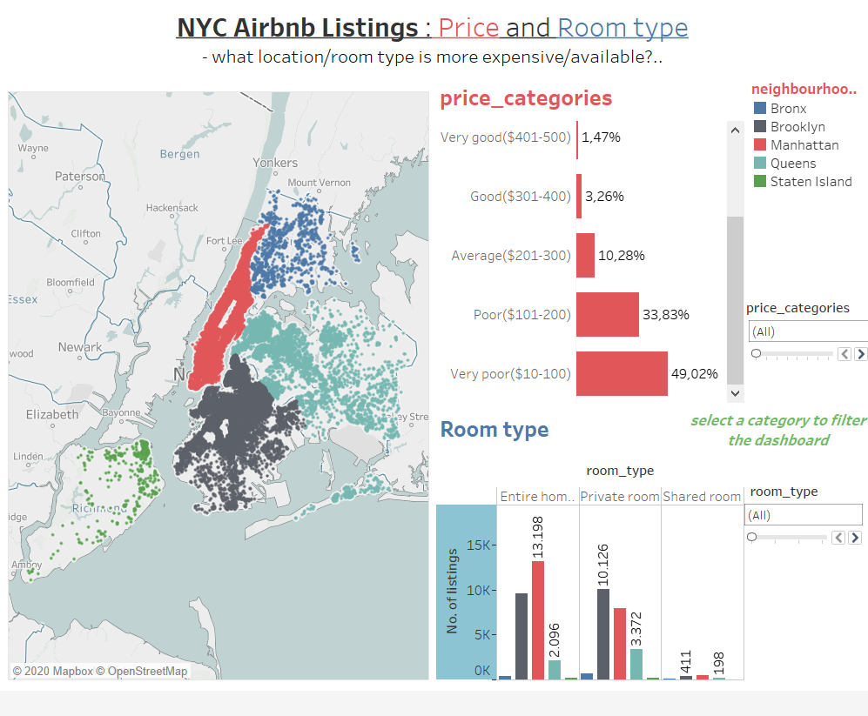

Slide 12
Findings and recommendations
Manhattan has the most expensive listings.
It’s most likely a more interesting location for tourists
The busiest hosts have properties across the 5 neighbourhood groups
There should be checks for possible cases of platform abuse
The readily available hosts are most likely operating a business.
limits could be placed on maximum availabilty days per year.
There should be strict control of permits/licences

Slide 13


