Slide 1
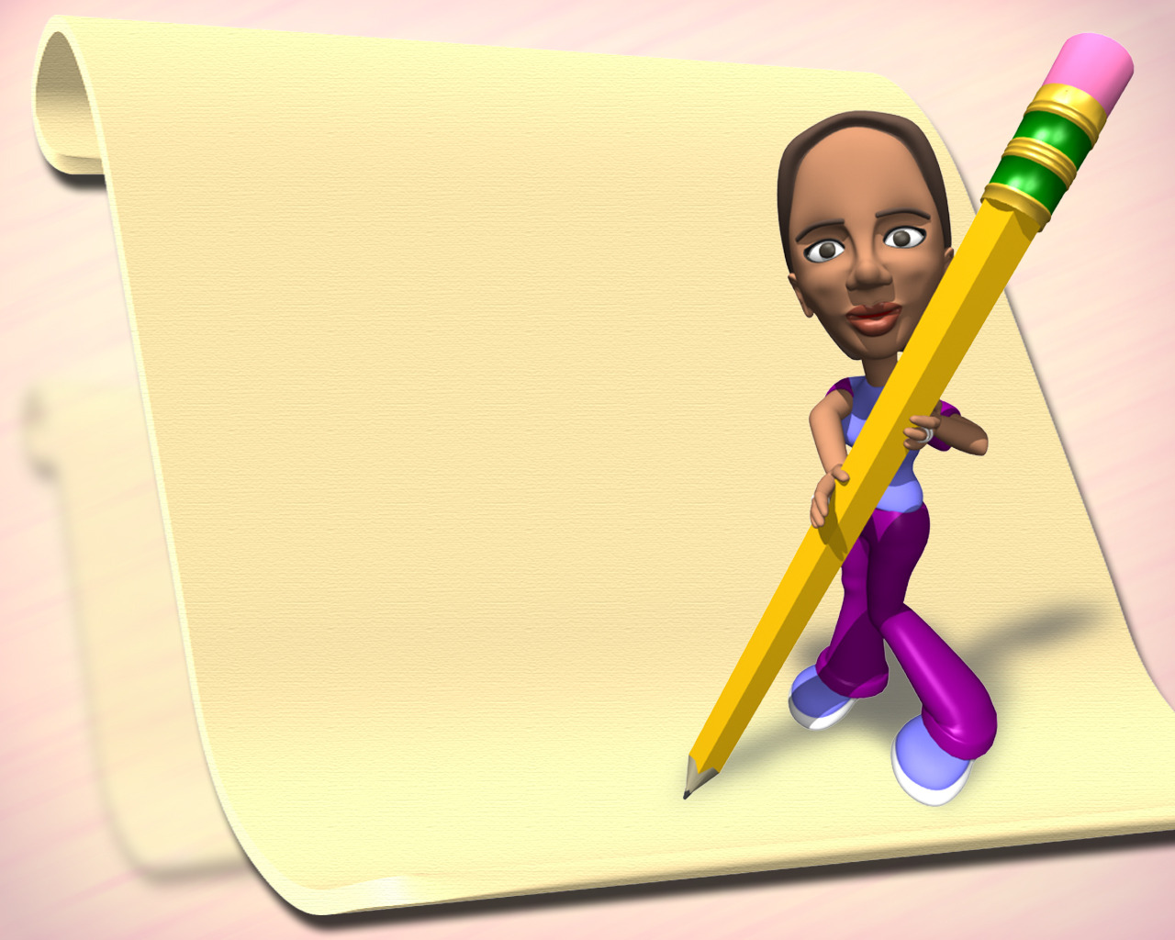

四级

Slide 2

一、对立观点型
1、作文套路
____ has become a hot topic among people recently. Opinions vary from person to person. Some people like to______________. For one thing,______________. For an¬other, ______________.
However, those people who ______________ argue that ______________. Furthermore, __________. Thus, _____________.
As far as I'm concerned, I am really in favor of _____________, because __________. Therefore,_____________.

Slide 3

2、练习与举例
My View on Job-hopping跳槽
（1） 有些人喜欢始终从事一种工作是因为……..
（2） 有些人喜欢经常更换工作是因为……..
（3） 我的看法。

Slide 4

一、对立观点型
Job-hopping has become a hot topic among people recently. Opinions vary from person to person. Some people like to do one particular job permanently. For one thing, they think the longer one works in a particular field, the more skillful one will be at it. For another, in their opin­ions, those who devote their lives to certain specific fields are the promising persons with great achievements.

Slide 5
一、对立观点型
However, those people who are in the habit of job-hopping argue that if one finds a more challenging position than the present job he has held and if the new job can demonstrate his talent, why not pursue it? Furthermore, some people like to meet more people, make more money and new acquaintances. Thus, they hop from job to job.

Slide 6
一、对立观点型
As far as I am concerned, I am not in favor of constant job-hopping, because my philosophy is once you choose a career, you should stick to it and do it well.

Slide 7
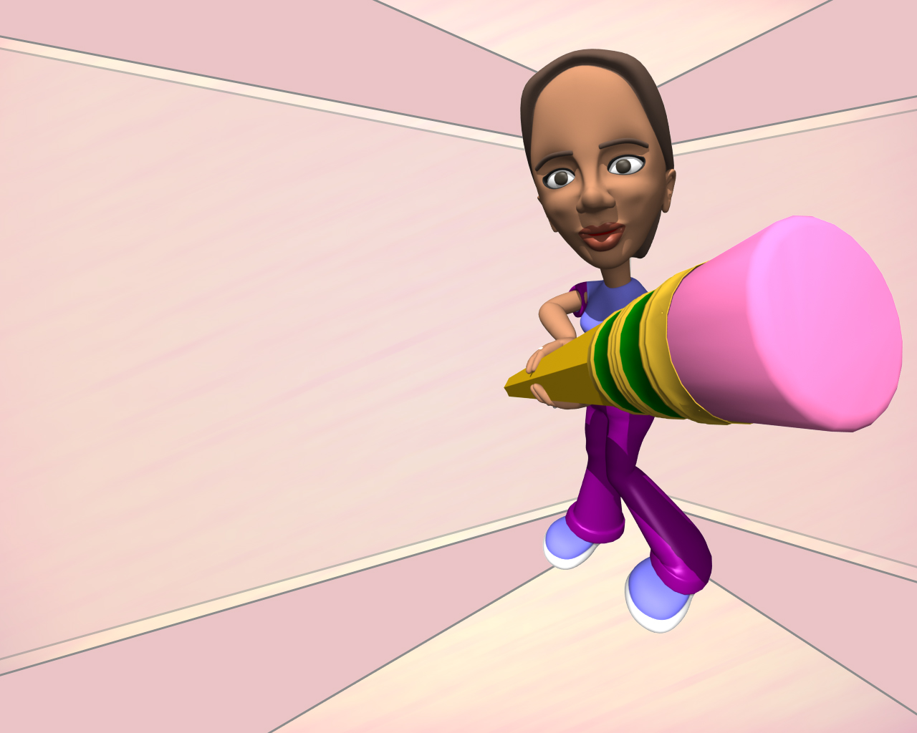


Slide 8
二、说明利弊型
1．作文套路
Recently,____ has been brought to the public attention. Like everything else,____ has both favorable and unfavorable aspects. Generally, the advantages can be listed as follows. First, Besides, ___________. Most important of all,.
But every coin has two sides, there are also some disadvantages in ____. To begin with, ___________. To make matter worse, ________. Worst of all, ________.
Now the conclusion is self-evident. Along with its benefits,___________ has also some problems. Therefore,___________________.

Slide 9

2.练习与举例
Studying Abroad
（1）留学海外有很多好处。
（2）留学海外也遇到一些问题。
（3）我的态度。

Slide 10

二、说明利弊型 Studying Abroad
Recently, studying abroad has been brought to the pubic attention. Like everything else. studying abroad has both favorable and unfavorable aspects. Generally, the advantages can be list¬ed as follows. First, by looking at our country from outside, we can best see the strong points and weak points of our nation and therefore widen our vision and broaden our minds. Besides, while studying in a foreign country, we can travel widely, visit famous scenic sports and make friends with the local people. Most important of all, we can use the foreign language in our daily life so that our ability in the second language may be improved quickly.

Slide 11
二、说明利弊型 Studying Abroad
But every coin has two sides. There are also some disadvantages in attending a foreign univer¬sity. To begin with, the tuition and the cost of living is much higher than in our country, which may add more burden to our family finance. To make matter worse, for lack of knowledge of the customs and way of life of the local people, we may run into trouble in dealing with various situa¬tions. Therefore, misunderstandings often arise. Worst of all, most of the students who are ready to go abroad do not have adequate knowledge of the language spoken there. As a result, on arriv¬ing there, they will find it difficult to understand what the instructors are saying.

Slide 12
二、说明利弊型 Studying Abroad
Now the conclusion is self-evident. Along with its benefits, studying abroad has also some problems. Therefore, given an opportunity to attend a university abroad, one must consider both sides of the factors carefully before making up his mind.

Slide 13
三、问题解决型
1、作文套路
In recent years, We have to face a problem of ____»which is becoming more and more seri¬ous. With the development of________ has become a critical problem in China. So it is of great importance for us to ____.
However, people have figured out many ways to solve this problem. Firstly,____. Sec¬ondly ____. Thirdly, what is the most important is that ____.
Personally, I believe that ____. All in all, the solutions may not bring the perfect result, but as long as we do it with our brains and hands, we will one day resolve the problem.

Slide 14
三、练习与举例
How to Solve The Problem of Air Pollution
（1）大气污染严重，人类生存的环境日益恶化。
（2）如何才能减轻大气污染。
（3）我的看法。

Slide 15

问题解决型
How to Solve The Problem of Air Pollution
In recent years, we have to face a problem of air pollution, which is becoming more and more serious. With the development of modern industries, air pollution has become a critical problem in China. Air in large dues is no longer as fresh as before. So it is of great importance for us to pay more attention to improving the air pollution.
However, people have figured out many ways to solve this problem. Firstly, people ought to be educated to realize the significance of and-air pollution. Secondly, if possible factories should be moved out of cities to reduce the severity of air pollution. Thirdly, what is the most important is chat the government should take strict measures to control it and finally scientists are expected to find new ways to purify- the air.
Personally, I believe that with common efforts of the society, the day will come when people can breathe dean air in large dues. All in all, the solutions may not bring the perfect result, but as long as we do it with our brains and hands, we will one day resolve the problem.

Slide 16
四、现象解释型
1、作文套路
Nowadays,____. There are many reasons for this phenomenon, but in general they come down to three major ones.
Why __ __? The primary reason, in my opinion, is __ __. Besides,__ __. Lastly,
As a matter of fact,__ __. On the one hand,__ __. On the other hand,__ __. There¬fore,__ __.

Slide 17
2.练习与举例
Why College Students Take a Part-time Job?
（1）近几年来越来越多的大学生利用业余时间打工。
（2）为什么大学生要打工
（3）结论

Slide 18

四、现象解释型 Why College Students Take a Part-time Job?
Nowadays, holding part-time jobs has become a growing tendency among college students. College students are seen waiting on tables, working in stores, advertising in street, teaching in families and doing whatever work they can find. There are many reasons for this phenomenon, but in general they come down to three major ones.

Slide 19
四、现象解释型 Why College Students Take a Part-time Job?
Why are more and more college students taking part-rime jobs? The primary reason, in my opinion, is money. According to the newly-adopted tuition policy in China, college students are supposed to pay an average sum of 4, 000 Yuan each year as tuition. In order to relieve the eco­nomic burdens of their parents, more and more students are doing part-time jobs. Besides, part-time jobs can provide them with a rare opportunity to know the outside world and prepare them for a favorite career. Lastly, part-time jobs not only enable them to cultivate their abilities but also help them apply their knowledge to practice.

Slide 21
四、现象解释型 Why College Students Take a Part-time Job?
As a matter of fact, the significance for college students of doing a part-time job means more than money and experience. On the one hand, it can broaden their outlook. On the other hand. it can exert a profound influence on their personality and life. Therefore, being a student, he should learn to balance his study and part-time job. I believe if he spends his time wisely, he •will do well in both study and part-time jobs.

Slide 22
五、观点论证型
1.作文套路
It is well known that .The truth of it is self-evident. No one can deny ____. Therefore, _ .
Many examples can be found to prove . Take ____ as a typical example. People ____. Furthermore____.
It goes without saying that____. Then,____. There is no doubt that____. In con¬clusion,____.

Slide 23
2. 练习与举例
Competition and Cooperation
（1）当今社会处处存在竞争
（2）竞争离不开合作，例如……
（3）我的看法

Slide 24
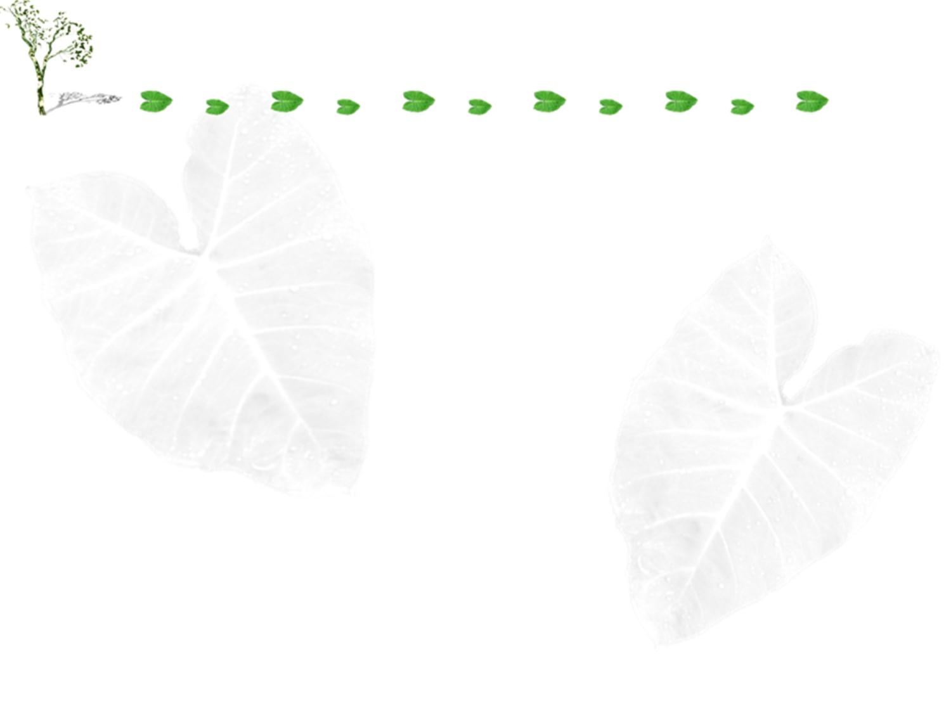
五、观点论证型Competition and Cooperation
It is well known that competition exists in every comer of the society. The truth of it is self-evident. No one can deny that the more developed the society is, the more fierce competition is. Therefore, competition will play an important role in future society.

Slide 25
五、观点论证型Competition and Cooperation
Many examples can be found to prove that competition is not always contrary⁷ to cooperation. Take football game as a typical example. People have to admit that each member of the team must cooperate with his teammates. Furthermore, the reluctance to cooperate with each other will defi­nitely cause a failure in a match.

Slide 26
五、观点论证型Competition and Cooperation
It goes without saying that competition has much to do with cooperation. Then, we should strengthen cooperation in a team work. There is no doubt that most tasks are accomplished by a cooperative team. In conclusion, competition often goes hand in hand with cooperation.

Slide 27
六、阐述主题型
1、作文套路
A famous old saying goes that"____". It means that ____. It' s the experience of our forefathers. However, it is correct in many cases even today.
A case in point is _________________. Another good example in point is ________. ___________. My experience proves the old saying; ________. Therefore, as college students, we should________.

Slide 28
2、练习与举例
No Pains, No Gains
（1）怎样理解“不劳无获”这一格言。
（2）例如：奥林匹克运动员需要刻苦训练才能……
（3）又如：在英语学习中……

Slide 29

六、阐述主题型 No Pains, No Gains
A famous old saying goes that “No pains, no gains”. It means that if one wants to fulfill a task, he must put in time and energy. In other words, nothing can be gained without painstaking（辛苦的） efforts. It's the experience of our forefathers. However, it is correct in many cases even today.

Slide 30
六、阐述主题型 No Pains, No Gains
A case in point is the Olympic athletes have to train for months or years before they can com­pete with others. Without praising, the athletes, even those with the best talents in sports, can‘t win the championship. Veteral（有经验的） athletes understand the old saying.

Slide 31
六、阐述主题型 No Pains, No Gains
Another good example in point is my English study. At first my English was not good. I was so dismayed沮丧 that I almost gave it up. It was the ancient saying that brought me back. It gave me full confidence to leam the language well. Since then, I have spent much time on it and made great progress. My experience proves the old saying: No pains, no gains. Therefore, as college students, we should work as hard as we can to accomplish our learning tasks. Those who trust to chance and windfalls will amount to nothing.

Slide 32
写作-题目
Prejudice

