Slide 1
Best Places in New York to setup Chinese Restaurants

Slide 2
Background
Significance of Project
Chinese immigrants in United States estimate to 2.5 million in 2018
5.5% of Overall Foreign-Born population in the US
China is the world’s largest economy
Having an attractive and culturally endearing place for the Chinese would attract more business influx from China
Boost economic growth in US
Why New York?
The epicenter of the finance industry
High startup cost
Important to select the write location from the get-go

Slide 3
Stakeholders
Business Chain owners interested in setting up Chinese restaurant chains
Raises their chances of success
Increases Profitability
Individuals looking to make a living
Helps them identify possible locations without consuming the resources they don’t have (for eg. Doing research on each venue in New York)

Slide 4
Data Acquisition and Cleaning
Coordinates of Neighborhoods and Boroughs in New York were taken from https://ibm.box.com/shared/static/fbpwbovar7lf8p5sgddm06cgipa2rxpe.json
Venues, details of each venue, and Chinese restaurants located in New York were taken from https://develop.foursquare.com
For Chinese restaurant, a Popularity label was given.
There are 3 popularity types: Popular, Average, Unpopular

Slide 5
Classification Models used to predict
K Nearest Neighbors
Decision Tree
Support Vector Machine
Logistic Regression

Slide 6
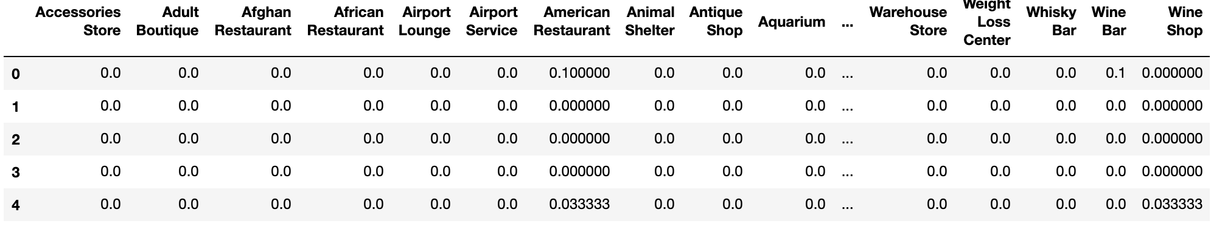
Feature Set
For each Chinese Restaurant, using the Foursquare API, I one-hot encoded each of the venues surrounding the restaurant.

Slide 7
Model Evaluation
Metrics:
Jaccard Similarity Score
F1-Score
Log Loss

Slide 8
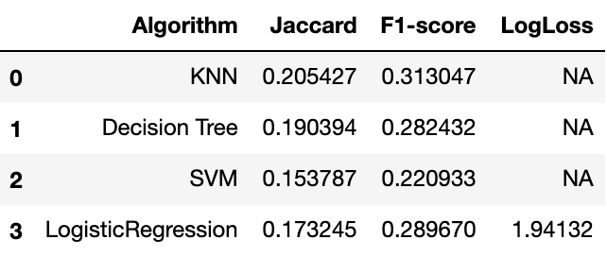
Model Evaluation
Scores calculated:
K Nearest Neighbors yielded the best scores amongst the other models

Slide 9
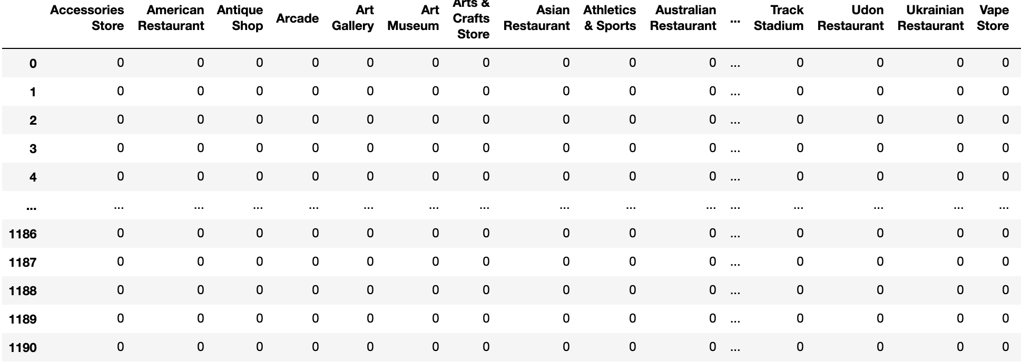
Model Application
Data Preparation
All venues in New York were scraped using Foursquare API
For each venue, nearby venues were one-hot encoded

Slide 10
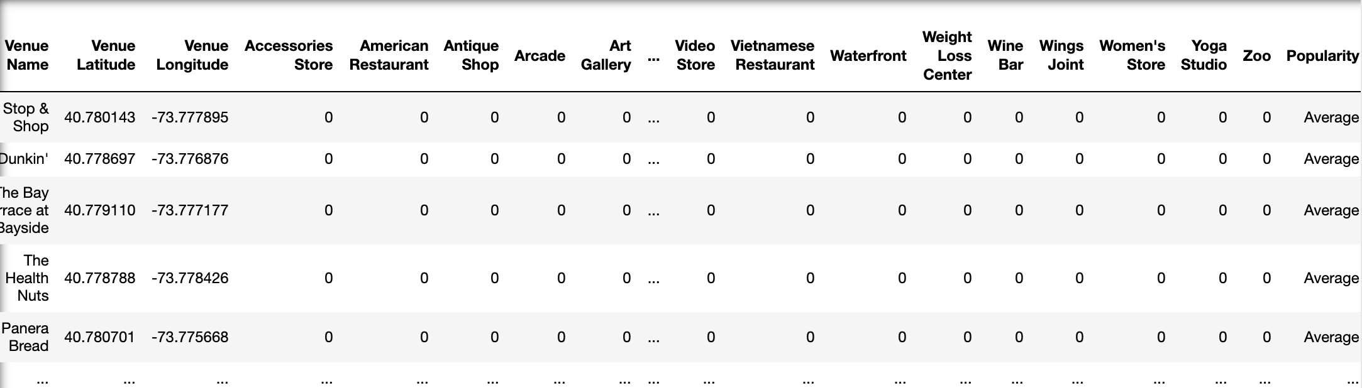
Model Results
After feeding the data into the KNN model, the resulting dataframe is as follows:
Each restaurant was given a predicted Popularity

Slide 11
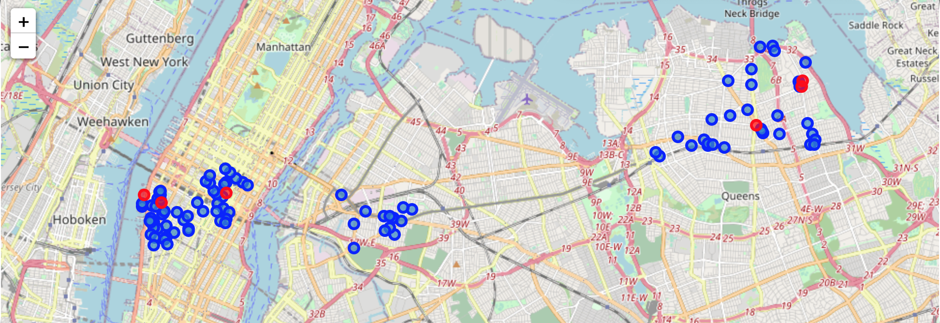
Visualizing Results
Blue markers are venues predicted to be ‘Popular’
Red markers are venues predicted to be ‘Unpopular’

Slide 12
Conclusion
Poor Accuracy
Overfitted due to lack of dataset
Unable to further scrape more data due to limitations of Foursquare API
Using percentile of ‘Likes’ as metric for Popularity
Restaurants that started earlier would likely have more likes
Popularity in this case wouldn’t have been due to Location – the entire point of project
Restaurants would’ve different levels of aggressiveness in encouraging consumers to ‘Like’ their restaurant
Does not indicate they are more often frequented

Slide 13
Future Work
Select only restaurants that have recently been created
Focuses value of Likes only based on location rather than other factors like ’Taste of Food’
Select only restaurants for predictions rather than all kinds of venues
Lowers the cost for businesses needed
Equipment for restaurants
Renovation

