Slide 1
WEEK 5 ASSIGNMENT PRESENTATION
Scrum
Deep Dive
Roles • Ceremonies • Definition of Done • Velocity • Burndown
X3 Lab • IT Student Internship • 2026

Slide 2
What We'll Cover Today
01
02
03
What Is Scrum?
The 5 Scrum Roles
The 4 Ceremonies
Framework, not a methodology
Who does what and why
Planning, Standup, Review, Retro
04
05
06
Definition of Done
Velocity & Burndown
Live Deliverables
What 'complete' actually means
Measuring and predicting progress
Sprint board, burndown, blockers

Slide 3
What Is Scrum?
A framework that breaks work into short cycles called Sprints. At the end of every sprint, you have something working that can be reviewed and adjusted. You never go more than 2 weeks without feedback.
WATERFALL
SCRUM
— Plan everything upfront before building anything
✓ Plan one sprint at a time — 1 to 4 weeks
— Build for months or years in one long phase
✓ Build, review, and adjust continuously
— Deliver at the end — by then the world has changed
✓ Working product at end of every sprint
— Changes are expensive and disruptive
✓ Changes are welcomed between sprints
— Like building a full house before showing the buyer
✓ Like building one room at a time with feedback after each

Slide 4
The 5 Scrum Roles
Product Owner
Voice of the customer. Owns the Product Backlog. Decides what gets built and in what order. Does NOT manage developers — manages the product.
Scrum Master
Protector of the process. Removes blockers. Facilitates all ceremonies. Not a project manager — serves the team, does not command it.
Dev Team
The builders — developers, designers, testers. Self-organising: they decide HOW to do the work. Ideal size 3–9 people. Cross-functional.
Stakeholders
Not inside the Scrum Team but attend Sprint Reviews to give feedback. In your project: the faculty HOD reviewing the voting system demo.
The Scrum Team
Product Owner + Scrum Master + Dev Team together. Accountable to each other and the sprint goal — not to a manager sitting outside the team.

Slide 5
Traditional Team vs Scrum Team
TRADITIONAL
SCRUM TEAM
Who assigns work
Manager tells you what to do
Team decides together every sprint
Skills
Designer only designs. Dev only codes.
Everyone helps where needed — cross-functional
Who you answer to
Your boss
Your teammates and the Product Owner
How long to ship
Months — everything planned upfront
Weeks — working product every sprint
SecureVote example:
Traditional: HOD assigns tasks, designer waits for approval before dev starts, no one knows what anyone else is doing, working product only at semester end. Scrum: team plans every Monday, 15-min check-in daily, designer stuck = developer helps, faculty sees a demo every 2 weeks.

Slide 6
The 4 Scrum Ceremonies
Sprint Planning
Daily Standup
When: Start of sprint • Time: 2–4 hrs
When: Every day • Time: 15 min
Who: Full team
Who: Dev team
Output: Sprint Goal + Sprint Backlog committed
Output: 3 Qs: Yesterday / Today / Blockers
Sprint Review
Sprint Retrospective
When: End of sprint • Time: 1–2 hrs
When: After review • Time: 45–90 min
Who: Team + Stakeholders
Who: Team only
Output: Demo of Done work + backlog update
Output: What went well / wrong / change next sprint

Slide 7
Definition of Done (DoD)
A shared, written agreement of exactly what 'complete' means for any task. If it does not meet the DoD, it is NOT done — even if the developer says it is.
Without a DoD
With a DoD
✕ Dev A: done = code written
✓ Code written and peer-reviewed
✕ Dev B: done = tested
✓ Unit tests written and passing
✕ Dev C: done = deployed
✓ Tested on mobile and desktop
✕ Nobody agrees — sprint review is a mess
✓ Deployed to staging + PO accepted
Healthcare.gov (USA) failed on launch day because 55 contractors each marked their components 'done' without a shared DoD. Nobody had defined done for the integrated system. $600M and it crashed on Day 1.
SecureVote DoD example:
Code reviewed • Tests passing • Works on target device • Encryption verified • No external network calls • PO signed off

Slide 8
Velocity & Burndown Logic
VELOCITY
BURNDOWN CHART
How much work a team completes per sprint, measured in Story Points.
Shows how much work remains in the sprint day by day. Goal: reach zero by last day.
Sprint 1: completed 22 pts
Sprint 2: completed 18 pts
Sprint 3: completed 25 pts
Average velocity:
(22+18+25) ÷ 3 = 21.7 pts/sprint
If 90 points remain:
90 ÷ 21.7 = ~4 sprints to finish
This replaces guessing with data.
Line ABOVE ideal:
Team is behind — not completing fast enough
Line BELOW ideal:
Team is ahead or tasks over-estimated
Line FLAT 3+ days:
Team is BLOCKED — Scrum Master must act
Line at zero:
Sprint complete — all work done
Story points MUST be set before sprint starts — not after.
This week's learning:
Story points were added after the sprint started — so Jira recorded the baseline as 0. In a real team, this is done during Sprint Planning before the sprint begins.

Slide 9
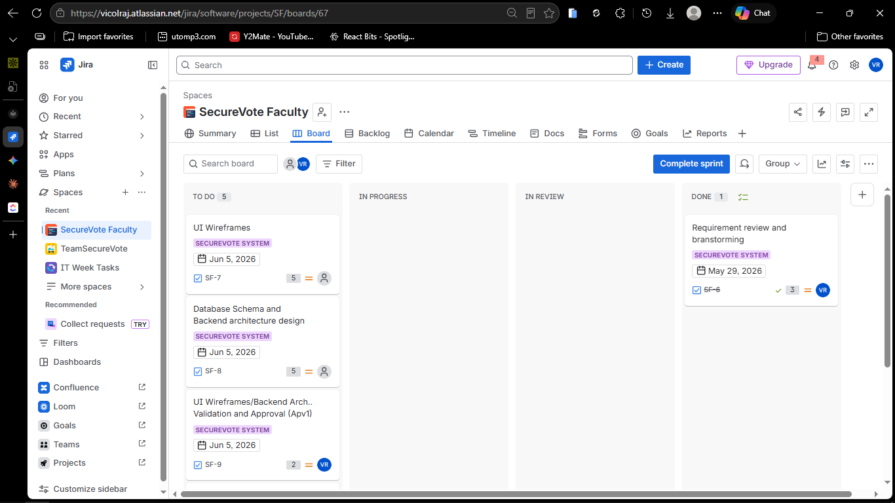
Deliverable 1 — Sprint Board (Active Sprint)
SecureVote Faculty — SF Sprint 1
What This Shows
Board shows TO DO, IN PROGRESS, IN REVIEW, DONE columns
SF-6 (Requirement review) in DONE with 3 story points
Remaining Sprint 1 tasks visible with story points
First real evidence of a task moving through the Scrum workflow

Slide 10
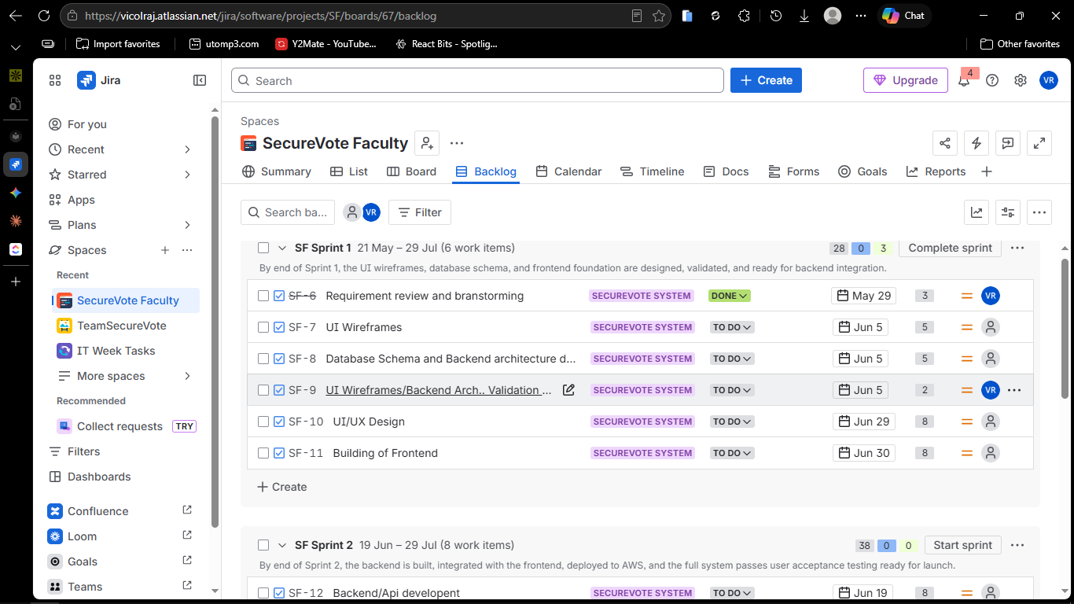
Deliverable 2 — Sprint 1 Backlog & Goal
6 tasks • 31 story points
What This Shows
Sprint 1 runs May 21 – Jul 29 with 6 work items
Sprint goal set: wireframes, database schema, and frontend foundation
Story points assigned to all tasks (3, 5, 5, 2, 8, 8)
Demonstrates Sprint Planning applied to a real project

Slide 11
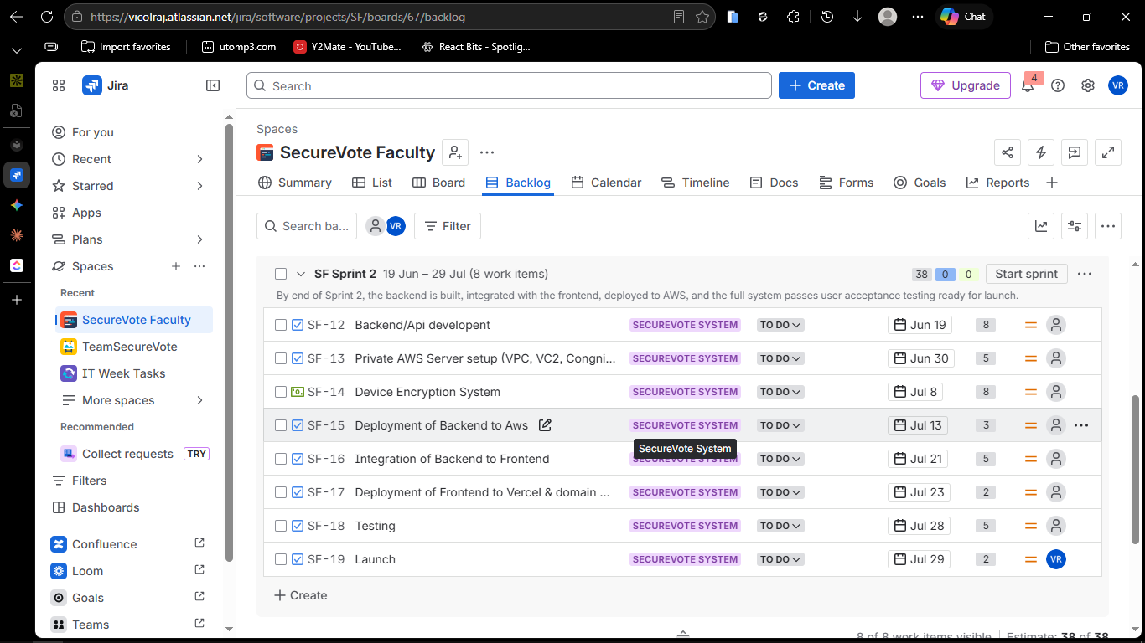
Deliverable 3 — Sprint 2 Backlog & Goal
8 tasks • 38 story points
What This Shows
Sprint 2 runs Jun 19 – Jul 29 with 8 work items
Sprint goal: backend built, integrated, deployed, and UAT complete
Story points: 8, 5, 8, 3, 5, 2, 5, 2 = 38 total
Two-sprint structure reflects realistic project sequencing

Slide 12
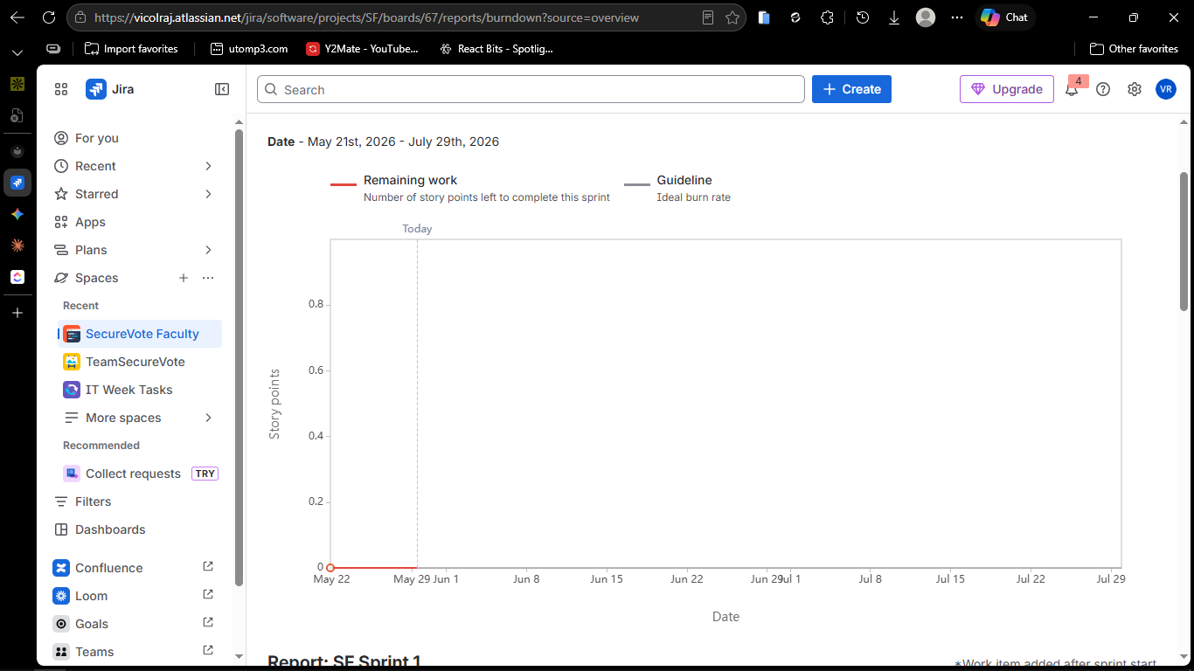
Deliverable 4 — BurnDown Chart
Sprint scope vs completion over time
What This Shows
Work scope line (red) shows 31 story points in Sprint 1
Guideline (grey) shows ideal completion rate to Jul 29
Story points added after sprint start — real lesson on Sprint Planning order
Demonstrates understanding of how velocity and burndown work in Jira

Slide 13
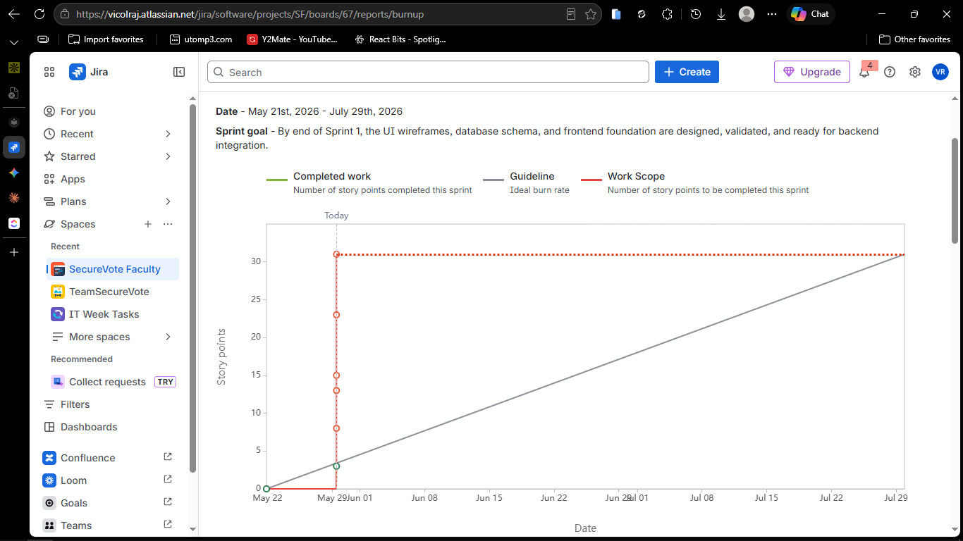
Deliverable 4 — Burnup Chart
Sprint scope vs completion over time
What This Shows
Work scope line (red) shows 31 story points in Sprint 1
Guideline (grey) shows ideal completion rate to Jul 29
Story points added after sprint start — real lesson on Sprint Planning order
Demonstrates understanding of how velocity and burndown work in Jira

Slide 14
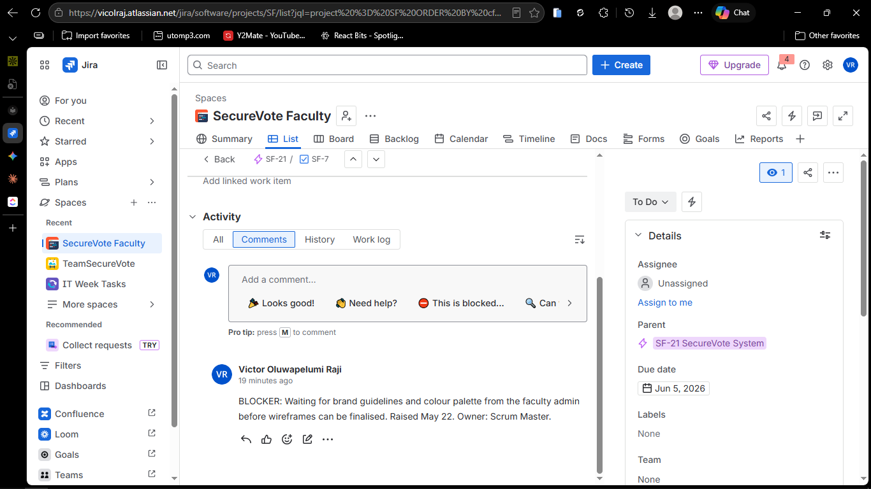
Deliverable 5 — Documented Blockers
3 blockers identified and logged
What This Shows
Blocker 1: Waiting for brand guidelines before wireframes can start (Open)
Blocker 2: AWS environment not provisioned — schema blocked (Open)
Blocker 3: PO unavailable for approval — rescheduled and resolved (Resolved)
Demonstrates Daily Standup blocker surfacing and Scrum Master response

Slide 15
Key Takeaway
Scrum does not make projects easier.
It makes problems visible before they become disasters.
The ceremonies force communication. The DoD forces honesty. The burndown forces visibility. Together they give a team the best possible chance of shipping something real.
Questions & Discussion • X3 Lab Internship • 2026

