Slide 1

07
Week 7: Execution Tracking
Executive Briefing
Dashboards · Timeline Variance · Critical Path · Float · Bottlenecks
Raji Victor Oluwapelumi
Corporate Strategy & Operations

Slide 2

Planning vs. Execution Tracking
Shifting from theoretical roadmaps to operational reality
Project Planning
Execution Tracking
Theoretical Roadmap
Operational Reality
Defines the ideal sequence of events and
Captures day-to-day progress, surfacing the truth
dependencies based on initial assumptions.
of project momentum.
Baseline Success
Variance Detection
Establishes the standard against which all future
Identifies deviations from the plan early enough to
progress will be measured.
enable proactive correction.
Strategic Allocation
Data-Driven Agility
Focuses on high-level resource distribution and
Provides the evidence required to make informed
long-term milestone setting.
adjustments to the original strategy.
SECTION 01 / PAGE 02

Slide 3

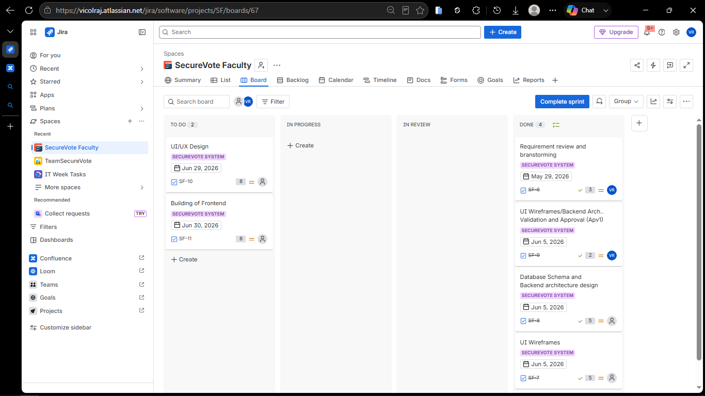
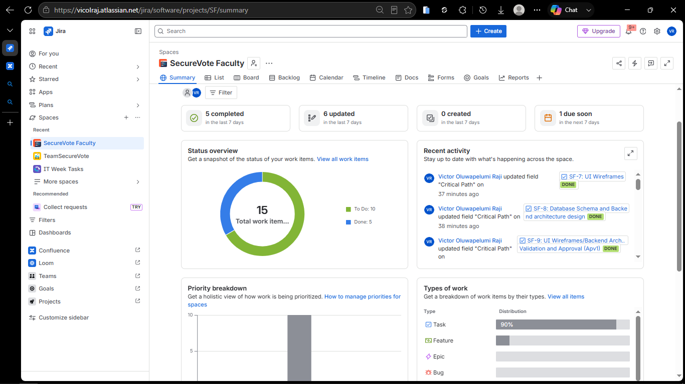
THE OPERATIONAL LENS
THE EXECUTIVE LENS
The “Sprint” Board
The “Delivery” Dashboard
For the development team
For stakeholders & supervisors
“What am I working on today?"
"Is this project going to deliver on time?"
To Do / In Progress / In Review / Done columns
Task-level detail
Updated continuously by the team
Used by: developers, Scrum Master, PO
Overall status: Green / Amber / Red
% complete, story points burned vs remaining
Active blockers & upcoming milestones
Used by: supervisors, clients, faculty HOD
SECTION 01 / PAGE 03

Slide 4

Timeline Management
STATUS COMMUNICATION STANDARDS
On Track
At Risk
Off Track
Proceeding as planned with no known risks to the critical path.
Facing potential delays; mitigation strategies are currently in progress.
Milestone missed or critical delay; immediate executive intervention required.
EXECUTIVE REPORTING EXAMPLE
Standard Reporting
Premium Reporting
“SF-12 is 3 days behind due to [reason]. This affects SF-15. We are [action] to recover [X] days. New launch date: [date]”
"We are working on the database schema and it's taking a bit longer than we thought it would."
SECTION 01 / PAGE 04

Slide 5

The Critical Path
Case Study: SF-8
The Database Schema (SF-8) serves as the technical foundation for all subsequent development chains.
CORE DEFINITION
The longest sequence of dependent tasks through a project which must be completed on time for the project to finish on its due date.
Current Status
In Progress with a 3-day variance against
the original baseline.
Any delay in a critical path task directly impacts the final project completion date.
Strategic Impact
This delay causes an immediate 3-day
Managing the critical path is the primary objective of professional execution tracking.
slip to the final integration milestone.
Resources should be prioritized for these tasks to ensure zero variance from the baseline.
Path 1: A→B→D => 3 + 5 + 4 = 12 days = CRITICAL
Path 2: A→C→D => 3 + 2 + 4 = 9 days (shorter)
SECTION 02 / PAGE 05

Slide 6

CORE CONCEPT
CALCULATION LOGIC
Understanding Float (Slack)
Strategic Buffer Analysis
Parallel Path (Task B)
5 Days
The amount of time a task can be delayed without affecting the project's overall end date.
Current Task (Task C)
2 Days Active + 3 Days Float
Calculation Result:
The Executive Rule
5 Days - 2 Days = 3 Days Float
Protect the critical path at all costs; use float as a strategic buffer for non-critical risks. Tasks with zero float are, by definition, on the Critical Path.
SECTION 02 / PAGE 06

Slide 7

GOVERNING PATH ★ CRITICAL
PARALLEL PATH
Frontend Chain
Backend Chain
SF-7 UI Wireframes
7 Days
SF-8 Database Schema
7 Days
SF-10 UI/UX Design
24 Days
SF-12 Backend/API
14 Days
SF-11 Build Frontend
18 Days
SF-15 Deploy Backend
5 Days
49 Days
26 Days
Total Duration
Total Duration
STRATEGIC IMPLICATION
The Frontend Chain governs the launch date. Resources must be prioritized here to protect the timeline, as the Backend Chain currently maintains 23 days of float.
CASE STUDY / PAGE 07

Slide 8

Bottleneck Detection
Identifying constraints in the delivery pipeline
TO DO
IN PROGRESS
IN REVIEW
DONE
2
3
9
5
tasks
tasks
tasks (bottleneck)
tasks
Visual Indicators
Operational Signals
One stage has significantly more tasks than any other in the pipeline.
Tasks sit in a specific status much longer than the historical average.
Work-in-Progress (WIP) continues to grow without corresponding completions.
One individual or resource has far more active tasks than the rest of the team.
SECTION 03 / PAGE 09

Slide 9




Fixing the Bottleneck
Applying the Theory of Constraints to delivery
THE PROBLEM
THE IMPACT
Systemic Stall
STRATEGIC ACTION
Restored Velocity
Capacity Expansion
Four critical tasks (SF-7 to SF-10) are stalled in the 'In Review' stage.
Review cycle time reduced by 60%, clearing the backlog within 48 hours.
Single Product Owner creates a linear dependency for parallel work.
Train a secondary reviewer to verify work against the Definition of Done.
Overall chain velocity increases as downstream tasks are unblocked.
Delegate approval authority for non-critical UI components.
SECTION 03 / PAGE 10

Slide 10

Live Execution Tracker
SecureVote Faculty — Week 7 Snapshot
TASK
OWNER
PLANNED END
ACTUAL/EST
STATUS
VARIANCE
CRITICAL?
VR
May 29
May 29
Done
0
No
SF-6
Requirements
—
Jun 05
Jun 08
In Progress
+3 days
★ Yes
SF-7
UI Wireframes
—
Jun 05
Jun 05
To Do
0
★ Yes
SF-8
Database Schema
—
Jun 19
TBD
To Do
—
No (float)
SF-12
Backend/API
—
Jun 29
TBD
To Do
—
★ Yes
SF-10
UI/UX Design
—
Jun 30
TBD
To Do
—
★ Yes
SF-11
Build Frontend
★ = On Critical Path (Zero Float) — Any delay in these tasks directly shifts the final launch date.
TRACKER / PAGE 11

Slide 11
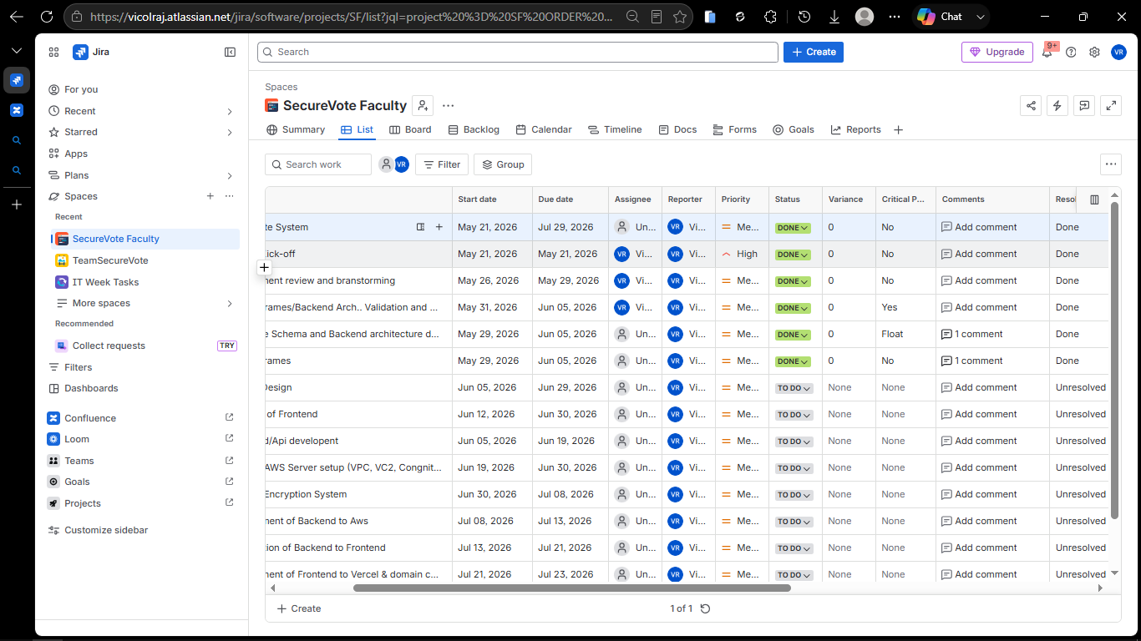

Slide 12

Weekly Status Update
ON TRACK
EXECUTIVE SUMMARY
PROGRESS METRICS
Week 7 Performance
Completion & Velocity
Core requirements and initial wireframes are 100% finalized. The database schema is ready to commence on schedule, maintaining alignment with the original project baseline.
2 of 19 total tasks (~10.5%) completed. Critical path focus remains strictly on Frontend development chains to protect the final launch date.
RISK ASSESSMENT
FORWARD PLANNING
Mitigation & Blockers
Immediate Next Steps
No active blockers identified. SF-8 remains the immediate priority. Resource allocation is optimized for critical path tasks.
Initiate SF-12 Backend/API development immediately upon SF-8 validation. Conduct mid-week review of Frontend chain progress.
EXECUTIVE SUMMARY / PAGE 12

Slide 13
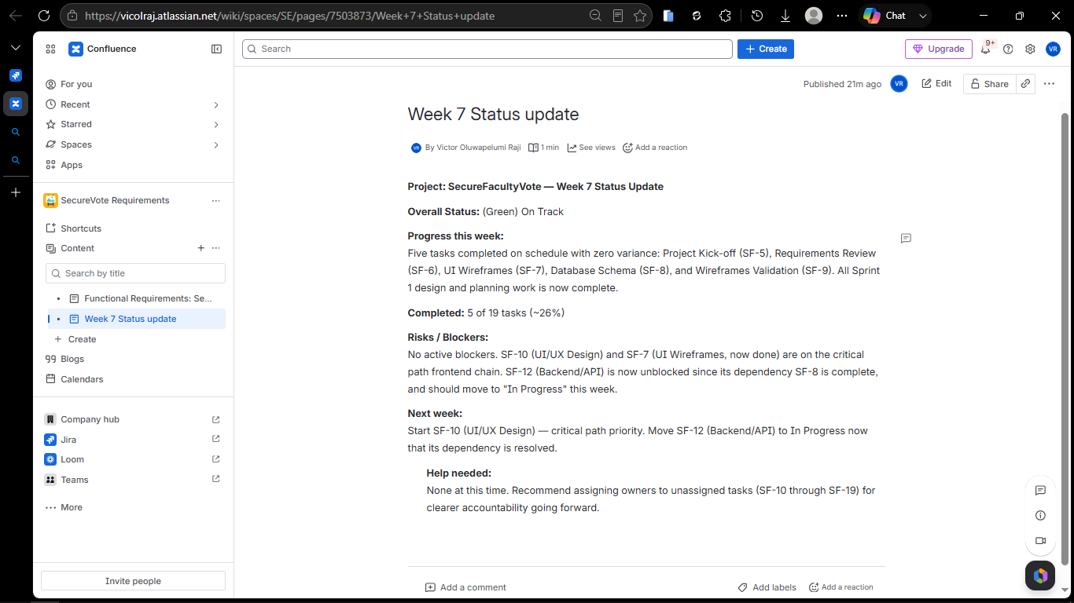

Slide 14

KEY TAKEAWAY
Planning tells you what should happen. Tracking tells you what is happening.
The critical path tells you what to protect. Float tells you what you can afford to lose. Bottlenecks tell you where to focus. Together, they are how you stay in control of your delivery.
EXECUTIVE SUMMARY / PAGE 13

