Slide 1

GUIDING THE PLAYER
Original slides by: Jeremy Gibson Bond
Adapted by: Erel Segal-Halevi
CHAPTER 13

Slide 2
Guiding the Player
The more you work on a game, the more you internalize its systems and levels
However, a new player won't have any of that knowledge
You must ensure that players who have never seen your game before intuitively understand it
This requires careful, sometimes invisible guidance
Two types of guidance
  Direct Guidance - The player knows that she is being guided
  Indirect Guidance - The player is guided without realizing it

Slide 3
Methods of Direct Guidance
Instructions
  The game explicitly tells the player what to do
  These can take the form of
    Text
    Dialogue with an authoritative non-player character (NPC)
    Visual diagrams
  Often incorporate combinations of the three
  One of the clearest forms of direct guidance
  Drawbacks
    May overwhelm the player with too much information
    May annoy the player by pedantically presenting information she already knows

Slide 4
Methods of Direct Guidance
Call to Action
  The game explicitly gives the player an action to perform and a reason to do so
  Often takes the form of missions given by NPCs
  Common strategy
    Present the player with a clear long-term goal
    Then give her progressively smaller medium- and short-term goals that must be accomplished on the way to the long-term goal
  Example: The Legend of Zelda: Ocarina of Time
    Long-Term Goal: Navi tells Link that he has been summoned by the Great Deku Tree. Link is told by another NPC this is a great honor.
    Smaller Goals: Link's path to the Great Deku Tree is blocked by Mido, who tells him that he will need a sword and shield before venturing into the forest
    The short-term goals are directly tied to the long-term goal of reaching the Great Deku Tree

Slide 5
Methods of Direct Guidance
Map or Guidance System
  Many games include a map or GPS-style guidance system
  Directs the player toward her goals or toward the next step in her mission
  Example: Grand Theft Auto V
    Radar/mini-map in the corner of the screen with a highlighted route for the player to follow to the next objective
    In the vast world of GTA V, the player relies very heavily on the GPS
  Drawbacks
    Can lead to players spending most of their time just following the directions of the virtual GPS
    Players don't thinking about a destination and choose their own path
    Takes longer for the player to learn the layout of the game world

Slide 6
Methods of Direct Guidance
Pop-Ups
  Contextual controls that change based on the objects near the player
  Example: Assassin's Creed IV: Black Flag
    The same button controls such diverse actions as
      Opening doors
      Lighting barrels of gunpowder on fire
      Taking control of mounted weapons
    Pop-ups with the icon for the controller button and a very short description of the action appear when a contextual action is possible

Slide 7
Judging the Quality of Direct Guidance
The various methods of Direct Guidance can all be judged by the same four criteria
  Immediacy
  Scarcity
  Brevity
  Clarity

Slide 8
Judging the Quality of Direct Guidance
Immediacy
  The message must be given to the player when it is immediately relevant
    Don't try to tell the player all the possible controls for the game at the very beginning unless they are very simple
  Direct information about controls should be provided immediately the first time that the player needs it
  Example: Kya: Dark Lineage
    A tree falls into the path of the player character, and she must jump over it to continue
    As it is falling, the game shows the player the message "Press X to jump" at exactly the time she needs to know that information

Slide 9
Judging the Quality of Direct Guidance
Scarcity
  Many modern games have lots of controls and lots of simultaneous goals
  The player must not be flooded with too much information all at one time
  Making direct controls more scarce makes them more valuable to the player and more likely to be heeded
  This is also the case with missions
    A player can only really concentrate on a single mission at once
    If a game gives the player too many simultaneous missions, many will eventually be ignored
    Example: Skyrim
      The author currently has >200 unfinished missions in Skyrim
      Average amount of time spent playing Skyrim is 90 hours per person!
      Though released in 2011, as of July, 2014, over 60,000 people on Steam still play Skyrim daily (#6 most popular game!)
      But only 30.7% of owners on Steam have ever finished the main quest

Slide 10
Judging the Quality of Direct Guidance
Brevity
  Never use more words than are necessary
  Don't give the player too much information at one time
  Example: Valkyria Chronicles
    A tactical combat game by Sega
    "When near sandbags, press O to take cover and reduce damage from enemy attacks."
Clarity
  Be very clear about what you're trying to convey
  Example: Valkyria Chronicles
    Why not just "When standing near sandbags, press O to take cover"
    In Valkyria Chronicles, cover not only shields you but also drastically reduces the amount of damage you take from bullets that do hit
    For the player to understand everything she needs to know about cover, she must also be told about the damage reduction.

Slide 11
Indirect Guidance
Much more subtle than Direct Guidance
Even as a designer you may not have noticed it
Methods of Indirect Control
  Constraints
  Physical Interface
  Visual Design
  Audio Design
  Player Avatar
  Non-Player Characters

Slide 12
Seven Methods of Indirect Guidance
Constraints
  If you give the player limited choices, she will choose one
    If given a choice of Red or Green, the player won't try to pick Blue
  Without constraint, players run the risk of choice paralysis
    A person is presented with so many choices that she can't weigh them all against each other and instead just doesn't make a choice
    This is why a restaurant menu might have 100 different items but only feature images of 20

Slide 13
Seven Methods of Indirect Guidance
Physical Interface
  The shape of a physical interface can be Indirect Guidance
  If you give the player a guitar-shaped controller, she will generally expect to use it to play music
  Giving a Guitar Hero player a regular game controller might lead her to think that she could control her character's movement around the stage
  The rumble feature on controllers can also provide guidance
    Example: Rumble strips in racing games

Slide 14
Seven Methods of Indirect Guidance
Visual Design — The broadest category of Indirect Guidance
  Light
    Humans are naturally drawn to light
    If you place a player in a dark room with a pool of light at one end, she will often move toward that light before exploring anything else
  Similarity
    Once a player has seen that something in the world is good in some way (helpful, healing, valuable, etc.), she will seek out similar things
  Trails
    Similarity can lead to a breadcrumb-trail-like effect
    The player picks up a certain item and then follows a trail of similar items to a location that the designer wishes her to explore

Slide 15

Seven Methods of Indirect Guidance
Visual Design
  Landmarks
    Large interesting objects can be used as landmarks
    Example: Journey by thatgamecompany
      The player starts in the middle of a desert next to a sand dune
      Everything around her is the same color except for a dark stone marker at the top of the tallest nearby dune
      The player is driven to move up the dune toward it
      Once she reaches the top, the camera rises above her, revealing a towering mountain with light bursting from the top
      The camera move causes the mountain to emerge from directly behind the stone marker, showing the player that the mountain is her new goal

Slide 16
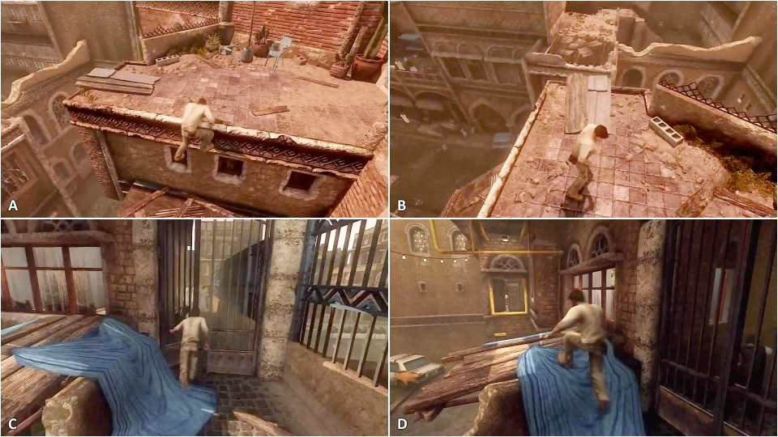
Seven Methods of Indirect Guidance
Visual Design
  Arrows
    Subtle arrows can be used to guide the player
    Example: Uncharted 3

Slide 17
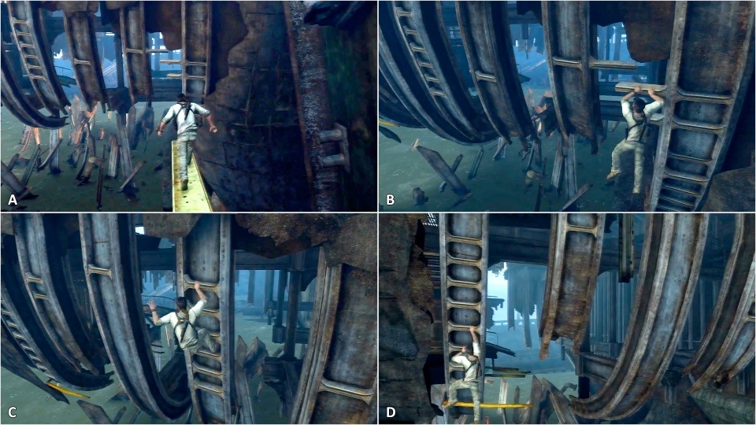
Seven Methods of Indirect Guidance
Visual Design
  Camera
    Commonly used in traversal puzzles (looks in direction of next move)
    Example: Uncharted 3

Slide 18
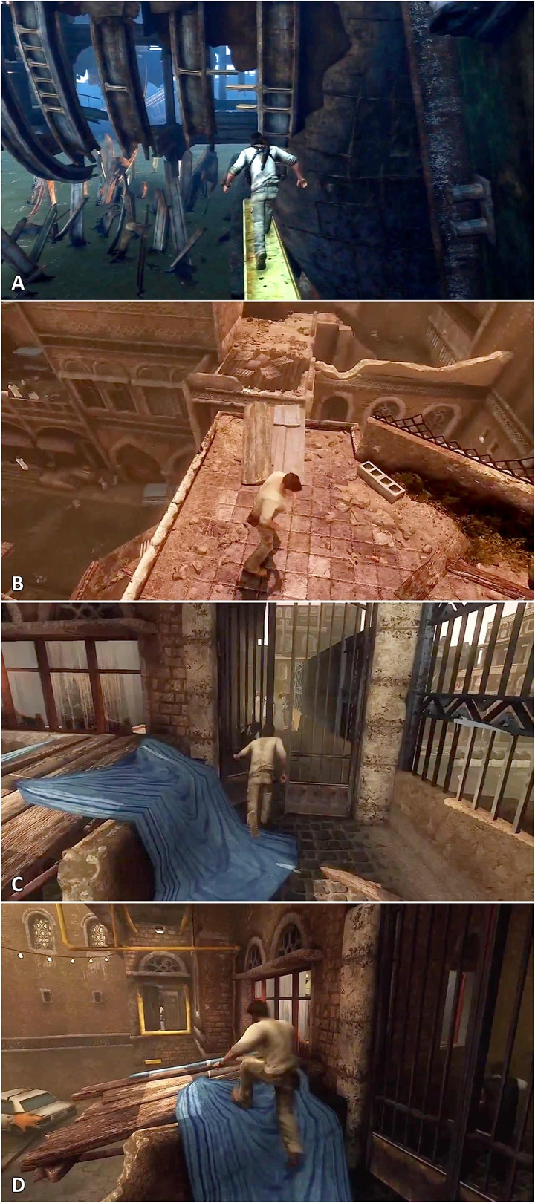
Seven Methods of Indirect Guidance
Visual Design
  Contrast
    Used to draw attention to certain objects
    Directionality
      Image A: Horizontal rungs contrast with vertical elements in scene
    Brightness
      Image B: Edges are marked with bright/dark borders
    Texture
      Image C: Smooth cloth texture provides texture contrast with rough rock and wood
    Color
      Image D: Blue cloth and yellow pipes contrast with beige environment

Slide 19
Seven Methods of Indirect Guidance
Audio Design
  Music can influence a player's mood
    Slow, quiet music can lead the player to be more stealthy
    Raucous, boisterous music can make the player more bold
  Sound effects can draw attention to possible player actions or hidden objects
    Example: Assassin's Creed 4 & Tomb Raider (2013)
      Special sounds are used to alert the player when a treasure chest (AC) or hidden tomb (TR) is nearby
Player Avatar
  A player's character model can have a strong guiding effect
  If the player character looks like a rock star with a guitar…
    The player will expect for her character to be able to play music
  If the player character has a sword…
    The player will expect to be able to hit things and run into combat

Slide 20
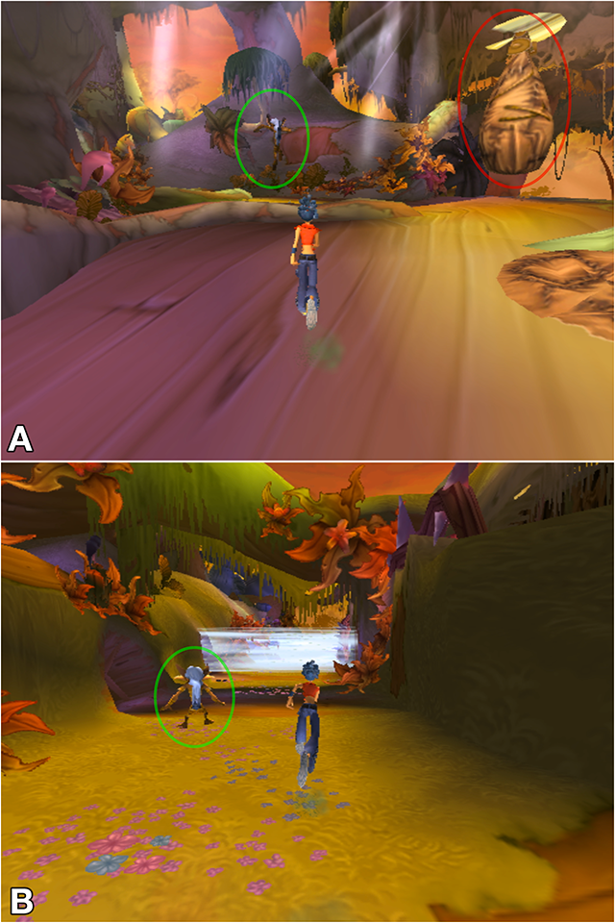
Seven Methods of Indirect Guidance
Non-Player Characters
  Modeling Behavior
    The NPC shows the player good or bad behavior and the consequences
  Example: Kya: Dark Lineage
  Negative behavior
    NPC shows what NOT to do
    Image A: Red circle shows a Nativ who stepped in a trap and was caught
  Positive behavior
    NPC shows proper bahavior
    Image A: Green circle shows Nativ jumping to avoid trap
    Image B: Green circle shows Native stopping to wait for wind trap

Slide 21
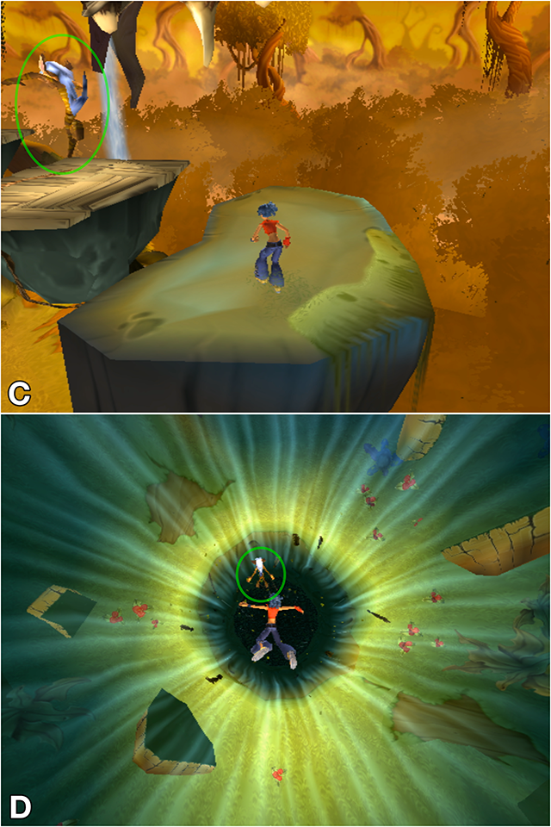
Seven Methods of Indirect Guidance
Non-Player Characters
  Safety
    Image C & D: Green circle shows Nativ taking potentially-dangerous action
    Because the Nativ shows confidence doing so, the player doesn't fear

Slide 22

Seven Methods of Indirect Guidance
Non-Player Characters
  Emotional Connections
    Players can be influenced by their emotional connections to NPCs
  Example: Journey
    Image A: The player encounters the first other creature she has seen in the game
    Image B: When the creature flies off, the player follows it (presumably to avoid loneliness)
  Players also chase NPCs out of anger (Assassin's Creed 4)

Slide 23
Teaching New Skills and Concepts
When games were simpler, this wasn't an issue
  Super Mario Bros. had on the NES controller had
    1 D-Pad - Direction
    A - Jump
    B - Run or Toss Fireball
    Start & Select Buttons
  With today's games, it's much more complex
    1 D-Pad
    2 Analog Sticks
    A, B, X, Y, LB, RB, L-Stick, R-Stick, Start, & Back Buttons
    Left and Right Analog Triggers
  Even then, many buttons on the controller are used for multiple actions
With so many controls, training of the player must be sequenced properly

Slide 24
Teaching New Skills and Concepts
Sequencing — The art of gently presenting new information
  Isolated Introduction
    The player is introduced to the new mechanic such that she must use it to continue
    No time pressure or danger of injury
  Expansion
    Expands use of the new mechanic
    Still not penalty for failing to do so correctly
  Adding Danger
    Some danger (penalty for failure) is added
    Success is still relatively easy
  Increased Difficulty
    Player must now demonstrate mastery over the new mechanic
  Integration
    Once the player understands the mechanic, she is required to integrate it with other mechanics in the game

Slide 25
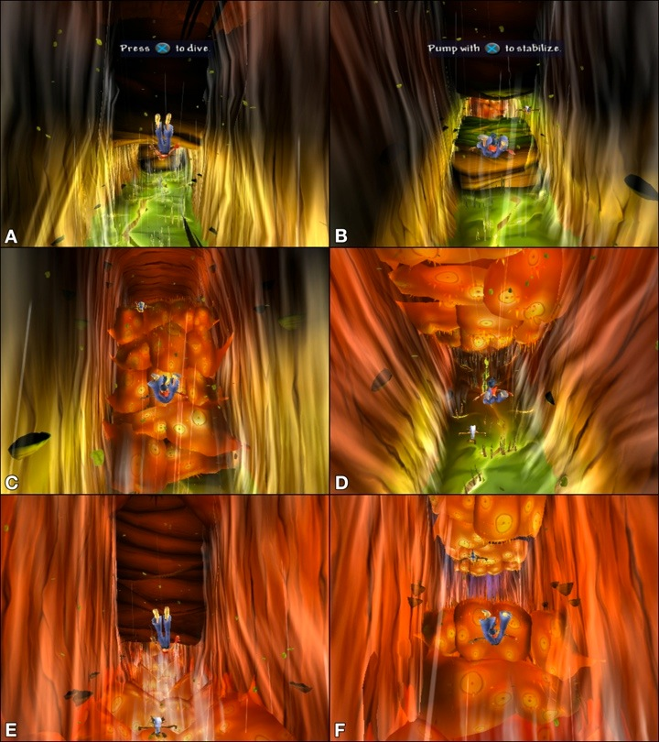
Teaching New Skills and Concepts
Example:
  Kya: Dark Lineage (PS2)
  Isolated Introduction: A
    Player must press X to drop below the wall
  Expansion: B
    Player must pump X to hover
  Adding Danger: C & D
    Dangerous areas are red
    Can pass C without pressing X
    Can just hold X to pass D
  Increased Difficulty: E & F
    Player must pump X to pass without damage

Slide 26
Judging the Quality of Indirect Guidance
Ask the following questions to judge your indirect guidance:
  What percentage of players acted in the way that you intended?
  How aware were the players that their actions were being influenced?
  How important is it to you that the guidance is covert?
  In other words, how important is it to you that the player feels like she made the decision on her own?

