Slide 1
Module 1 – Project 3
Data cleaning
Eric Martinet
Victoire Rey

Slide 2
Description of the dataset
Education sector
Age
Gender
Individual project
Entrepreneurship competency
Perseverance
Desire to take initiative
Competitiveness
Self reliance
Strong need to achieve
Self confidence
Good physical health
Key trait
Mental disorder
City
Influenced
Reasons for lack
Data collected from 198 university students in India to predict the likelihood for students to become entrepreneur.
Identify if there is a correlation between different personality traits associated with Entrepreneurship and create a target variable of entrepreneurship competency (0 or 1).
Personality
traits
rating 1 to 5 scale

Slide 3
Process
PYTHON (Functions)
Description of the dataset (general statistics, distribution of values, missing values)
Filtering of columns with low variance and rows with too many missing values and duplicates
Fill of missing values based on a method/columns dictionary
Homogenization of data (e.g. columns names, datatypes)
Export clean dataset to CSV format and AWS-hosted MySQL database
MySQL
Select tables for analysis:
Students' profiles
Likeliness to have entrepreneur competency by education sector and gender
Average traits of entrepreneur vs non-entrepreneur competency
Reasons for not having entrepreneur competency

Slide 4
Challenges & highlights
Understanding of dataset’ fields
Development of a functional approach: time-consuming at first, but offers great flexibility and reusability for any other dataset
Functions open for sharing ☺

Slide 5
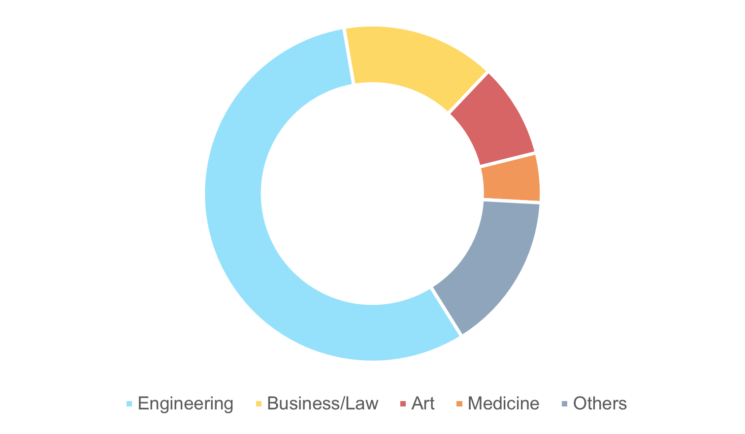
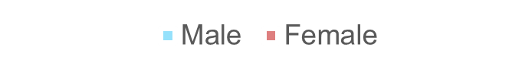
Results
Gender
Education sector
19.6
years
210
students
Likelihood of becoming entrepreneur
Average personality traits

Slide 6
Questions? Thank you!

