Slide 1


Operating System
Priority Scheduling Algorithm
by Ajitesh Kumar

Slide 2
Priority Scheduling
Priority Scheduling is a method of scheduling processes based on priority.
The processes with higher priority should be carried out first, whereas jobs with equal priorities are carried out on FCFS basis.
Priority depends upon memory requirements, time requirements, etc.

Slide 3
Types of Priority Scheduling
Preemptive
A preemptive priority scheduling will preempt the CPU if the priority of the newly arrived process is higher than the currently running process.
Nonpremptive
A nonpreemptive priority scheduling algorithm will simply execute the process till its termination.

Slide 4
Nonpreemptive Priority Scheduling

Slide 5
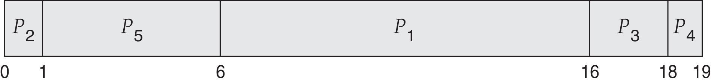
Example of Priority Scheduling
Process Burst TimeT Priority
P₁ 10 3
P₂ 1 1
P₃ 2 4
P₄ 1 5
P₅ 5 2
Average waiting time = 8.2
Assume low numbers represent high priority

Slide 6
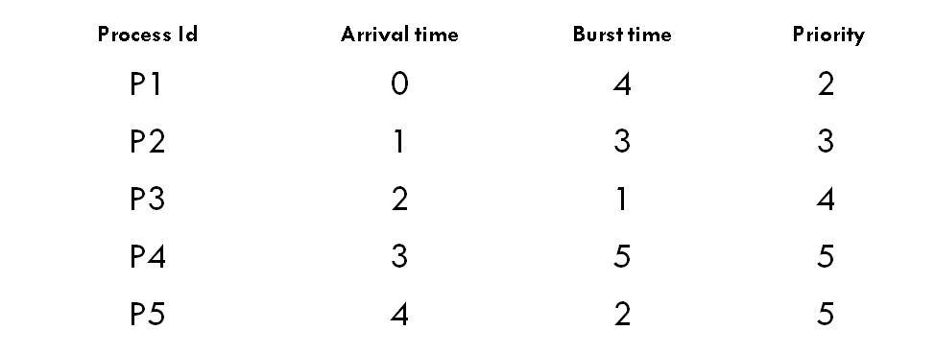
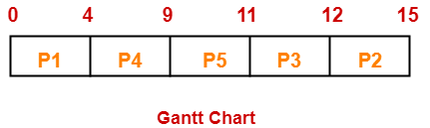
Calculate the average waiting time and average turn around time. (Higher number represents higher priority)

Slide 7
Process Id | CT | TAT(CT-AT) | WT(TAT-BT)
P1 | 4 | 4 – 0 = 4 | 4 – 4 = 0
P2 | 15 | 15 – 1 = 14 | 14 – 3 = 11
P3 | 12 | 12 – 2 = 10 | 10 – 1 = 9
P4 | 9 | 9 – 3 = 6 | 6 – 5 = 1
P5 | 11 | 11 – 4 = 7 | 7 – 2 = 5

Slide 8
Average Turn Around time = (4 + 14 + 10 + 6 + 7) / 5 = 41 / 5 = 8.2 unit
Average waiting time = (0 + 11 + 9 + 1 + 5) / 5 = 26 / 5 = 5.2 unit

Slide 9
Preemptive

Slide 10
Process Id | Arrival time | Burst time | Priority
P1 | 0 | 4 | 2
P2 | 1 | 3 | 3
P3 | 2 | 1 | 4
P4 | 3 | 5 | 5
P5 | 4 | 2 | 5

Slide 11
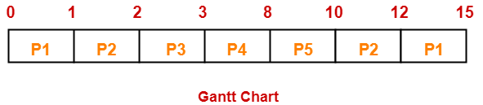
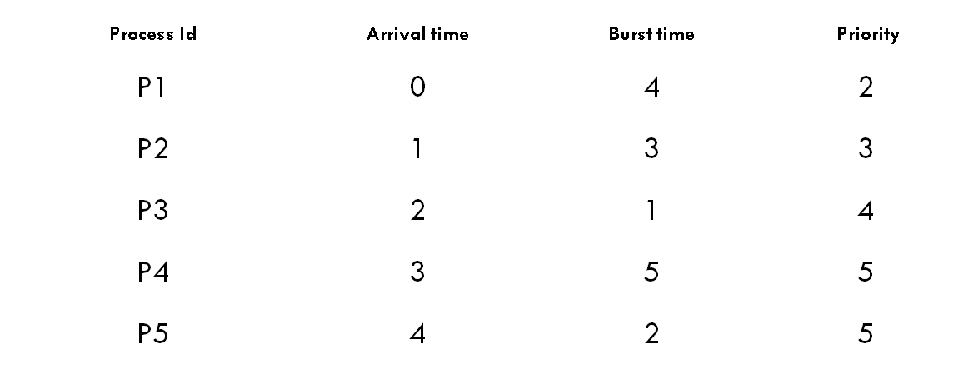
Process Id | CT | TAT | WT
P1 | 15 | 15 – 0 = 15 | 15 – 4 = 11
P2 | 12 | 12 – 1 = 11 | 11 – 3 = 8
P3 | 3 | 3 – 2 = 1 | 1 – 1 = 0
P4 | 8 | 8 – 3 = 5 | 5 – 5 = 0
P5 | 10 | 10 – 4 = 6 | 6 – 2 = 4

Slide 12
Average Turn Around time = (15 + 11 + 1 + 5 + 6) / 5 = 38 / 5 = 7.6 unit
Average waiting time = (11 + 8 + 0 + 0 + 4) / 5 = 23 / 5 = 4.6 unit

Slide 13
Preemptive
Process Priority Burst time Arrival time
P1 1 4 0
P2 2 3 0
P3 1 7 6
P4 3 4 11
P5 2 2 12
Average Waiting time = (0+11+0+5+2)/5 = 18/5= 3.6

Slide 14
Advantages
It considers the priority of the processes and allows the important processes to run first.
Priority scheduling in preemptive mode is best suited for real time operating system.

Slide 15
Disadvantages
Processes with lesser priority may starve for CPU.
There is no idea of response time and waiting time.

Slide 16
Round Robin CPU Scheduling
Round Robin is a CPU scheduling algorithm where each process is assigned a fixed time slot in a cyclic way.
It is simple, easy to implement, and starvation-free as all processes get fair share of CPU.
It is preemptive as processes are assigned CPU only for a fixed slice of time at most.
The disadvantage of it is more overhead of context switching.

Slide 17
Example 1
Process Burst Time
P₁ 24
P₂ 3
P₃ 3

Slide 18
Example 2
Process Id | Arrival time | Burst time
P1 | 0 | 5
P2 | 1 | 3
P3 | 2 | 1
P4 | 3 | 2
P5 | 4 | 3

Slide 19
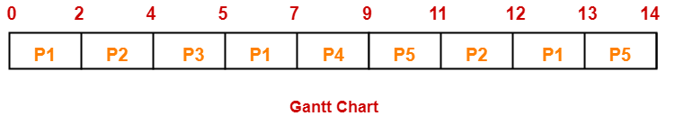
Process Id | Exit time | Turn Around time | Waiting time
P1 | 13 | 13 – 0 = 13 | 13 – 5 = 8
P2 | 12 | 12 – 1 = 11 | 11 – 3 = 8
P3 | 5 | 5 – 2 = 3 | 3 – 1 = 2
P4 | 9 | 9 – 3 = 6 | 6 – 2 = 4
P5 | 14 Average | 14 – 4 = 10 8.6 Unit | 10 – 3 = 7 5.8 Unit

Slide 20
Practice Questions
Process Id | Arrival time | Burst time
P1 | 5 | 5
P2 | 4 | 6
P3 | 3 | 7
P4 | 1 | 9
P5 | 2 | 2
P6 | 6 | 3
Time Quantum=2 units

