Slide 1
Process and its States

Slide 2
Process
A program in execution is called process. A process is more than the set of instructions, besides it contains memory area, local, global variable, CPU registers, Program Counters.
Process is an active entity that requires a set of resources, including a processors, program counters, registers, registers to perform its functions. Multiple process may associate with one program

Slide 3
Process Concept
Program is passive entity stored on disk (executable file); process is active
  Program becomes process when an executable file is loaded into memory
Execution of program started via GUI mouse clicks, command line entry of its name, etc.
One program can be several processes
  Consider multiple users executing the same program

Slide 4
Process Concept(process in memory)
Multiple parts
  The program code, also called text section
  Current activity including program counter, processor registers
  Stack containing temporary data
    Function parameters, return addresses, local variables
  Data section containing global variables
  Heap containing memory dynamically allocated during run time

Slide 5
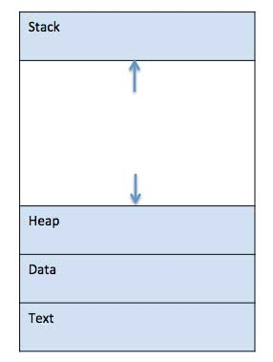
Process in Memory
When a program is loaded into the memory and it becomes a process, it can be divided into four sections ─ stack, heap, text and data.

Slide 6
Types of Processes
CPU Bound Process: If the process is intensive in terms of CPU operations then it is called CPU bound process.
I/O Bound Process: If the process is intensive in terms of I/O operations then it is called IO bound process.

Slide 7
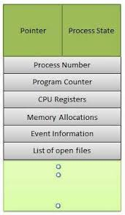
Process Control Block (PCB)
Each process is represented in the OS by a PROCESS CONTROL BLOCK (PCB)- also called Task control Block.

Slide 8
Q1. which section of a program does not contain in the memory?
Heap
Data
Stack
Program counter
Q2. A process stack does not contain:
A. function parameters
B. local variables
C. return addresses
D. PID of child process

Slide 9
Q3. The address of the next instruction to be executed by the current process is provided by the:
A. CPU registers
B. program counter
C. process stack
D. pipe
Q4. A Process Control Block(PCB) does not contain which of the following :
A. Program counter
B. List of open files
C. Process State
D. I/O status information
E. bootstrap program

Slide 10
Q5. The Process Control Block is :
A. Process type variable
B. Data Structure
C. a secondary storage section
D. a Block in memory
Q6. The degree of multi-programming is :
A. the number of processes executed per unit time
B. the number of processes in the ready queue
C. the number of processes in the I/O queue
D. the number of processes in memory

Slide 11

Process State Diagram (5-States)
Awake ( Process-name) : New -> Ready
Dispatch ( Process-name): ready -> running
Timerrunout ( Process-name): running -> ready
Block( Process-name): running -> blocked
wakeup( Process-name): blocked-> ready

Slide 12
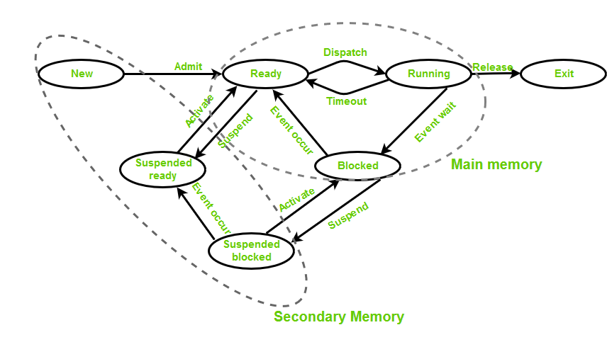
Process State Diagram ( 7 States)

Slide 13
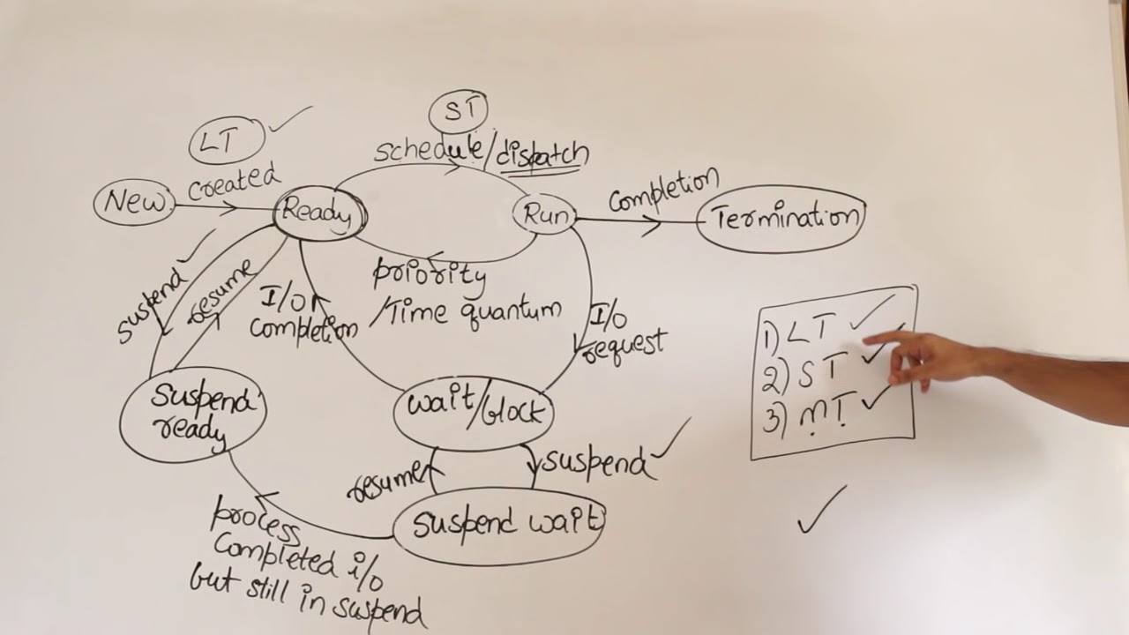

Slide 14
Q1. Which of the following is not the state of a process ?
A. new
B. old
C. Waiting
D. Running
E. Terminated
Q2. The ----------- is used as the repository for any information of the process.
a) process state
b) deadlock
c) CPU
d) PCB

Slide 15
Q3. The maximum number of processes that can be in Ready state for a computer system with n CPUs is
(A) n
(B) n^2
(C) 2n
(D) Independent of n
Q4. In a time-sharing operating system, when the time slot given to a process is completed, the process goes from the running state to the :
A. Blocked state
B. Ready state
C. Suspended state
D. Terminated state

Slide 16
Q5. Suppose that a process is in “Blocked” state waiting for some I/O service. When the service is completed, it goes to the :
A. Running state
B. Ready state
C. Suspended state
D. Terminated state
Q6. Which of the following state transitions is not possible ?
A. blocked to running
B. ready to running
C. blocked to ready
D. running to blocked
Q7. What is the ready state of a process?
a) when process is scheduled to run after some execution
b) when process is unable to run until some task has been completed
c) when process is using the CPU
d) none of the mentioned

Slide 17
Q8. When I/O is completed What is the transition of the state?
waiting to ready
ready to wait
ready to running
running to waiting

Slide 18
Concept of Multiprogramming
Pre-emption – Process is forcefully removed from CPU. Pre-emption is also called as time sharing or multitasking.
Non pre-emption – Processes are not removed until they complete the execution.

Slide 19
Process Scheduling
Process scheduler selects among available processes for next execution on CPU core
Goal -- Maximize CPU use, quickly switch processes onto CPU core
Maintains scheduling queues of processes
  Ready queue – set of all processes residing in main memory, ready and waiting to execute
  Wait queues – set of processes waiting for an event (i.e., I/O)
  Processes migrate among the various queues

Slide 20
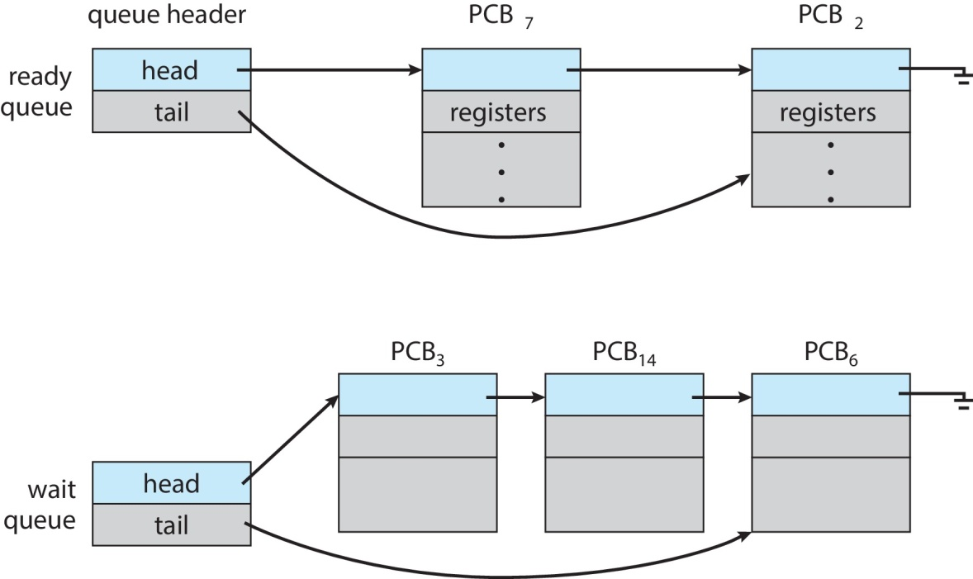
Ready and Wait Queues

Slide 21
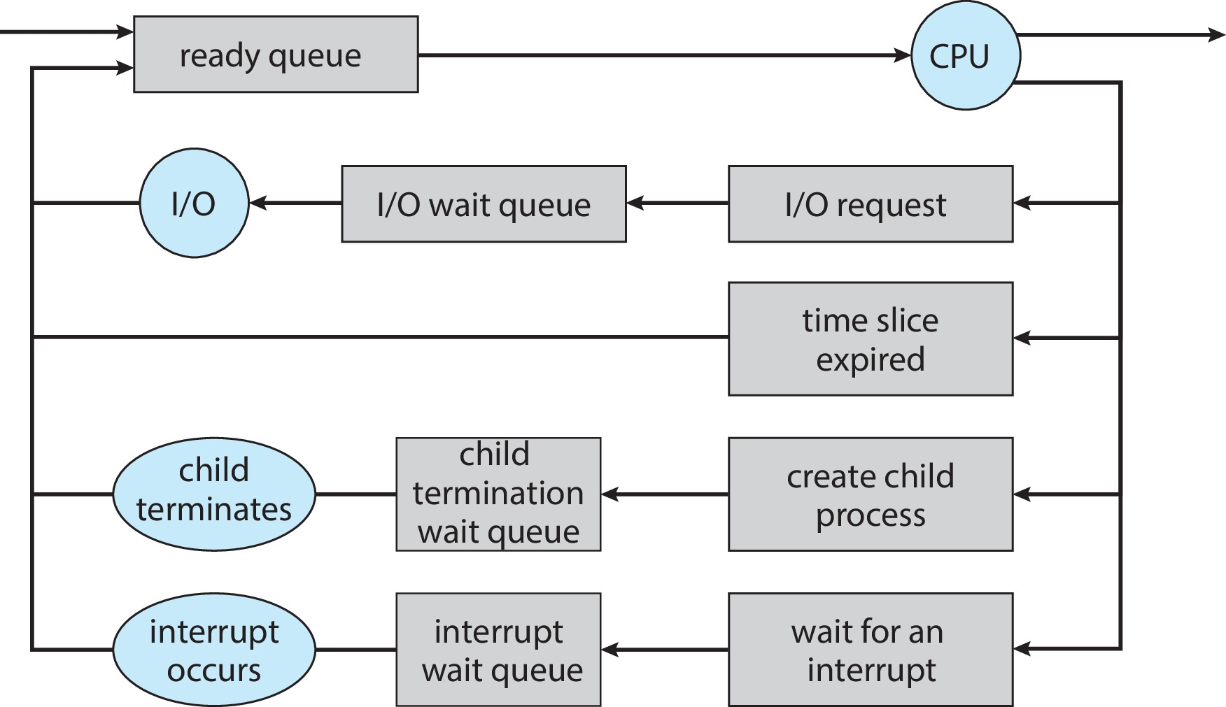
Representation of Process Scheduling

Slide 22
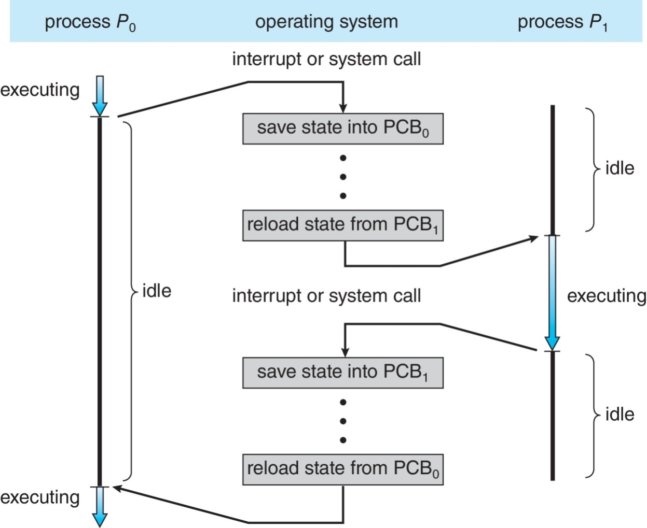
CPU Switch From Process to Process
A context switch occurs when the CPU switches from one process to another.

Slide 23
Context Switch
When CPU switches to another process, the system must save the state of the old process and load the saved state for the new process via a context switch
Context of a process represented in the PCB
Context-switch time is pure overhead; the system does no useful work while switching
  The more complex the OS and the PCB ➔ the longer the context switch
Time dependent on hardware support
  Some hardware provides multiple sets of registers per CPU ➔ multiple contexts loaded at once

Slide 24
Schedulers
Schedulers are special system software which handles process scheduling in various ways. Their main task is to select the jobs to be submitted into the system and to decide which process to run. Schedulers are of three types −
Long-Term Scheduler
Short-Term Scheduler
Medium-Term Scheduler

Slide 25
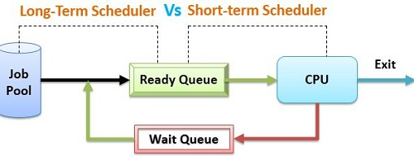
Long-Term Vs Short Term Scheduler

Slide 26
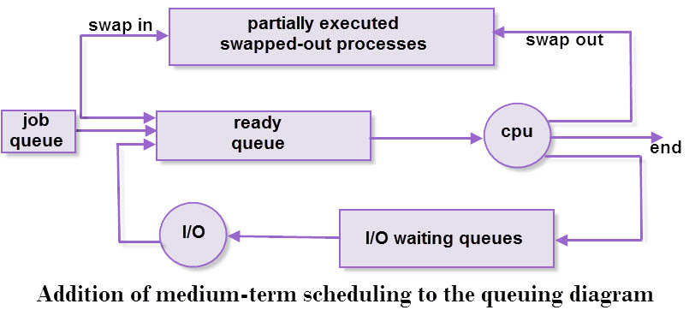
Medium Term Scheduler

Slide 27
Q1. The strategy of allowing processes that are logically runnable to be temporarily suspended is called
A. preemptive scheduling
B. non preemptive scheduling
Q2. What is a long-term scheduler ?
A. It selects which process has to be brought into the ready queue
B. It selects which process has to be executed next and allocates CPU
C. It selects which process to remove from memory by swapping
D. None of these
Q3. What is a medium-term scheduler ?
A. It selects which process has to be brought into the ready queue
B. It selects which process has to be executed next and allocates CPU
C. It selects which process to remove from memory by swapping
D. None of these

Slide 28
Q4. What is a short-term scheduler ?
A. It selects which process has to be brought into the ready queue
B. It selects which process has to be executed next and allocates CPU
C. It selects which process to remove from memory by swapping
D. None of these

Slide 29
Fill in the blank
A program in execution is called ----------- .
Interval between the time of submission and completion of the job is called
A scheduler which selects processes from secondary storage device is called…..
-------- system is used when there are rigid time requirements on the operation of processor.
The ------------- memory is a technique that allows the execution of processes that may not be completely in memory.
In ------- scheduling algorithm, a small unit of time, called time quantum, for each process.

