Slide 1
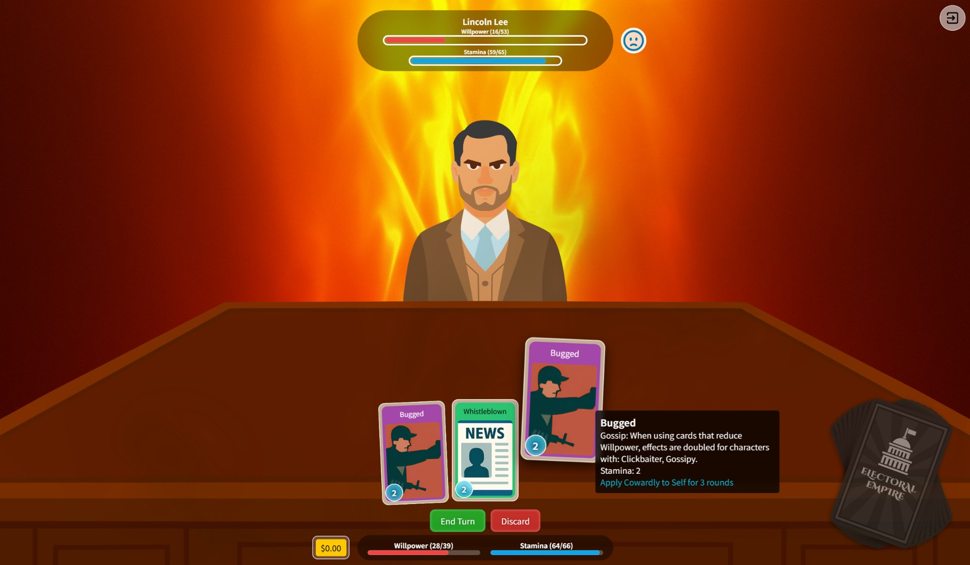
ELECTORAL EMPIRE
All Lies Trump Truth
A dark satirical political strategy sim about power, narratives, and consequences.
Steam: store.steampowered.com/app/3677060

Slide 2
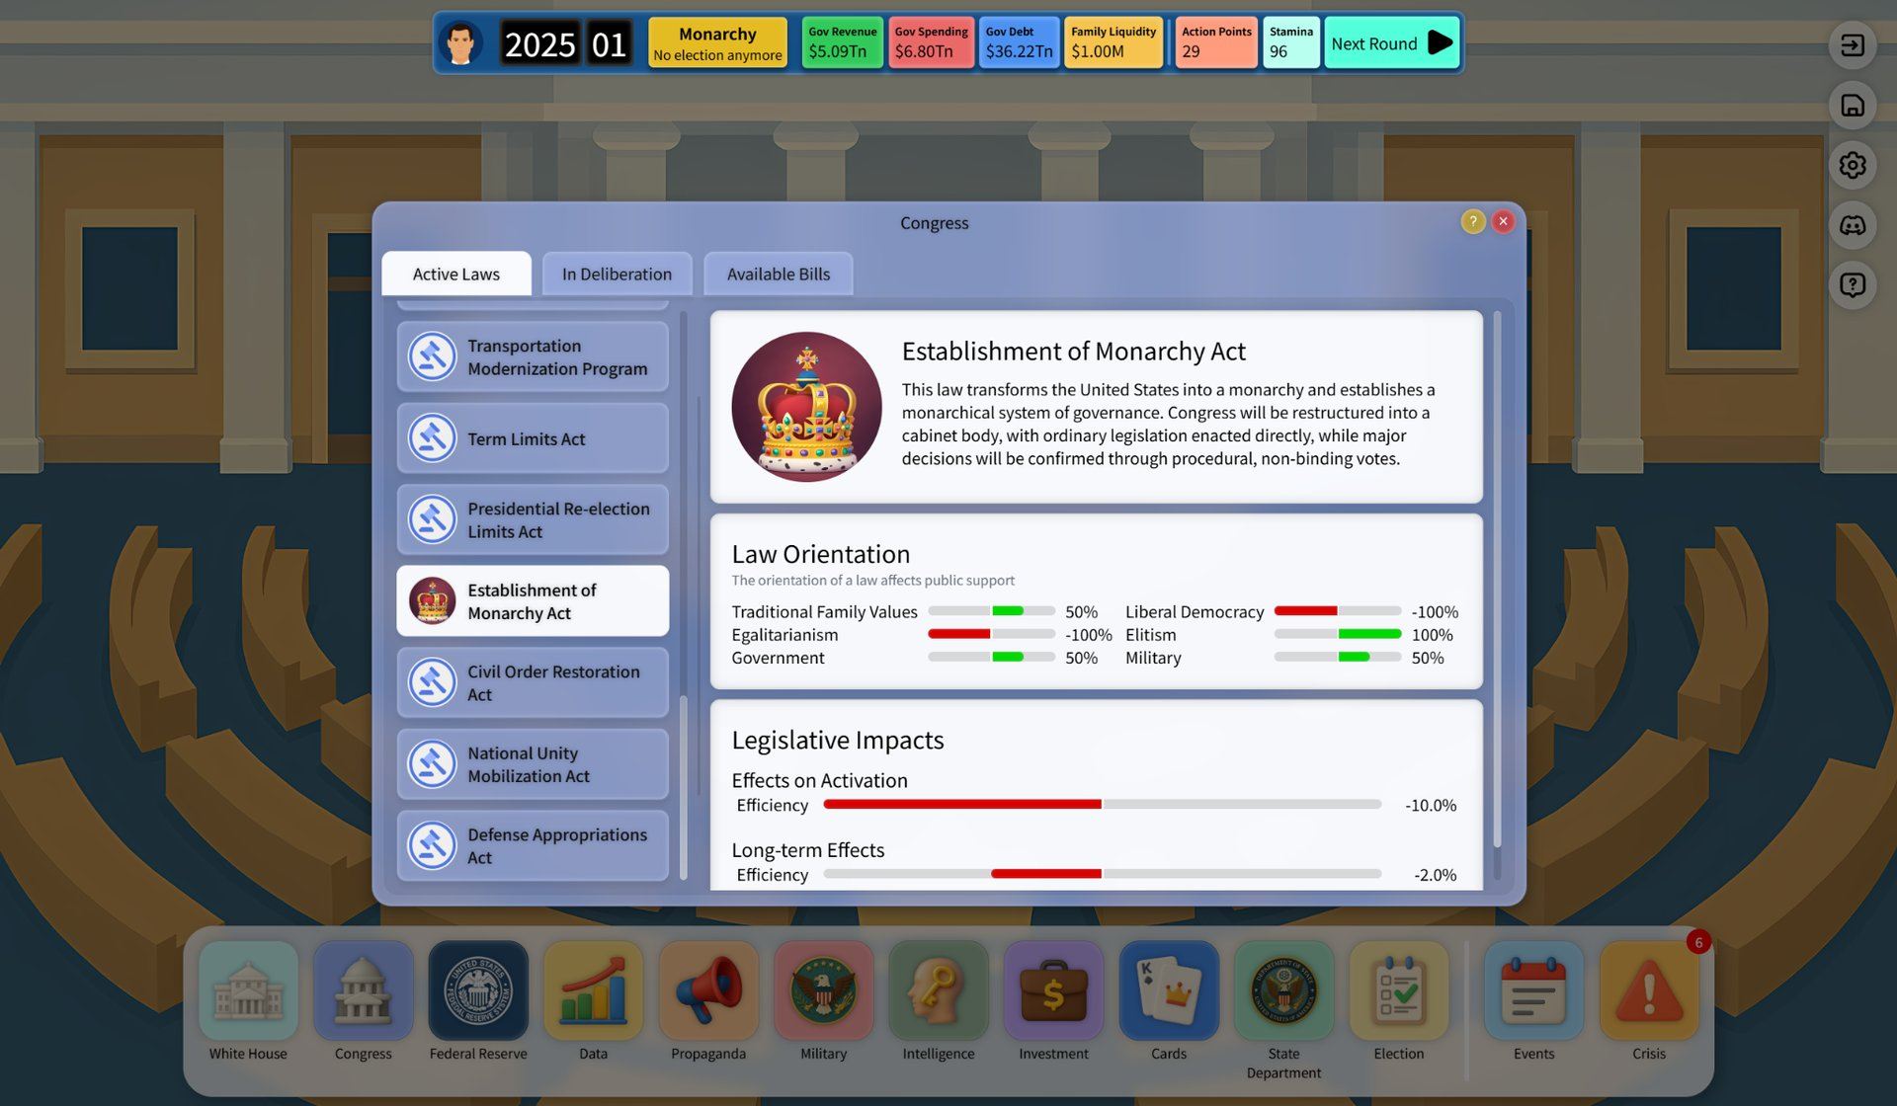
The fantasy
Run a modern democracy as an interconnected system of incentives.
POSITIONING
Win elections by shaping reality
Players should feel:
- Clever and resourceful: you spot leverage and execute a plan across multiple systems.
- Uneasy laughter: the satire is funny, but it stings because it feels plausible.
- Accountable: every shortcut has a cost, and the world pushes back.
The goal is tension: "I won, but I am not sure I should feel proud."
Policy can reshape the entire regime - and the consequences follow.
Electoral Empire - Pitch Deck

Slide 3
Core gameplay loop
Turn-based strategy with persistent consequences across politics, economy, and society.
Read the nation
Spend political capital
Win key battles
Live with fallout
Track public opinion, demographics, and national indicators.
Use action points to legislate, campaign, invest, and negotiate.
Card-based negotiations decide Congress, diplomacy, and deals.
Markets move, unrest rises, allies react. Adapt next round.
Key design principle: the player is not "roleplaying a hero" - they are managing a system.
When you optimize for power, the simulation responds with second-order effects (economy, unrest, geopolitics).
Electoral Empire - Pitch Deck

Slide 4
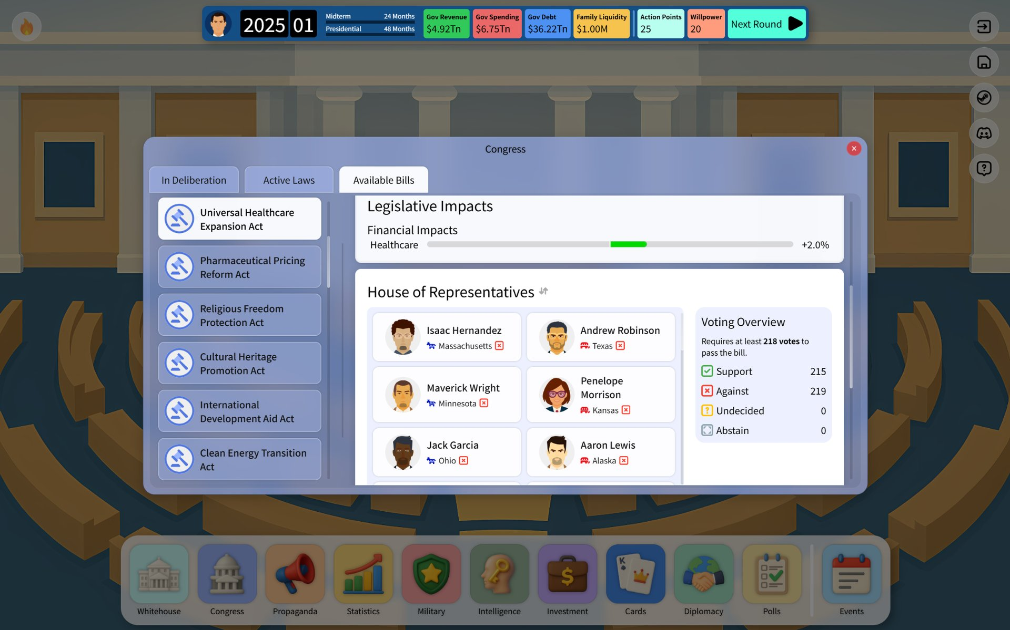
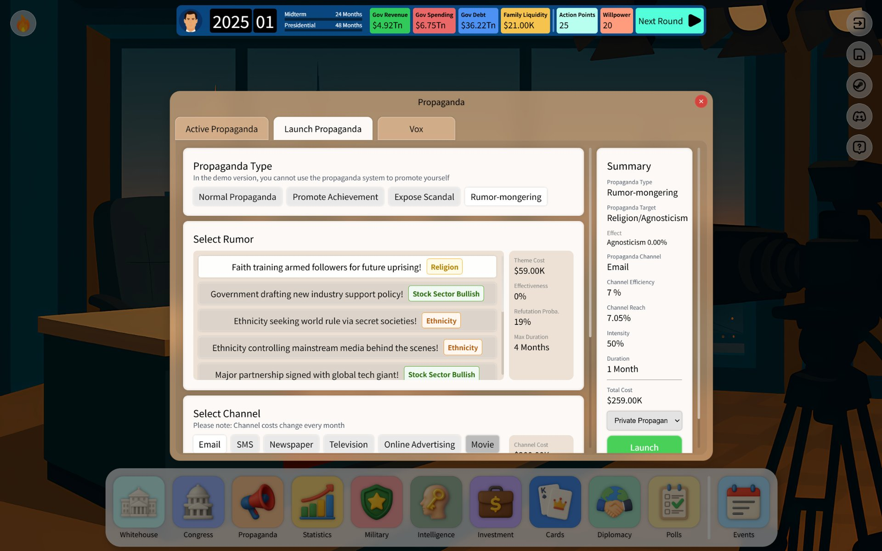
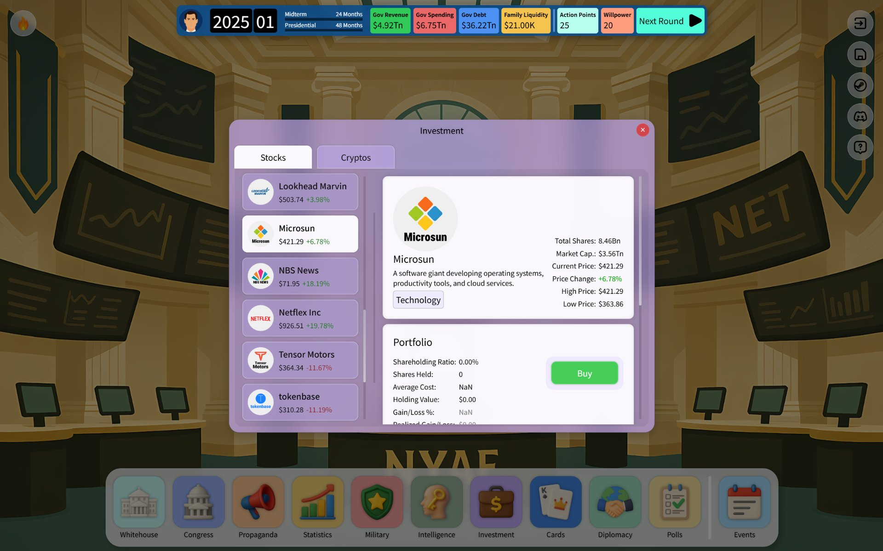
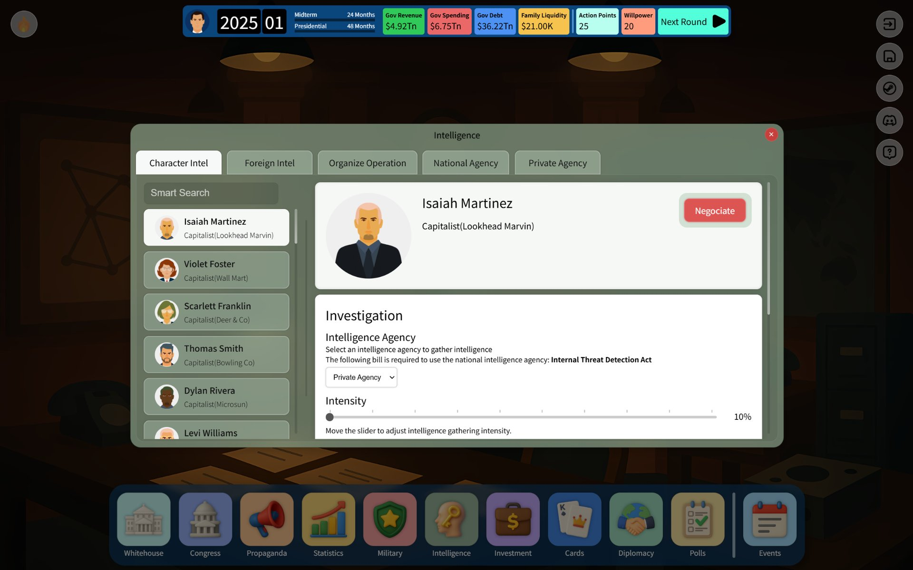
Four interconnected pillars
Each system is fun on its own - the strategy comes from their interactions.
Congress
Propaganda
Economy
Intelligence
Pass bills by winning support. Laws change the simulation.
Shape narratives through channels and themes. Risk backlash.
Markets react to policy. Invest, speculate, and survive cycles.
Gather leverage and evidence. Unlock stronger negotiation options.
Electoral Empire - Pitch Deck

Slide 5
Congress and legislation
Policy is not a menu - it is a battle for votes.
SYSTEM
Pass bills by building coalitions
- Vote counting and party alignment are explicit.
- Bills carry concrete economic and social effects.
- You persuade key representatives through negotiation battles (cards), favors, and timing.
Legislation becomes your main lever for reshaping the simulation, not a cosmetic choice.
Bills, voting thresholds, and representative-level persuasion.
Electoral Empire - Pitch Deck

Slide 6
Propaganda and elections
Campaigning is a resource-management problem - and a moral one.
SYSTEM
Manufacture narratives, not just policies
- Multiple channels: SMS, phone, TV, newspapers, online ads, and more.
- Themes: achievements, scandals, rumors, "empty" messaging, etc.
- Campaigns decay over time, can be refuted, and can trigger backlash or international reactions.
You can win with propaganda - but the simulation remembers.
Launch campaigns with different channels, intensity, and durations.
Electoral Empire - Pitch Deck

Slide 7
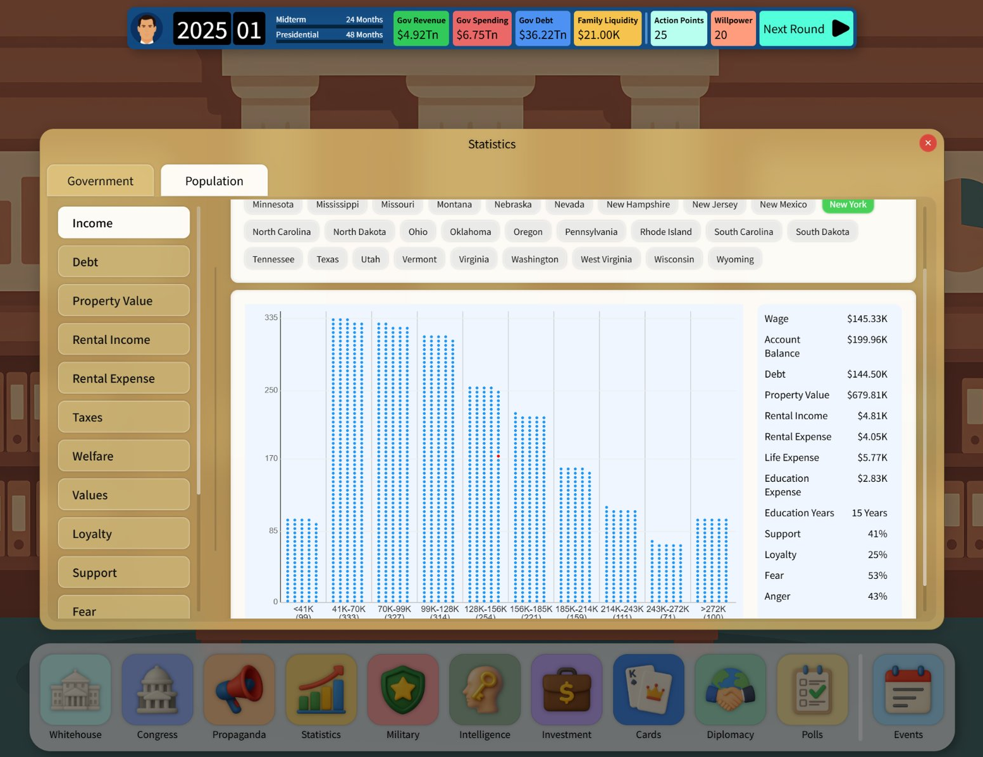
Population simulation
Politics only matters because people react differently.
SYSTEM
Data-driven voter behavior
- Demographics are modeled across states/districts with measurable outcomes.
- Track support, loyalty, fear, and anger - not just approval rating.
- Policy, propaganda, and economic shifts propagate through different groups.
The goal is clarity: you can see why a strategy worked - and why it failed.
Income distribution and voter sentiment in a selected state.
Electoral Empire - Pitch Deck

Slide 8
Intelligence and leverage
Power comes from what you know - and what you can prove.
SYSTEM
Investigate rivals and elites
- Investigations generate evidence and unlock stronger negotiation options.
- Choose agencies and intensity; higher intensity costs more and risks exposure.
- Intelligence feeds directly into propaganda, diplomacy, and card battles.
It is not flavor - it is a core strategic resource.
Investigations with adjustable intensity and agency choice.
Electoral Empire - Pitch Deck

Slide 9
Economy and markets
Your policies move the economy - and the economy moves your election.
SYSTEM
A strategy game with real financial feedback
- National indicators respond to policy, trade, and conflict.
- Markets react to narratives and regulation; cycles create opportunities and traps.
- Players can invest/speculate, but every trade has political consequences.
The economy is not a background number - it is a weapon and a liability.
Stock market interface with company profiles and performance changes.
Electoral Empire - Pitch Deck

Slide 10
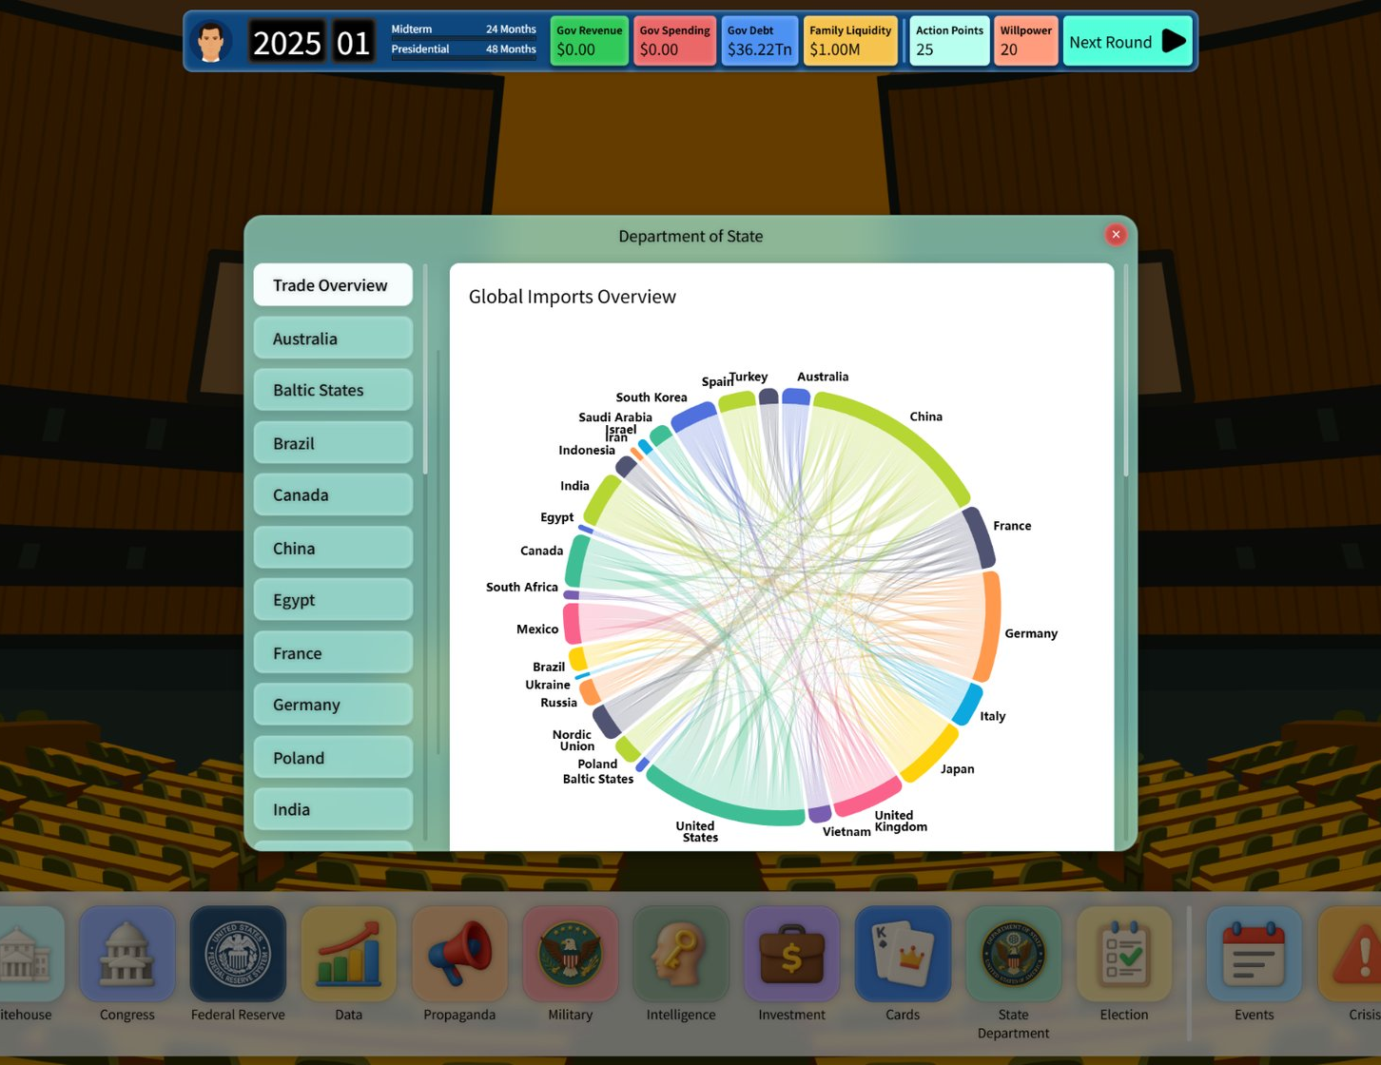
Global systems
Trade links everyone - which means every disruption cascades.
SYSTEM
Tariffs, sanctions, and supply chains
- Multi-country trade network with visible dependencies.
- Tariffs and sanctions redirect demand, create inflation pressure, and trigger retaliation.
- Domestic replacement and strategic industries create long-term trade-offs.
Players can "win" a trade war and still lose an election.
Global import network visualization (dependencies and concentration).
Electoral Empire - Pitch Deck

Slide 11
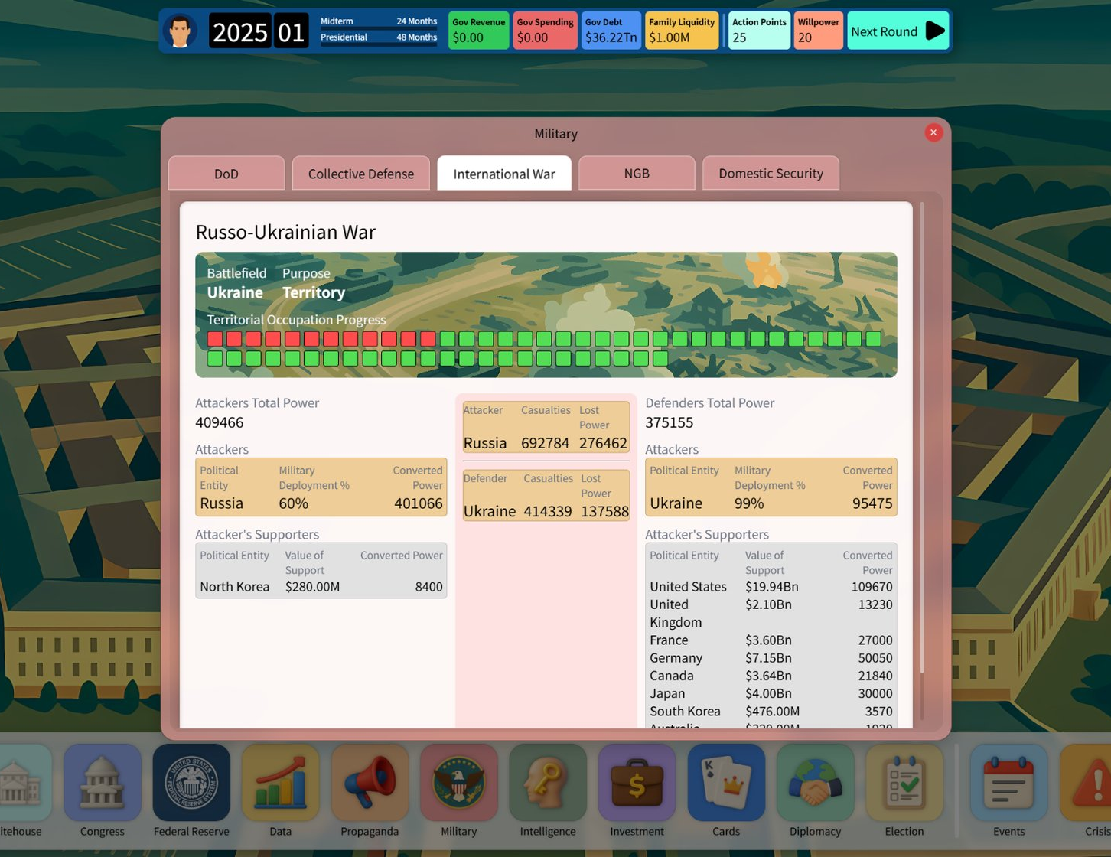
War and geopolitics
Conflict is expensive, unpredictable, and politically tempting.
SYSTEM
Wars reshape budgets and legitimacy
- Ongoing conflicts drain resources and shift public sentiment.
- Allies can provide support; rivals can exploit instability.
- War interacts with diplomacy, trade, and propaganda.
The player is rewarded for understanding second-order effects, not for clicking "attack".
War overview: progress, participants, support, and converted power.
Electoral Empire - Pitch Deck

Slide 12
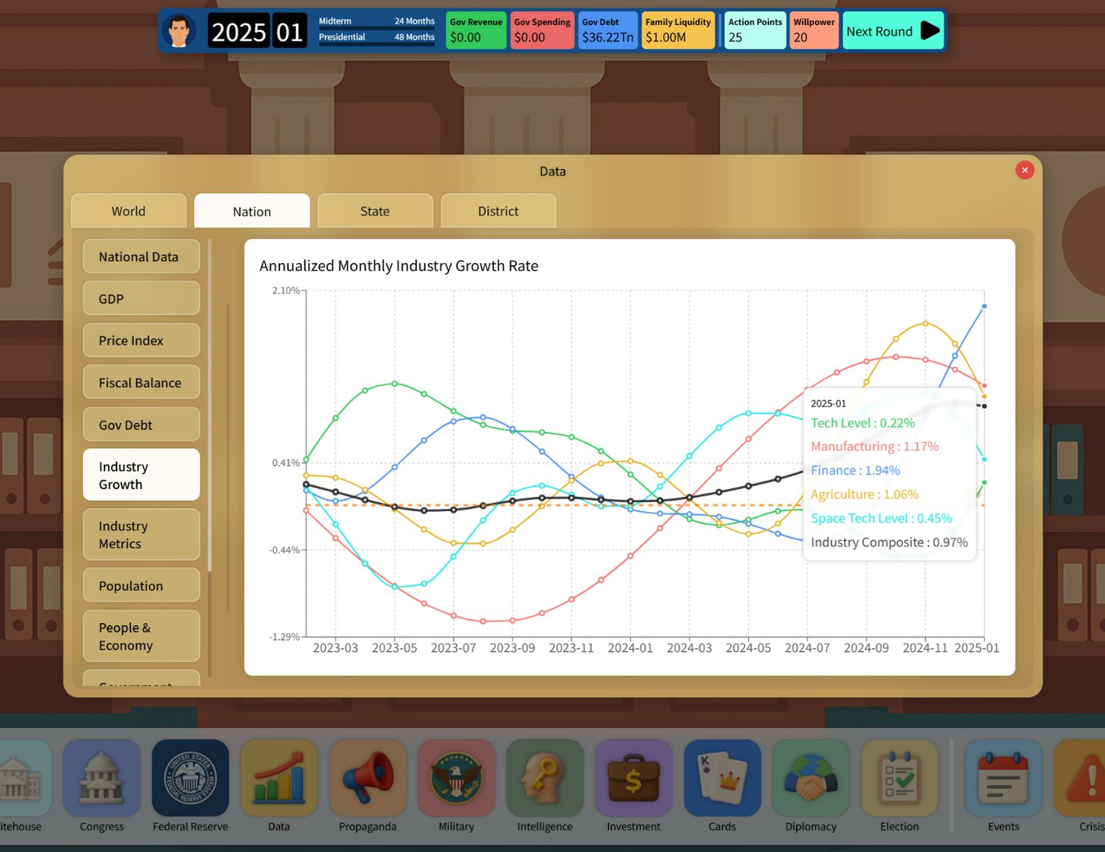
Development status
A playable build exists today. We are seeking a publishing partner for launch.
STATUS
Playable + systems-complete foundation
Current:
- Core loop implemented (politics, propaganda, economy, intelligence, diplomacy, war).
- Steam page live; Steam Playtest build available (keys on request).
Next (publisher-aligned):
- Content expansion + balancing (events, laws, cards).
- Trailer/promo iteration based on publisher positioning.
- QA + localization pipeline for launch.
Platform scope: Steam (PC) first.
Example of tracked national indicators across time (industry growth).
Electoral Empire - Pitch Deck

Slide 13
What we are looking for
- Publishing partner for Steam launch (store strategy, pricing, release timing).
- Marketing/PR: positioning, beats, creators, press outreach, and festivals.
Steam page: store.steampowered.com/app/3677060
Playtest keys: available on request
Contact:
Water Wood Games
Victor.yeung.it@hotmail.com

