Slide 1

Enhancing Seismic Safety in Munich's Geothermal Energy Sector: Data-driven Model Updating for Building Vibrations under Induced Seismicity
M.Sc. Wei-Teng, Kao
Technical University of Munich
TUM School of Engineering and Design
Chair of Structural Mechanics
Munich, 23.09.2024

Slide 2
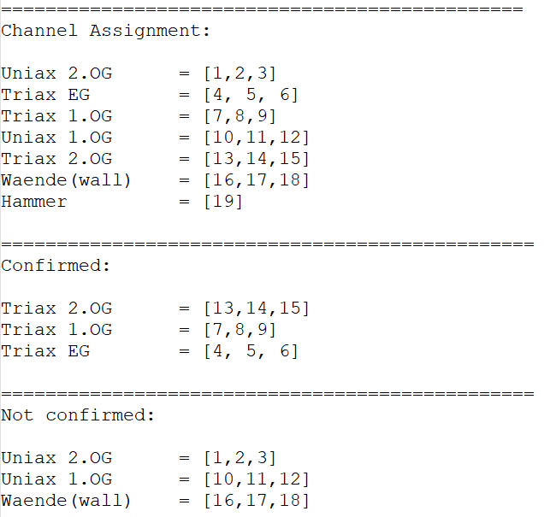
Channel assignment
For Triax EG:
[x, y, z] = [4, 5, 6]
For Triax 1.0G:
[x, y, z] = [7, 8, 9]
For Triax 2.0G:
[x, y, z] = [13, 14, 15]
For Uniax: vertical dirs.
For Waende: horizontal dirs.

Slide 3
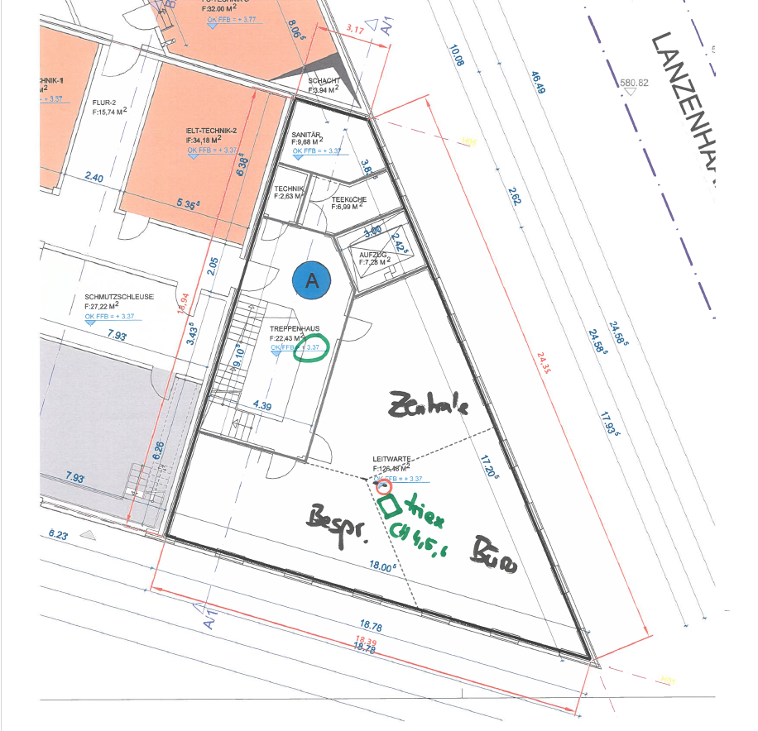
Channel at 1. OG
Q: Does the Triex sensor point in the same direction as the Menhir device? Yes
Q: The corresponding channel for the Triex sensor at 1. OG should be channel [7,8,9] for [X, Y, Z]?

Slide 4
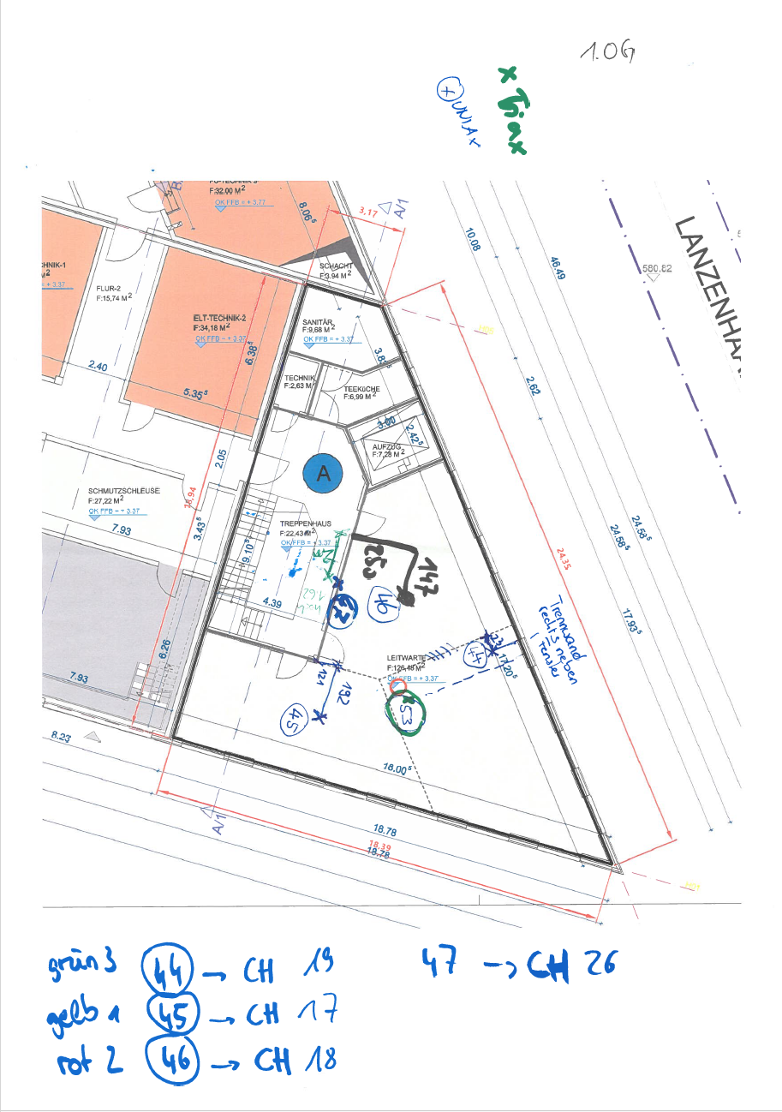
Channel at 1. OG
Q: What are the corresponding channels for positions [44,45,46,47]?
44 = CH:
45 = CH:
46 = CH:
47 = CH: (Waende)
Q: Positions 44, 45, and 46 should be in vertical dir., and 47 should be in horizontal?
Q: The unit here should be cm?

Slide 5
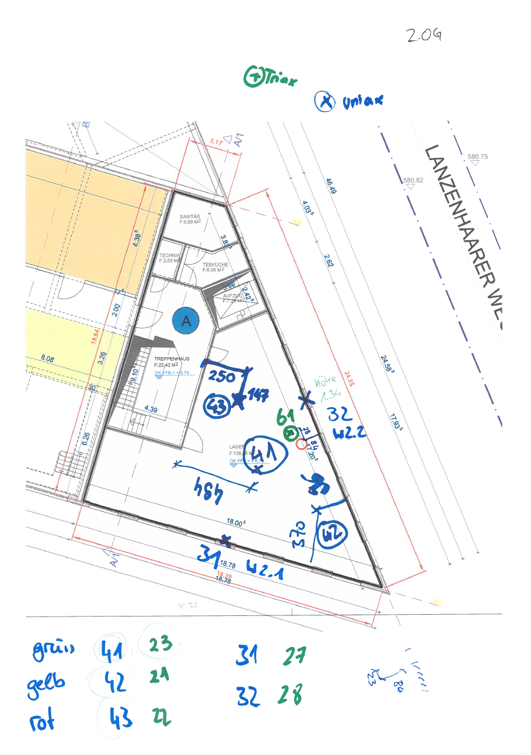
Channel at 2. OG
Q: What are the corresponding channels for positions [41,42,43,31,32]?
41 = CH:
42 = CH:
43 = CH:
31 = CH: (Waende)
32 = CH: (Waende)
Q: Positions 41, 42, and 43 should be in vertical dir., and 31,32 should be in horizontal?

