Slide 1

Enhancing Seismic Safety in Munich's Geothermal Energy Sector: Data-driven Model Updating for Building Vibrations under Induced Seismicity
M.Sc. Wei-Teng, Kao
Technical University of Munich
TUM School of Engineering and Design
Chair of Structural Mechanics
Munich, 23.09.2024

Slide 2
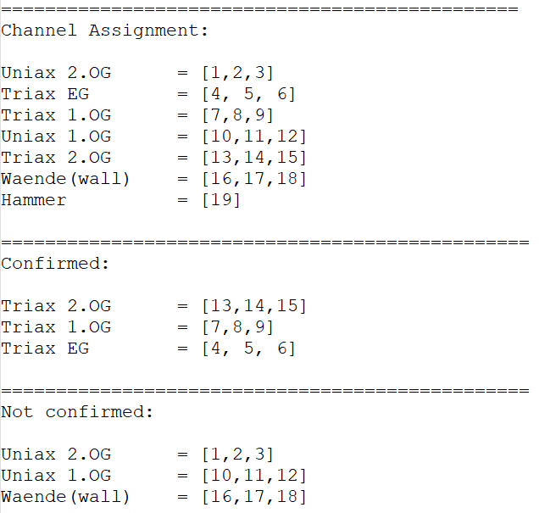
Channel assignment
For Triax EG:
[x, y, z] = [4, 5, 6]
For Triax 1.0G:
[x, y, z] = [7, 8, 9]
For Triax 2.0G:
[x, y, z] = [13, 14, 15]
For Uniax: vertical dirs.
For Waende: horizontal dirs.

Slide 3
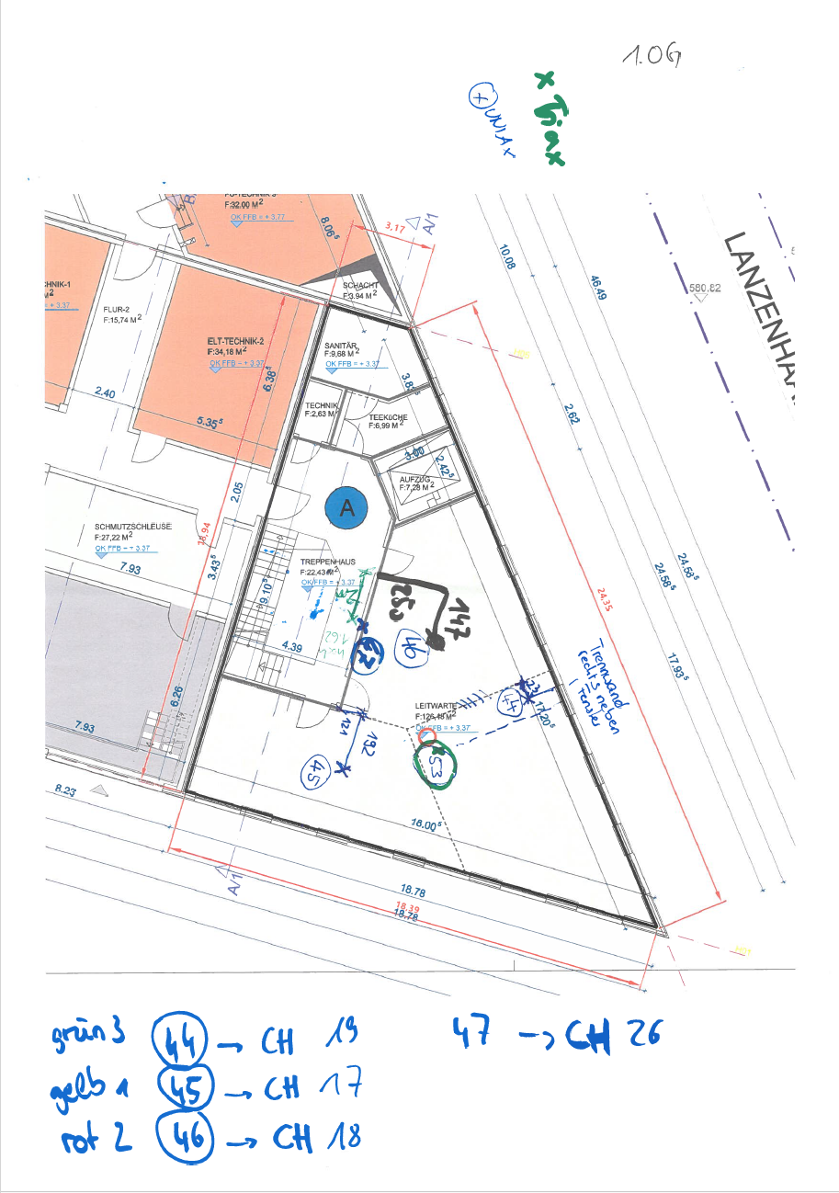
Channel at 1. OG
Q: What are the corresponding channels for positions [44,45,46,47]?
44 = CH: 19 = MAT 12
45 = CH: 17 = MAT 10
46 = CH: 18 = MAT 11
47 = CH: 26 = MAT 16 (Waende)
Q: Positions 44, 45, and 46 should be in vertical dir., and 47 should be in horizontal?
Q: The unit here should be cm?

Slide 4
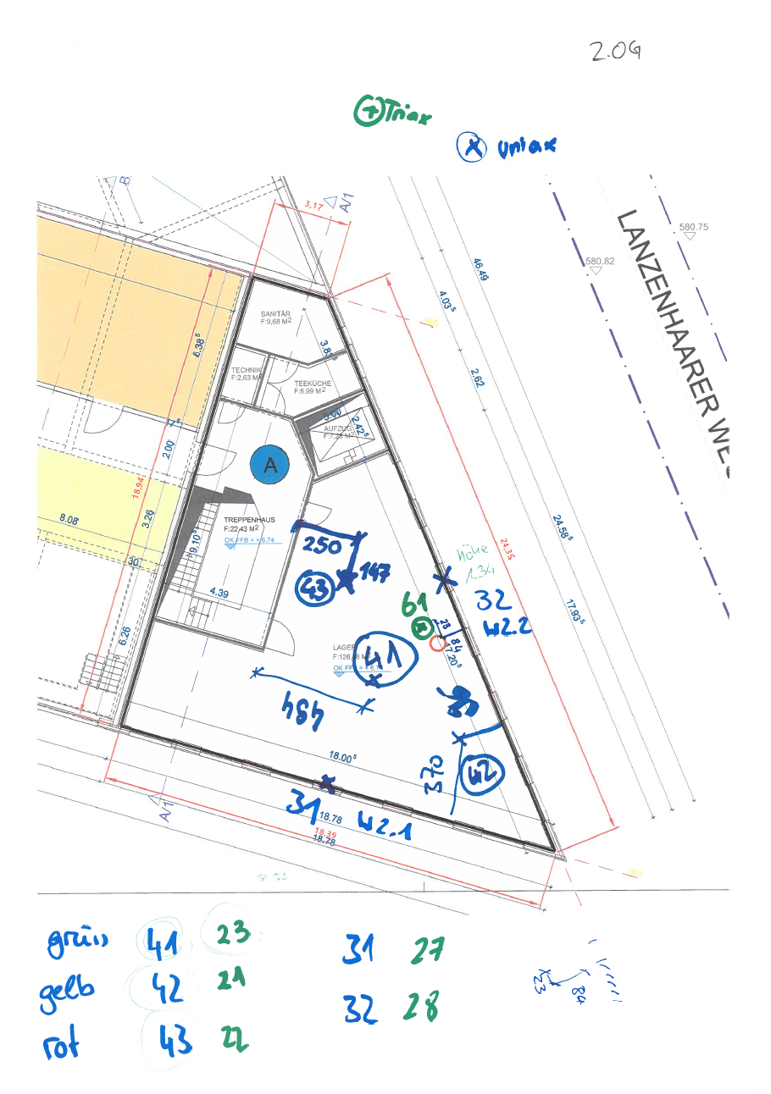
Channel at 2. OG
Q: What are the corresponding channels for positions [41,42,43,31,32]?
41 = CH: 23 = MAT 15
42 = CH: 21 = MAT 13
43 = CH: 22 = MAT 14
31 = CH: 27 = MAT 17 (Waende)
32 = CH: 28 = MAT 18 (Waende)
Q: Positions 41, 42, and 43 should be in vertical dir., and 31,32 should be in horizontal?

Slide 5
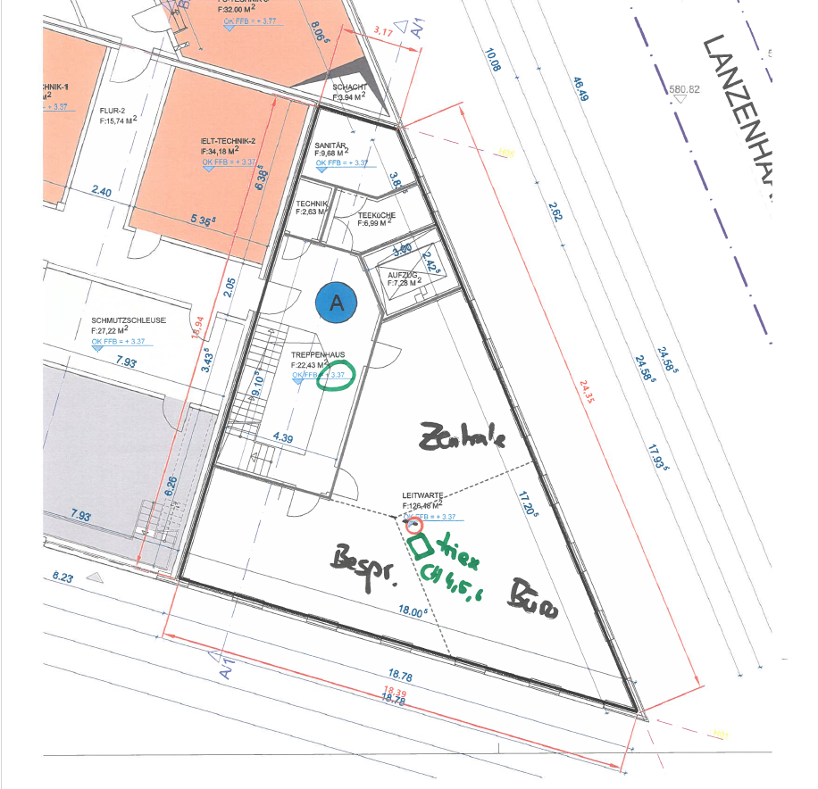
Channel at 1. OG
Q: Does the Triex sensor point in the same direction as the Menhir device? Yes
Q: The corresponding channel for the Triex sensor at 1. OG should be channel [7,8,9] for [X, Y, Z]?

Slide 6
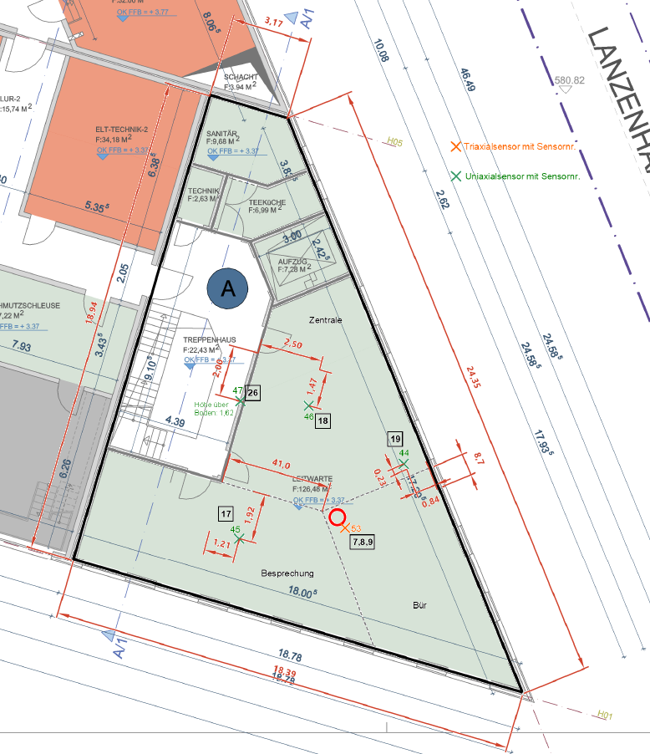
Channel at 1. OG
Compute the position by scaling ratio:
58.5 cm: 18.39m = 26 cm: X
60 cm : 18:94m = 14.5 cm: Y
-> LOCATION of Triex: [8.50 m, 4.58 m]

Slide 7
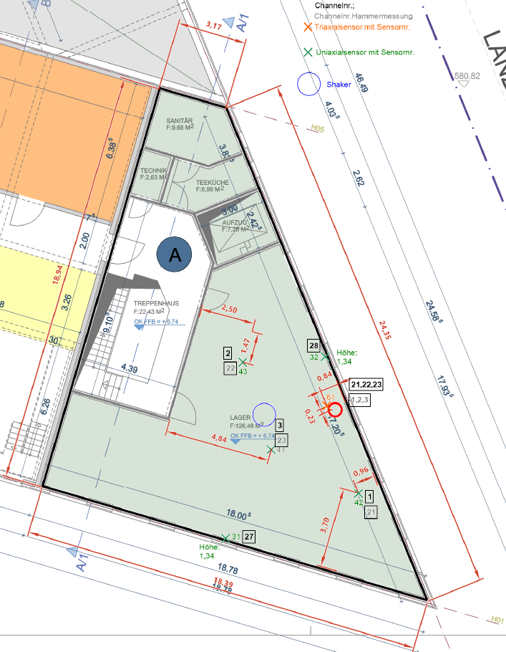
Channel at 1. OG
Compute the position by scaling ratio:
-> LOCATION of Triex: [9.23 m, 4.58 m]

Slide 8
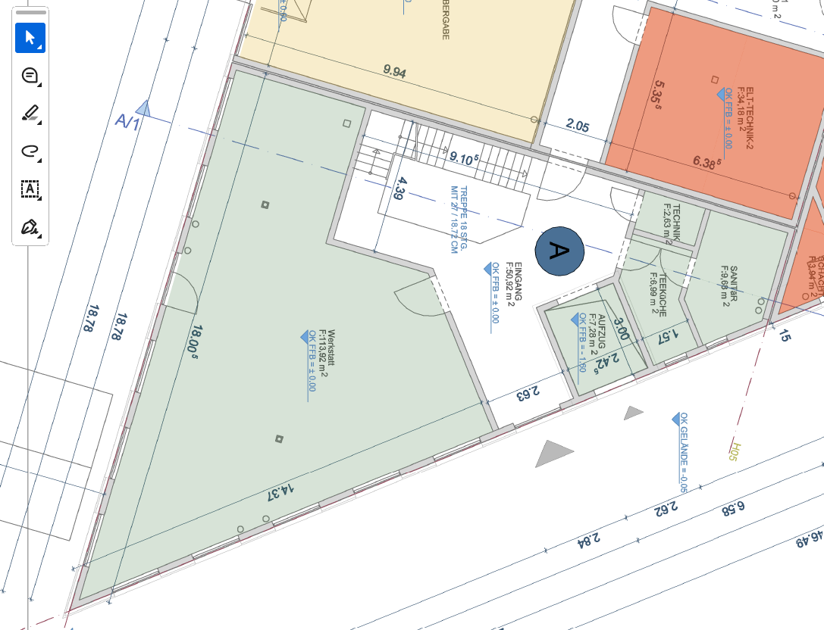
Building info
Height of each floor (OK FFB) = 3.37 m
Thickness of each floor = appr. 80.5 cm (18.72 cm * 4.3 Treppe)

Slide 9
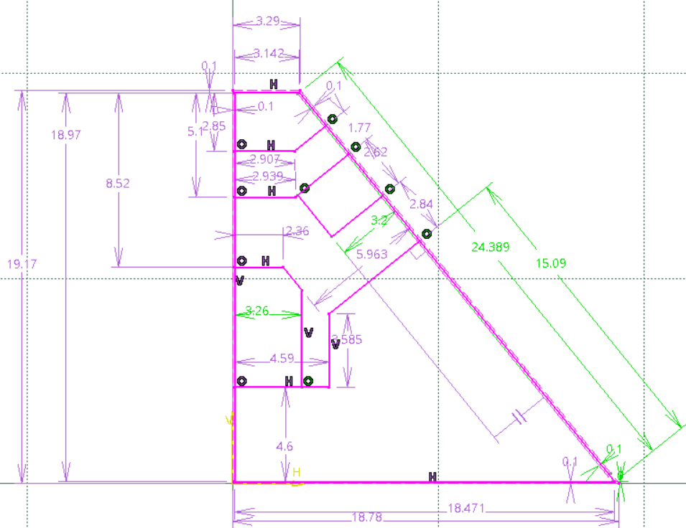
EG

Slide 10
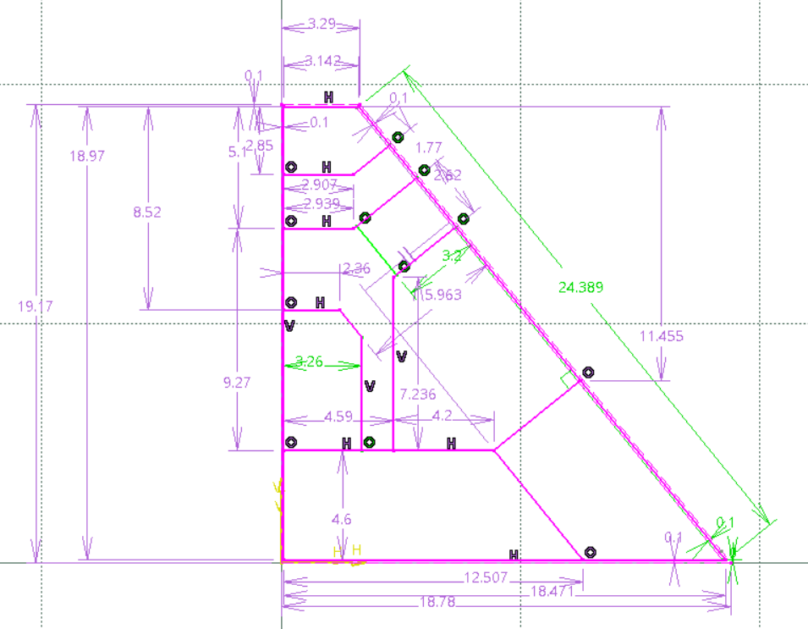
1OG

Slide 11
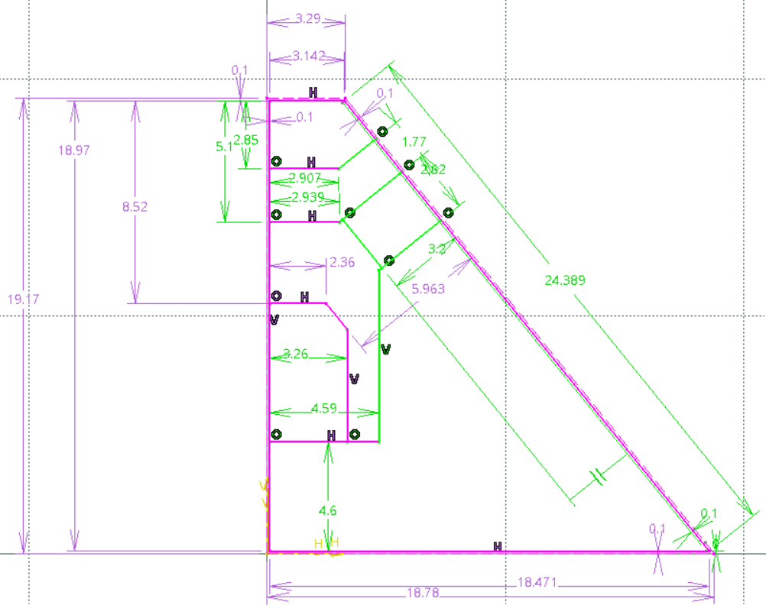
2OG

Slide 12
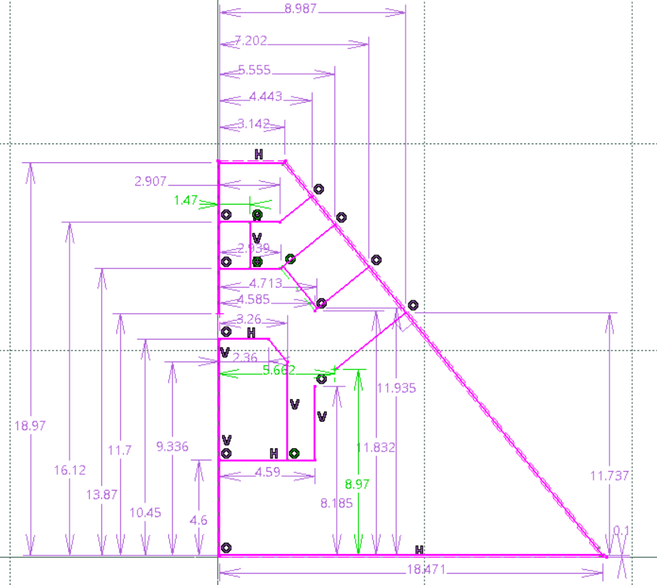
EG coord

Slide 13
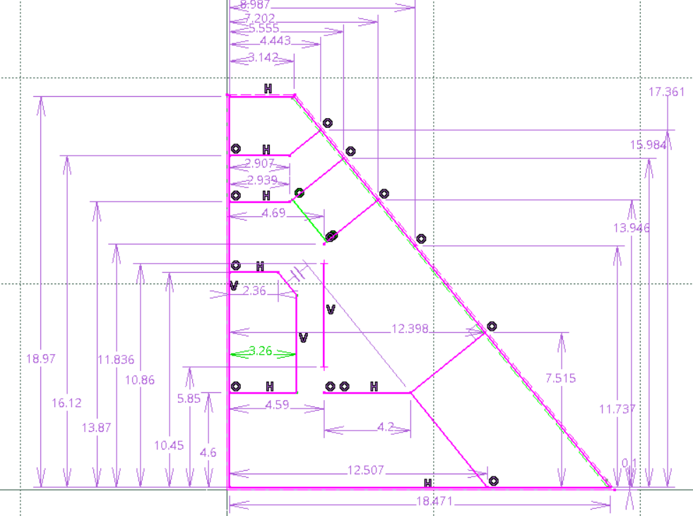
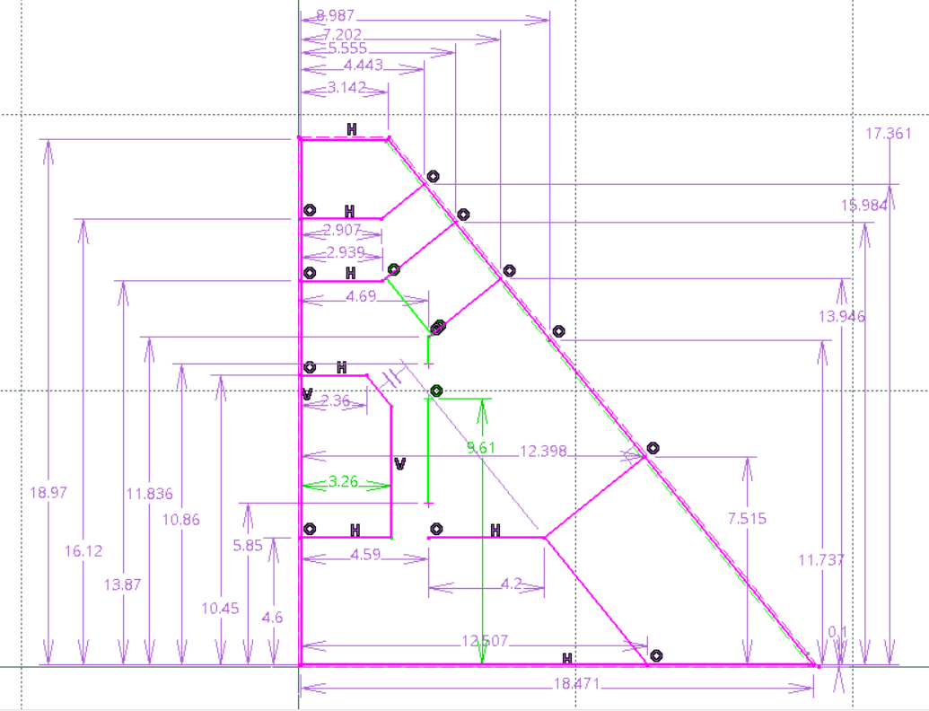
1, 2 OG coord

Slide 14
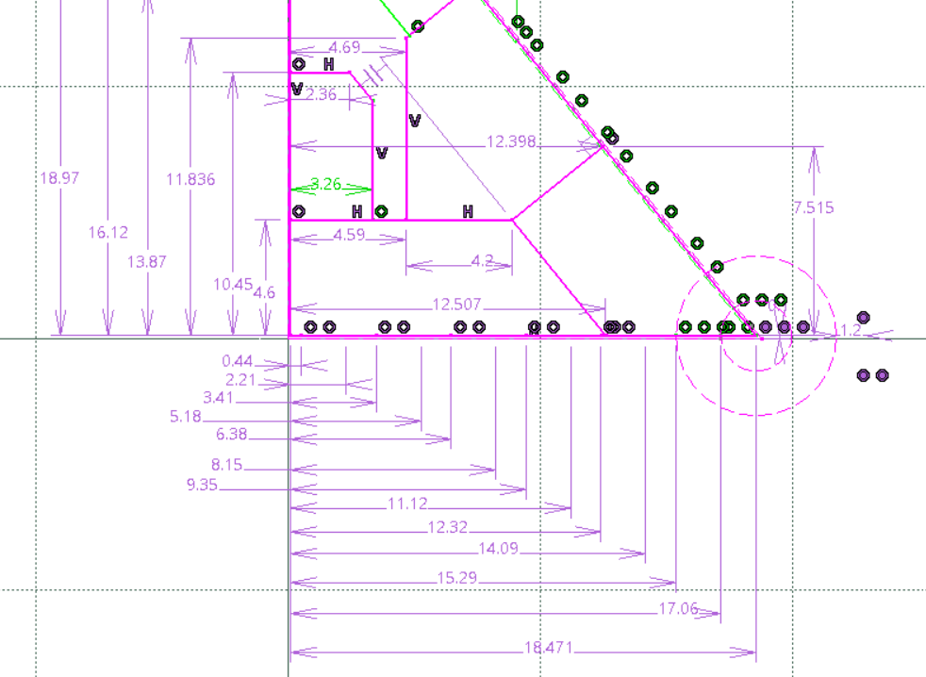
1, 2 OG coord

Slide 15
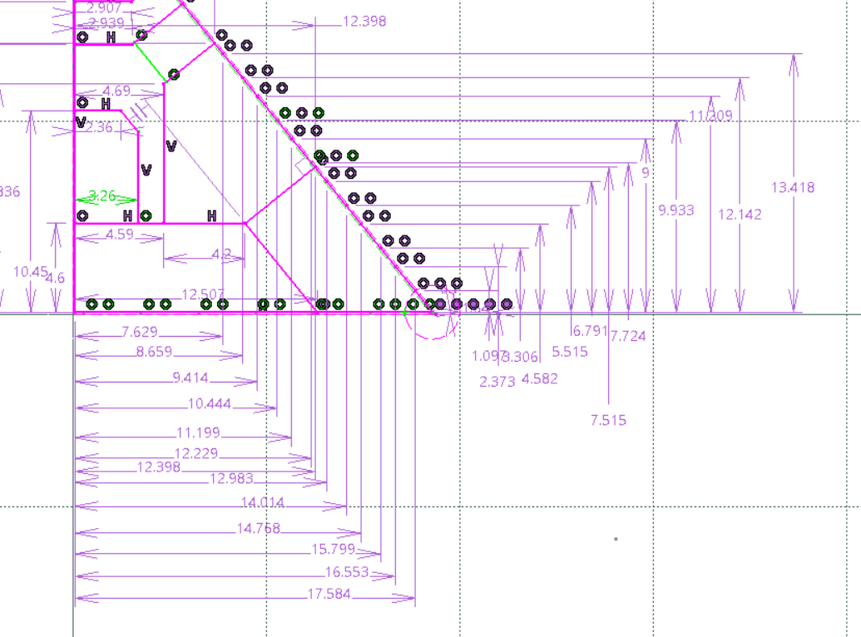
1, 2 OG coord

Slide 16
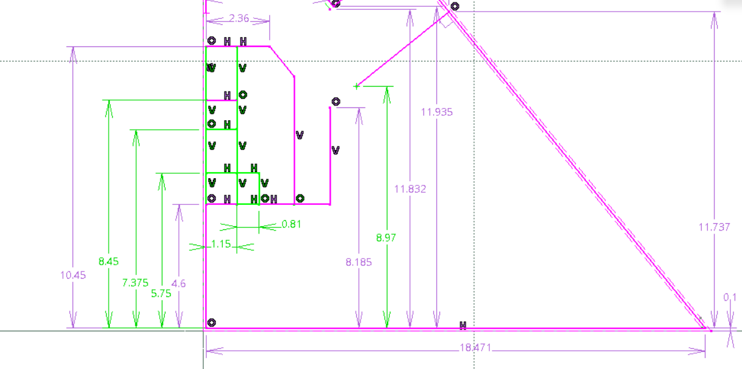
Stair

Slide 17
Sensitivity based FEMU:
Not working, due to an underdetermined system
[1]: Improved finite element model updating of a fullscale steel bridge using sensitivity analysis
[2]: The sensitivity method in finite element model updating: A tutorial

