Slide 1
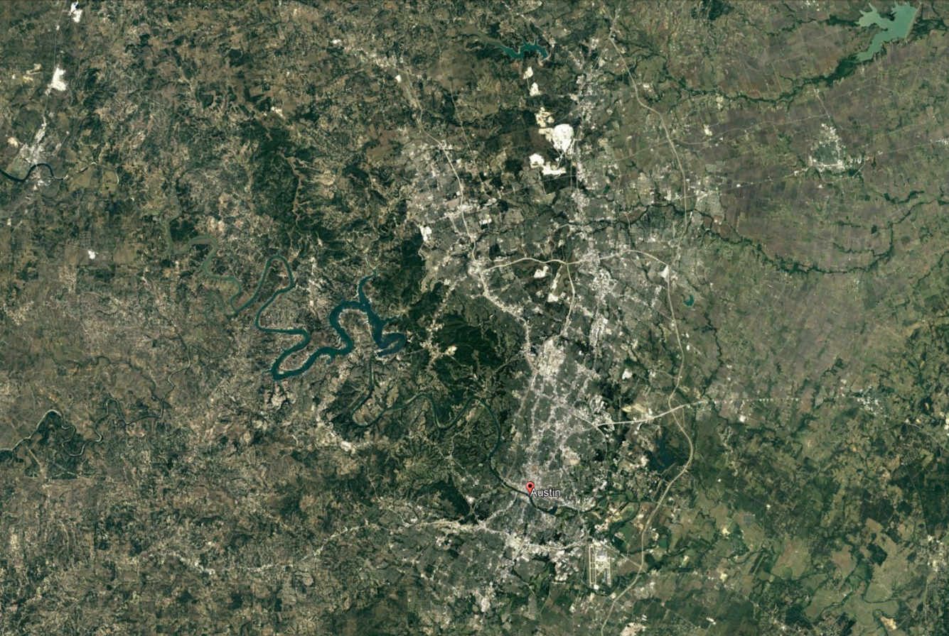

Slide 2
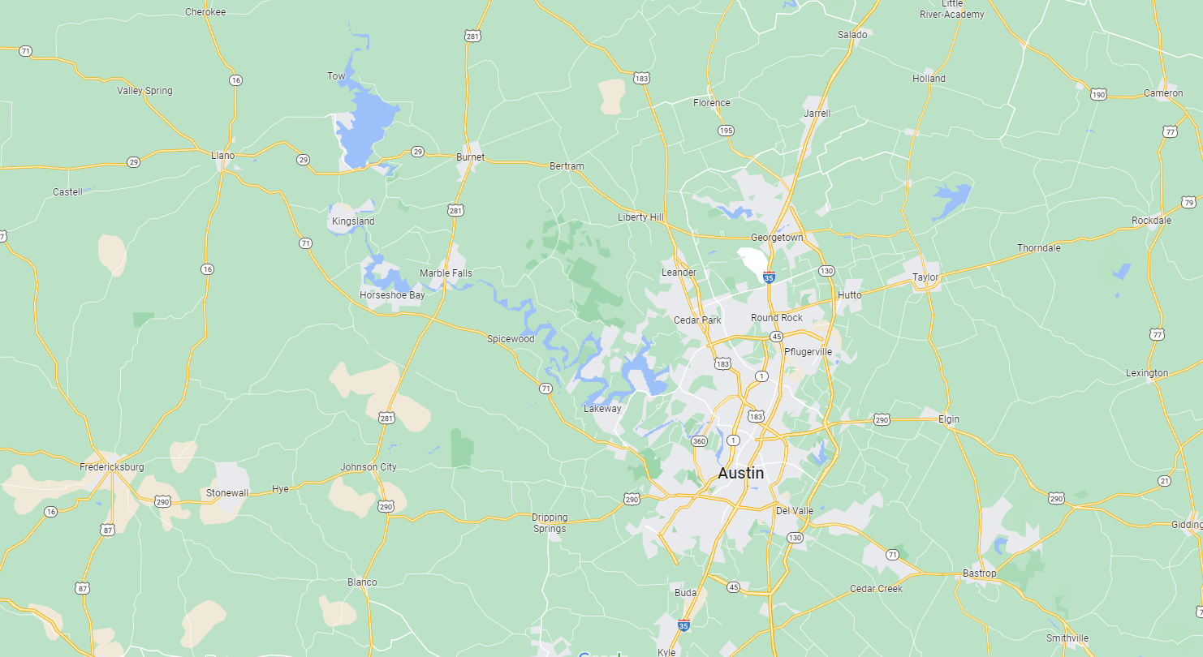




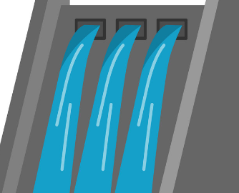

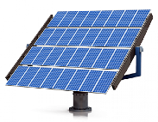
100 km
170 km
150 km
200 km
80 km
110 km
90 km
180 km

Slide 3
Z
B0
L1=100 km
B2
B3
B1
L4=200 km
L2=140 km
L5=140 km
L3=100 km
B4
B6
L8=100 km
L7=100 km
B8
B7
L6=140 km
B5

Slide 4
Z
B0
L10=224 km
L1=100 km
B2
B3
B1
L4=200 km
L2=140 km
L5=140 km
L11=140 km
L3=100 km
B4
B6
L8=100 km
L7=100 km
B8
L9=140 km
B7
L6=140 km
B5

Slide 5
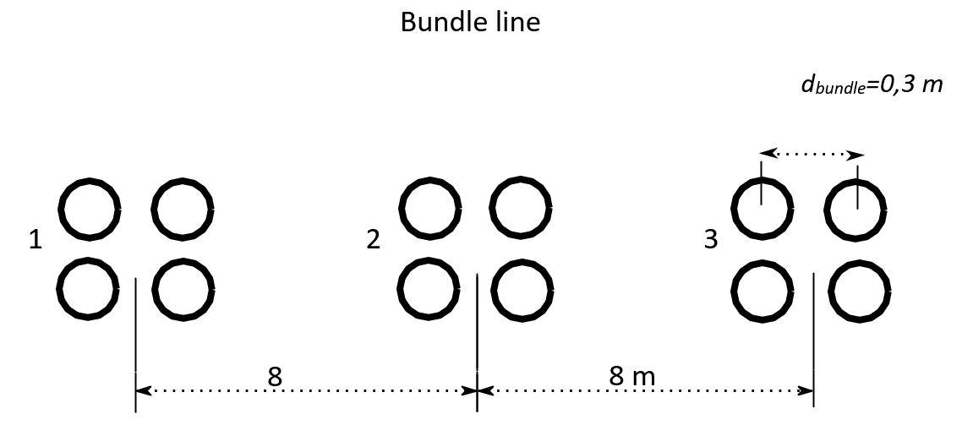
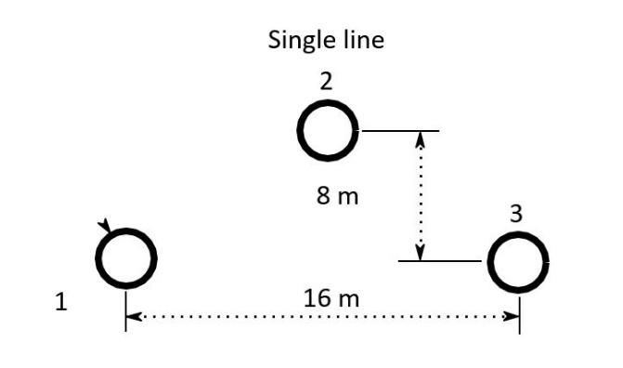
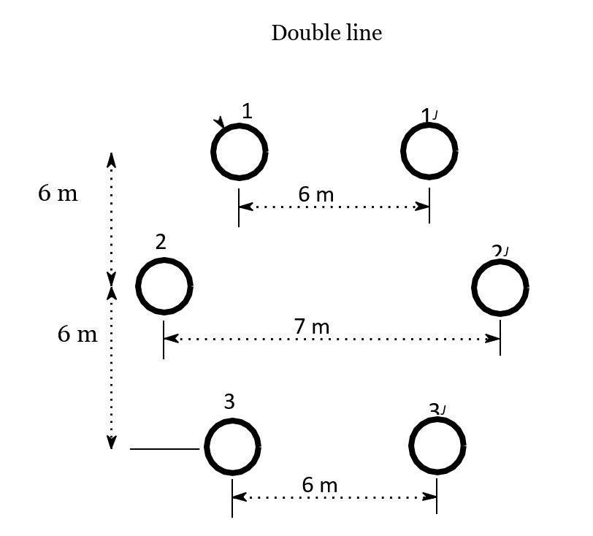
Bundle line
Single line
Dbundle= 0,3
3m
12m
6m
6m
Double line
Single line
Single line
6m
8m
6m

