Slide 1
BioRobotics

Slide 2
Why EMG?
Prosthetics
Gesture Control
Rehabilitation
Exoskeletons
Intuitive control of robotic limbs using muscle signals
Hands-free interaction with devices and computers
Biofeedback for stroke recovery and physical therapy
Assistive devices that respond to user intent
EMG provides a direct window into motor intent

Slide 3
The Big Picture
Brain
Intent
Muscle
Contraction
EMG
Signal
Signal
Processing
Classification
Robot
Control
→
→
→
→
→

Slide 4
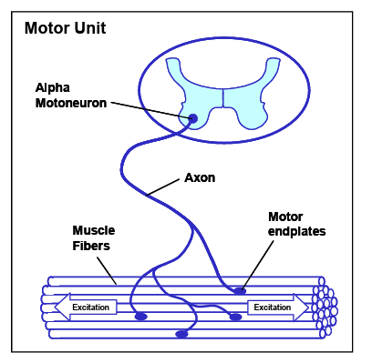
The Motor Unit
Motor neuron + all muscle fibers it innervates
Each motor unit fires as a single unit (all-or-none)
Force control: recruit more motor units or increase firing rate
The fundamental unit of muscle control

Slide 5
What is EMG?
Electromyography (EMG)
Electrical recording of muscle activity during contraction
Frequency Range
Amplitude
Electrode Types
2 - 500 Hz
(most energy 20-150 Hz)
50 µV - 5 mV
(depends on electrode)
Surface: non-invasive
Intramuscular: high resolution
We'll focus on surface EMG (sEMG)

Slide 6
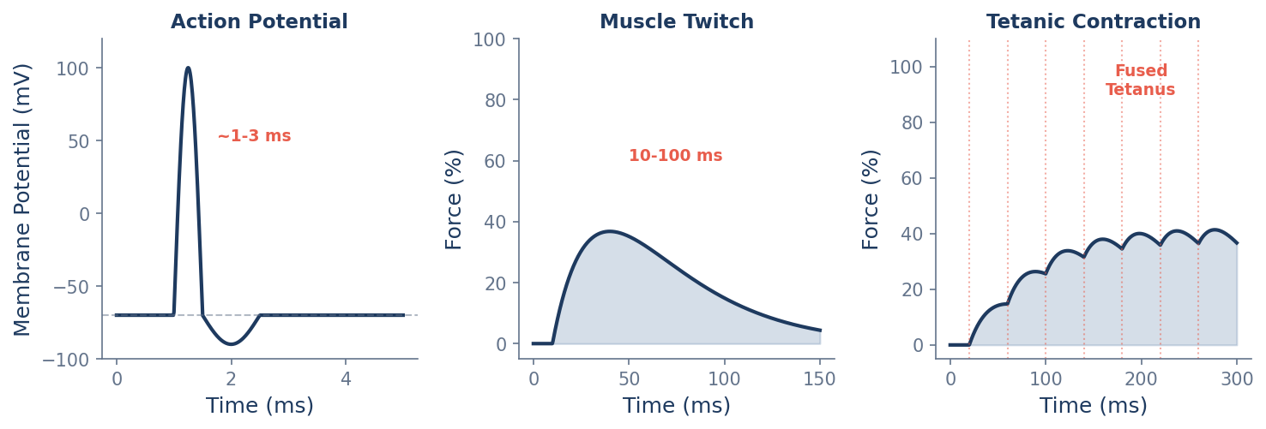
From Action Potential to Contraction
Action potential: 1-3 ms electrical spike
Twitch: 10-100 ms mechanical response
Tetanus: fused contractions at high firing rates (>30 Hz)

Slide 7
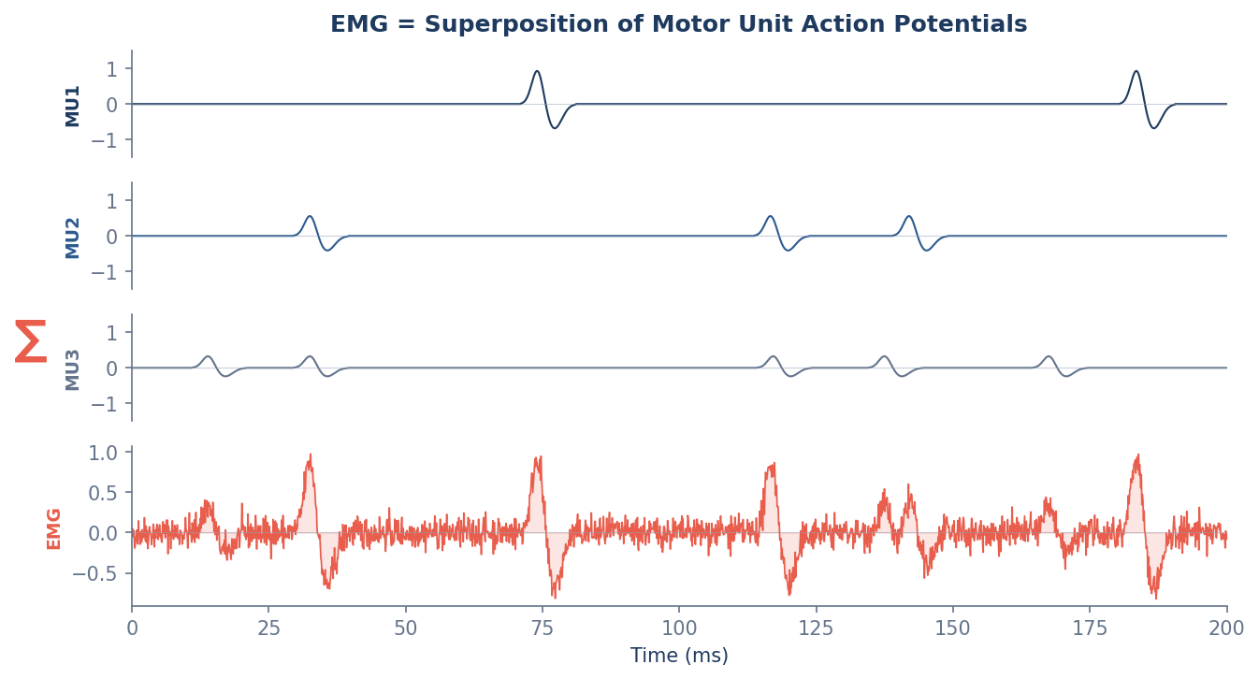
EMG as Superposition

Slide 8
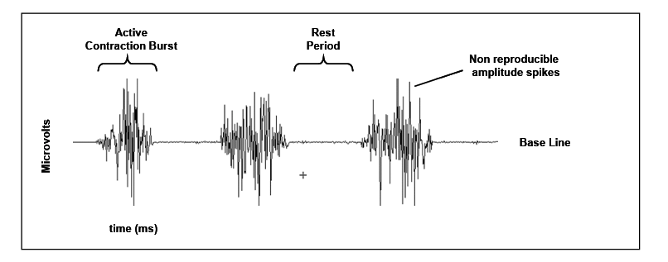
EMG Signal

Slide 9
Electrode Configuration
Bipolar differential: 2 electrodes + reference
Measures voltage difference to reject common noise
Placement matters: along muscle fiber direction
Inter-electrode distance: 1-2 cm typical
Myo Armband Specifications:
8 channels (dry electrodes)
200 Hz sampling rate
8-bit resolution
Wireless via Bluetooth
Good for gesture classification

Slide 10
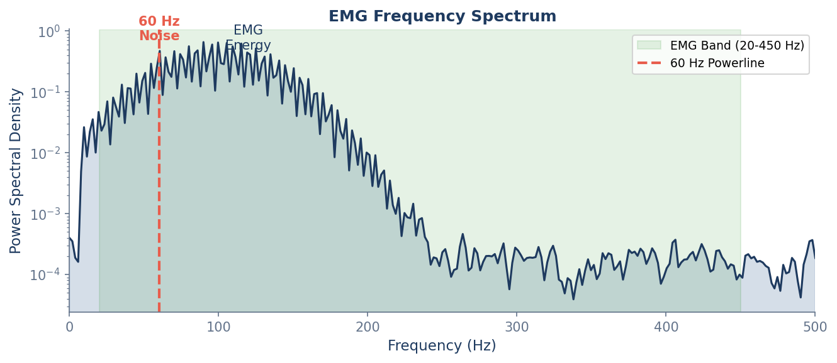
Noise Sources in EMG

Slide 11
Filtering Fundamentals
Nyquist Theorem
Common Filters
Sample at ≥ 2× max frequency to avoid aliasing
Myo: 200 Hz → can capture up to 100 Hz
High-pass (20 Hz): remove motion artifacts
Low-pass (450 Hz): anti-aliasing
Notch (50/60 Hz): powerline rejection
Butterworth: smooth frequency response

Slide 12
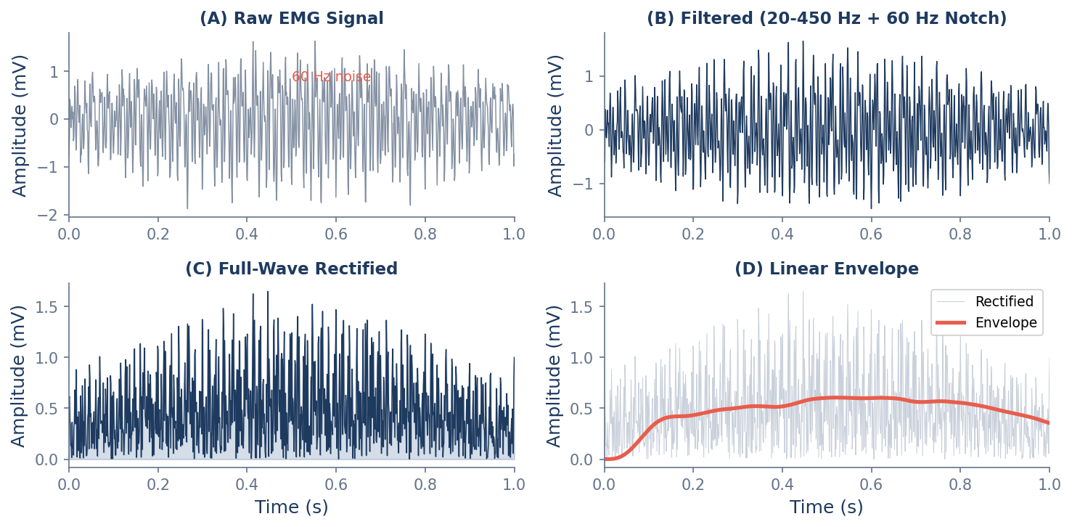
Signal Processing Pipeline
Raw → Bandpass → Rectify → Smooth
Each step reveals different information

Slide 13
Envelope Extraction
Rectification
Linear Envelope
y(t) = |x(t)|
Low-pass filter the rectified signal
Convert bipolar signal to unipolar
Makes averaging meaningful
Smooths rapid fluctuations
Tracks muscle activation level
Used for proportional control
Proportional control: Envelope amplitude → Robot speed/force

Slide 14
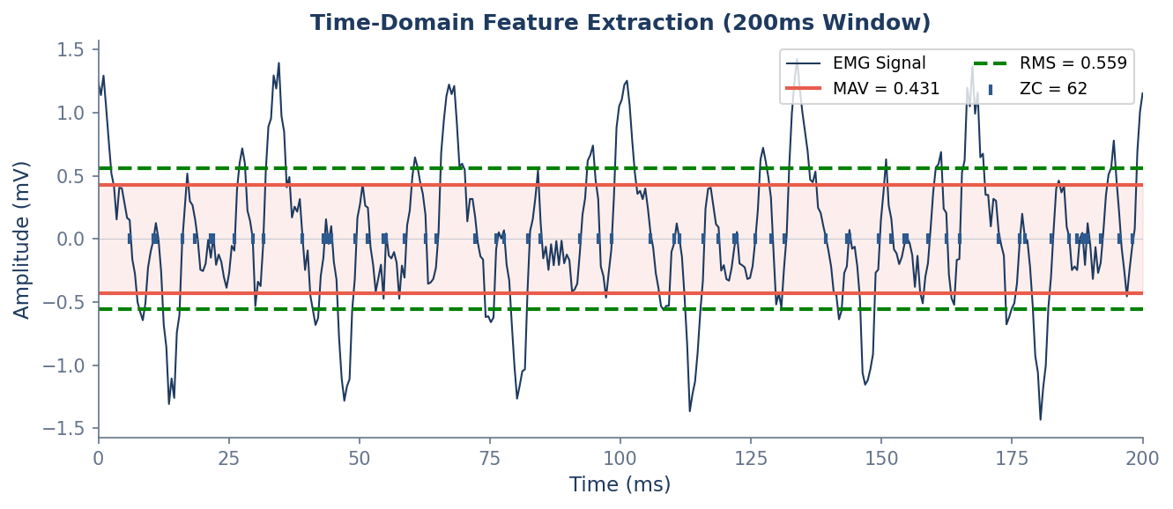
Time-Domain Features (Hudgins Set)
MAV: Mean Absolute Value - overall activation level
RMS: Root Mean Square - signal power
ZC: Zero Crossings - frequency content proxy
WL: Waveform Length - signal complexity
SSC: Slope Sign Changes - high-frequency content

Slide 15
Feature | Description | Physiological Correlation | Application
Median Frequency (MDF) | Frequency dividing power spectrum into equal halves | ↓ Decreases with FATIGUE (spectral shift to lower freq) | Fatigue monitoring, ergonomic assessment
Mean Frequency (MNF) | Centroid of the power spectral density | ↓ Decreases with FATIGUE (tracks conduction velocity) | Endurance studies, rehabilitation progress
RMS / MAV | Root mean square / Mean absolute value | ↑ Increases with FORCE (motor unit recruitment) | Proportional control, force estimation
Zero Crossings (ZC) | Number of times signal crosses zero per second | ~ Reflects FIRING RATE (motor unit discharge) | Gesture classification, MUAP analysis
Waveform Length (WL) | Cumulative length of the EMG waveform | ↑ Increases with ACTIVITY (amplitude + complexity) | Onset detection, activity quantification
💡 Key Insight: Median frequency (MDF) is the gold standard for fatigue detection. As muscle fatigues, conduction velocity decreases and action potentials broaden, shifting power to lower frequencies. A 10-15% drop in MDF typically indicates significant fatigue.

Slide 16
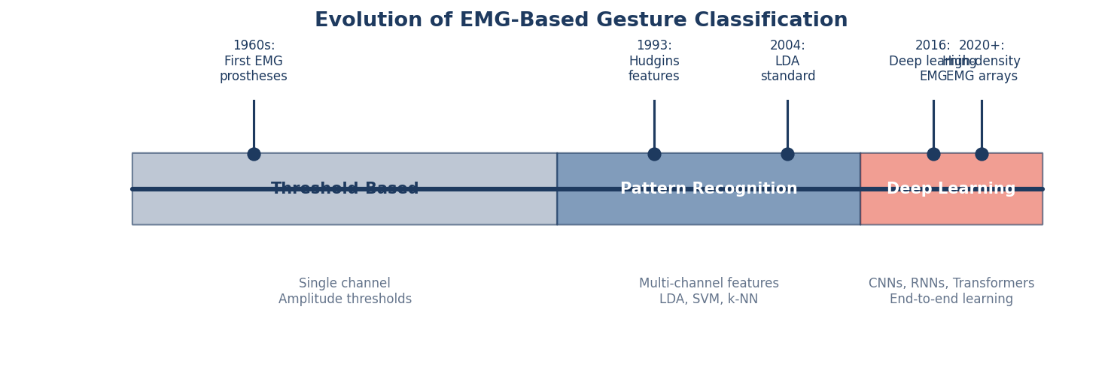
Evolution of EMG Classification
1960s-80s: Simple threshold detectors
1990s-2010s: Pattern recognition (LDA dominates)
2010s+: Deep learning approaches

Slide 17
Linear Discriminant Analysis (LDA)
The Workhorse of EMG Classification
Projects features to maximize class separation
Assumes Gaussian distributions, shared covariance
Fast training, fast inference, interpretable
QDA: allows different covariance per class
Typical Pipeline
8 EMG channels
→ Window (200ms)
→ Features per channel
→ Concatenate (8×4=32 features)
→ LDA classifier
Real-world accuracy: 90-98% for 6-10 gestures in controlled conditions

Slide 18
Deep Learning Approaches
CNNs: Learn spatial patterns across channels
1D Convolutions: Temporal feature learning
RNNs/LSTMs: Capture temporal dynamics
Transformers: Emerging approach
Advantages:
Learn features automatically
Better generalization (sometimes)
Challenges:
Need more training data
Harder to interpret
Computational requirements

Slide 19
The Robustness Challenge
Lab accuracy ≠ Real-world performance
Electrode Shift
Muscle Fatigue
Small position changes degrade accuracy
Signal characteristics change over time
Cross-Session
Arm Position
Models don't transfer between sessions
Different limb positions → different signals
Active research area: adaptive algorithms, domain adaptation, user calibration

Slide 20
Prosthetic Control
Evolution of Prosthetic EMG
Commercial Systems
Direct Control (1960s): 1 electrode → 1 function
Pattern Recognition: Multiple gestures from muscle patterns
Simultaneous Control: Multiple DOF at once
• LUKE Arm (Mobius Bionics)
• bebionic (Ottobock)
• COAPT pattern recognition
Key insight: Pattern recognition enables more natural, intuitive control

Slide 21
Rehabilitation & Therapy
Stroke Recovery: EMG biofeedback helps relearn movements
Motor Learning: Real-time feedback accelerates skill acquisition
Gamification: Engaging exercises improve compliance
Biofeedback Loop
Attempt movement
→ EMG detected
→ Visual/audio feedback
→ Reinforces correct patterns

Slide 22
Exoskeletons & Cobots
Assistive Exoskeletons: EMG triggers and modulates assistance
Collaborative Robots: EMG for intent detection and safety
Industrial Augmentation: Reduce worker fatigue and injury
Key Advantage
EMG provides intent ~50-100ms before motion begins

Slide 23
Consumer & Emerging Applications
Myo Armband (2014-2018): First mainstream consumer EMG. Gesture control for presentations, drones, gaming.
Meta Neural Interface: Wristband with high-density EMG for AR/VR. Acquired CTRL-labs (2019).
Gaming & VR: Hands-free control, accessibility
Emerging Applications:
Silent speech (facial EMG)
Music performance (accessibility)
Fitness tracking (muscle activation)
Accessibility (computer control)

Slide 24
Research Frontiers
High-Density EMG (HD-EMG): 64-256 electrode grids for spatial mapping, motor unit decomposition
Implantable Sensors: Targeted muscle reinnervation (TMR), intramuscular electrodes
Hybrid Brain-Muscle Interfaces: EEG + EMG fusion for intent detection
Emerging Research:
Transfer learning: Adapt to new users
Unsupervised adaptation: Self-updating
Regression control: Continuous force
Real-time edge AI: On-device inference
Open challenge: Robust control that works all day, every day

