Slide 1
BioRobotics

Slide 2
What is Galvanic Skin Response?
Also known as Electrodermal Activity (EDA) or Skin Conductance
Key Facts
Core Concept
GSR measures the electrical conductance of the skin, which varies with sweat gland activity controlled by the sympathetic nervous system.
Signal Source
Eccrine sweat glands
Controlled By
Sympathetic nervous system
Emotional arousal → Sympathetic activation → Sweat secretion → Increased skin conductance
Reflects
Psychological/physiological arousal
The response is involuntary and difficult to consciously control, making it a reliable indicator of autonomic arousal.
Amplitude
0.1 - 30 μS (microsiemens)
Response Latency
1-3 seconds after stimulus

Slide 3
Skin Anatomy & Sweat Glands
The physiological basis of electrodermal activity
Eccrine Sweat Glands
Why the Palms?
• Highest density on palms and soles • ~2,000-4,000 glands per cm² on palm • Respond to emotional stimuli • Innervated by sympathetic nervous system • Secrete sweat containing electrolytes
• Highest concentration of eccrine glands • Most sensitive to emotional stimuli • Easy electrode placement • Minimal interference from movement • Standard measurement location
Measurement Principle
A small constant voltage (typically 0.5V DC) is applied between two electrodes. As sweat fills the ducts, the ionic solution creates conductive pathways, increasing skin conductance. This change is measured in microsiemens (μS).

Slide 4
Tonic vs Phasic Components
Two distinct aspects of the GSR signal
Tonic Component
Phasic Component
Skin Conductance Level (SCL)
Skin Conductance Response (SCR)
• Slow-changing baseline conductance • Changes over minutes to hours • Reflects general arousal state • High individual variability • Typically 2-20 μS range • Useful for overall stress levels
• Rapid, event-related changes • Onset 1-3 seconds after stimulus • Duration 1-5 seconds • Amplitude 0.1-1.0 μS typical • More consistent across individuals • Used for event-related analysis
Think of it as the "background" arousal level
Think of it as "spikes" in response to events

Slide 5
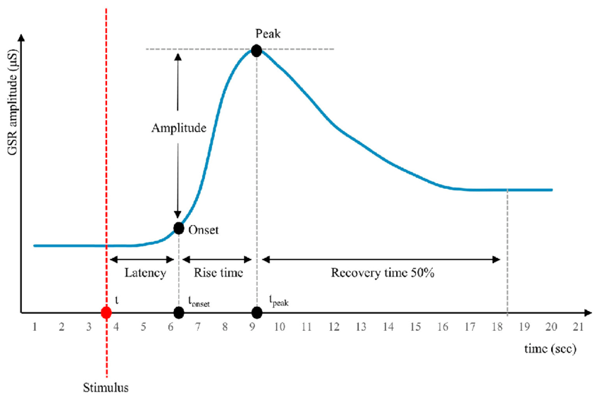
SCR Characteristics
Anatomy of a skin conductance response
Key Parameters
Latency
1-3 seconds
Time from stimulus to response onset
Rise Time
1-3 seconds
Time from onset to peak
Amplitude
0.1-1.0 μS
Peak minus baseline
Recovery
2-10 seconds
Return to 50% of amplitude

Slide 6
GSR Signal Characteristics
Technical parameters for recording
Parameter | Value | Notes
Measurement Unit | Microsiemens (μS) | Conductance = 1/Resistance
Typical Range | 0.1 - 30 μS | High individual variability
Frequency Content | DC - 5 Hz | Very low frequency signal
Sample Rate | 10 - 100 Hz | Lower than EMG/EOG required
Response Latency | 1 - 3 seconds | Relatively slow response
Electrode Coupling | DC (essential) | Must capture slow changes
Electrode Sites | Palmar surface | Fingers or palm

Slide 7
GSR vs EMG vs EOG
Property | GSR | EMG | EOG
Signal Source | Sweat gland activity | Muscle action potentials | Corneo-retinal potential
Frequency Range | DC - 5 Hz | 20 - 500 Hz | DC - 30 Hz
Typical Amplitude | 0.1 - 30 μS | 50 μV - 5 mV | 15 - 200 μV
Sample Rate Needed | 10 - 100 Hz | 1000+ Hz | 250 - 500 Hz
Response Latency | 1 - 3 seconds | ~50 ms | Immediate
Voluntary Control | Minimal | Full | Full
Primary Application | Arousal/stress | Movement/force | Gaze tracking
Note: GSR reflects autonomic (involuntary) nervous system activity, while EMG and EOG reflect somatic (voluntary) control.

Slide 8
Electrode Placement
Standard locations for GSR measurement
Common Electrode Sites
Best Practices
Palmar Surface (Fingers)
• Clean skin with water only (no alcohol)
Most common - high sensitivity, easy access. Typically index and middle finger, medial phalanges.
• Use isotonic gel or pre-gelled electrodes
• Maintain consistent electrode spacing
Thenar/Hypothenar
Palm surface - useful when fingers unavailable. Good signal quality.
• Secure electrodes to prevent movement
• Allow 2-5 minutes for stabilization
Plantar Surface (Feet)
• Use non-dominant hand (less movement)
Alternative when hands unavailable. Similar sweat gland density.
• Keep room temperature consistent

Slide 9
Signal Quality Considerations
Common issues and solutions
Issue | Cause | Solution
No signal / flat line | Poor electrode contact | Check gel, clean skin, secure electrodes
Excessive noise | Movement artifacts | Stabilize hand, reduce cable movement
Rapid baseline drift | Temperature changes | Control room temperature, allow stabilization
Very low amplitude | Dry skin | Hydrate electrodes, ensure proper gel contact
60 Hz interference | Power line noise | Move cables away from power sources
Sudden jumps | Electrode shift | Resecure electrodes, check connections
Important: Do NOT use alcohol to clean skin before GSR measurement - it dries the skin and reduces conductance.

Slide 10
Decomposing Tonic and Phasic
Separating baseline from event-related responses
Common Decomposition Methods
Low-pass Filtering
Pro: Simple
Apply very low cutoff (~0.05 Hz) to extract tonic. Subtract from original for phasic.
Con: Less accurate
Through-to-Peak
Pro: Intuitive
Find local minima (troughs) and maxima (peaks) to identify discrete SCRs.
Con: Threshold dependent
Continuous Decomposition
Pro: Most accurate
Model-based approach using deconvolution to estimate underlying driver signal.
Con: Complex
For this lab, we'll use simple baseline correction and peak detection for SCR analysis.

Slide 11
Feature Extraction
Quantifying GSR for analysis
Tonic Features (SCL)
Phasic Features (SCR)
• Mean SCL - Average conductance level
• SCR Count - Number of responses
• SCL Range - Max minus min
• SCR Amplitude - Peak height
• SCL Slope - Rate of change over time
• SCR Latency - Time to peak
• SCL Variance - Signal variability
• SCR Rise Time - Onset to peak duration
Combined / Derived Features
• Area Under Curve (AUC) - Total response magnitude over time window • NS-SCR Rate - Non-specific SCRs per minute (responses without clear stimulus) • SCR/SCL Ratio - Phasic activity relative to tonic level • Recovery Time - Time for signal to return to baseline

Slide 12
GSR Applications Overview
1
2
3
Stress & Anxiety
Lie Detection
UX Research
Workplace wellness, mental health
Forensic and security
Product testing, advertising
4
5
Clinical Biofeedback
Affective Computing
Anxiety, PTSD treatment
Emotion-aware AI systems

Slide 13
Stress & Anxiety Monitoring
Continuous assessment of psychological state
Use Cases
How It Works
• Workplace wellness programs
GSR increases with psychological stress due to sympathetic nervous system activation: • Work deadlines → Elevated SCL • Social anxiety → Increased SCR frequency • Cognitive load → Higher baseline + more responses • Emotional events → Clear SCR peaks Wearable devices now incorporate GSR sensors for continuous stress tracking.
• Mental health monitoring
• Performance optimization
• Sleep quality assessment
• Meditation feedback
• PTSD episode detection

Slide 14
Lie Detection (Polygraph)
The controversial but widespread application
The Theory
Limitations
Deception causes emotional arousal (fear, guilt) which triggers autonomic responses including increased skin conductance. GSR is one of several measures in a polygraph.
• Measures arousal, not deception • Innocent people may show responses • Can be beaten by countermeasures • Not admissible in most courts • ~85-90% accuracy at best
Modern research focuses on concealed information tests (CIT) and machine learning approaches, but fundamental limitations remain.

Slide 15
UX Research & Affective Computing
Measuring unconscious user responses
Users often can't articulate their emotional responses. GSR provides objective data about engagement, frustration, and excitement that surveys miss.
Website/App Testing
Ad Effectiveness
Identify frustrating UI elements
Measure emotional impact of content
Gaming
Adaptive Interfaces
Optimize difficulty and engagement
Systems that respond to user state
Clinical Biofeedback
GSR biofeedback helps patients with anxiety disorders, PTSD, and phobias learn to recognize and control their arousal through real-time feedback.

Slide 16
Why Experimental Design Matters
The foundation of valid scientific conclusions
Without proper experimental design, we cannot determine if observed effects are real or due to chance, bias, or confounding factors.
1
2
3
4
Control
Randomization
Replication
Validity
Manipulate only what you intend to test
Reduce systematic bias
Ensure effects are repeatable
Measure what you claim to measure

Slide 17
Variables in Experiments
Independent, dependent, and confounding
Independent Variable (IV)
Dependent Variable (DV)
Confounding Variables
What you manipulate
What you measure
What you control for
• Task difficulty • Stimulus type • Condition order • Trial parameters
• Mean SCL • SCR count • SCR amplitude • Response time
• Time of day • Room temperature • Caffeine intake • Practice effects
Example:
"Does cognitive load increase skin conductance?"
IV: Task type (rest, easy, hard) | DV: Mean SCL, SCR count | Control: Same time, room, instructions

Slide 18
Within vs Between Subjects
Two fundamental approaches to experimental design
Within-Subjects Design
Between-Subjects Design
Same participants in ALL conditions
Different participants in EACH condition
Advantages:
Advantages:
• Fewer participants needed • Controls for individual differences • More statistical power
• No order effects • Shorter individual sessions • No carryover
Disadvantages:
Disadvantages:
• Order/practice effects • Fatigue • Longer sessions
• More participants needed • Individual differences add noise • Less statistical power

Slide 19
Counterbalancing
Controlling for order effects in within-subjects designs
Problem: If everyone does A → B → C, we can't tell if differences are due to the condition or the order.
Solution: Counterbalancing - vary the order across participants
Full Counterbalancing
Latin Square
Every possible order (n! permutations)
Each condition once in each position
Participant | Order
P1 | A → B → C
P2 | A → C → B
P3 | B → A → C
P4 | B → C → A
P5 | C → A → B
P6 | C → B → A
Participant | Order
P1, P4, P7... | A → B → C
P2, P5, P8... | B → C → A
P3, P6, P9... | C → A → B
More practical for many conditions

Slide 20
The Stroop Effect
A classic demonstration of cognitive interference
Named after John Ridley Stroop (1935), this effect demonstrates interference when the brain processes conflicting information.
Congruent
Incongruent
Word matches ink color
Word conflicts with ink color
RED
BLUE
GREEN
RED
BLUE
GREEN
The Task: Name the INK COLOR, ignore the word meaning
Reading is automatic - we can't help but read the word. When it conflicts with the color, our brain must suppress the automatic response. This cognitive conflict increases response time, errors, and physiological arousal (including GSR).

Slide 21
Stroop Task Parameters
Variables you can manipulate to control difficulty
Number of Trials
20 - 100+
More trials = more data, but fatigue increases. Trade-off between power and burden.
Congruent/Incongruent Ratio
50/50 to 25/75
Higher incongruent ratio = more difficult. Manipulating expectation affects load.
Inter-Stimulus Interval (ISI)
500ms - 3000ms
Shorter ISI = faster pace, more demand. Longer ISI allows recovery.

Slide 22
Paired t-tests
Comparing conditions in within-subjects designs
After collecting GSR data, we need to determine if differences are statistically significant.
Paired t-test
Use when comparing the SAME participants across two conditions
• Compares each participant's score in Condition A to their score in Condition B • Controls for individual differences (each person is their own control) • More powerful than independent t-test when assumptions are met • Null hypothesis: The mean difference between conditions = 0
Example: Is mean SCL during Stroop > mean SCL during Rest?
H₀: μ_Stroop - μ_Rest = 0 vs H₁: μ_Stroop - μ_Rest ≠ 0
If p < 0.05, we reject H₀ and conclude the conditions differ significantly.

Slide 23
Interpreting Results
Understanding p-values and effect sizes
p-value
Effect Size (Cohen's d)
Probability of observing results this extreme if H₀ is true. • p < 0.05: "Significant" • p < 0.01: More confident • p < 0.001: Highly significant
Magnitude of difference, independent of sample size. • |d| < 0.2: Small • |d| ≈ 0.5: Medium • |d| > 0.8: Large
Example Report
"Mean SCL was significantly higher during the Stroop task (M = 8.2 μS, SD = 2.1) compared to rest (M = 5.4 μS, SD = 1.8), t(19) = 4.32, p < .001, d = 0.96."
• Reports both conditions' means and SDs • States test statistic t(df) and p-value • Includes effect size (d = 0.96 is large)

Slide 24
References & Further Reading
Textbook
Boucsein, W. (2012). Electrodermal Activity (2nd ed.). Springer.
Methods
Braithwaite, J.J., et al. (2013). A Guide for Analysing Electrodermal Activity.
Stroop
Stroop, J.R. (1935). Studies of interference in serial verbal reactions.
Software
Ledalab - http://www.ledalab.de/ (MATLAB toolbox)
Python
NeuroKit2 - https://neuropsychology.github.io/NeuroKit/

