Slide 1
2.8” Color TFT Touch Screen Hardware & Software

Slide 2
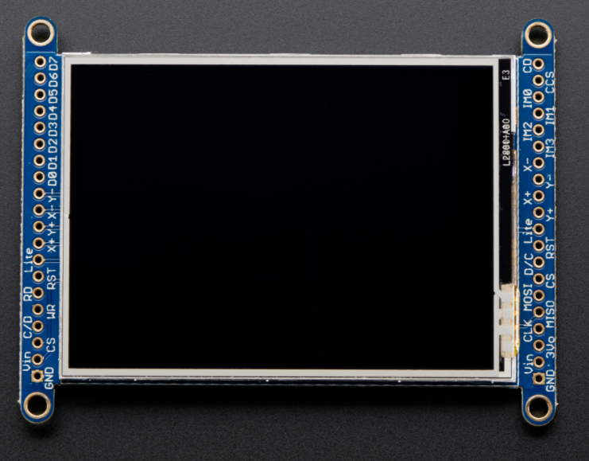
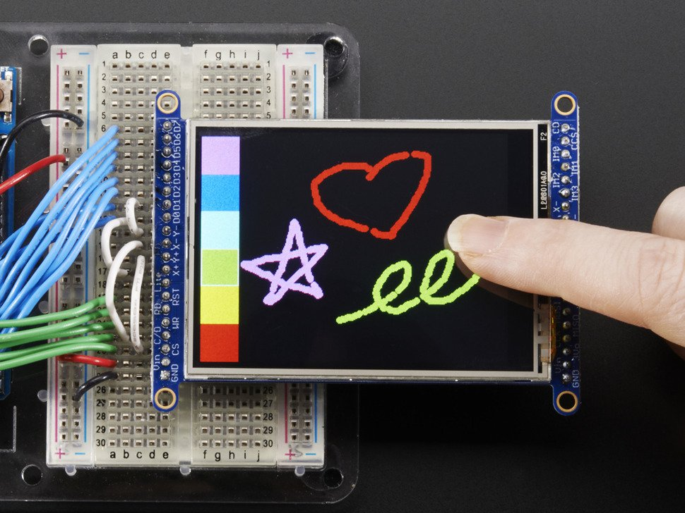

Slide 3
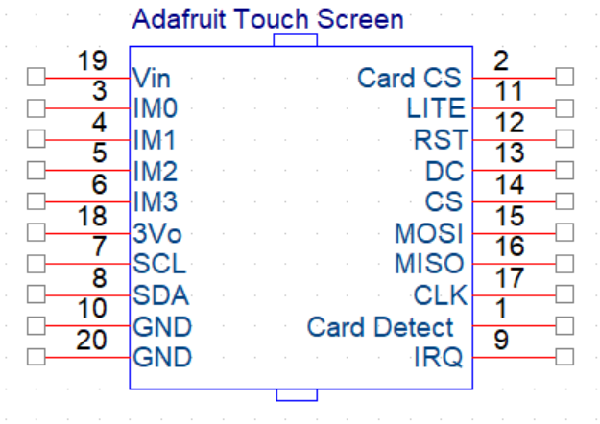
Wiring The TFT

Slide 4
Wiring Continued
There are 4 pins needed for the SPI mode:
Pin 17 – CLK
Pin 15 – MOSI
Pin 14 – CS
Pin 13 – DC
The microcontroller is the master SPI and the TFT is the slave SPI in this case.
There are 2 pins needed for the capacitive touch controller that uses I²C:
Pin 7 – SCL
Pin 8 – SDA
IM1, IM2, and IM3 should all be pulled up to 3.3 V (NOT 5 V). This will indicate to the TFT that it should operate in the SPI mode. Jumpers on the back of the board can be soldered together to accomplish this. If users wish to not solder they can simply tie them to the 3Vo pin of the board.

Slide 5
The Interrupt Pin
Pin 9, the IRQ pin, is the interrupt pin. When the TFT is touched, this pin is pulled low at an average frequency of 77 Hz (for as long as the screen is touched); this pin operates on 3.3 V.
When using the interrupt pin with a 5 V system make sure to use logic shifters or that the microcontroller will read the 3.3 V as a logic 1.

Slide 6
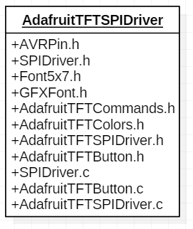
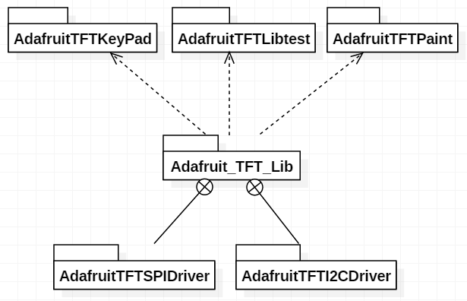
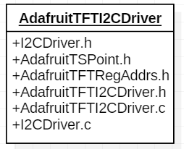
The Libraries

Slide 7
The AVRPin data structure
AVRPin is a simple structure used to store information in regards to a specific Port on an AVR 8-bit microcontroller. The AVRPin has three uint8_t pointers. One for each of the associated registers of a Port (DDRx, PORTx, PINx). The AVRPin also contains an 8-bit mask. This structure can be used to specify a specific pin on the microcontroller. This structure can be found in “AVRPin.h”.

Slide 8
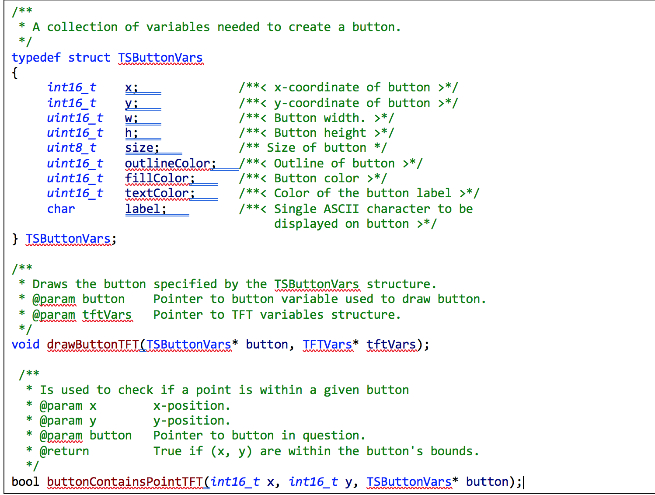
Implementing Buttons on the Touch Screen

Slide 9
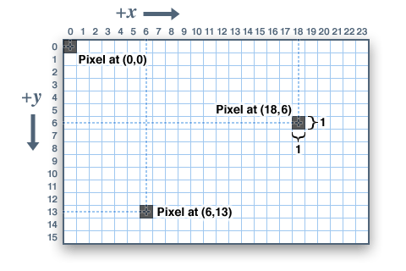
The Coordinate System: Pixel
The coordinate system places the origin (0,0) at the top left corner, with positive X increasing to the right and positive Y increasing downward.

Slide 10
Representing Color in 16 Bits
The MSB is R4 and the LSB is B0
R4
R3
R2
R1
R0
G5
G4
G3
G2
G1
G0
B4
B3
B2
B1
B0

Slide 11
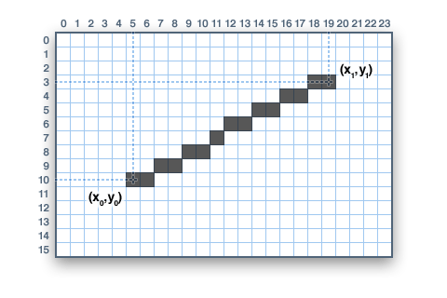
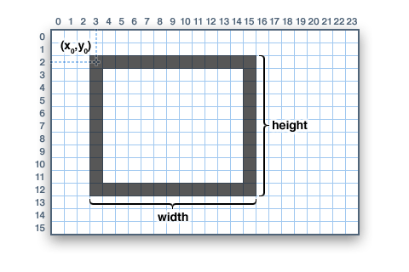
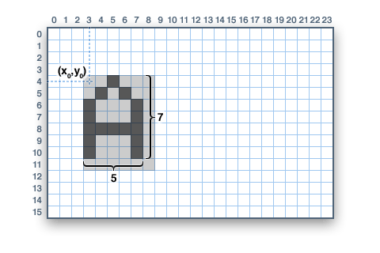
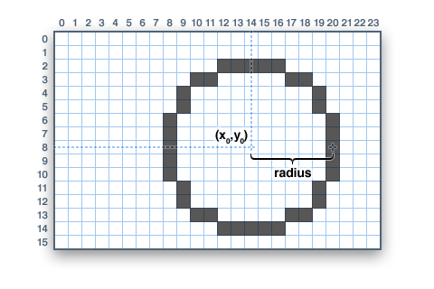

Slide 12
DRAWING METHODS
void drawPixel(uint16_t x, uint16_t y, uint16_t color);
void drawLine(uint16_t x0, uint16_t y0, uint16_t x1, uint16_t y1, uint16_t color);
void drawFastVLine(uint16_t x0, uint16_t y0, uint16_t length, uint16_t color);
void drawFastHLine(uint8_t x0, uint8_t y0, uint8_t length, uint16_t color);
void drawRect(uint16_t x0, uint16_t y0, uint16_t w, uint16_t h, uint16_t color);
void fillRect(uint16_t x0, uint16_t y0, uint16_t w, uint16_t h, uint16_t color);
void drawChar(uint16_t x, uint16_t y, char c, uint16_t color, uint16_t bg, uint8_t size);
void drawBitmap(int16_t x, int16_t y, uint8_t *bitmap, int16_t w, int16_t h, uint16_t color);

Slide 13
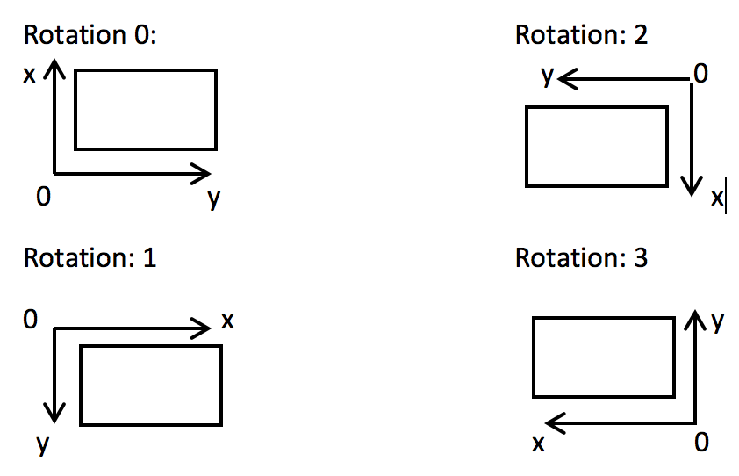
Screen Orientation
When using the library to draw text, shapes, or buttons onto screen, it assumes that x grows to the right and y grows downward. When getting a point from the TFT, the point returned is given in terms of rotation 2.

Slide 14
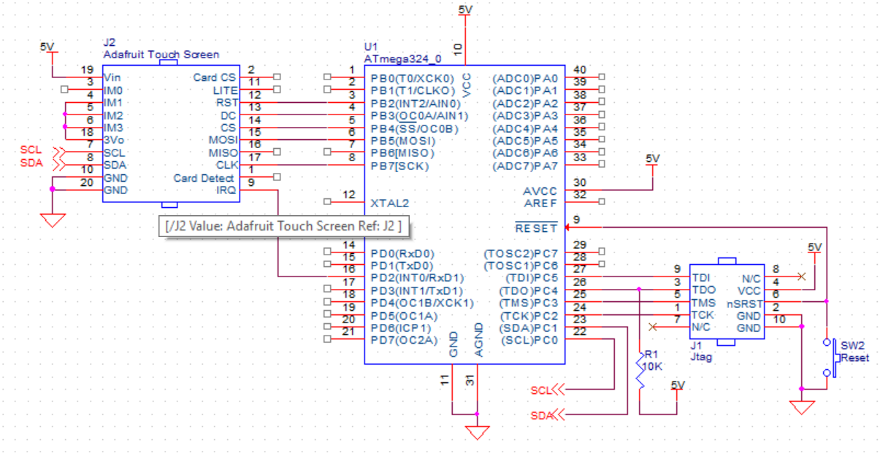
Sample Project

