Slide 1
What Is GitHub?
An entry-level tour, with real screenshots
Notes:
This is an entry-level tour of GitHub: what it does, the handful of words you will hear constantly, and a real project to show each one.

Slide 2
Where does your code live?
Notes:
If your project only lives on your laptop, losing the laptop loses the project, and nobody else can work on it with you. GitHub is the usual answer to that.

Slide 3
Git
A tool that remembers every version of your files
Notes:
Git is a tool that remembers every version of your files, so you can see what changed and go back to any earlier point.

Slide 4
Git and GitHub Are Not the Same
Git
GitHub
VS
On your computer
On the web
Notes:
Git runs on your computer. GitHub is a website that keeps a copy of your Git project online, where other people can see it and work on it.

Slide 5
Repository
One project's folder, with its whole history
Notes:
A repository, or repo, is one project's folder together with its complete history of changes.

Slide 6
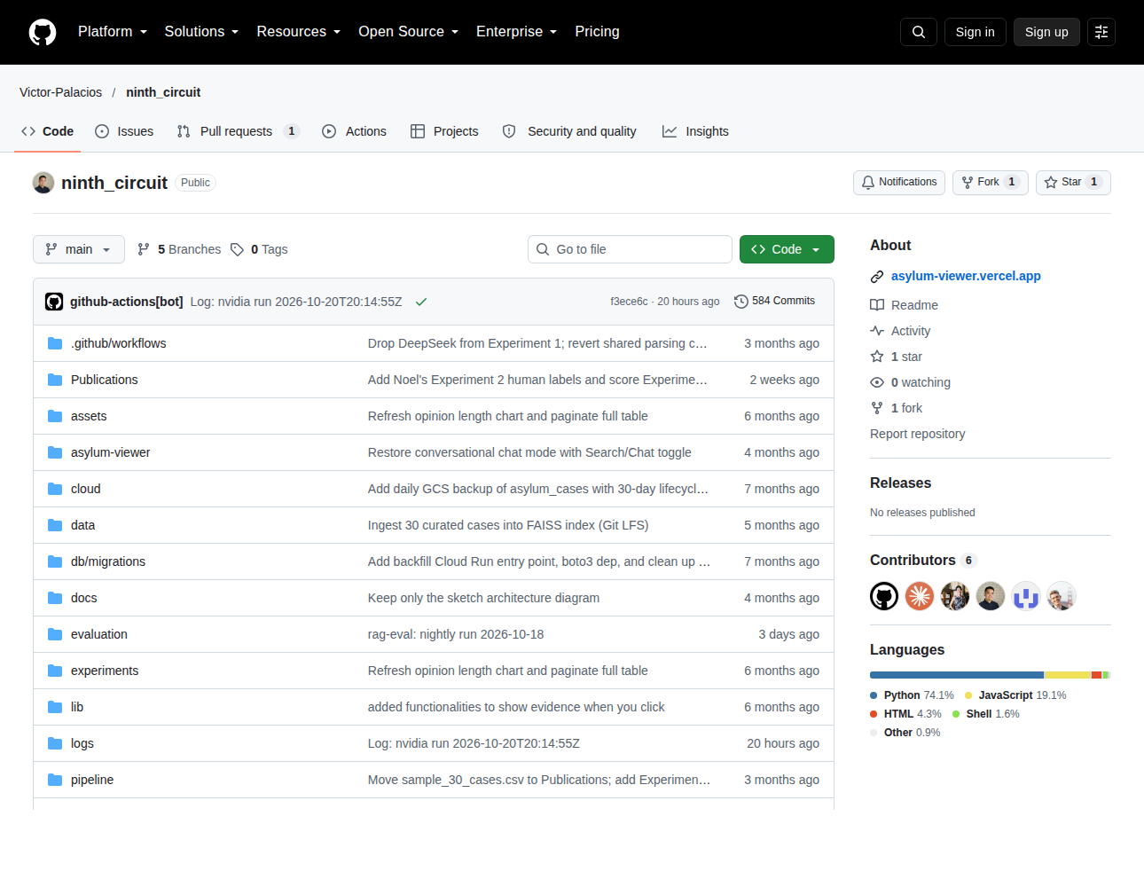
A Real Repository
This is ninth_circuit
Folders and files
584 commits of history
Source
Notes:
This is a real public repository called ninth_circuit. You can see its folders and files, and in the corner, five hundred and eighty-four commits of history.

Slide 7
Where Things Are on the Page
Tab
What it holds
Code
The files themselves
Issues
To-dos and bug reports
Pull requests
Changes waiting for review
Actions
Jobs that run by themselves
Notes:
Across the top of every repository are the same tabs. Code holds the files, Issues holds to-dos and bug reports, Pull requests holds changes waiting for review, and Actions holds jobs that run by themselves.

Slide 8
Commit
A saved snapshot, with a note saying why
Notes:
A commit is a saved snapshot of your files, with a short note saying what changed and why.

Slide 9
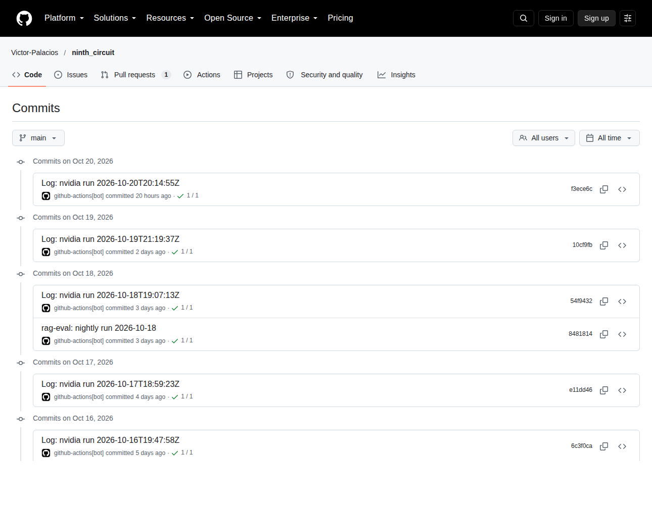
History You Can Read
Newest at the top
Who, when, and why
Any one can be restored
Source
Notes:
This is that project's commit history: newest at the top, each one saying who made it, when, and why — and any one of them can be restored.

Slide 10
The Basic Loop
01
Edit
Change files on your computer
02
Commit
Save a snapshot with a note
03
Push
Send it up to GitHub
Notes:
Day to day the loop has three steps: edit files on your computer, commit a snapshot with a note, and push it up to GitHub.

Slide 11
Branch
A separate line of work that leaves main alone
Notes:
A branch is a separate line of work. You can try something out on it without touching the main version everyone else relies on.

Slide 12
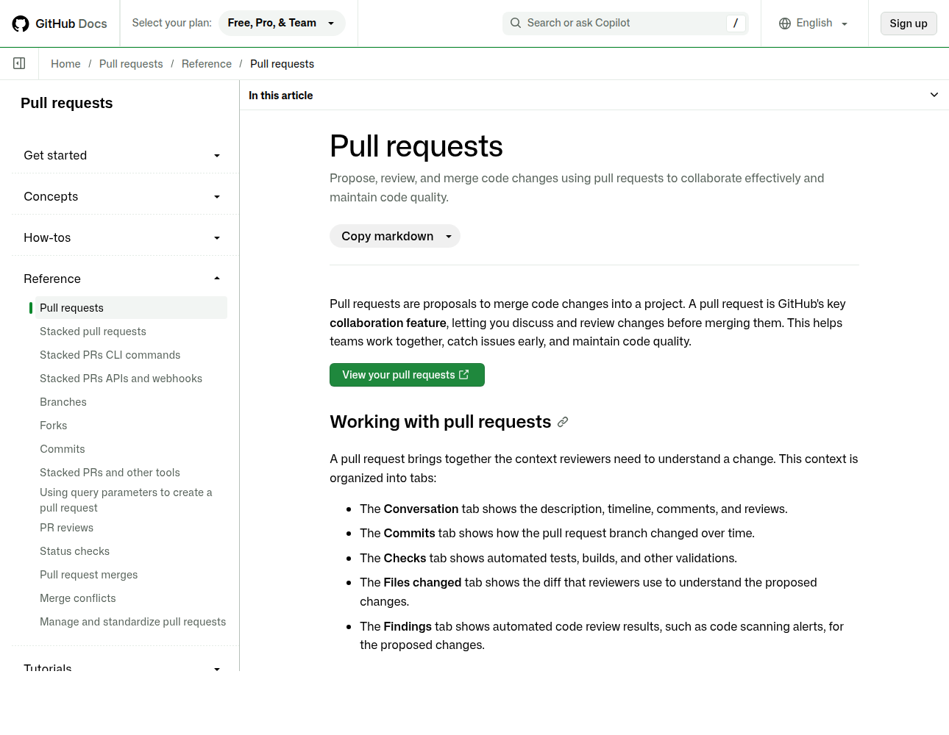
Proposing a Change
Show what you changed
Others review it
Then it is merged
Source
Notes:
When a branch is ready, you open a pull request. It shows exactly what you changed, other people review it, and then it is merged into the main version.

Slide 13
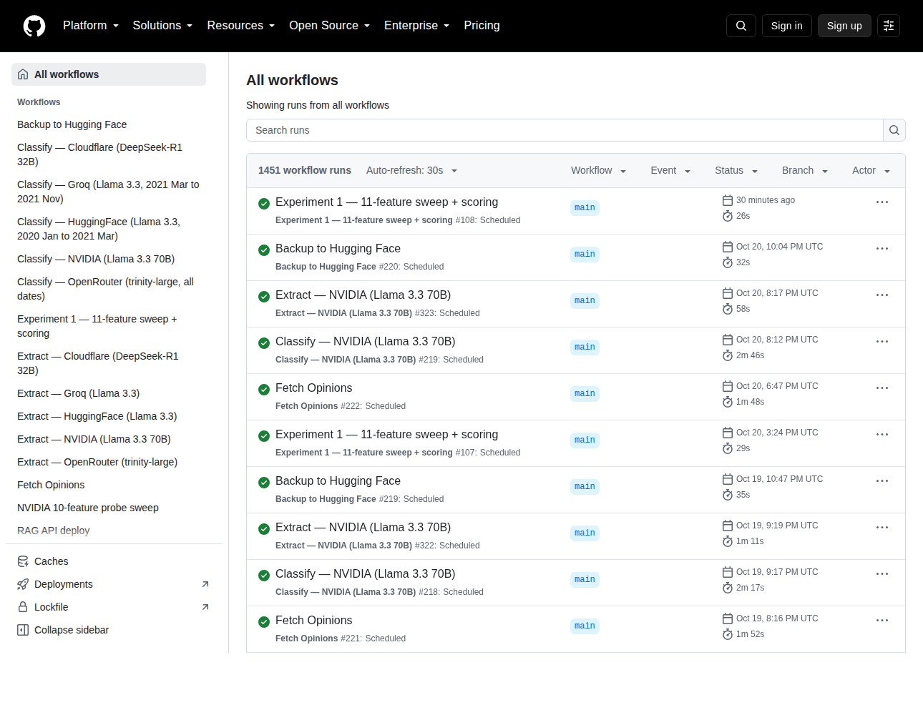
Work That Runs Itself
Jobs on a schedule
1,451 runs so far
No laptop required
Source
Notes:
GitHub Actions runs jobs for you on GitHub's own computers. This project's Actions tab shows one thousand four hundred and fifty-one runs, most of them on a schedule, with no laptop involved.

Slide 14
What Actions Are Good For
Running your tests on every change
A job every night, like fetching data
Publishing a website
Backing up your results
Notes:
Actions are good for running tests on every change, a nightly job such as fetching new data, publishing a website, and backing up results — all four of which that project does.

Slide 15
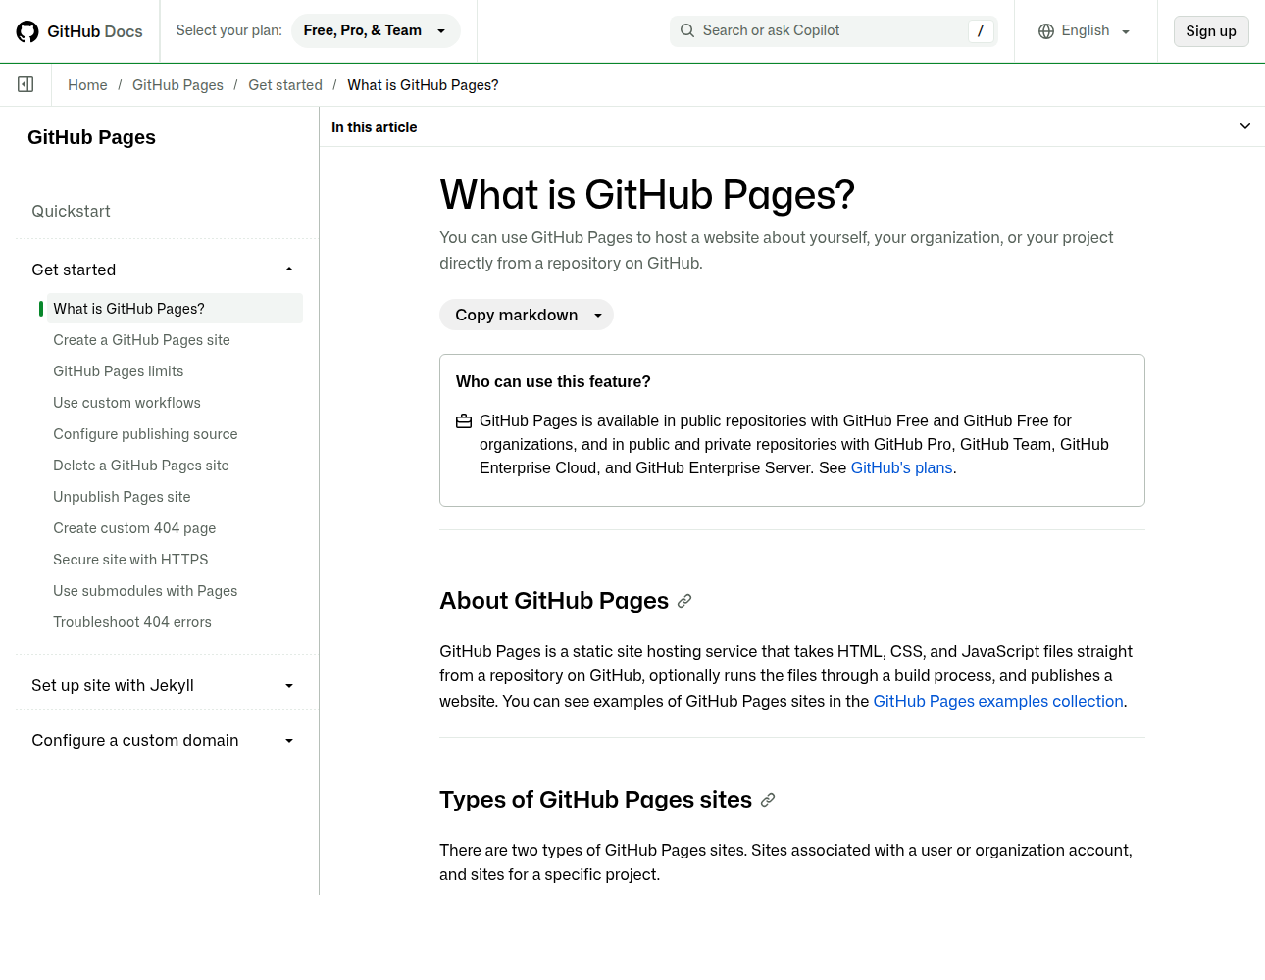
A Free Website From a Repo
HTML, CSS, JavaScript
Served from your repo
A public web address
Source
Notes:
GitHub Pages turns a repository into a website. It takes HTML, CSS and JavaScript files straight from your repo and gives them a public web address.

Slide 16
Public or Private
Public: anyone can read it
Private: only people you invite
Both keep the full history
So never commit a password
Notes:
A public repository can be read by anyone, a private one only by people you invite, and both keep their full history forever — which is why a password should never be committed to either.

Slide 17
Your First Ten Minutes
01
Make an account
It is free
02
Create a repository
Tick the box to add a README
03
Edit the README
Commit it, and look at History
Notes:
To try it: make a free account, create a repository with a README, then edit that README on the website, commit it, and look at the history you just made.

Slide 18
Screenshots, Captured 21 Oct 2026
Screenshot
Captured from
Repository
…/ninth_circuit
Commit history
…/ninth_circuit/commits
Actions
…/ninth_circuit/actions
Pull requests
docs.github.com
Pages
docs.github.com
Notes:
Every screenshot in this deck was captured on the twenty-first of October 2026 from the pages listed here, and each slide's Source link opens the exact page.

Slide 19
What will you put in yours?
Notes:
So the last question is yours: what will you put in your first repository?

