Slide 1
What Is Supabase?
An entry-level tour, with real screenshots
Notes:
This is an entry-level tour of Supabase: what it is, what its pieces do, and how a real project uses it.

Slide 2
Where does your data live?
Notes:
Every app that remembers anything — a login, a saved list, an uploaded photo — has to keep that information somewhere. That somewhere is what this deck is about.

Slide 3
Backend
The part of an app you never see
Notes:
A backend is the part of an app you never see: the place where data is stored and the rules about who may touch it are enforced.

Slide 4
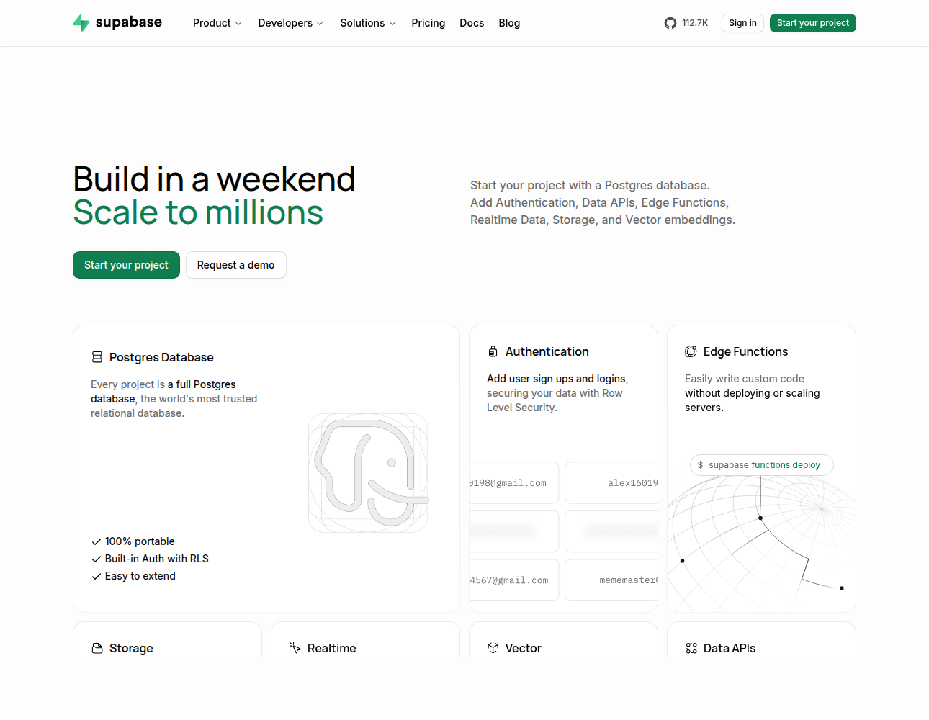
How Supabase Describes Itself
It starts as a database
Then adds what apps need
All in one project
Source
Notes:
This is Supabase's own homepage. It starts from a Postgres database and adds the other things an app needs, all inside one project.

Slide 5
The Four Main Pieces
Database
Auth
Storage
API
Tables of your data
Who is signed in
Files people upload
How your page asks
Notes:
Four pieces matter to start with: a database holding tables of your data, auth for who is signed in, storage for files people upload, and an API that your web page uses to ask for any of it.

Slide 6
Database
Organised tables your app can read and write
Notes:
A database is a set of organised tables that your app can read from and write to.

Slide 7
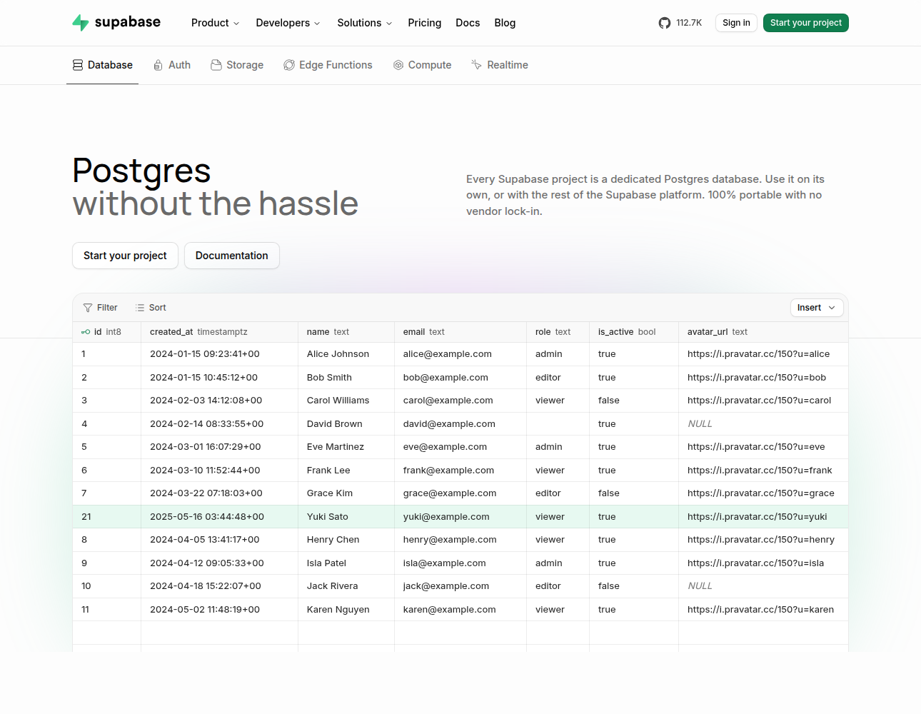
A Table, Concretely
Each row is one record
Each column is a field
A spreadsheet with rules
Source
Notes:
Here is a table in Supabase's own editor. Each row is one record, each column is one field such as a name or an email, and you can think of it as a spreadsheet that enforces rules.

Slide 8
Four Things You Do to a Table
Add a row
Find the rows you want
Change a row
Delete a row
Notes:
Almost everything an app does with a table is one of four things: add a row, find rows, change a row, or delete one.

Slide 9
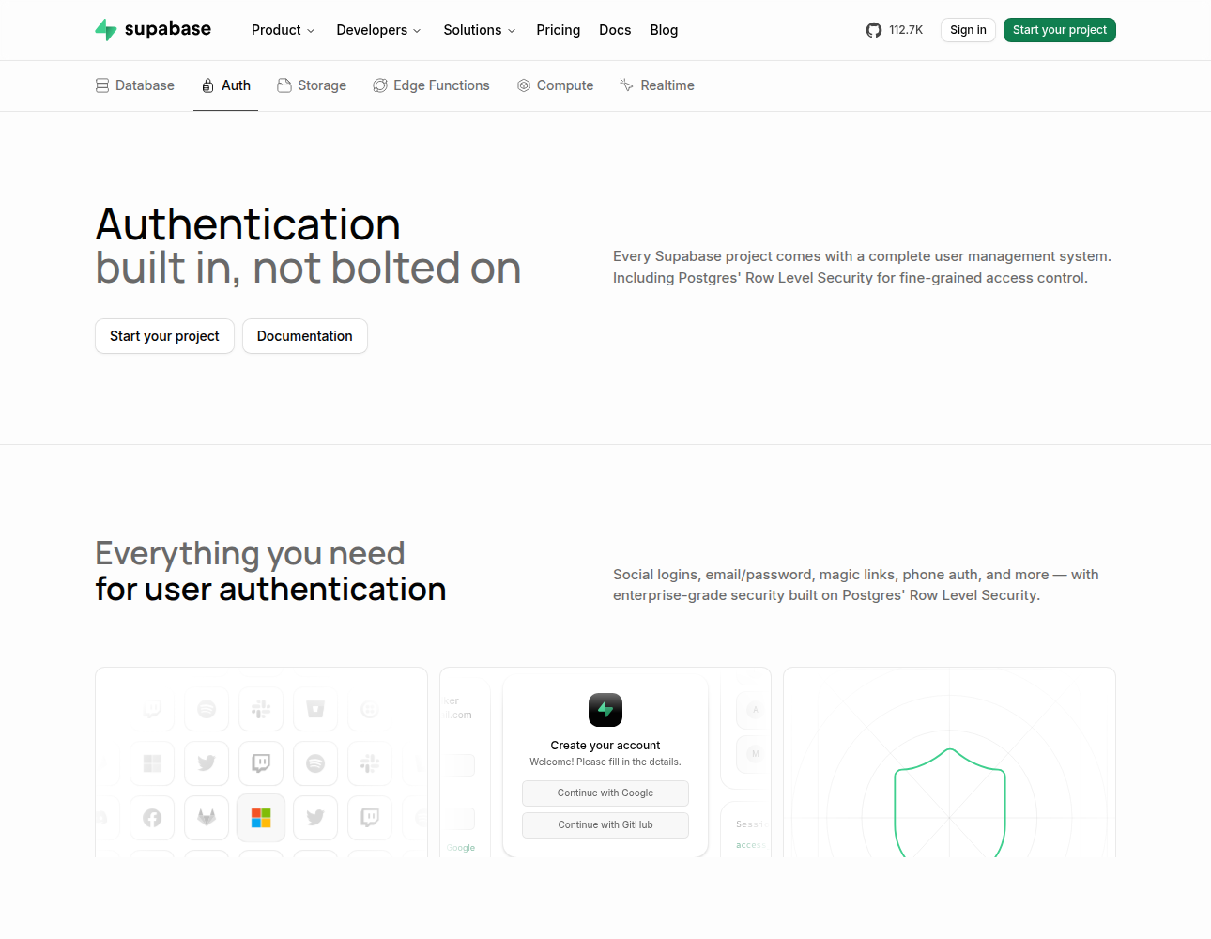
Sign-In, Built In
Email and password
Google, GitHub, others
No login code to write
Source
Notes:
Sign-in comes built in. Email and password, or signing in with Google, GitHub and others, without you writing any login code yourself.

Slide 10
Storage Is for Files
Profile photos
Uploaded PDFs
Anything too big for a table
Same access rules as the data
Notes:
Storage is for files rather than rows: profile photos, uploaded PDFs, and anything too big to sit in a table — protected by the same kind of access rules as your data.

Slide 11
API
How your page talks to the database
Notes:
An API is the way your web page talks to the database over the internet, asking for rows or sending new ones.

Slide 12
Why People Use It
Server
Supabase
VS
You build and run it
You set up a project
Notes:
Without a service like this you would build and run a server yourself. With Supabase you set up a project and the server side is handled for you.

Slide 13
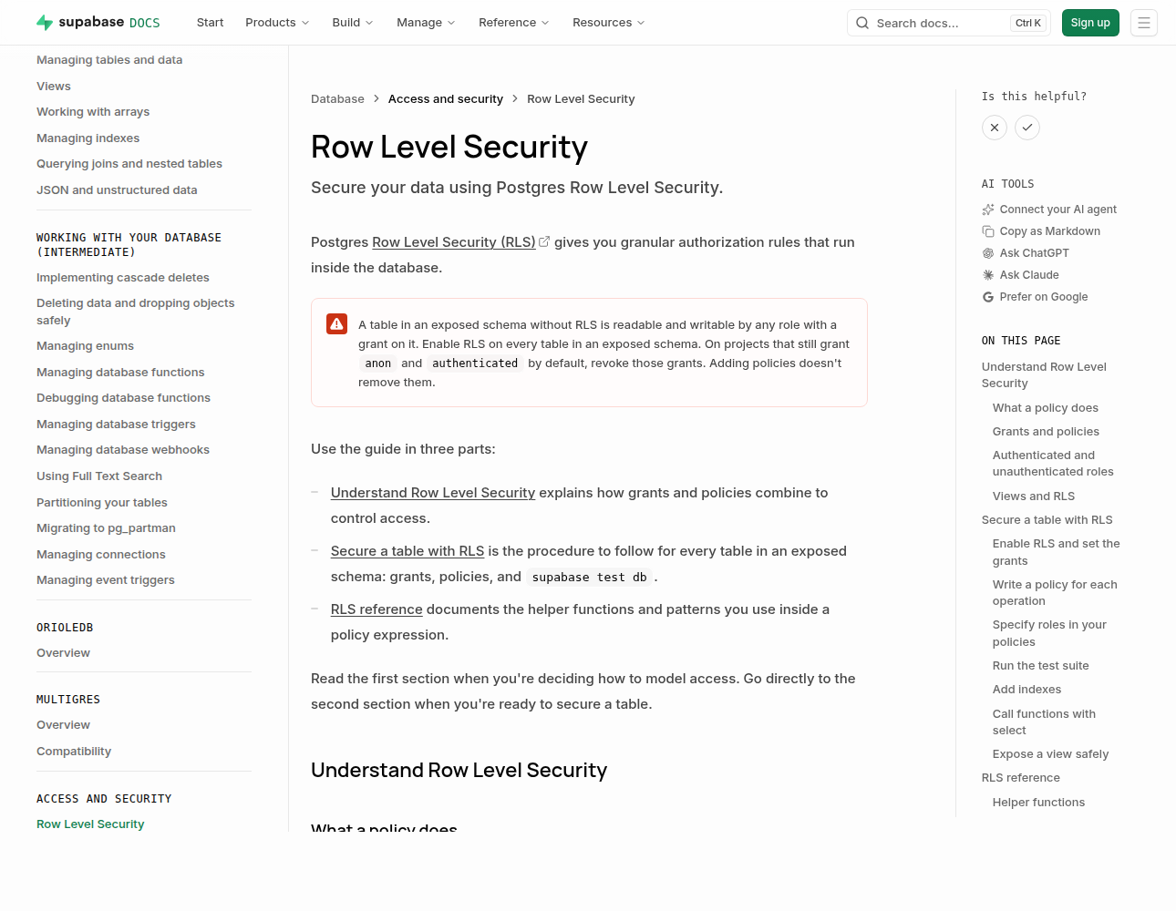
The Rule That Protects It
Turn on row level security
Without it, data is open
Supabase warns you itself
Source
Notes:
This is Supabase's own documentation, and the red box is its warning: a table without row level security can be read and written by anyone who can reach it. Turning it on is the one setting you must not skip.

Slide 14
Row Level Security, by Example
Setting
What a visitor gets
Security off
Every row, read and write
On, with no policy
Nothing at all
On, owner policy
Only their own rows
Notes:
Three settings make it concrete. With security off, a visitor gets every row. Switched on with no policy, they get nothing. Switched on with an owner policy, each person sees only their own rows.

Slide 15
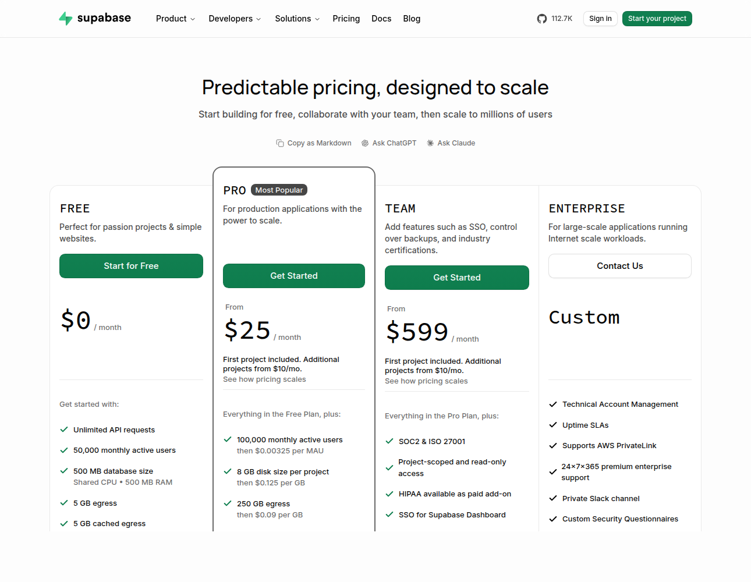
What It Costs to Start
Free to begin
500 MB of database
50,000 users a month
Source
Notes:
Starting costs nothing. The free plan on the pricing page includes a five hundred megabyte database and up to fifty thousand monthly active users, which is far more than a class project needs.

Slide 16
A Real Project That Uses It
What it stores
Example
Court opinions
Thousands, fetched daily
Is it about asylum?
A yes or a no each
Case details
Country, outcome, more
Notes:
A real example: the ninth_circuit project keeps its court opinions in Supabase — thousands of them, fetched daily — along with a yes-or-no for whether each concerns asylum and the case details pulled out of it.

Slide 17
Your First Ten Minutes
01
Make an account
The free plan is enough
02
Create a project
You get a database right away
03
Make one table
Then add a row by hand
Notes:
To try it: make an account on the free plan, create a project, which gives you a database straight away, then make one table and add a row by hand.

Slide 18
Screenshots, Captured 21 Oct 2026
Screenshot
Captured from
Homepage
supabase.com
Table editor
supabase.com/database
Sign-in
supabase.com/auth
Security warning
supabase.com/docs
Pricing
supabase.com/pricing
Notes:
Every screenshot in this deck was captured on the twenty-first of October 2026 from the pages listed here, and each slide's Source link opens the exact page.

Slide 19
What should it remember?
Notes:
So, for your own project: what should it remember? That answer is your first table.

