Slide 1
What Is MCP?
The Model Context Protocol, from the source
Notes:
This is an entry-level tour of MCP, the Model Context Protocol, using the protocol's own documentation and Anthropic's announcement as sources.

Slide 2
What can an AI app reach?
Notes:
On its own, an AI app only knows what you type into it. The question MCP answers is how it reaches everything else — your files, your tools, your data.

Slide 3
MCP
An open standard for connecting AI apps to systems
Notes:
MCP is an open standard for connecting AI applications to the external systems where your information and tools actually live.

Slide 4
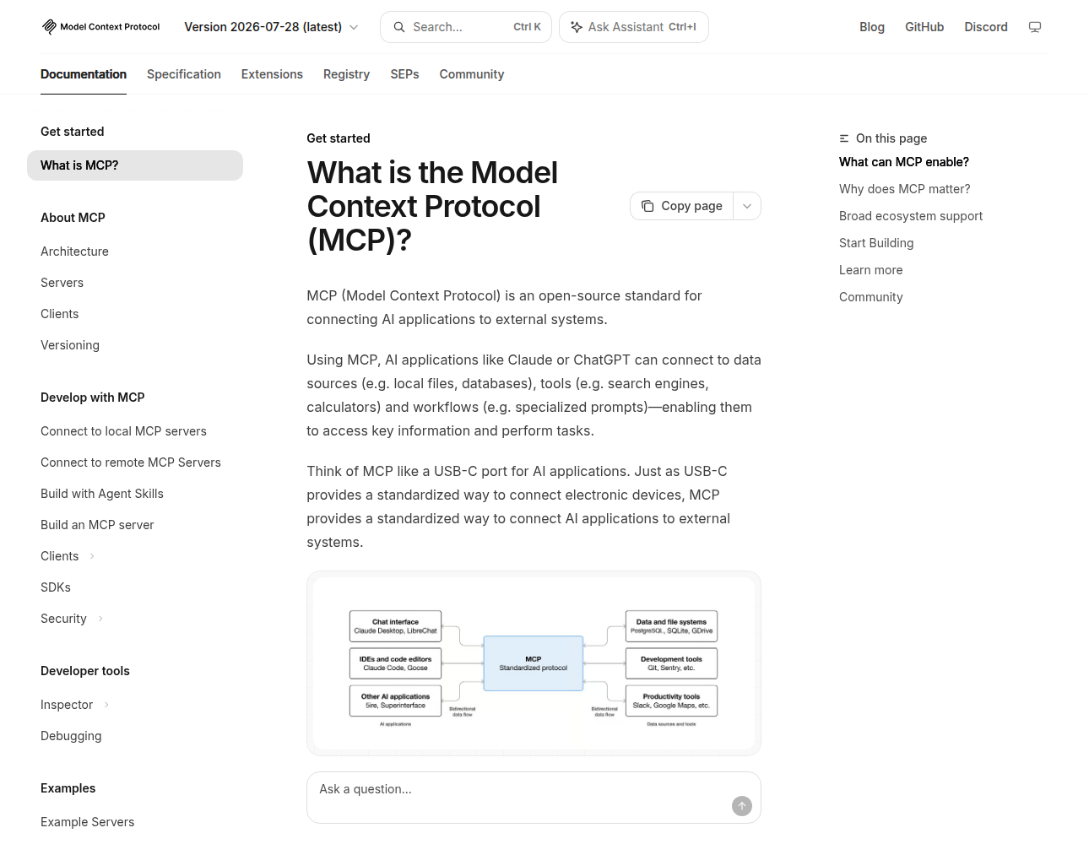
The Official Analogy
A USB-C port for AI
One plug, many devices
One protocol, many tools
Source
Notes:
The protocol's own site puts it this way: MCP is like a USB-C port for AI applications. One standard plug connects many devices, and one protocol connects an AI app to many tools.

Slide 5
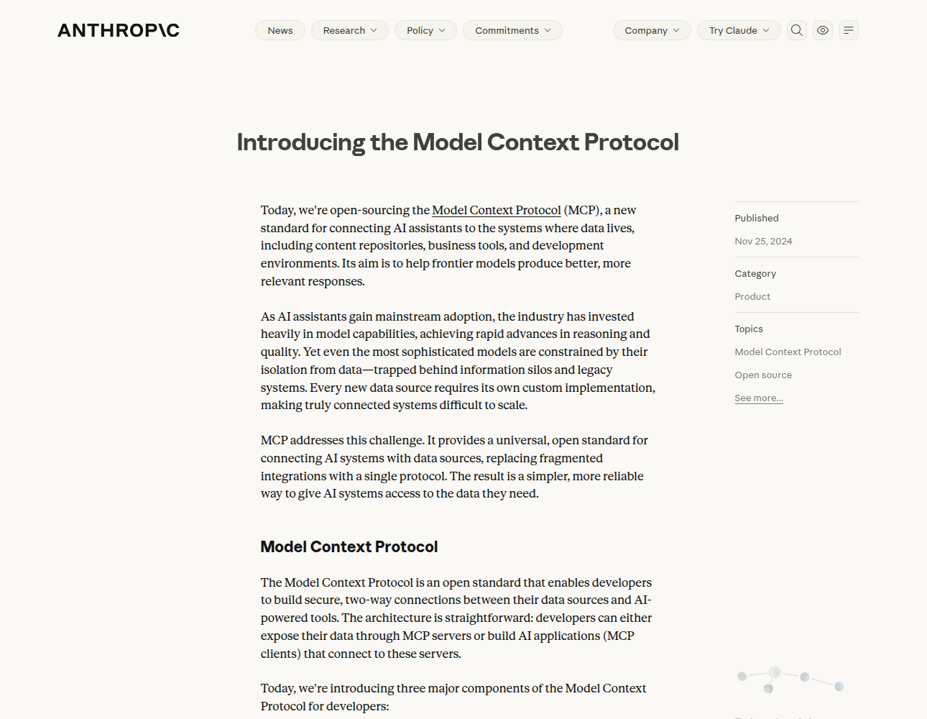
Where It Came From
Anthropic, November 2024
Open source from day one
Replaced one-off links
Source
Notes:
Anthropic open-sourced MCP in November 2024. Before it, every data source needed its own custom connection, and the announcement describes MCP as replacing those fragmented links with a single protocol.

Slide 6
Three Participants
Host
The AI app, such as Claude Code
Client
One connection to one server
Server
A program that offers context
Notes:
There are three participants. The host is the AI application, such as Claude Code. A client is one connection to one server. And a server is a program that offers context to the app.

Slide 7
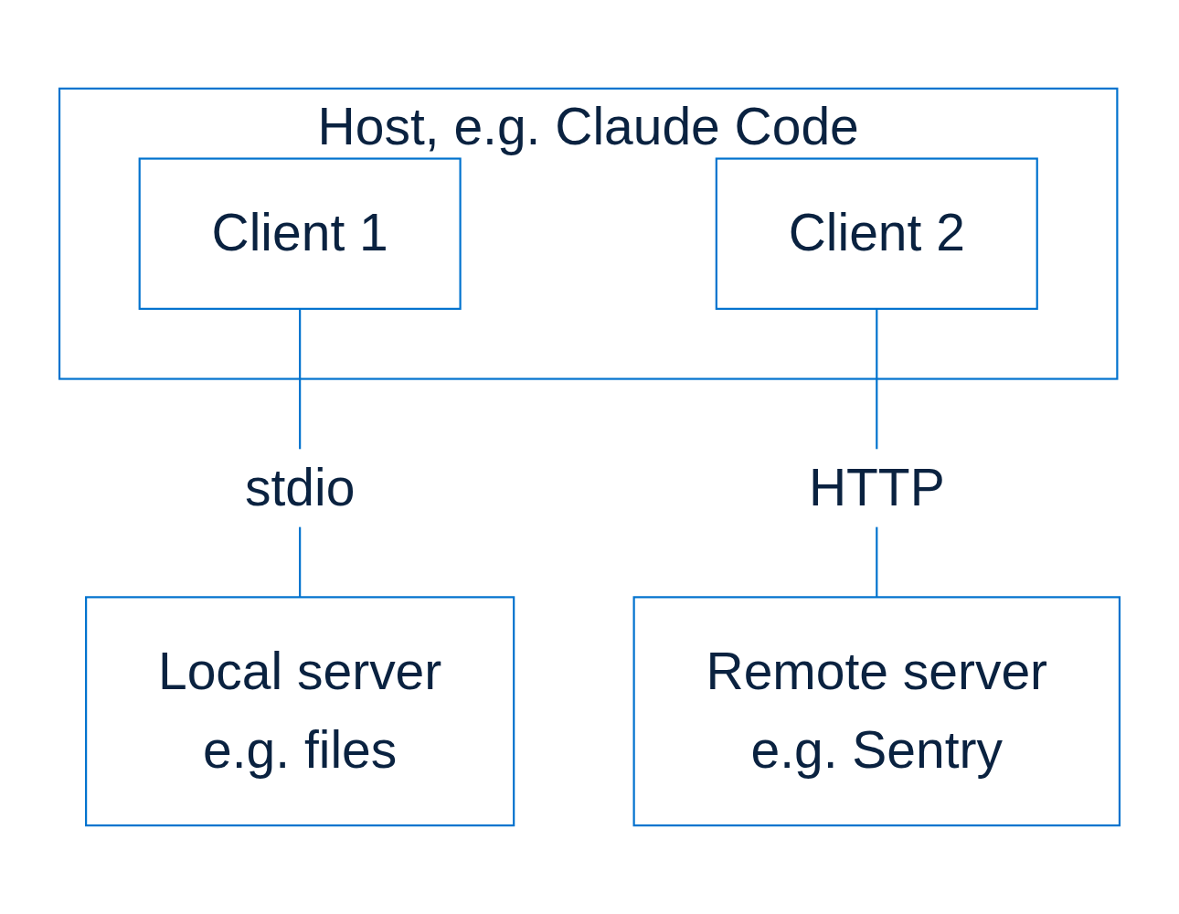
How They Connect
One client per server
Local servers use stdio
Remote servers use HTTP
Source
Notes:
The host creates one client for each server it connects to. A server on your own machine talks over standard input and output, called stdio, and a remote server talks over HTTP.

Slide 8
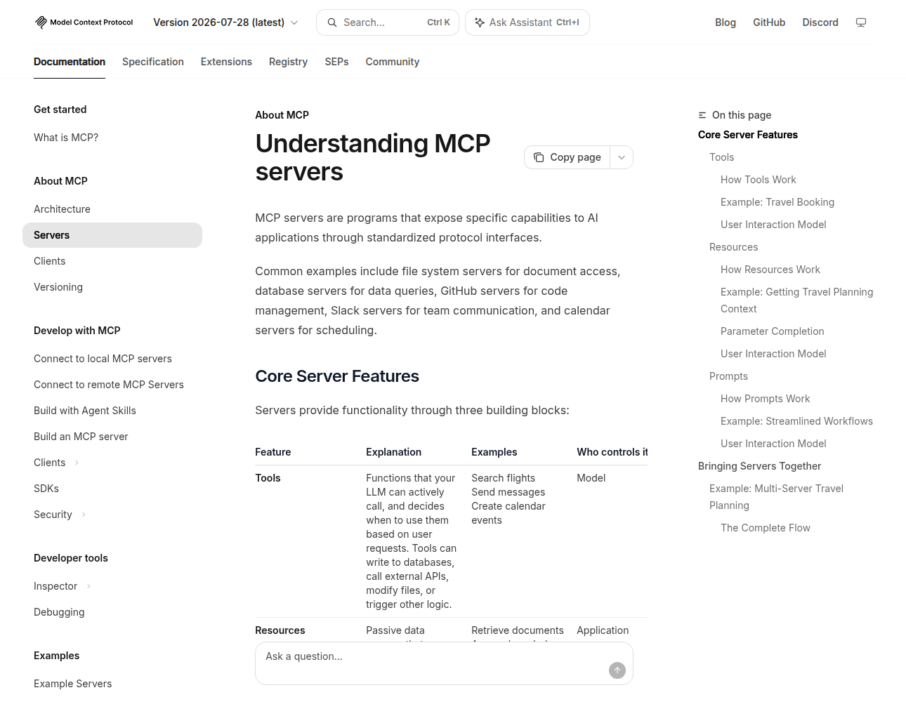
What a Server Offers
Tools: actions to take
Resources: data to read
Prompts: ready templates
Source
Notes:
A server offers three kinds of thing: tools, which are actions the AI can take; resources, which are data it can read; and prompts, which are ready-made templates for common tasks.

Slide 9
Who Controls Each One
Feature
Controlled by
Example
Tools
The model
Search flights
Resources
The application
Read a calendar
Prompts
The user
Plan a vacation
Notes:
Each one has a different owner. The model decides when to call a tool, the application decides which resources to include, and the user chooses a prompt — those are the documentation's own examples.

Slide 10
One Tool Call, Step by Step
01
Discover
The app asks the server for its tools
02
Decide
The model picks one for the task
03
Call
The server runs it and sends back a result
Notes:
A tool call happens in three steps. The app asks the server which tools it has, the model picks one that fits the task, and the server runs it and sends the result back into the conversation.

Slide 11
What Travels Between Them
JSON-RPC 2.0 messages
Each request carries the version
Servers say what they support
Same format, local or remote
Notes:
Under the hood the messages are JSON-RPC 2.0. Every request carries the protocol version, servers announce what they support, and the format is identical whether the server is local or remote.

Slide 12
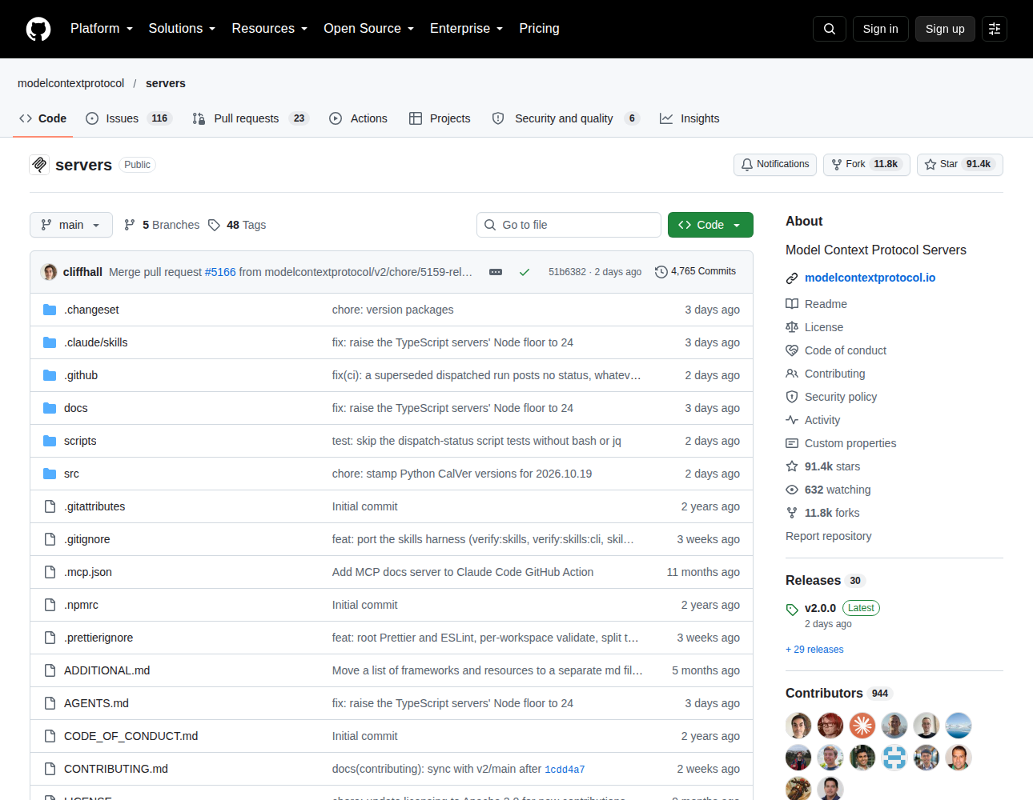
Ready-Made Servers
Open-source examples
91.4k stars on GitHub
Start from one of these
Source
Notes:
You rarely start from nothing. The protocol's reference servers are open source on GitHub, with ninety-one thousand stars on the day these screenshots were taken.

Slide 13
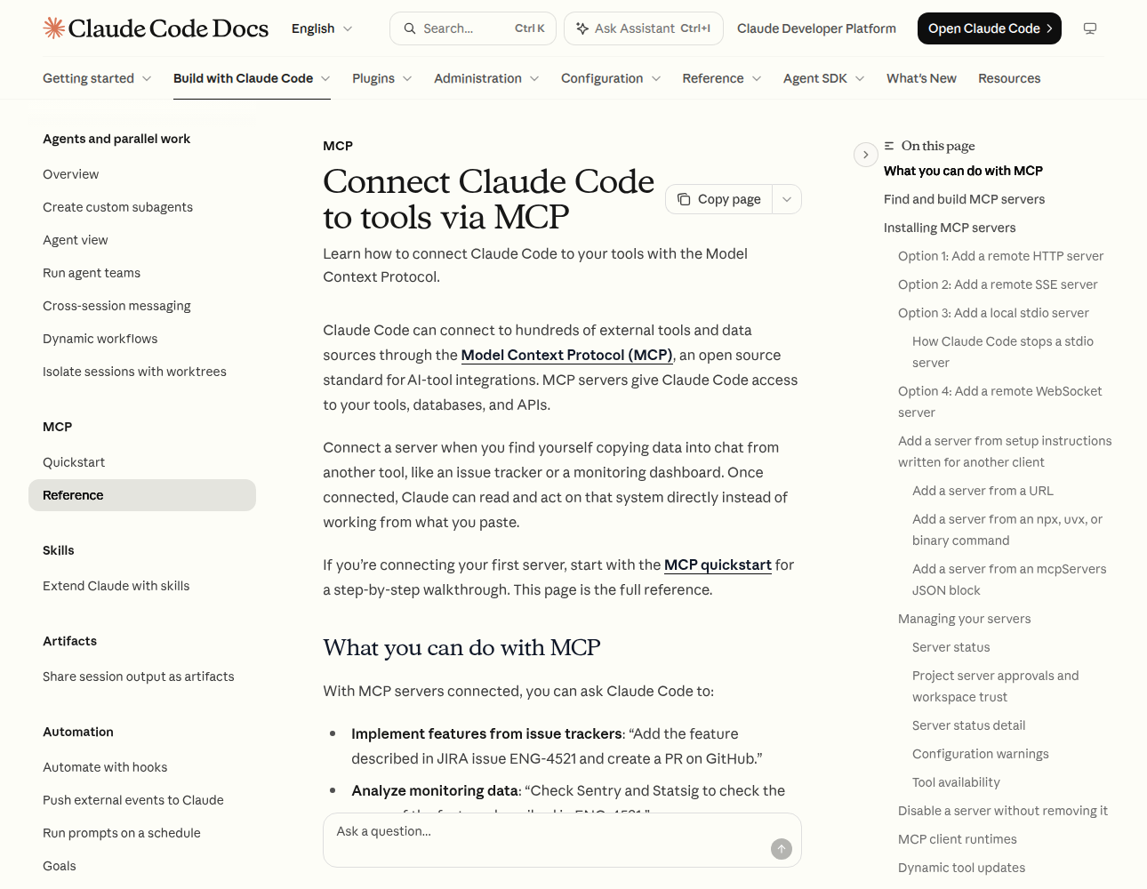
Using It From Claude Code
Hundreds of tools
Connect, then just ask
Documented by Anthropic
Source
Notes:
Claude Code is one host you can try today. Its documentation says it can connect to hundreds of external tools this way, and once a server is connected you simply ask Claude to use it.

Slide 14
Adding a Server
To do this
Use
Add a server
claude mcp add
See your servers
claude mcp list
Remote, e.g. Notion
--transport http
Local, e.g. Airtable
--transport stdio
Notes:
Two commands do most of the work: claude mcp add to connect a server and claude mcp list to see what you have. A remote server such as Notion uses the HTTP transport, and a local one such as Airtable uses stdio.

Slide 15
Use It Safely
Only connect servers you trust
Fetched content can carry instructions
Approve tool calls you did not expect
A local server runs with your access
Notes:
Anthropic's own advice is to verify you trust each server before you connect it, because content a server fetches can carry hidden instructions. Approve only the tool calls you expect, and remember a local server runs with your access.

Slide 16
What MCP Is, and Is Not
It is
It is not
A protocol for context
An AI model
Open source
An app you install
The same for every app
A rule for using models
Notes:
MCP is a protocol for sharing context, it is open source, and it works the same for every app. It is not a model, not an app you install, and it says nothing about how an app should use its model.

Slide 17
Your First Ten Minutes
01
Pick a server you trust
Start from the reference list
02
Add it to your host
In Claude Code, claude mcp add
03
Ask for something it does
And approve the tool call
Notes:
To try it: pick a server you trust from the reference list, add it to your host — in Claude Code that is claude mcp add — then ask for something only that server can do, and approve the call.

Slide 18
Sources, Captured 21 Oct 2026
Slide
Taken from
Analogy, architecture
modelcontextprotocol.io
Server features
modelcontextprotocol.io
Announcement
anthropic.com/news
Reference servers
github.com
Claude Code
code.claude.com/docs
Notes:
Every screenshot was captured on the twenty-first of October 2026 from the pages listed here, the architecture diagram is redrawn from the protocol's own, and each slide's Source link opens the exact page.

Slide 19
What would you connect?
Notes:
So, the question for your own work: what would you connect first?

