Slide 1
What Is UML?
Drawing software before you build it
Notes:
This is an entry-level tour of UML, the Unified Modeling Language: what it is, the diagrams you will actually meet, and how to read them.

Slide 2
How do you draw a design?
Notes:
Describing a system in words gets confusing fast. The question is how to draw it so that anyone reading the picture understands it the same way.

Slide 3
UML
A standard visual language for software designs
Notes:
UML is a standard visual language for describing software designs, so a box or an arrow means the same thing to everyone who reads it.

Slide 4
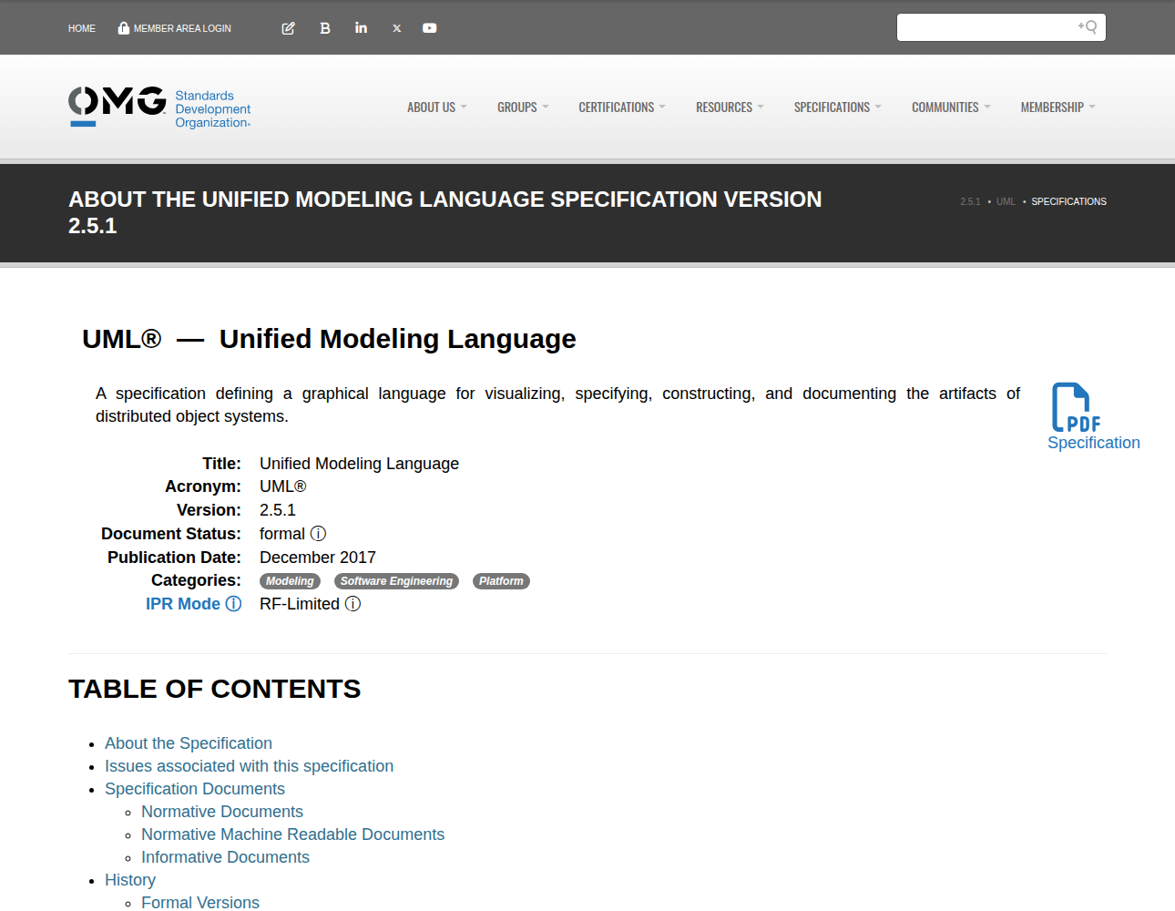
The Official Standard
Maintained by the OMG
Current version 2.5.1
Free to read as a PDF
Source
Notes:
UML is maintained by the Object Management Group. The current version is 2.5.1, and the full specification is free to read as a PDF.

Slide 5
Fourteen Diagrams, Two Families
Structure: what it is
Behaviour: what it does
Class
Use case
Component
Sequence
Deployment
State machine
Notes:
UML defines fourteen diagram types in two families of seven. Structure diagrams show what a system is made of, and behaviour diagrams show what it does. Here are three common ones from each.

Slide 6
Class diagram
The things in a system and how they relate
Notes:
A class diagram shows the kinds of thing in a system and how they relate to one another.

Slide 7
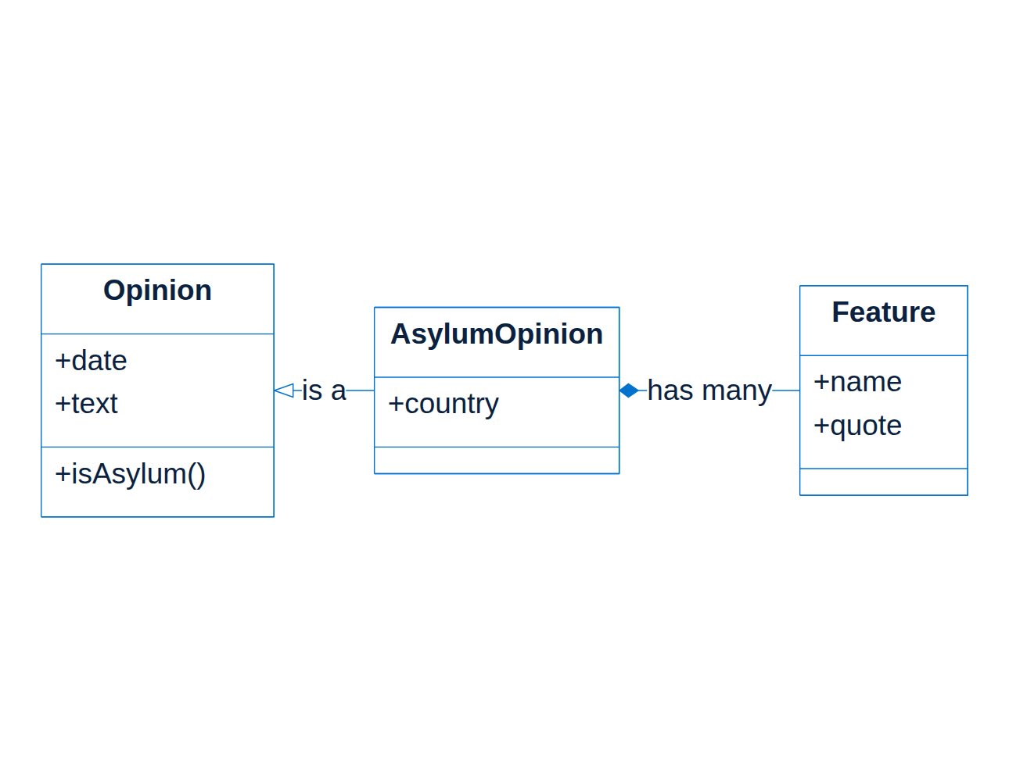
A Class Diagram, Concretely
Each box is a class
Each line is a link
Modelling ninth_circuit
Source
Notes:
Here is one drawn for a real project, ninth_circuit, which reads court opinions. An asylum opinion is a kind of opinion, and it has many features pulled out of it.

Slide 8
Reading a Class Box
Part of the box
What it holds
Top
The class name
Middle
Its attributes
Bottom
Its operations
Notes:
Every class box reads the same way: the name at the top, its attributes — the data it holds — in the middle, and its operations, the things it can do, at the bottom.

Slide 9
The Lines Between Classes
Line end
Means
Hollow triangle
Is a kind of
Filled diamond
Owns, and dies with
Hollow diamond
Has, but shares
Plain line
Knows about
Notes:
The line ends carry the meaning. A hollow triangle means is a kind of. A filled diamond means owns completely. A hollow diamond means has, but shares. A plain line means one simply knows about the other.

Slide 10
Sequence diagram
Who talks to whom, and in what order
Notes:
A sequence diagram shows who talks to whom, and in what order.

Slide 11
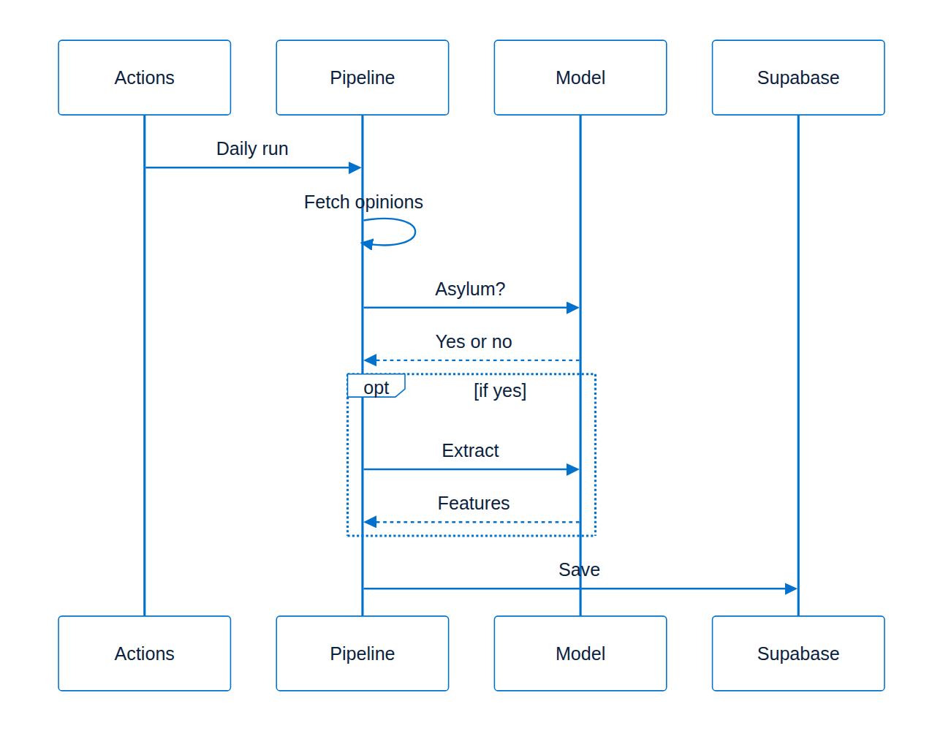
A Sequence Diagram, Concretely
Time runs downward
Solid arrows: requests
Dashed arrows: replies
Source
Notes:
This is that project's daily run. Time runs downward, a solid arrow is a request, and a dashed arrow is the reply that comes back.

Slide 12
Boxes That Change the Flow
opt: happens only if true
alt: one branch or the other
loop: repeats while true
par: happens at the same time
Notes:
A labelled box around some messages changes how they run. Opt means they happen only if a condition is true, alt picks one branch, loop repeats them, and par runs them at the same time.

Slide 13
State machine
The stages one thing moves through
Notes:
A state machine diagram shows the stages that one thing moves through over its life.

Slide 14
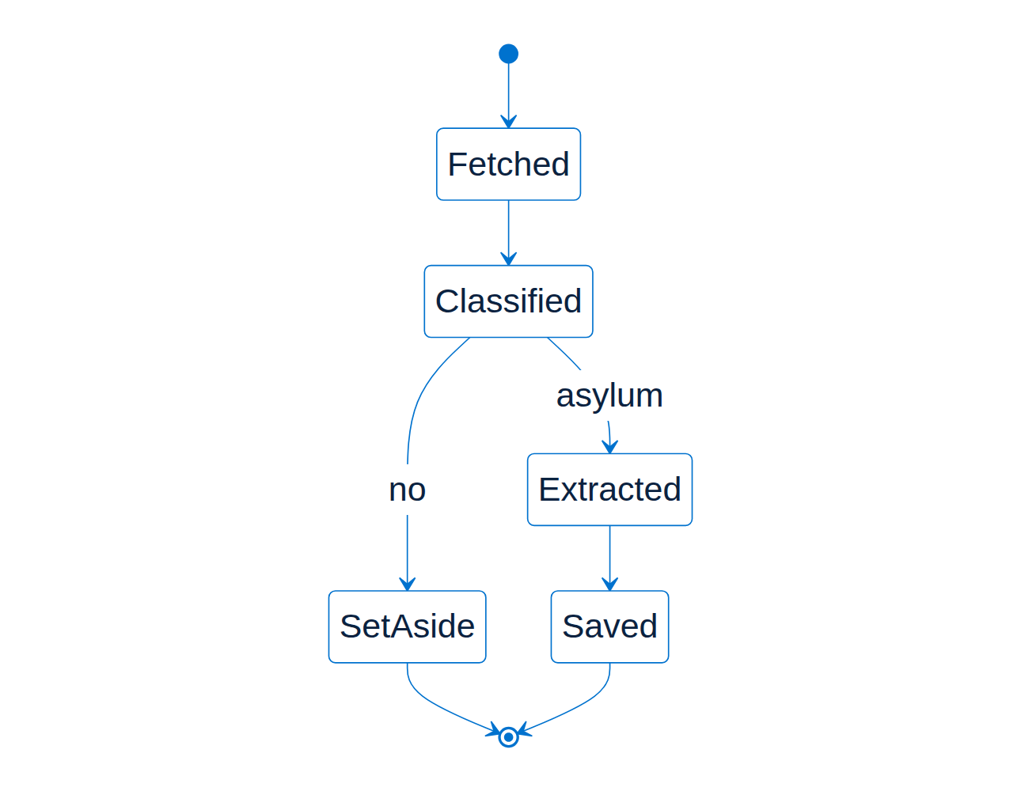
A State Diagram, Concretely
Filled dot: the start
Ringed dot: the end
Labels say why it moves
Source
Notes:
Here is one opinion's life in that project. The filled dot is where it starts, the ringed dot is where it ends, and the labels on the arrows say why it moves from one stage to the next.

Slide 15
Which Diagram, When
If you are asking
Draw a
What is it made of?
Class diagram
Who talks to whom?
Sequence diagram
What stages can it be in?
State diagram
What can a user do?
Use case diagram
Notes:
Pick the diagram from the question. What is it made of calls for a class diagram, who talks to whom for a sequence diagram, what stages it can be in for a state diagram, and what a user can do for a use case diagram.

Slide 16
Tools for Drawing It
Pen and paper, honestly
Mermaid: diagrams written as text
PlantUML: also text
draw.io: drag and drop
Notes:
You need very little to start: pen and paper works. Mermaid, which drew the diagrams in this deck, and PlantUML both turn text into diagrams, and draw.io lets you drag shapes around.

Slide 17
Sources
Slide
Taken from
Specification
omg.org/spec/UML
The diagram types
Wikipedia, UML
Example diagrams
Drawn with Mermaid
What they model
ninth_circuit README
Notes:
The specification screenshot was captured on the twenty-first of October 2026, the list of diagram types comes from Wikipedia's UML article, and the example diagrams were drawn for this deck from the ninth_circuit README.

Slide 18
Good Habits
Draw to explain, not to archive
One question per diagram
Leave out what does not matter
Keep it next to the code
Notes:
Draw to explain rather than to archive everything, answer one question per diagram, leave out whatever does not matter to that question, and keep the diagram next to the code it describes.

