Slide 1
Sorting
Dirty tricks to sort faster than O(n log n)
Terence Parr
MSDS program University of San Francisco

Slide 2
Sorting
We can sort any kind of element for which we have a similarity or distance measure between any two elements (subject to triangle inequality property*)
Traditional sorting algorithms: bubble sort, merge sort, quicksort
Dirty tricks: pigeonhole sort, bucket sort can often sort in O(n)
Really dirty trick: nested bucket sort
What’s the fastest we could ever sort n numbers?
It depends on whether we’re stuck using comparisons only
Sorting notebook https://github.com/parrt/msds689/blob/master/notes/sorting.ipynb
*https://en.wikipedia.org/wiki/Triangle_inequality

Slide 3
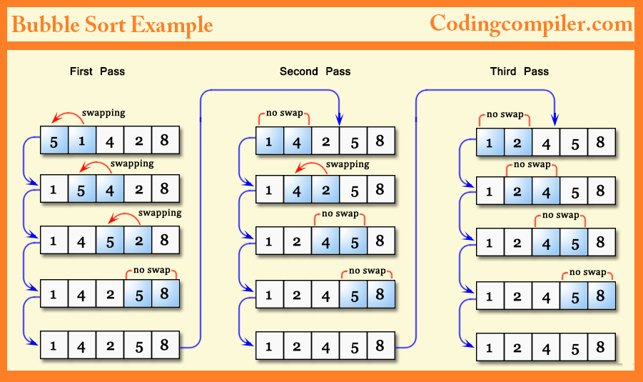
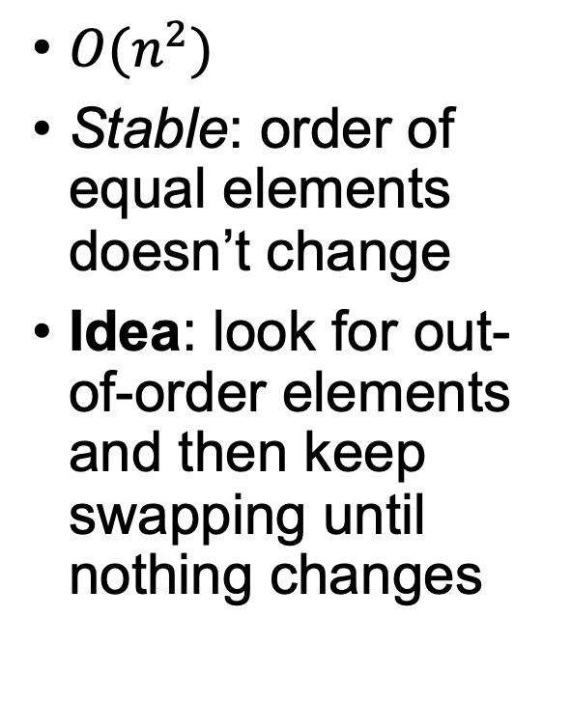
Bubble sort
$O(n^{2})$
Stable: order of equal elements doesn’t change
Idea: look for out-of-order elements and then keep swapping until nothing changes
Image credit https://codingcompiler.com/bubble-sort-program-in-c-using-function/

Slide 4
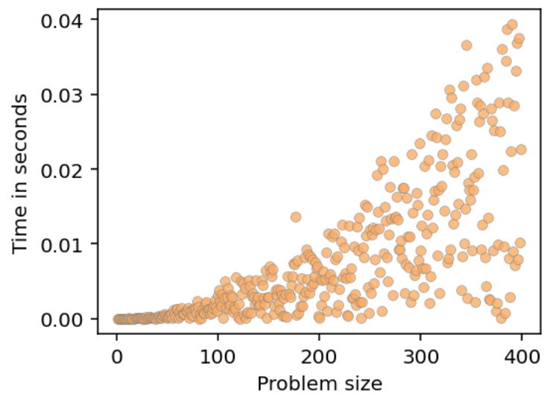
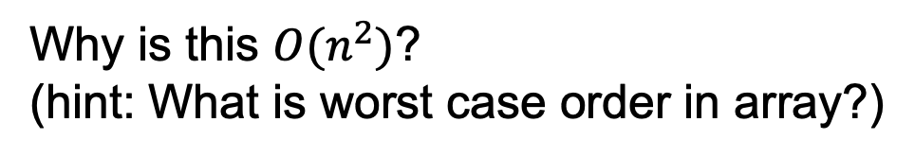
Bubble sort in Python
changed=True
second_to_last_idx = len(A)-2
while changed:
changed=False
for i in range(second_to_last_idx+1):
if A[i] > A[i+1]:
A[i], A[i+1] = A[i+1], A[i]
changed=True
Why is this $O(n^{2})$?
(hint: What is worst case order in array?)
Sorting notebook https://github.com/parrt/msds689/blob/master/notes/sorting.ipynb

Slide 5
Merge sort (review)
Faster than bubblesort: O(n log n)
Simpler too, if you are comfortable with recursion
It’s stable
Not in-place, uses lots of extra storage (sort halves)
Idea: split currently active region in half, sorting both the left and right subregions, then merge two sorted subregions
Eventually, the regions are so small we can sort in constant time; i.e., sorting 2 nums is easy
Merging two sorted lists can be done in linear time

Slide 6
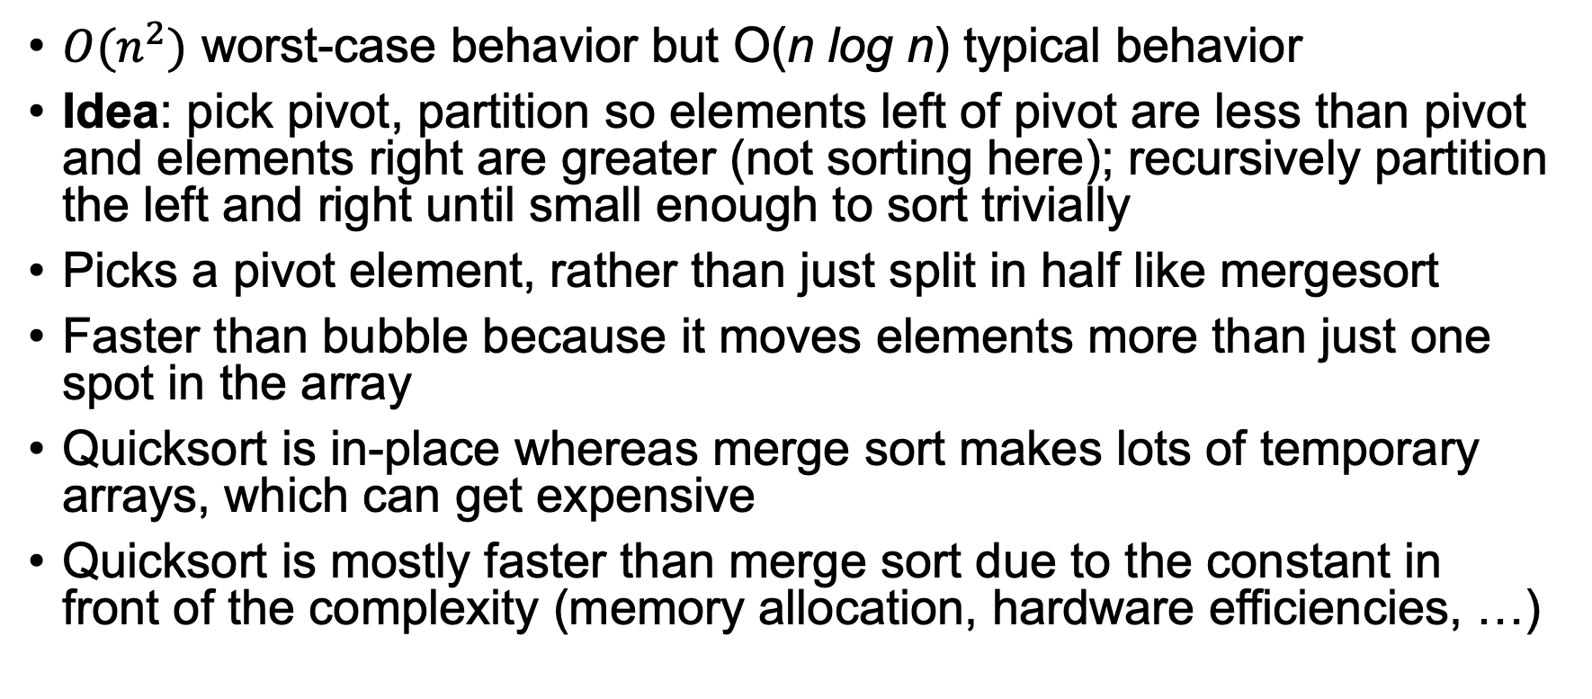
Quicksort, another divide and conquer sort
$O(n^{2})$ worst-case behavior but O(n log n) typical behavior
Idea: pick pivot, partition so elements left of pivot are less than pivot and elements right are greater (not sorting here); recursively partition the left and right until small enough to sort trivially
Picks a pivot element, rather than just split in half like mergesort
Faster than bubble because it moves elements more than just one spot in the array
Quicksort is in-place whereas merge sort makes lots of temporary arrays, which can get expensive
Quicksort is mostly faster than merge sort due to the constant in front of the complexity (memory allocation, hardware efficiencies, …)
Sorting notebook https://github.com/parrt/msds689/blob/master/notes/sorting.ipynb

Slide 7
Quicksort algorithm
In-place quicksort in notebook https://github.com/parrt/msds689/blob/master/notes/sorting.ipynb
def qsort(A, lo=0, hi=len(A)-1):
if lo >= hi: return
pivot_idx = partition(A,lo,hi)
qsort(A, lo, pivot_idx-1)
qsort(A, pivot_idx+1, hi)
# many ways to do this; here’s a slow O(n) one
# breaks idea of in-place for qsort
def partition(A,lo,hi):
pivot = A[hi] # pick last element as pivot
left = [a for a in A if a<pivot]
right = [a for a in A if a>pivot]
A[lo:hi+1] = left+[pivot]+right # copy back to A
return len(left) # return index of pivot
Partitioning important for decision and isolation trees
Video on partitioning: https://www.youtube.com/watch?v=MZaf_9IZCrc

Slide 8
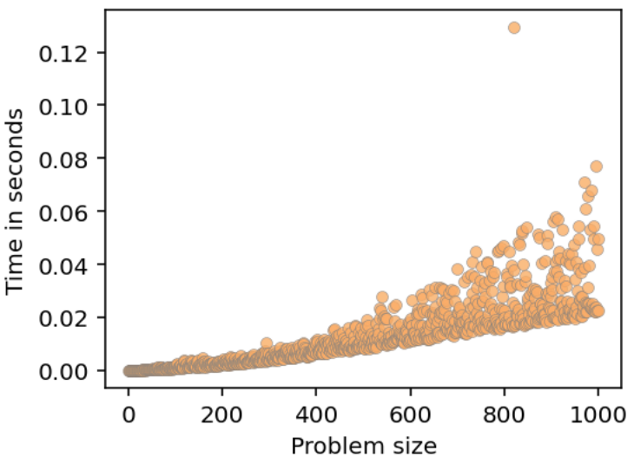
Compare bubble, quicksort
Bubble sort
Quicksort

Slide 9
So much for traditional sorts
Theory says we can’t beat O(n log n)…
…for generic elements and doing comparisons
But, what if we know the elements are ints or strings or floats?
What if we know something about the values?
E.g., what if we know the elements are ints in range 0..99?
How can we sort those numbers in less than O(n log n)?

Slide 10
Pigeonhole sort
Idea: Map each key to unique pigeonhole in ordered range of holes; then just walk pigeonholes in order to get sorted elements
Works best when the range of keys, m, is similar to the number of elements, n; why is that?
T(n,m) = n + m
This should smack of perfect hashing to you!
https://en.wikipedia.org/wiki/Pigeonhole_sort

Slide 11
Pigeonhole sort algorithm
# fill holes
size = max(A) + 1
holes = [0] * size
for a in A:
holes[a] += 1
# pull out in order
A_ = []
for i in range(0,size):
for j in range(holes[i]):
A_.append(i)
See sorting notebook

Slide 12
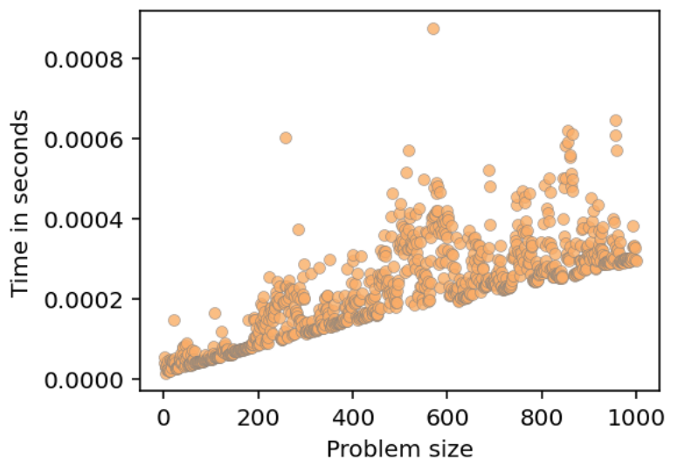
Compare quicksort, pigeonhole
Quicksort
Pigeonhole

Slide 13
Issue with pigeonhole sort
Super fast and simple but…
What do we do when m >> n? E.g., sort 2 numbers, 5 and 5 million. Takes T(n,m) = n + m = 5 + 5,000,000
How can we handle this case & generalize to work for floats too?
Hint: compress m, number of buckets, to some fixed number instead of range of numbers
Now we have hash table but with special hash function

Slide 14
Bucket sort (also called bin sort)
Idea: distribute n elements across m buckets, sort elements within buckets, then concatenate elements from buckets in order
Hash must preserve order of values!
Similar to pigeonhole sort but pigeonhole has 1 key per bucket
Best when there is even distribution of values like hash table
Works for floats not just ints; see notebook for implementation
https://en.wikipedia.org/wiki/Bucket_sort
See sorting notebook

Slide 15
Key bits of bucket sort algorithm
mx = max(A)
…
for a in A:
a_normalized = a / mx # get in 0..1
i = int(a_normalized * nbuckets) # spread across buckets
buckets[i].append(a)
…
for i in range(max_bucket_idx+1):
A_.extend( sorted(buckets[i]) )

Slide 16
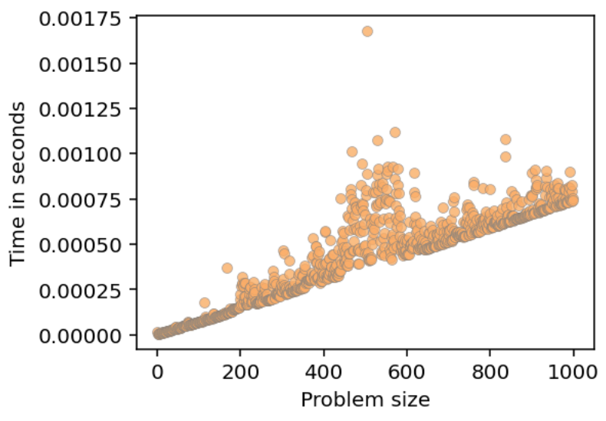
Bucket sort worst-case analysis
What is T(n,m) worst-case?
What if all values are the same? All go into 1 bucket!
Sorting one bucket at best costs us O(n log n)
Bubblesort might be faster for small buckets but that’s O(n^2) worst-case in theory
Can use insertion sort is O(k^2) for adding to bucket or leave unsorted and sort later

Slide 17
Bucket sort best-case analysis
What’s the best case or average case look like?
Assume even distribution of elements across m buckets
Choose m always so k=n/m is some small fixed constant size k
Sort k elements m times (bubblesort O(k^2)), merge m sorted lists
T(n,m,k=n/m) = m * k^2 + n
T(n,k) = n/k * k^2 + n = n*k + n = n(k+1) (choose small k)
That gives us O(n)

Slide 18
Bucket sort on strings
Use first letter as bucket key
Add strings to buckets
Sort within bucket
Walk a..z buckets, concatenating those sorted lists into single list
See sorting notebook for implementation

Slide 19
Key bits of string bucket sort
for s in A:
i = ord(s[0])-ord('a’)
holes[i].append(s)
…
for i in range(ord('z')-ord('a') + 1):
A_.extend( sorted(holes[i]) )
Exercise: What if all words start with same letter?

Slide 20
Nested or recursive string bucket sort (Called TRIEs and we’ll see again)
Nested indexes based upon s[i]
With nesting k deep, words are sorted uniquely to first k letters, giving nested bucket sort
Nested dynamically to full len of string gives nested pigeonhole sort
Walk all edges in alpha order to collect words in leaves
What is rough complexity?
O(n*k) for k = max length of any string

Slide 21
Summary
If asked, sorting is O(n log n) (via comparisons)
Divide and conquer, merge and quicksort, are primary algorithms
Mergesort merges to sorted halves recursively; takes extra memory
Quicksort partitions instead of sorting halves; works in-place (usually better)
But, we can do better with pigeonhole sort, mapping each element to unique bucket based on the key; O(n)
If mapping to unique bucket is hard, as with floating-point numbers, use bin/bucket sort like a hash table; O(n) if reasonably evenly distributed
Use ord(char) for strings to bucket sort
Use all letters in strings, get nested bucket sort (called a TRIE)

