Slide 1
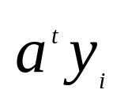
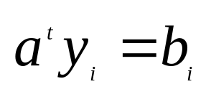

5.8 Minimum Squared Error Procedures
Criterion function involves all of the samples, not just misclassified ones
Previously we were interested in making all of the inner products positive
Now try to make where are some
arbitrarily specified positive constants

Slide 2
5.8 Minimum Squared Error Procedures
Thus replace the problem of solving a set of
linear inequalities with more stringent but better understood problem of finding a solution to a set of linear equations

Slide 3
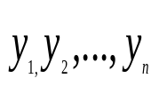
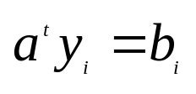
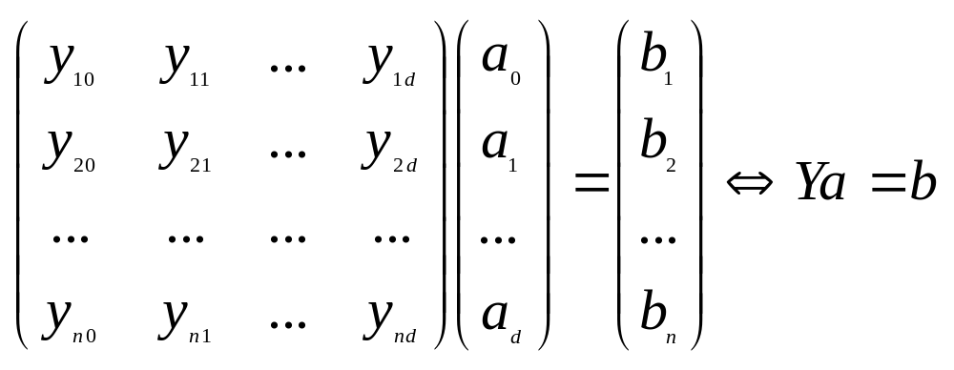

Minimum Squared Error and Pseudoinverse
For all the samples we want a weight vector a so that for some arbitrarily specified positive numbers. The matrix notation :
Error vector:

Slide 4
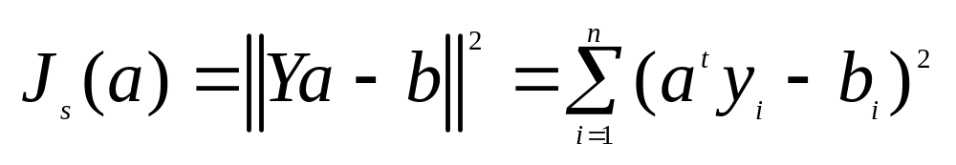
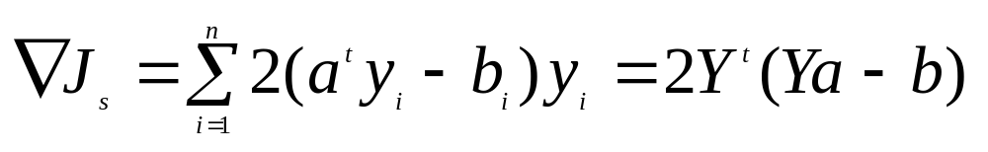
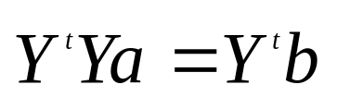
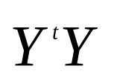
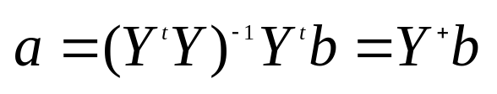

  Sum-of-squared-error criterion function:
  The gradient
  Set it to zero, we get
  If is nonsingular,
  The d by n matrix is call the pseudoinverse of Y.
  Remarks: For an arbitrarily fixed b, MSE solution may not be a separating vector.

Slide 5
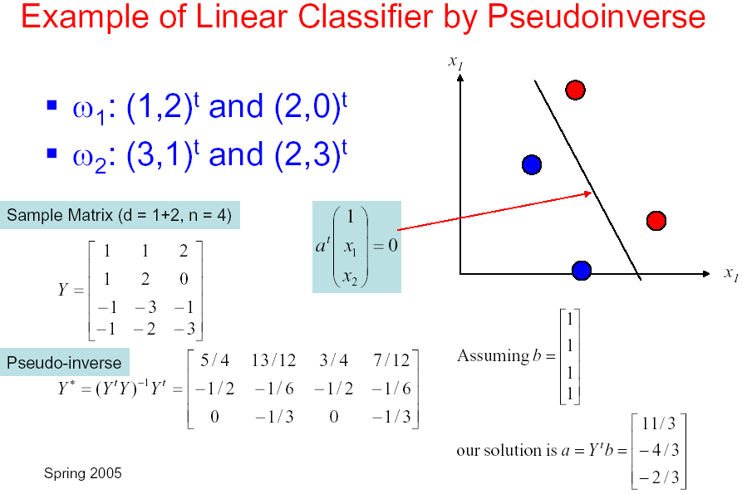

Slide 6
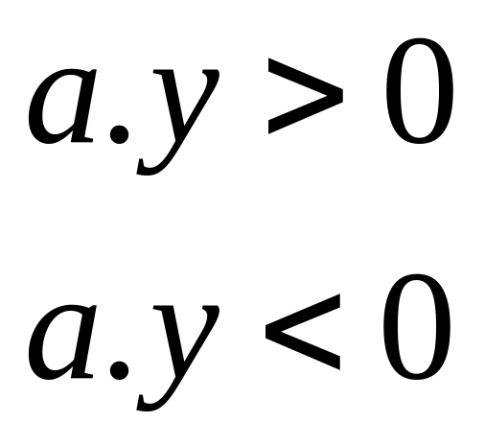
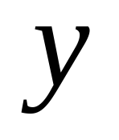
How to classify new samples (test samples)?
First class
Second class
: new sample

Slide 7
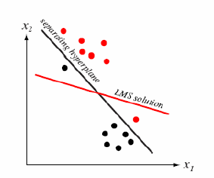
The Widrow-Hoff or LMS Procedure
(1) Iterative procedure: no matrix inverse
(2) Need not converge to a separating hyperplane even if there exist one

Slide 8
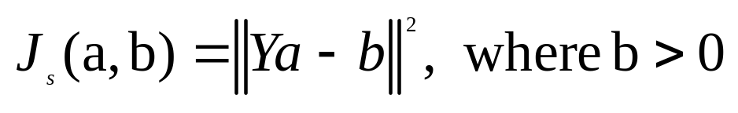
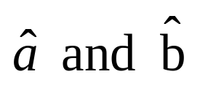
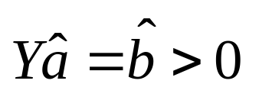


5.9 The Ho-Kashyap Procedure
Take the criterion function as a function of two variables a and b:
If the training samples are linearly separable, then there should exist an such that:
If we knew such beforehand. We would get the separating vector using the MSE procedure

Slide 9
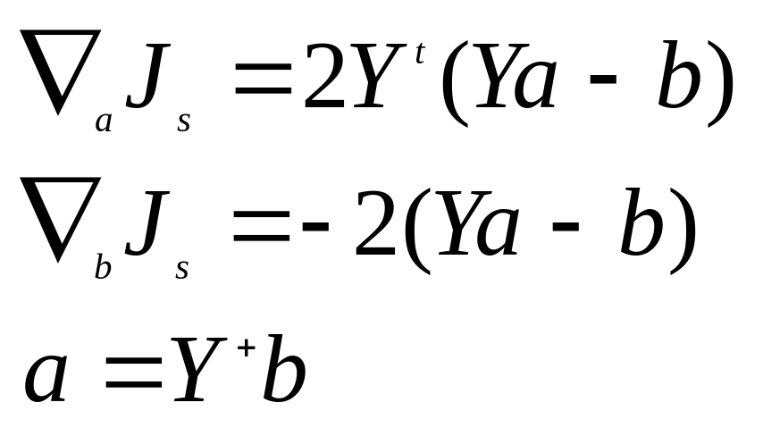
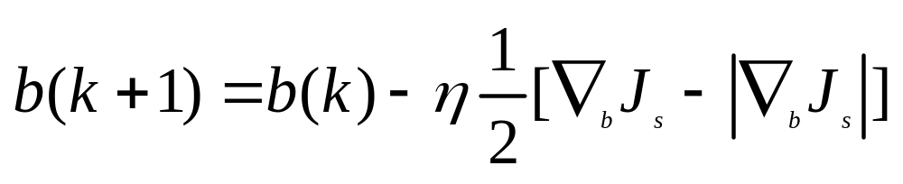

Slide 10

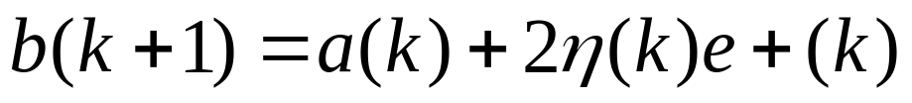
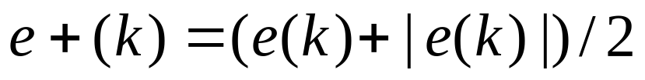
Ho-Kashyap Procedure

Slide 11
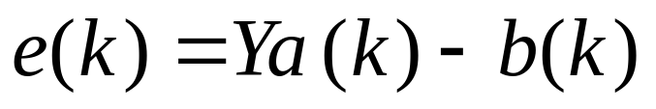
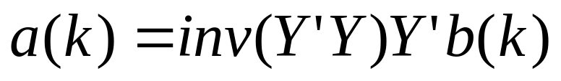

Slide 12
  5.12 Multicategory Generalizations

Slide 13
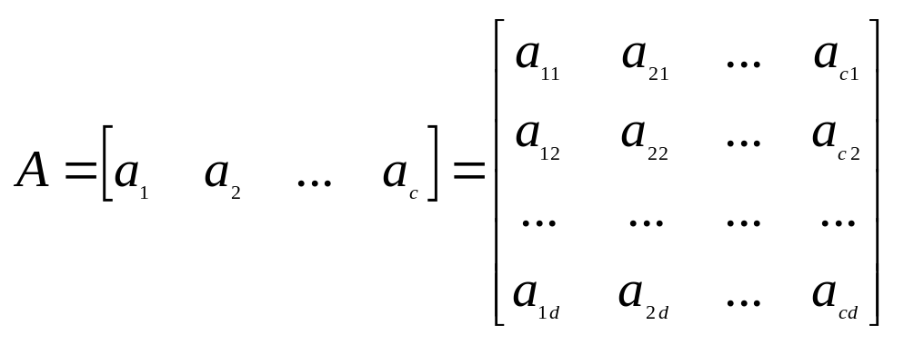
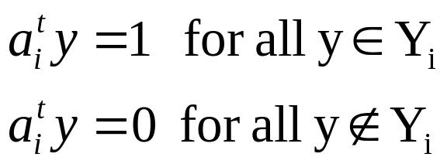
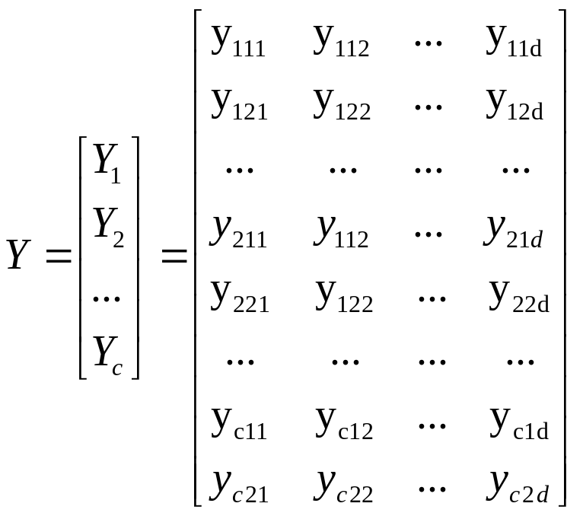
Generalization for MSE Procedure
consider multicategory case as a set of c two-class problem

Slide 14
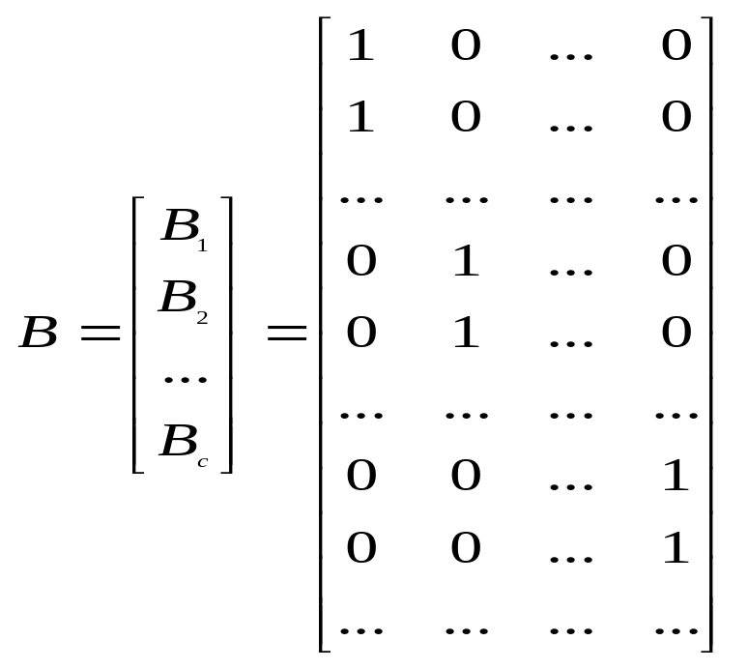
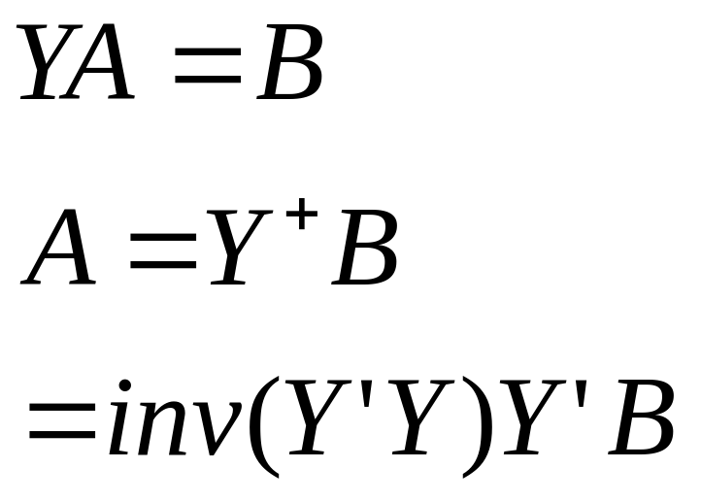
Generalization for MSE Procedure
consider multicategory case as a set of c two-class problem

Slide 15
Nonlinear Minimum Squared Error Procedures:
Just for your reference
Recently proposed new methods
Extension of Minimum Squared Error Procedures
Equivalent to the Minimum Squared Error Procedures in feature space

Slide 16
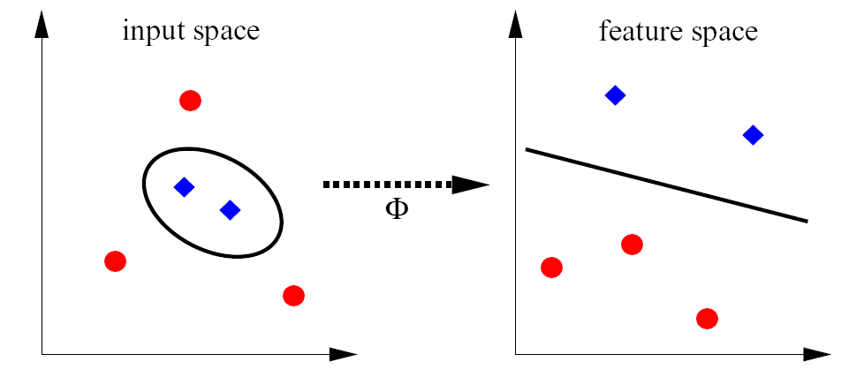
Nonlinear transform

Slide 17
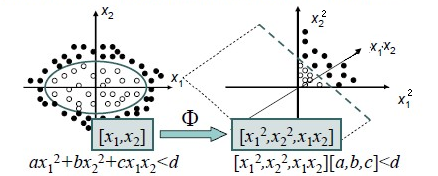
Nonlinear Minimum Squared Error Procedures

Slide 18
Nonlinear Minimum Squared Error Procedures

Slide 19
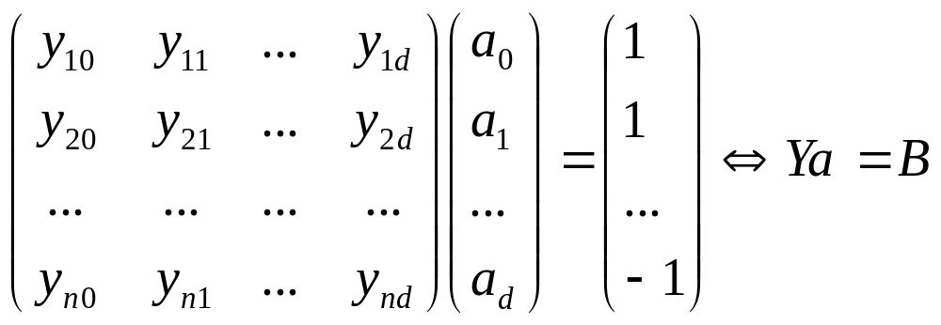
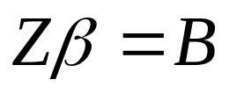


Nonlinear Minimum Squared Error Procedures
Original Minimum Squared Error procedure in the original space:
Minimum Squared Error procedure in the new space:

Slide 20
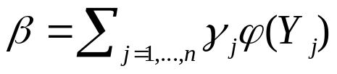

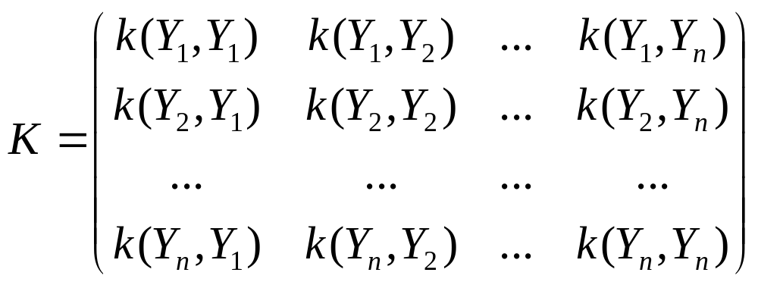
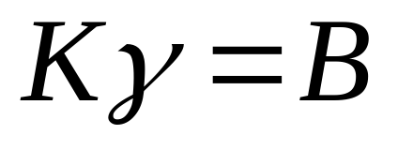
Nonlinear Minimum Squared Error Procedures: KMSE
Because of
we have

Slide 21
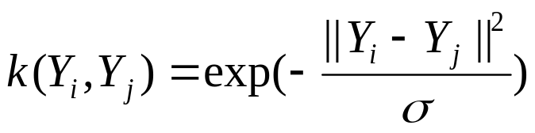
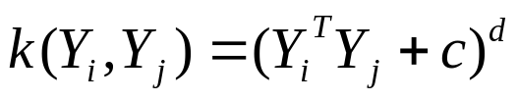
Nonlinear Minimum Squared Error Procedures: KMSE
Kernel functions:
(1)
(2)

Slide 22
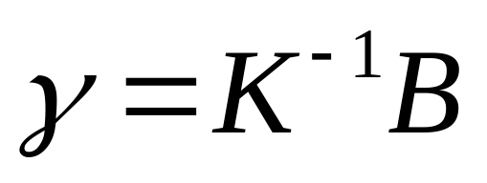


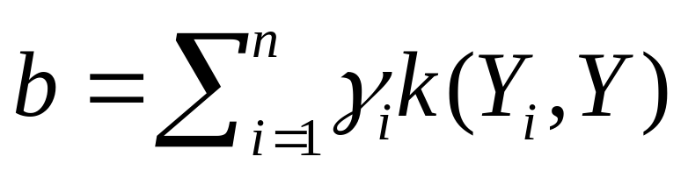
Nonlinear Minimum Squared Error Procedures: KMSE
Training phase:
Obtain
Testing phase ( is the output of testing sample ):
If is closer to 1 than -1, then the testing sample is classified into the first class;
otherwise, it is classified into the second class.

Slide 23
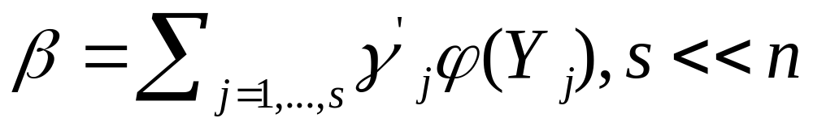
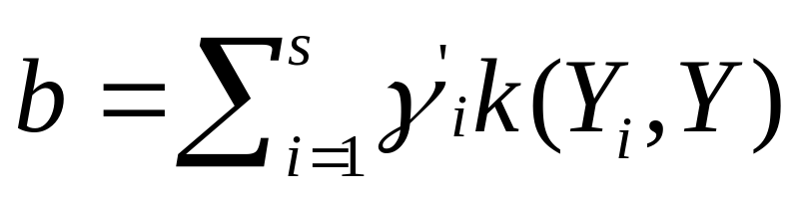
Disadvantage of and improvement to KMSE
The more the training samples, the higher the computational complexity !
If
Then and the computational complexity will be greatly reduced.

Slide 24
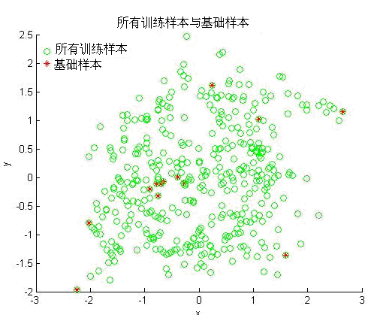
Disadvantage of and improvement to KMSE: one improvement

Slide 25
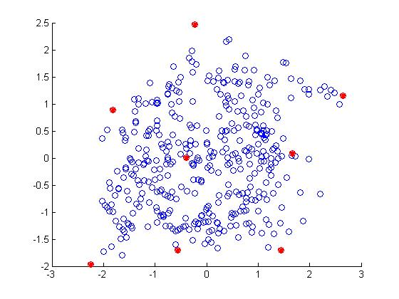
Disadvantage of and improvement to KMSE: another improvement

Slide 26
Nonlinear Minimum Squared Error Procedures : KMSE
References
Yong Xu, David Zhang, Zhong Jin, Miao Li, Jing-Yu Yang, A fast kernel-based nonlinear discriminant analysis for multi-class problems, Pattern Recognition, 2006, 39(6) : 1026-1033.
Yong Xu, J.-Y. Yang, J.-F. Lu, An efficient kernel-based nonlinear regression method for two-class classification, Proceedings of 2005 International Conference on Machine Learning and Cybernetics, Guangzhou, China, August, 2005, pp.4442-4445.
Yong Xu, David Zhang , Fengxi Song, Jing-Yu Yang, Zhong Jing , Miao Li, A method for speeding up feature extraction based on KPCA,Neurocomputing, 70, 1056-1061,2007
徐勇,张大鹏,杨健,模式识别中的核方法及其应用,北京:国防工业出版社(优秀图书二等奖),2010

